Slide 1
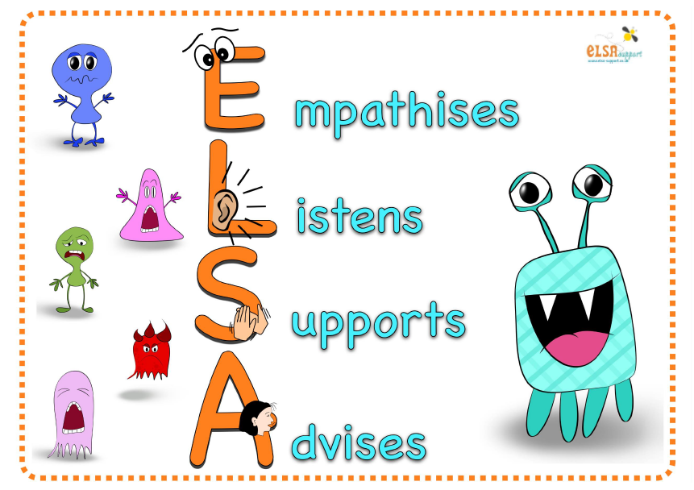
Emotional Literacy Support Assistant

Slide 2
Mental health Issues
More than 200,000 young people in England and Wales are admitted to A & E each year because they have tried to kill themselves. (papyrus)
Child line had 34,517 phone counselling sessions with young people who talked about suicidal thoughts in 2013-2014
In the UK, suicide is now the most common cause of death in the 15-34 age group.
In 2012 there were 1625 young people who took their own life. This was a slight decrease from 2011 where the number was 1746.
Young men are the most vulnerable (in the 25-29 age group 505 suicides in 2012)
Suicide in people under 15 not included in statistics.
Three quarters of people not in touch with mental health support
(Papyrus)
Could early intervention in Primary and Secondary school make a difference?

Slide 3
Why is emotional literacy important?
“Developing children as rounded people and active members of the community is at the heart of what schools are about.” Estelle Morris
Academic achievement
Children learn more effectively if they are happy in their work, believe in themselves, like their teachers, and feel school is supporting them.
Achievement in school in academic subjects is vital to pupil happiness and self-esteem. (Gordon and Grant 1997)
The benefits of focusing on emotional literacy
feel good - learn better
raises standards
making learning more enjoyable
reduces unnecessary stress
turns vicious circles into virtuous circles (Sharp,2001)

Slide 4
More benefits….
positive emotions influence concentration, memory, problem-solving and all learning skills
positive relationships enable individuals to break out of dysfunctional patterns
emotional literacy promotes creativity, innovation and leadership
Benefits to pupils
feel very supported by having ‘special time’ and being listened to
develop greater self awareness
learn to talk about difficulties
develop coping strategies
interact more successfully with others
feel better about themselves
manage better in school

Slide 5
What is an ELSA ?
There will always be children and young people in schools facing life challenges that detract from their ability to engage with learning. Some will require greater support to increase their emotional literacy than others. ELSA is an initiative developed and supported by Educational Psychologists. It recognises that children learn better and are happier in school if their emotional needs are also addressed.
We have a qualified Emotional Literacy Support Assistant at Guilden Sutton Primary school. We have a training contract with The Psychology Service, our Elsa has been trained and is regularly supervised by Educational Psychologists to plan and deliver programmes of support to pupils who are experiencing temporary or longer term additional emotional needs. The majority of ELSA work is delivered on an individual basis, but sometimes small group work is more appropriate, especially in the areas of social and friendship skills. Sessions are fun, they use a range of activities such as: games, role-play with puppets or arts and craft. ELSA sessions take place in our very own 'ELSA space' in the library which provides a calm, safe, and private space for the child to feel supported and nurtured.

Slide 6
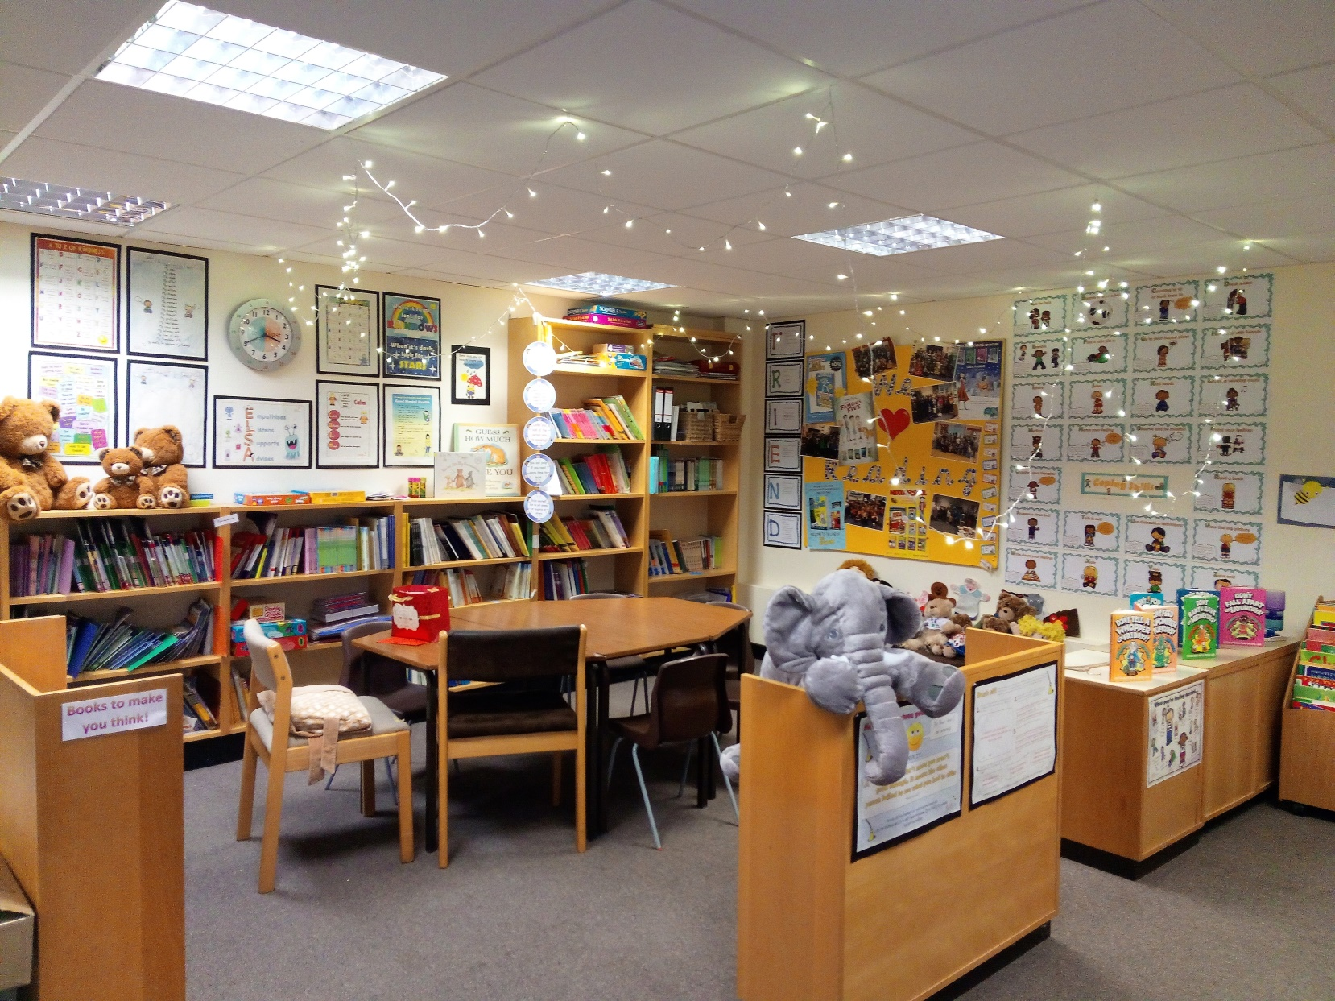

Slide 7
What can an ELSA help with?
Self-esteem
Emotions
Attachment issues
Loss and Bereavement
Social skills
Friendship
Autism
Basic counselling
Social stories
Therapeutic stories
Bullying
Conflict – restorative practice
Anger management
Anxiety
Relationships/friendships
Behaviour management
Problem solving and thinking skills

Slide 8
Expressing feelings
I can think about all the good things about myself and share these thoughts with others in the group
I can tell you why I feel part of a group
I can tell you what being worried feels like and how to share my worries
I can tell you the things that hurt my feelings
I can understand that everyone is different and unique.
I can understand that ‘giving’ can make me feel happy.
I can give and receive a compliment
I can tell you what being a good friend means to me
I can disagree with someone’s opinion without falling out
I can tell you what my triggers for anger are.
I can think of some ways to calm myself down.
I can tell you what I have learnt in the friendship group.

Slide 9
How does ELSA Work?
Children are usually referred for ELSA support by their class teacher, SENCo, Education Psychologists or by a request from a parent to the Head Teacher. Their aim is to remove any barriers to learning or wellbeing and to have happy, healthy pupils.
A referral form is completed for each child by the class teacher. This helps to identify strengths and weaknesses and ultimately identify the kind of intervention to most support the child.
With the programme aims in mind, support sessions are planned to facilitate the child in developing new skills and coping strategies that allow them to manage social and emotional demands more effectively.

Slide 10
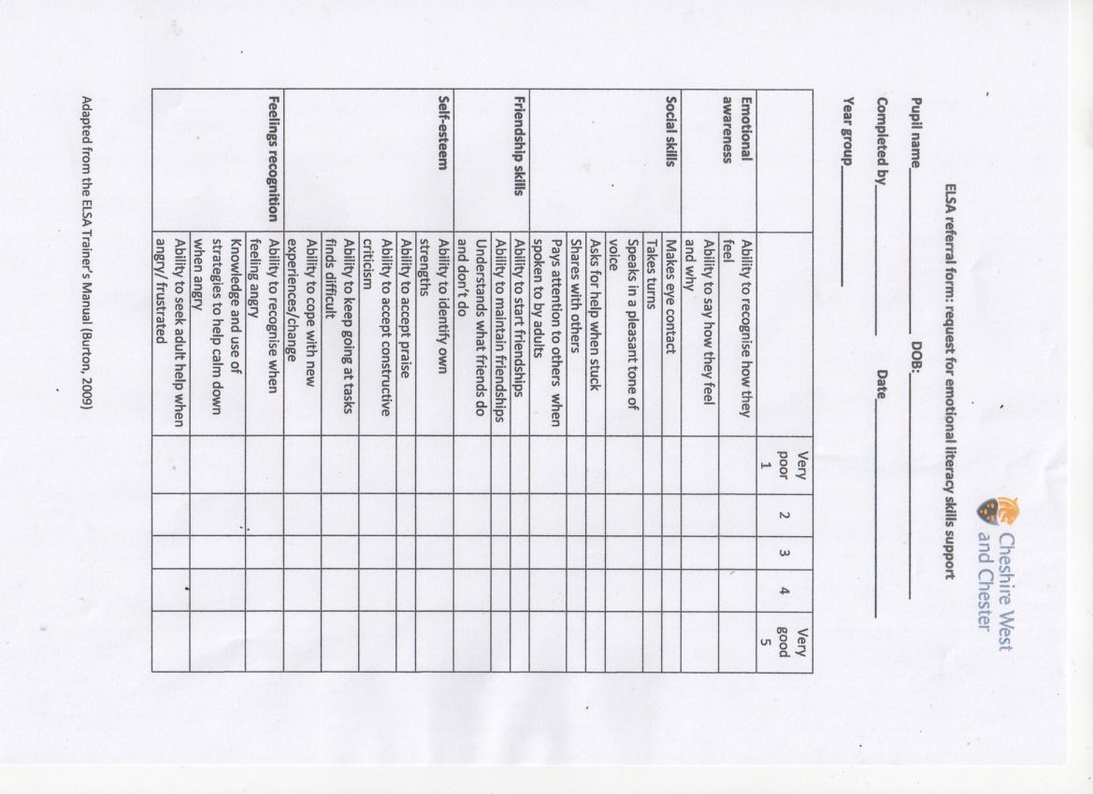
ELSA Referral form

Slide 11
Supporting - not fixing
Remember, ELSAs are not there to fix children's problems. What they can do is provide emotional support.
Our aim is to establish a warm, respectful relationship with a pupil and to provide a reflective space where they are able to share honestly their thoughts and feelings.
It needs to be appreciated that change cannot necessarily be achieved rapidly and is dependent upon the context and complexity of the presenting issues. For children with complex or long-term needs it is unrealistic to expect an ELSA intervention to resolve all their difficulties, however support will be designed to target specific aspects of a child's need.
Training and development of ELSAs is an ongoing process and good judgement is required to recognise when issues are beyond the level of expertise that could reasonably be expected of an ELSA. The Educational Psychologist that works with our school would be able to offer advice on suitability or nature of the ELSA involvement in complex cases.

Slide 12
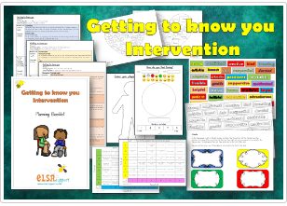
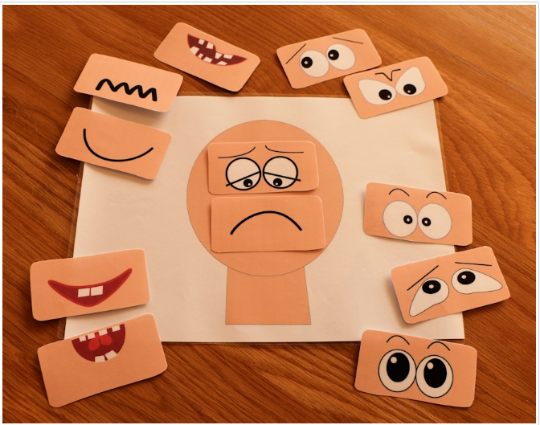
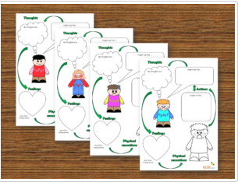
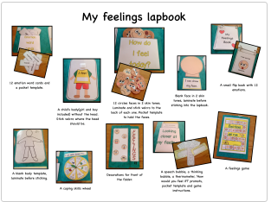
Resources

Slide 13
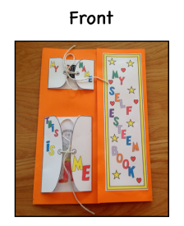
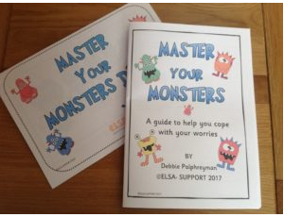
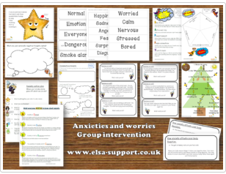
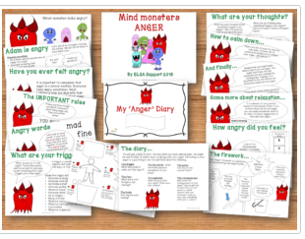

Slide 14
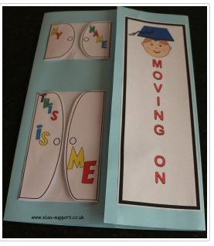
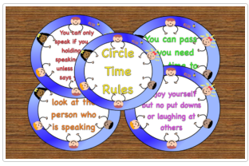
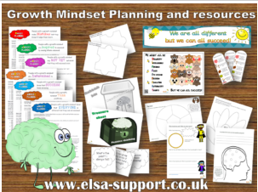
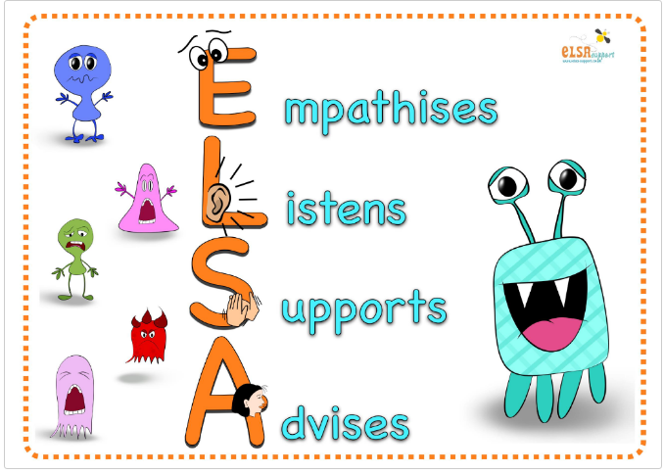

Slide 15
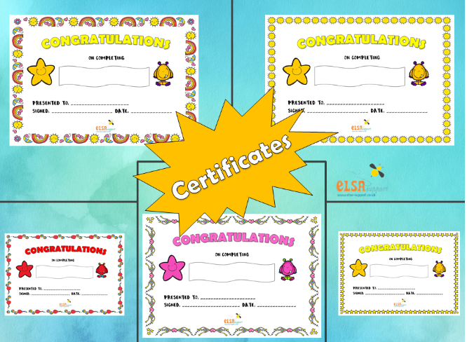
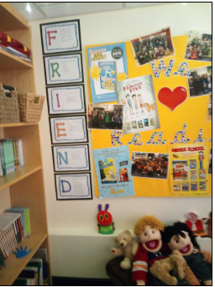
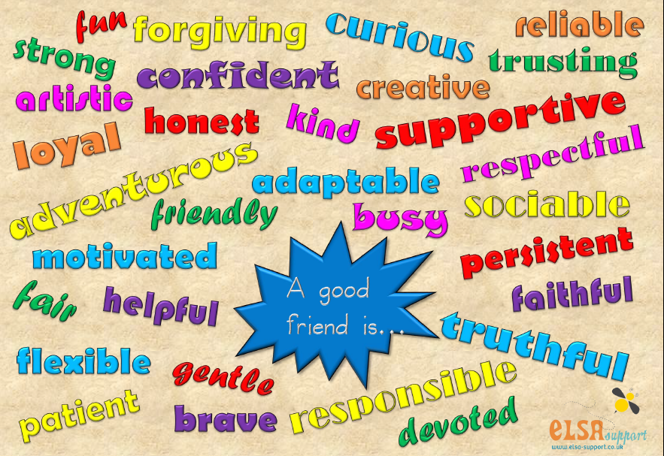
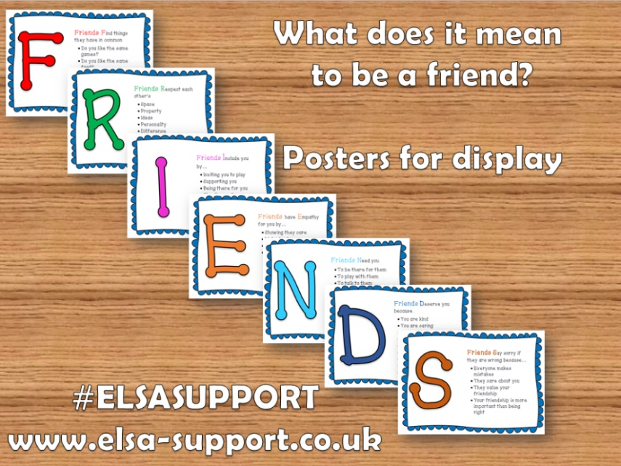

Slide 16
