Slide 1
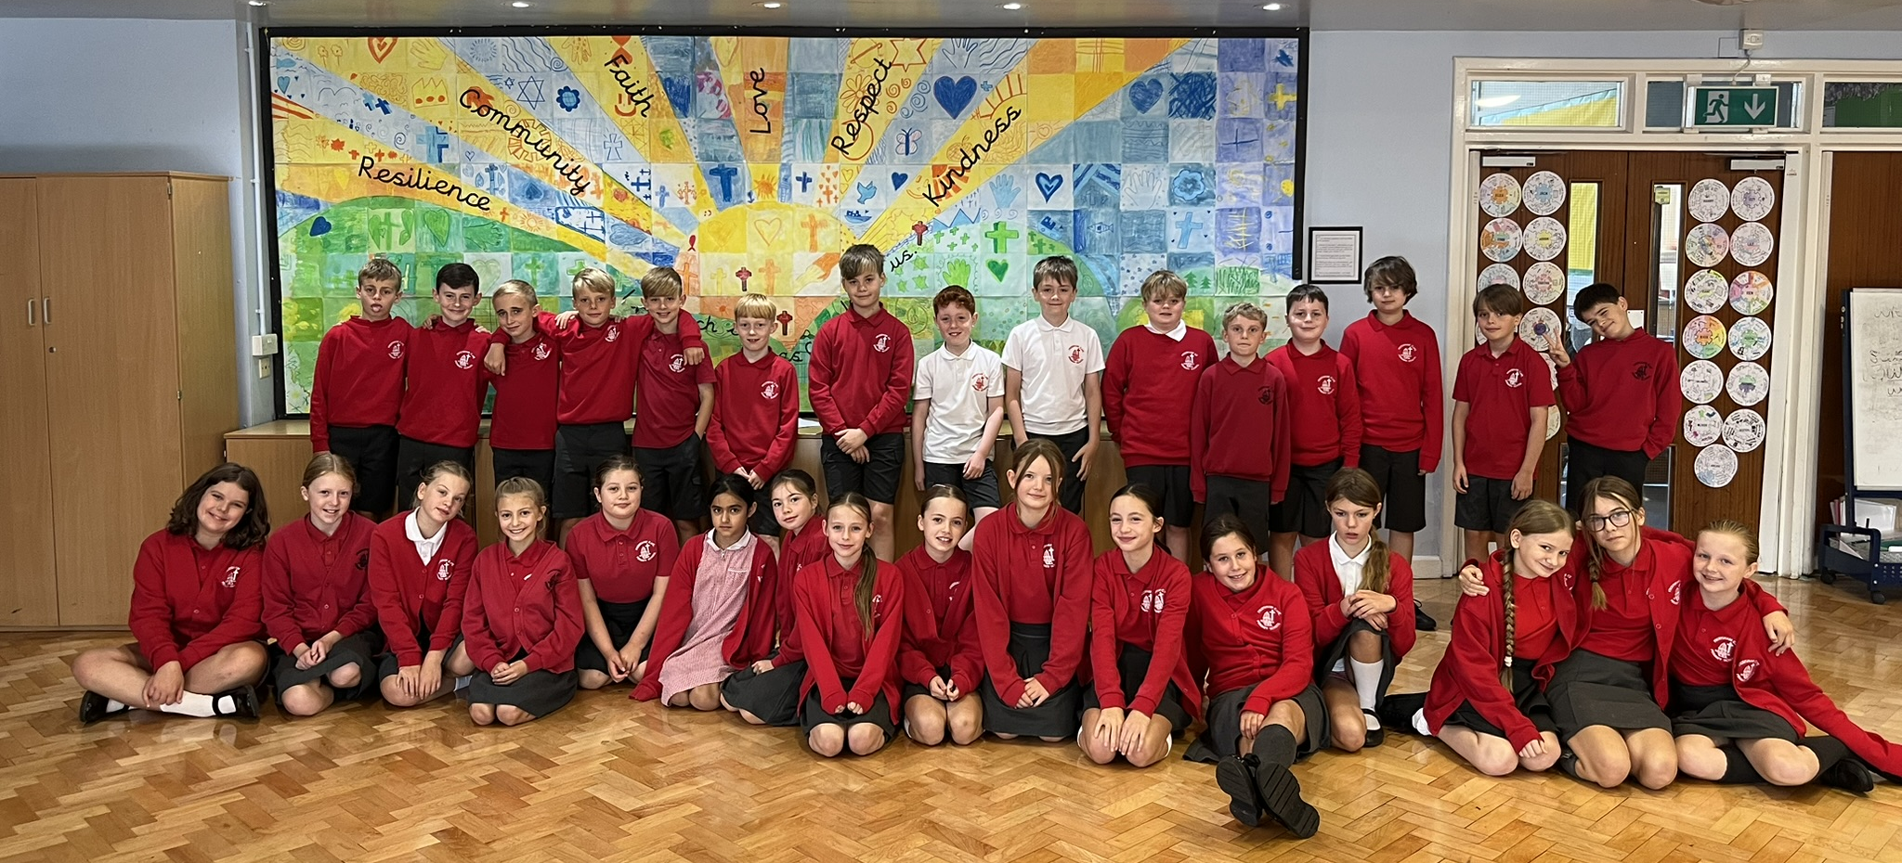
Welcome to year 6

Slide 2

Year 6 staff
Mr Coates
Mrs Fray
Miss Highdale
Mrs Williams

Slide 3

Communications
School Spider
School office
E-mails
Instagram
Year 6 webpage
Newsletter and Topic Web each term

Slide 4
Timetable
PE – Monday
Forest School – at least once a half term
Writing, Reading, Maths – daily
RE, Science, History/Geography, Music, PSHE – weekly
Computing, Art, DT - across the half term

Slide 5
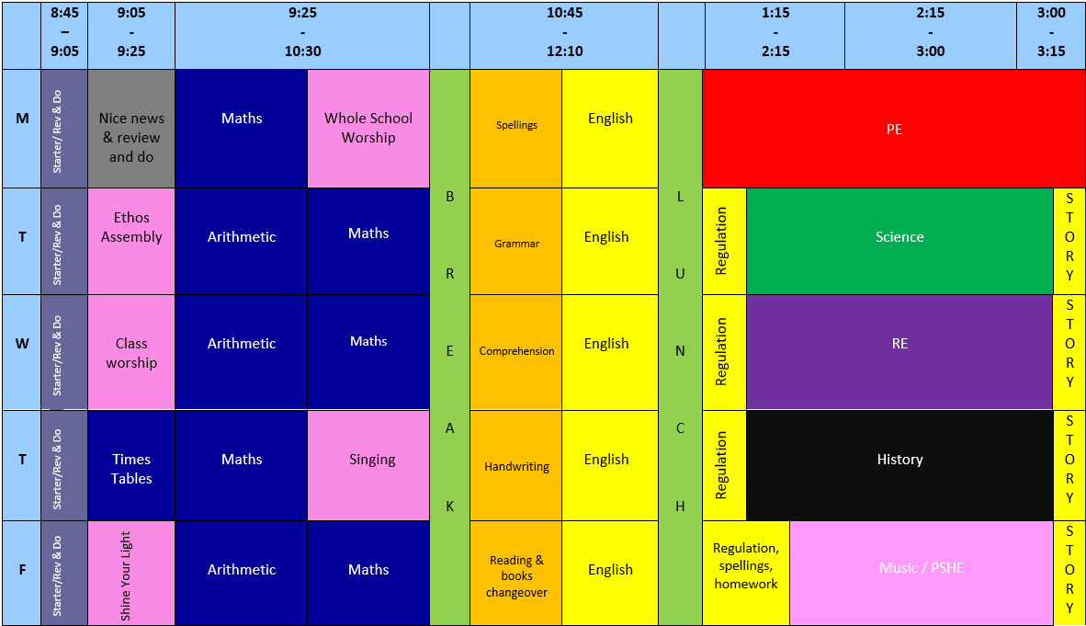

Slide 6
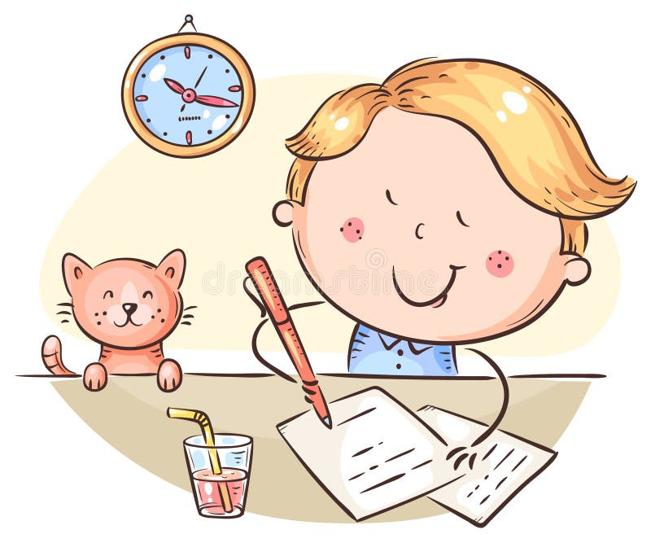
Routines
Attendance
Reading at home – as often as possible
Times Tables Rockstars - regular
Weekly homework – maths, English, spellings,
Spelling Shed, Letter Join, TTRS

Slide 7
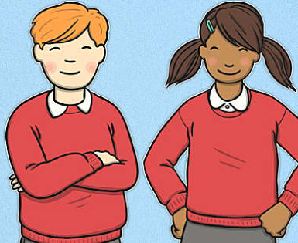
equipment
Water bottles
PE Kit
Uniform
Coats
Forest school

Slide 8

ALLERGY SAFETY

Slide 9
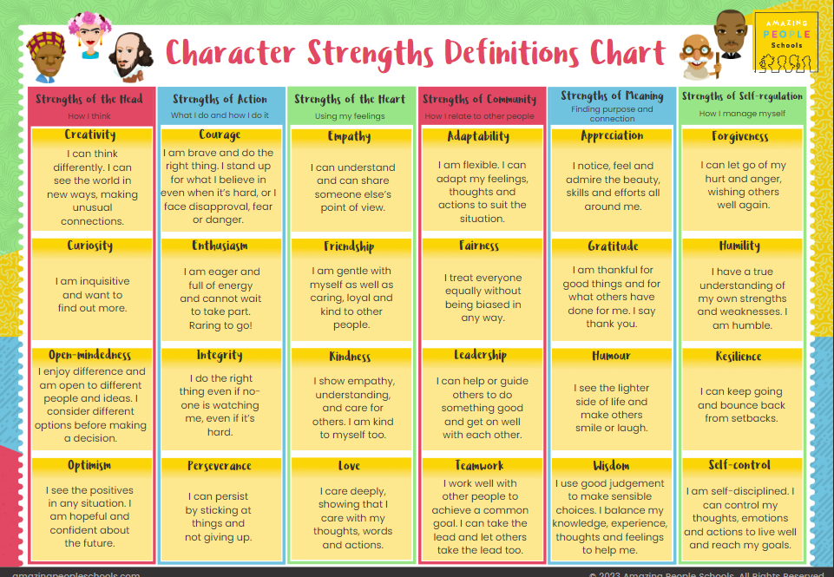
Behaviour

Slide 10
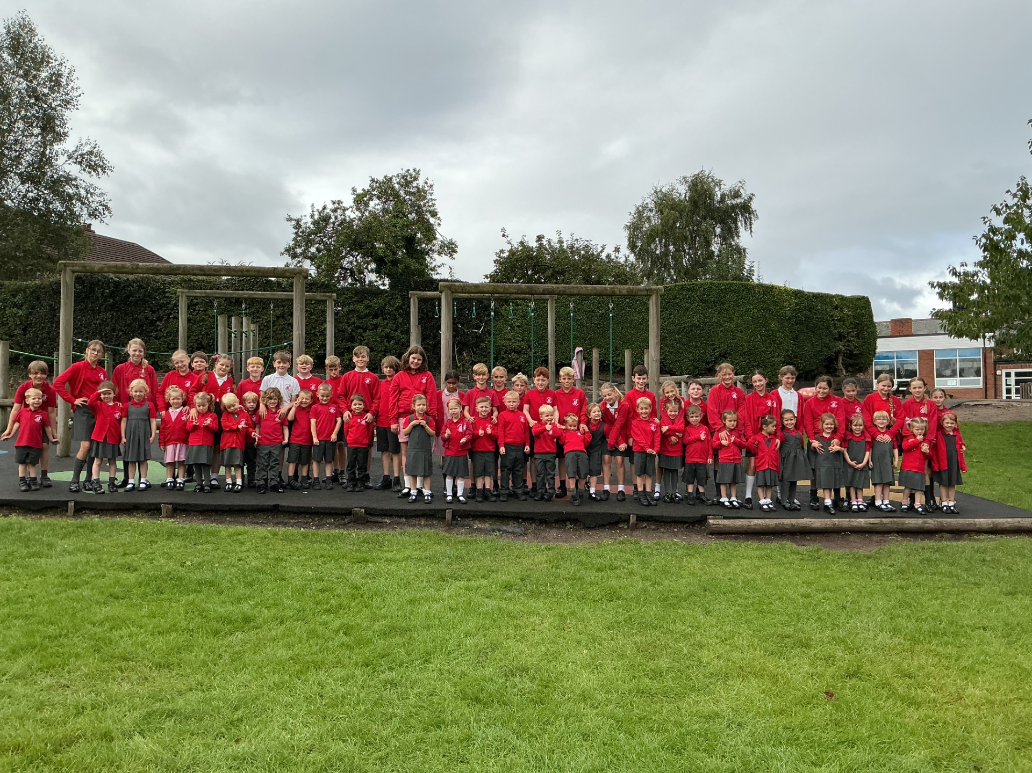
What makes year 6 special?
The children!
Oldest in school
Little buddies
Fun subjects
Exciting trips
Conway residential

Slide 11
Diary Dates
· Safer Internet Day – Tuesday 9th February
· Prayer Spaces Week – Beginning Monday 1st February
· Ash Wednesday – Wednesday 10th February
· Half Term – Friday 12th February to Monday 22nd February
· School Disco – Friday 26th February
· World Book Day – Thursday 4th March
· Parents' Evenings – Wednesday 17th & Thursday 18th March
· Easter Service – Tuesday 23rd March, 9:15am
· Spring Break – Thursday 25th March to Monday 12th April
· Class Photos – Friday 7th May
· SATs Week – Monday 10th to Thursday 13th May
· Careers Week and BikeAbility Week – Beginning Monday 17th May
· Half Term – Friday 28th May to Monday 7th June
· Conway Centre Residential – Monday 14th to Friday 18th June
· Sports Day – Friday 25th June (Reserve date: Wednesday 30th June)
· E-Safety Parents' Evening – Monday 28th June
· Summer Fair – Friday 2nd July
· Year 6 Induction at HHS – Monday 5th & Tuesday 6th July
· End-of-Year Production – Monday 12th & Tuesday 13th July, likely 6:00pm
· Leavers' Service – Thursday 15th July, likely 9:30am in church
· Summer Holidays – Friday 16th July (Year 6's last day)
· PTA AGM – Monday 21st September, 8:00pm
· Forest School – Wednesday 23rd September
· VR workshop – Thursday 24th September
· MacMillan Coffee Morning – Friday 25th September
· Spirituality Day – Wednesday 30th September
· Harvest Service – Tuesday 6th October, 9:30am
· Open Morning – Wednesday 7th October
· School Disco – Friday 9th October
· Parents' Evenings – Wednesday 14th & Thursday 15th October
· Individual School Photos – Friday 16th October
· Healthy Week – Beginning Monday 19th October
· Half Term – Friday 23rd October to Tuesday 3rd November
· WWII Tattenhall trip – Friday 6th November
· Year 6 Class Assembly – Friday 13th November, 9:05am
· Anti-Bullying Week – Beginning Monday 16th November
· Advent Spiral Service – Friday 27th November
· Frodsham Christmas Festival – Saturday 28th November
· Forest School – Wednesday 2nd December
· Christmas Dinner – Thursday 10th December
· KS2 Carol Service – Monday 14th December, 6:00pm
· Christmas Party Day – Wednesday 16th December
· Storyhouse Theatre Visit – Thursday 17th December
· Christmas Holidays – Friday 18th December to Monday 4th January

Slide 12

Any questions?

Slide 13


