Slide 1
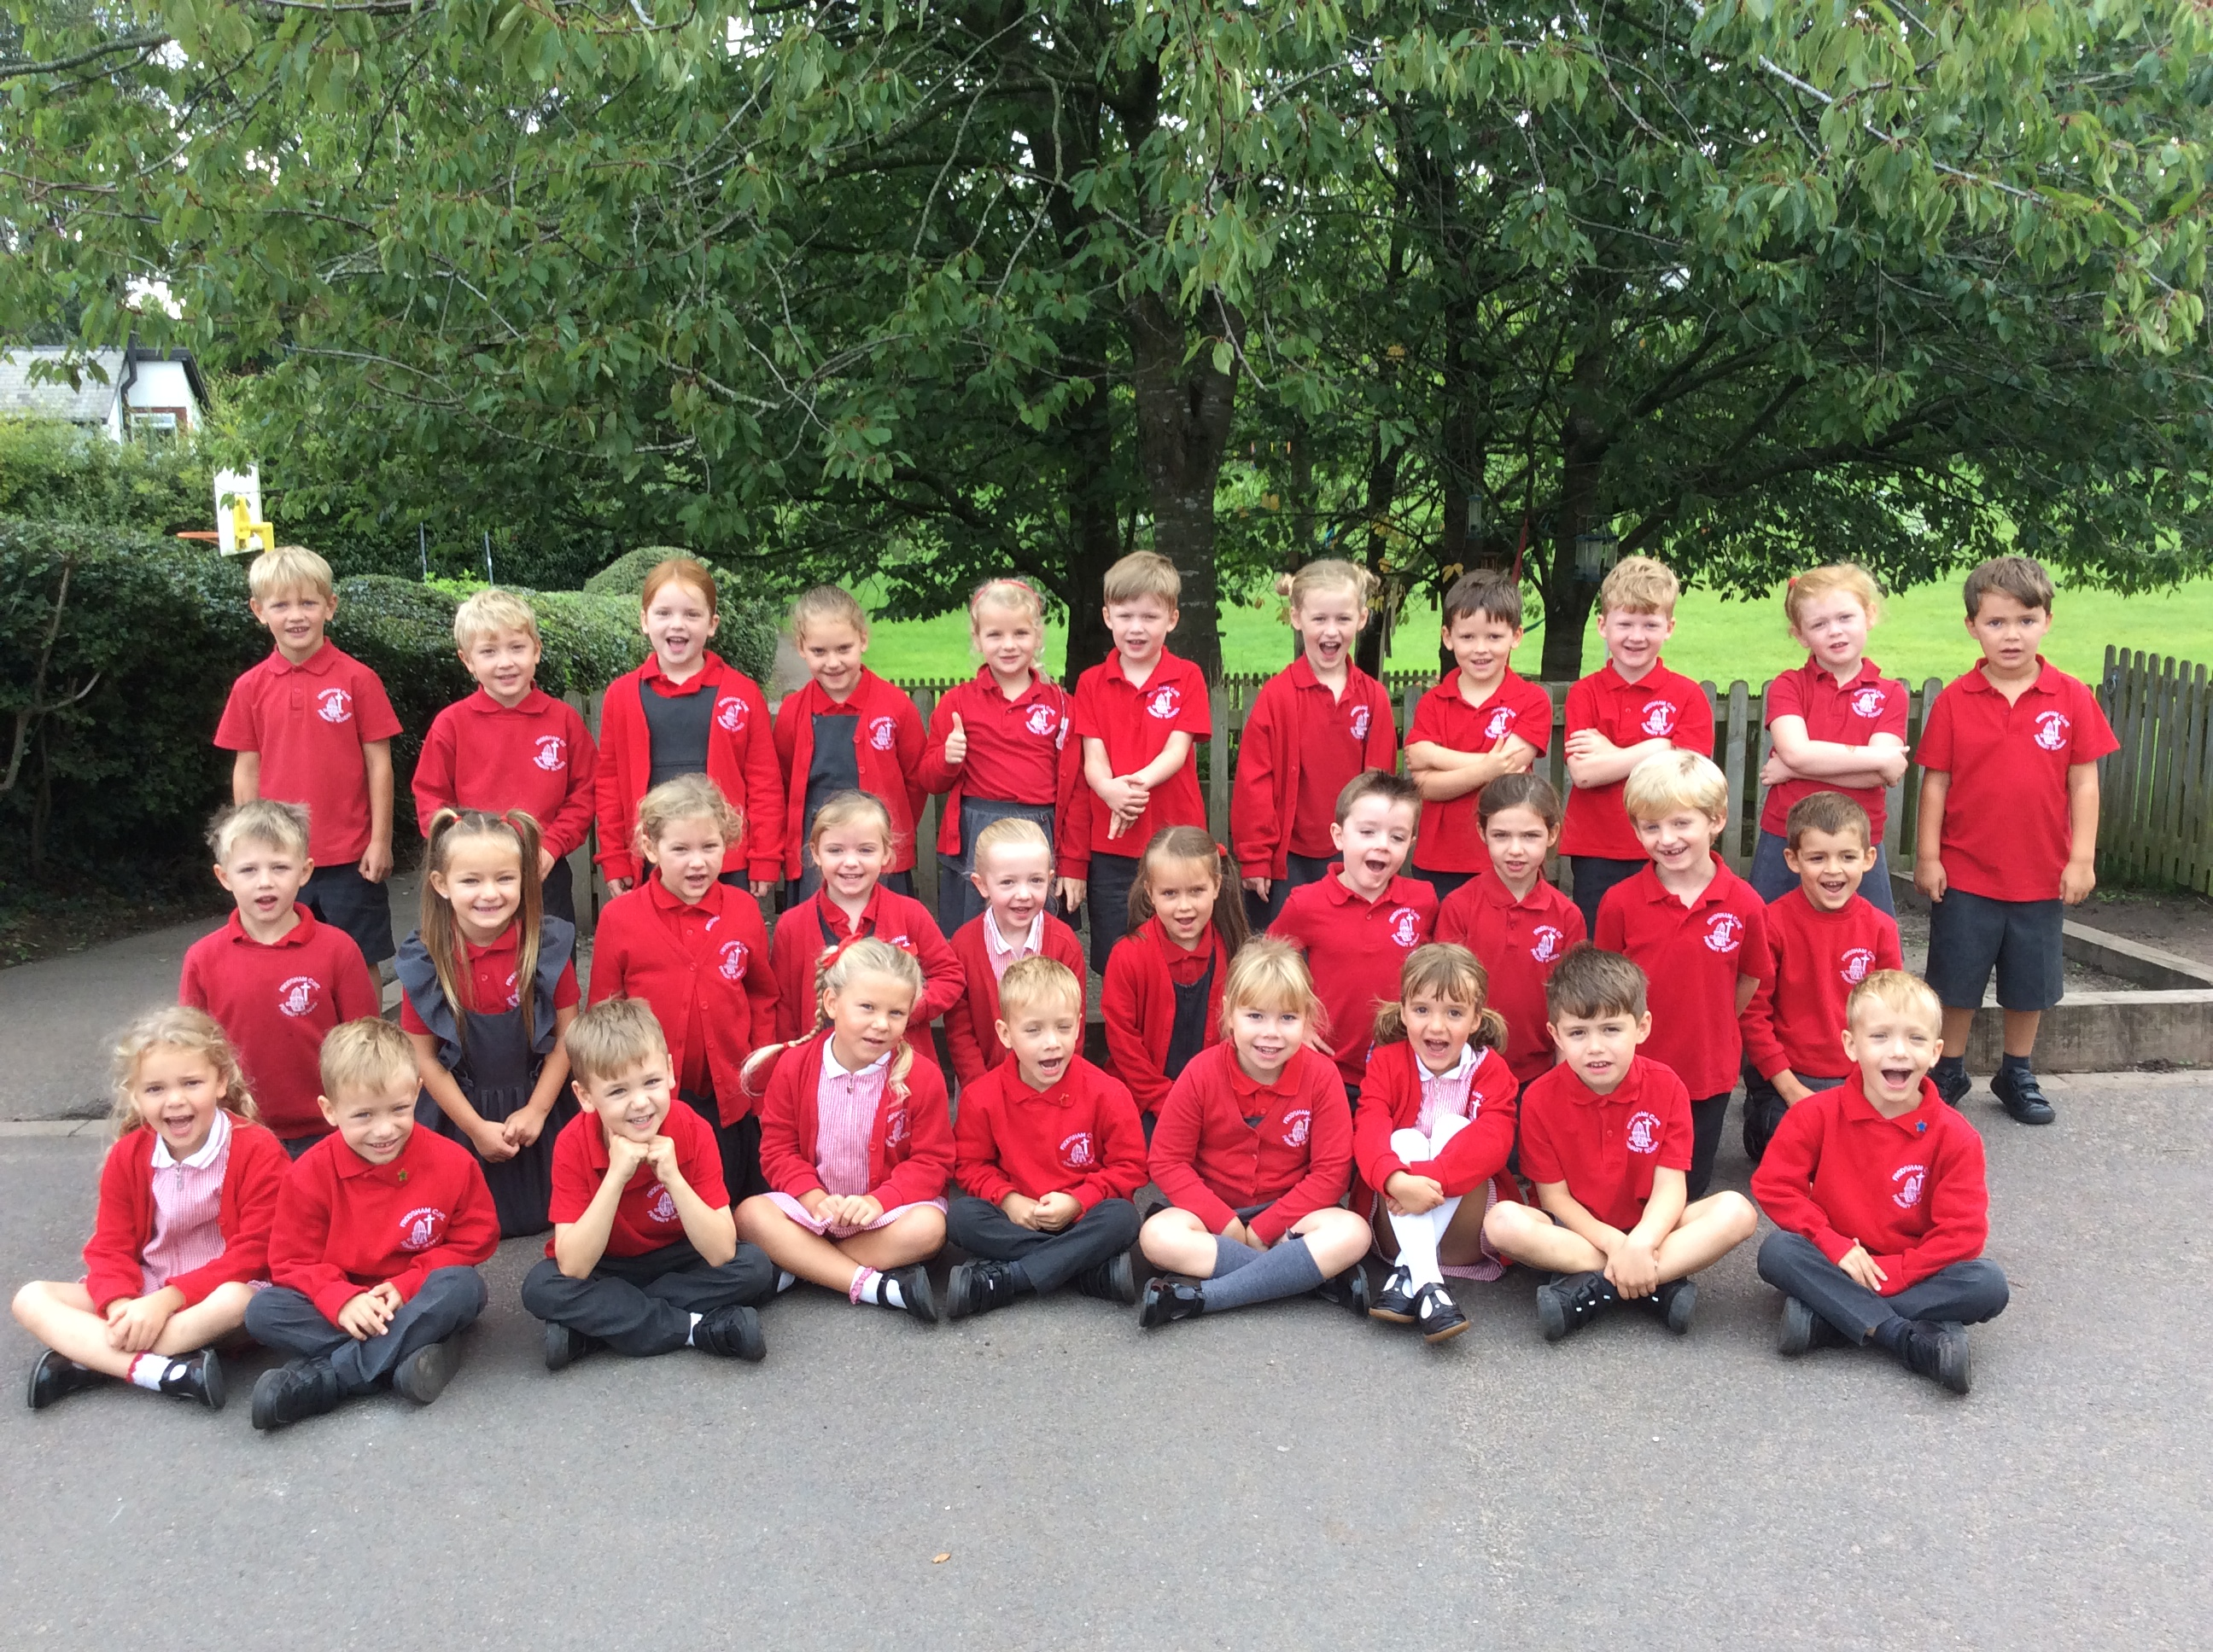
Welcome to Year 1

Slide 2
Staff
Mrs Kavanagh
Miss Casey (Thursday pm)
Myself

Slide 3
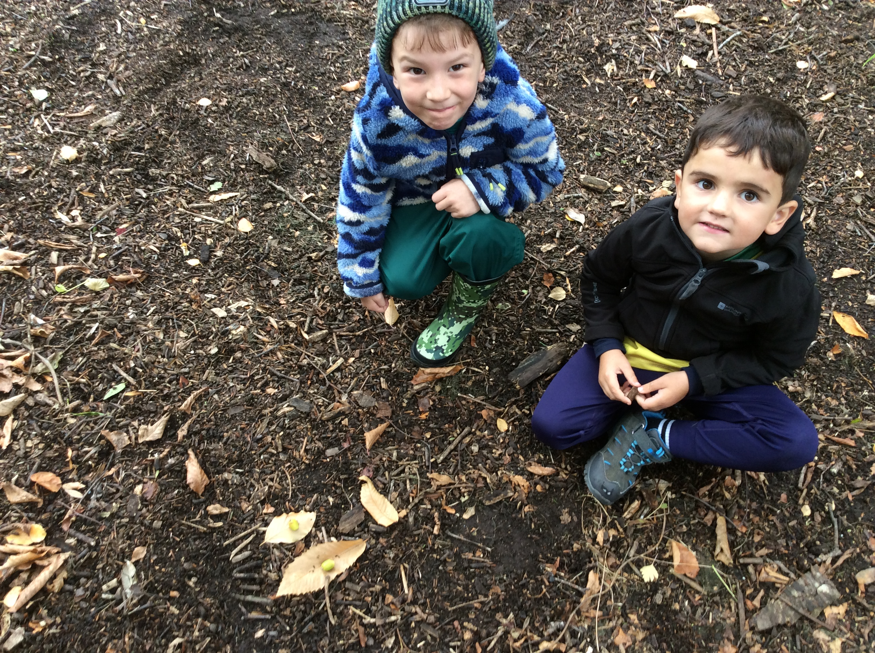
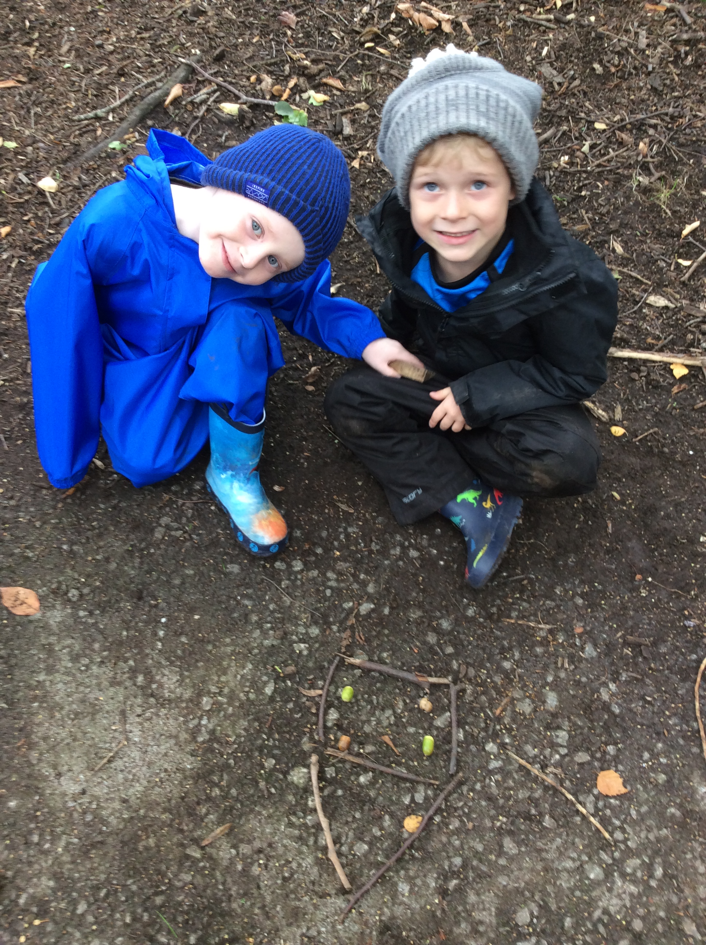
Timetable
PE – Wednesday and Friday
Forest School – generally fort-nightly
Phonics, English / Maths – daily
RE, Science, PSHE – weekly
Geography, History, Computing, Art, DT, Music - across the half term
Assessments – as and when

Slide 4
Helping at home
Reading at home – as often as possible
Homework – weekly – phonics / maths – basic skills
- occasionally RE / science
Recommended Reading List: themedhttps://www.lovereading4kids.co.uk/lists/view-all
Times Table Rock Stars Award:
Counting in 10’s, 2’s, 5’s

Slide 5
Equipment
Water bottles
Snacks
Book bags
PE Kit
Apron
Uniform
Coats
Wet weather – wellies

Slide 6
Behaviour
Conduct ambassadors – Character Strengths

Slide 7
Attendance
As a school we are aiming for 95%+ attendance
If your child is registered after 9am in the morning this is classed as an absence as out registers close at 9am – therefore punctuality is of the utmost importance but also allows your child to settle into the routine of the day alongside their friends

Slide 8
Alleregies
If your child has an allergy please can you let us know asap
If your child uses an inhaler please let us have an ‘in-date’ to keep in school with clear dosage written on a label
We are a nut aware school
Children are not allowed to share any food in school during play-time or lunchtime

Slide 9
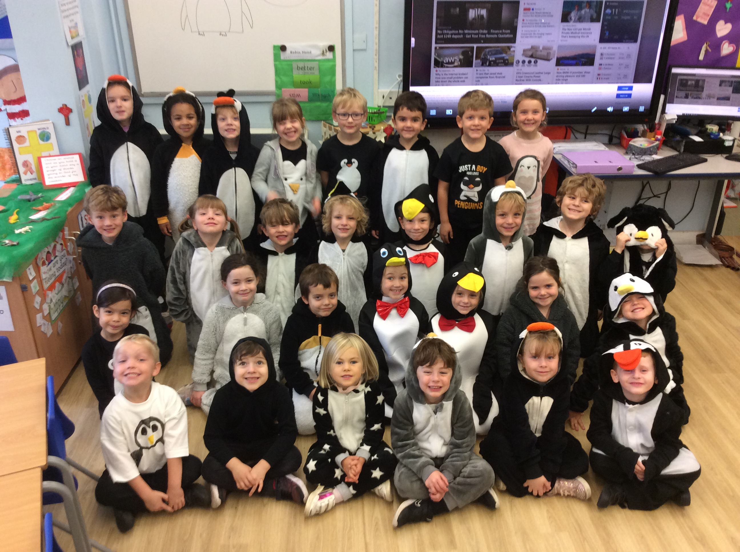
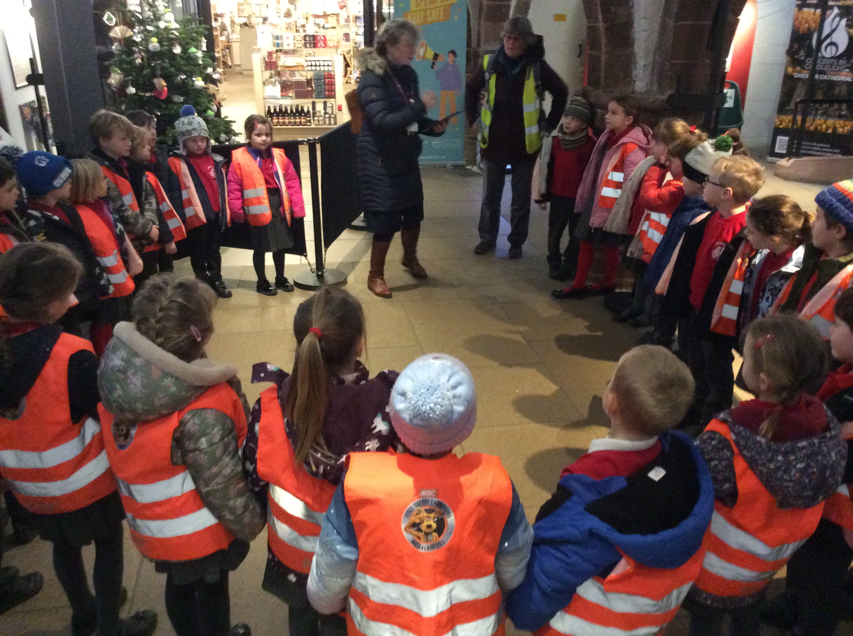
What makes Year 1 Special
The lovely children
Progress and maturity
Phonics screening – w/b June 14th 2026
Penguin Day – 19th October
Nativity on the Move – 24th November
Visit to Frodsham Methodist Church in Summer as part of RE curriculum
Moving from Reception through Year 1 to Year 2!
- Own learning tasks
- Independent tasks
- Staff led tasks

Slide 10
Communication
School Spider
Dates
Forest School
School Office
Newsletter and Topic Web each term

Slide 11
Diary Dates
PTA – AGM – 21st September - via Zoom 8pm
MacMillan Coffee Morning – 25th September – 9.15am to 10.15am
Spirituality Day - 30th September
Harvest Service - 6th October 9.30am
New Reception Open Morning – 7th October
School Disco – 9th October
Parents’ Evening - 14th & 15th October
Individual School Photos - 16th October
Penguin Day – 19th October
Half Term: Friday 23rd October - Tuesday 3rd November
Anti Bullying Week - 16th November- Odd Socks Day
Nativity on the Move – 24th November
Advent Spiral - 27th November
Frodsham Christmas Festival - 28th November
Nativity Play - 9th December 2.00pm & 10th December 6pm
KS2 Carol Service - 14th December 6pm
Christmas Party Day - 16th December
Storyhouse Theatre Visit - 17th December
Bound in Sounds – 17th December
Christmas Holidays: Friday 18th - Monday 4th January

Slide 12
Deadline Reception applications - 15th January
Young Voices – 27th January
Prayer Spaces Week – 1st February
Half Term: Friday 12th – Monday 22nd February
World Book Day - 4th March
Parents’ Evening - 17th & 18th March
Easter Service - 23rd March 9.15am
Spring Break: Thursday 25th March - Monday 12th April
Class Photos - 7th May
Careers Week – 17th May
Half Term: Friday 28th May - Monday 7th June
Phonics Screening Week – 14th June
Sports Day - 25th June (Reserve: 30th June)
E’Safety Evening – 28th June
Summer Holidays - Friday 16th July

Slide 13
PTA
We have a very successful PTA which raises money to support the education of your children by helping to buy school equipment and paying for extra treats for the school i.e. paying for the coaches to the theatre / buying hoodies for our leavers etc.
If you would be happy to be part of the team – many hands make light work – please chat to the current members, someone in the office or to Mrs Kirby

Slide 14
Any Questions

