Slide 1
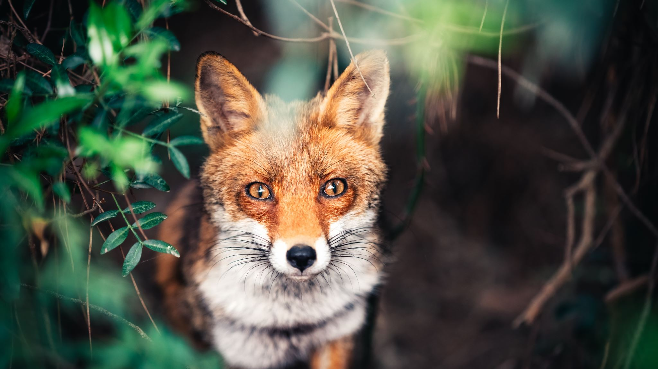
Fox Howl 2026 Parent information meeting

Slide 2
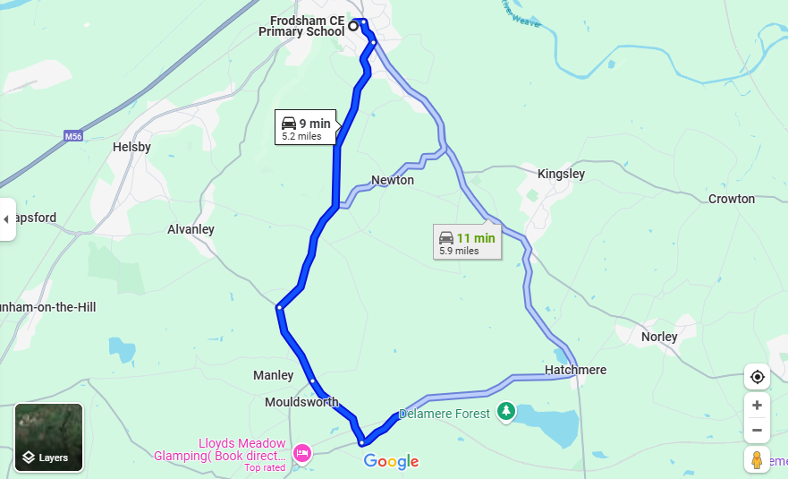
9:10 departure group:
Children with surnames between (and including) Booth and Hughes in the register.
9:50 departure group:
Children with surnames between (and including) Hunter and Williamson-White on the register.

Slide 3
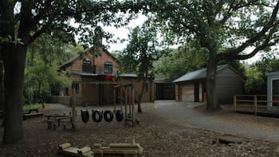

Slide 4
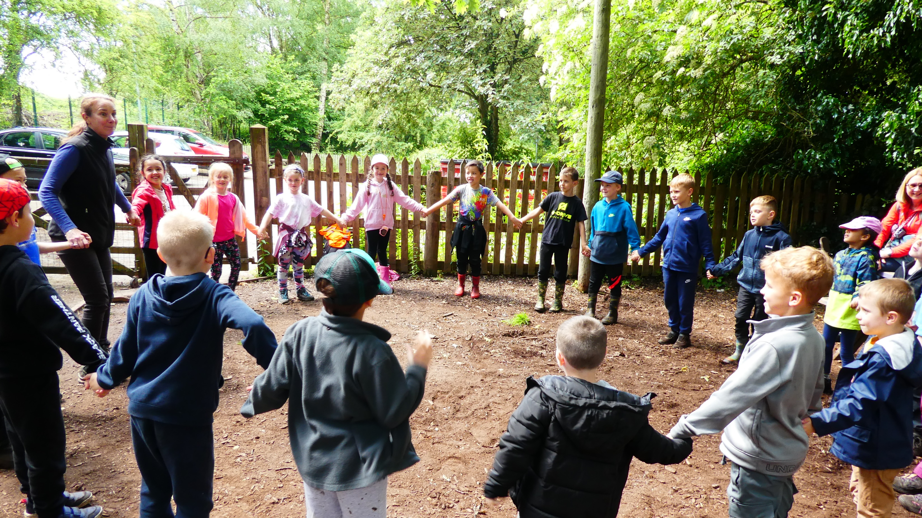

Slide 5
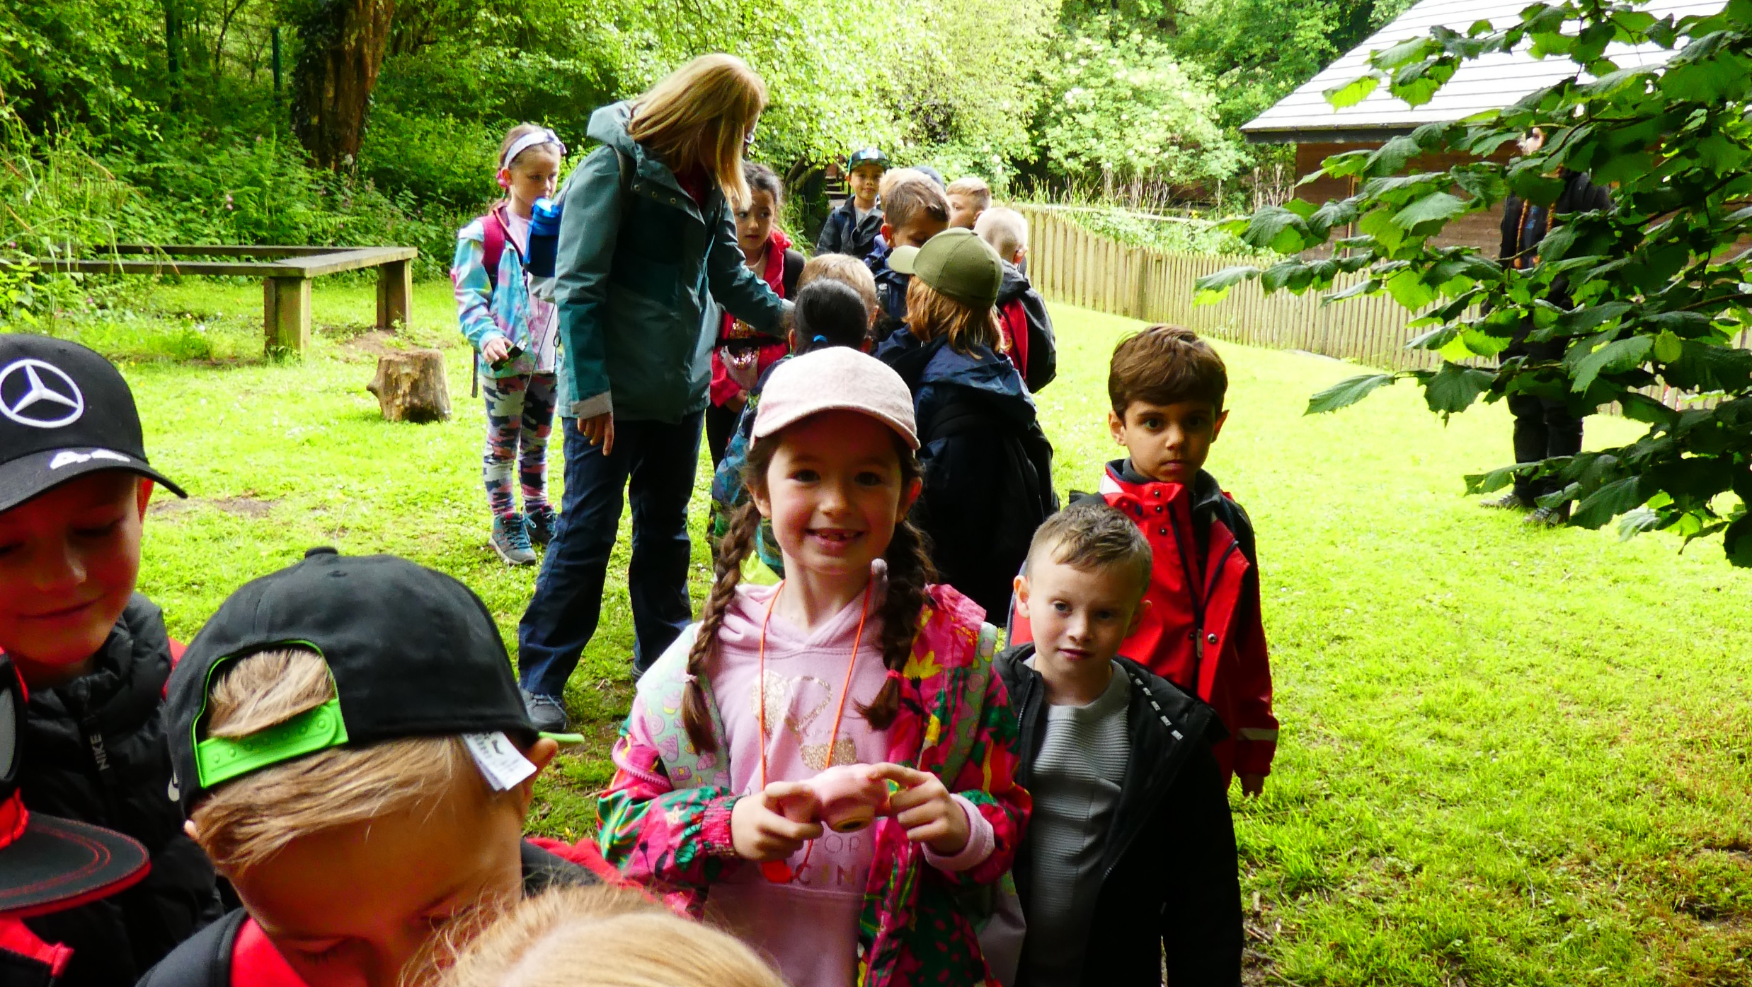

Slide 6
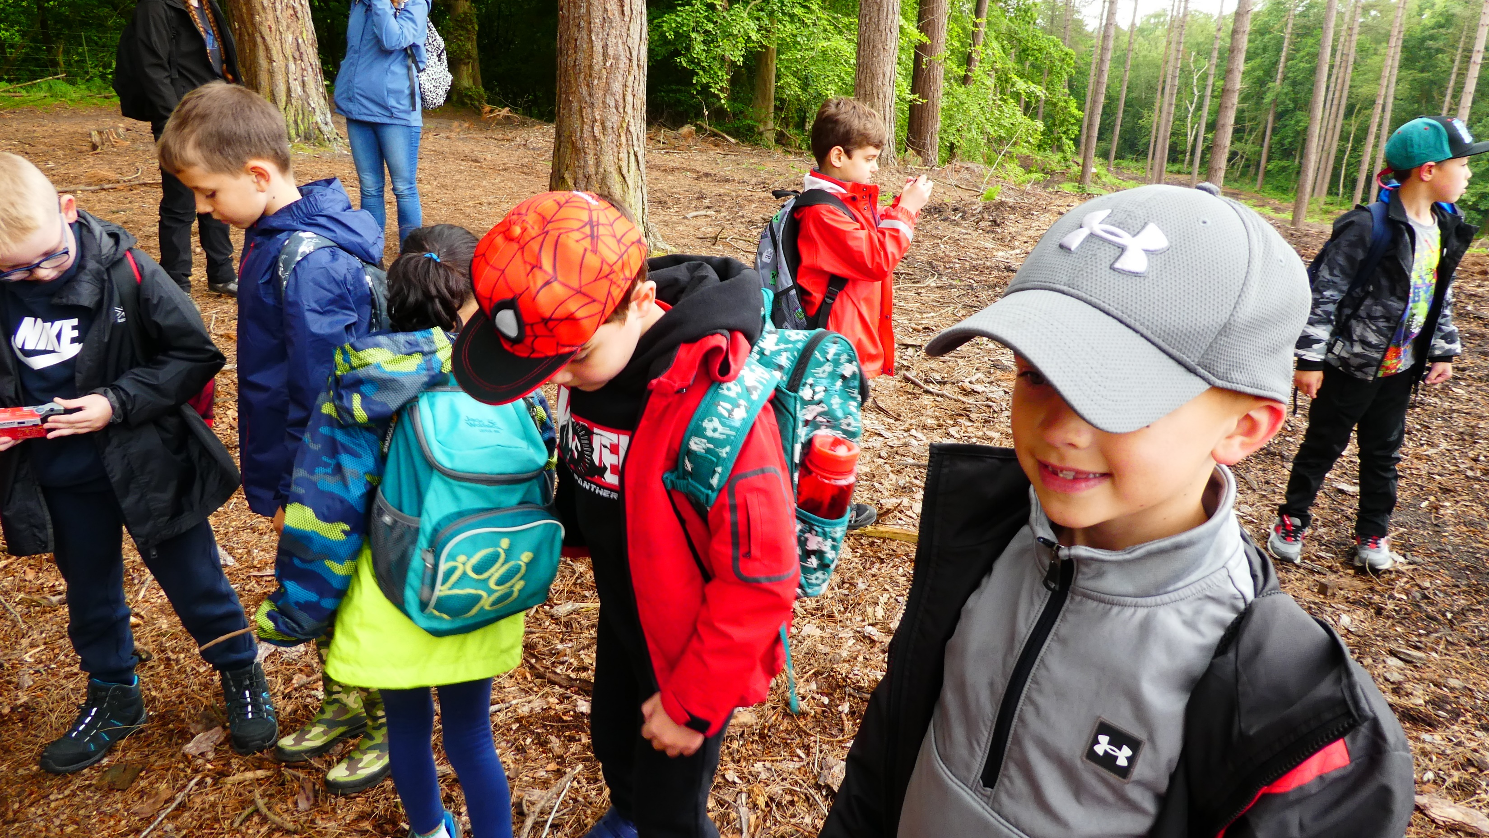

Slide 7
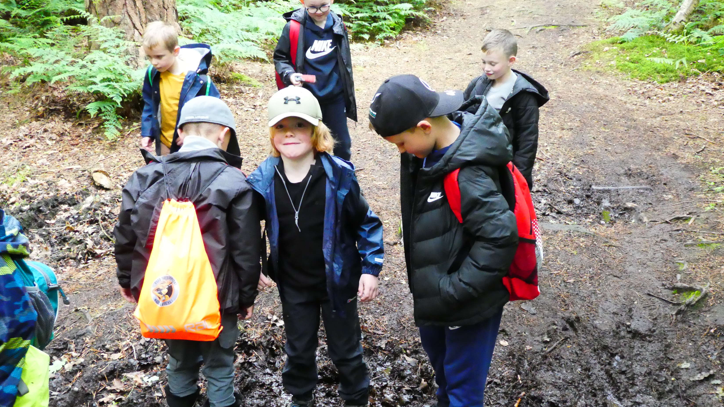

Slide 8
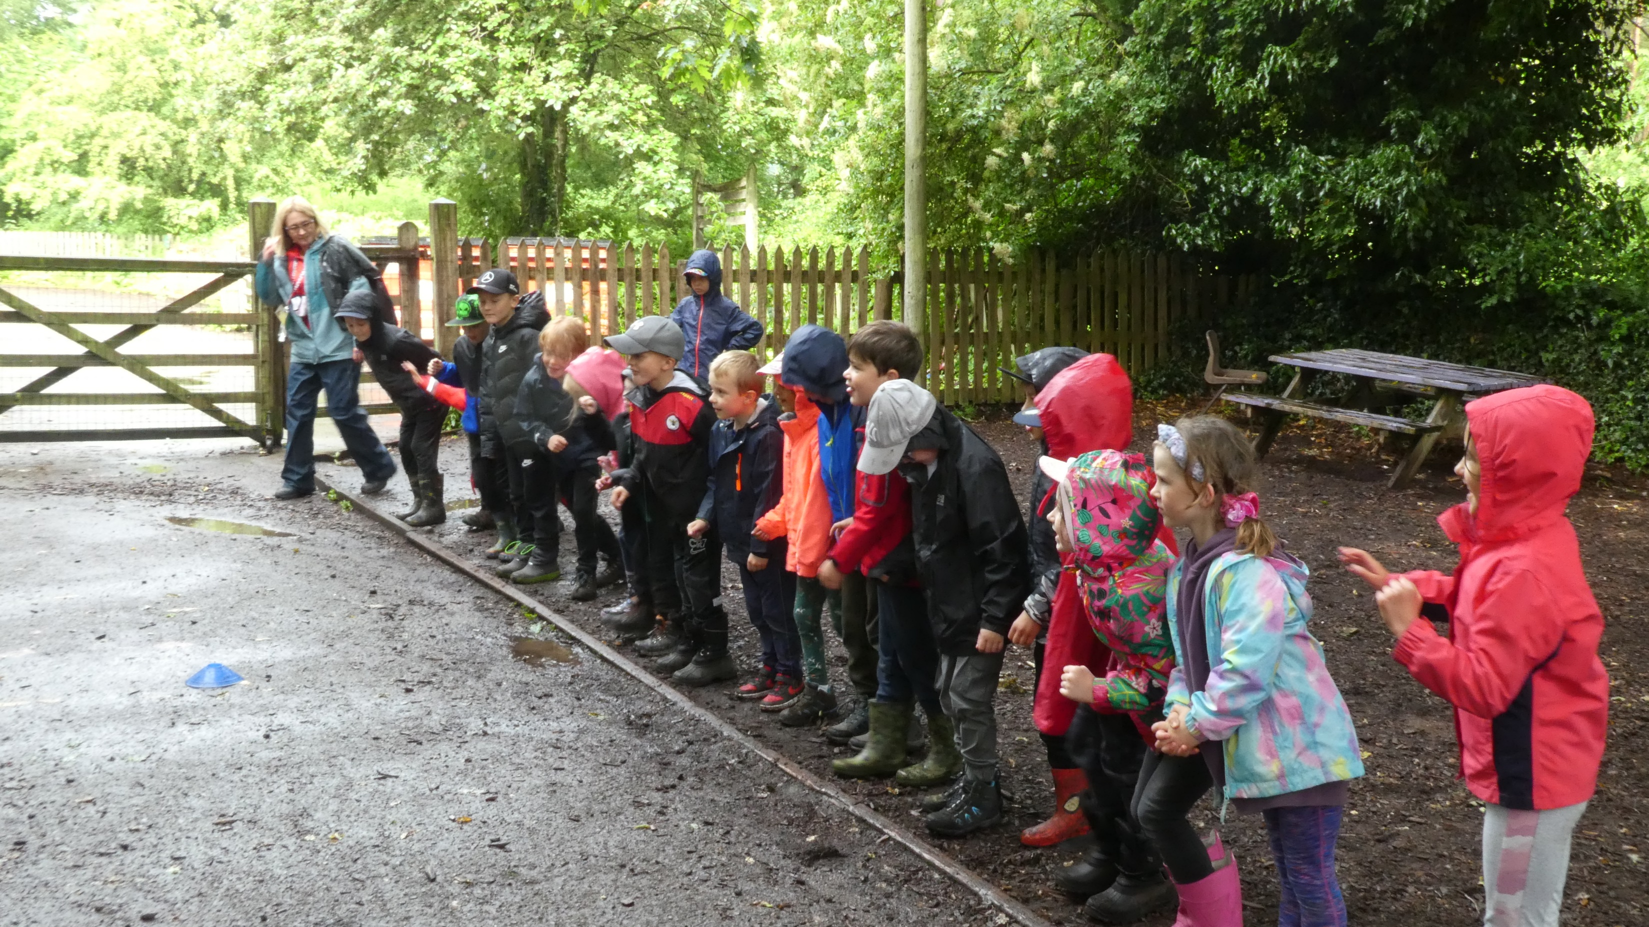

Slide 9
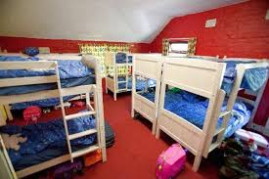

Slide 10
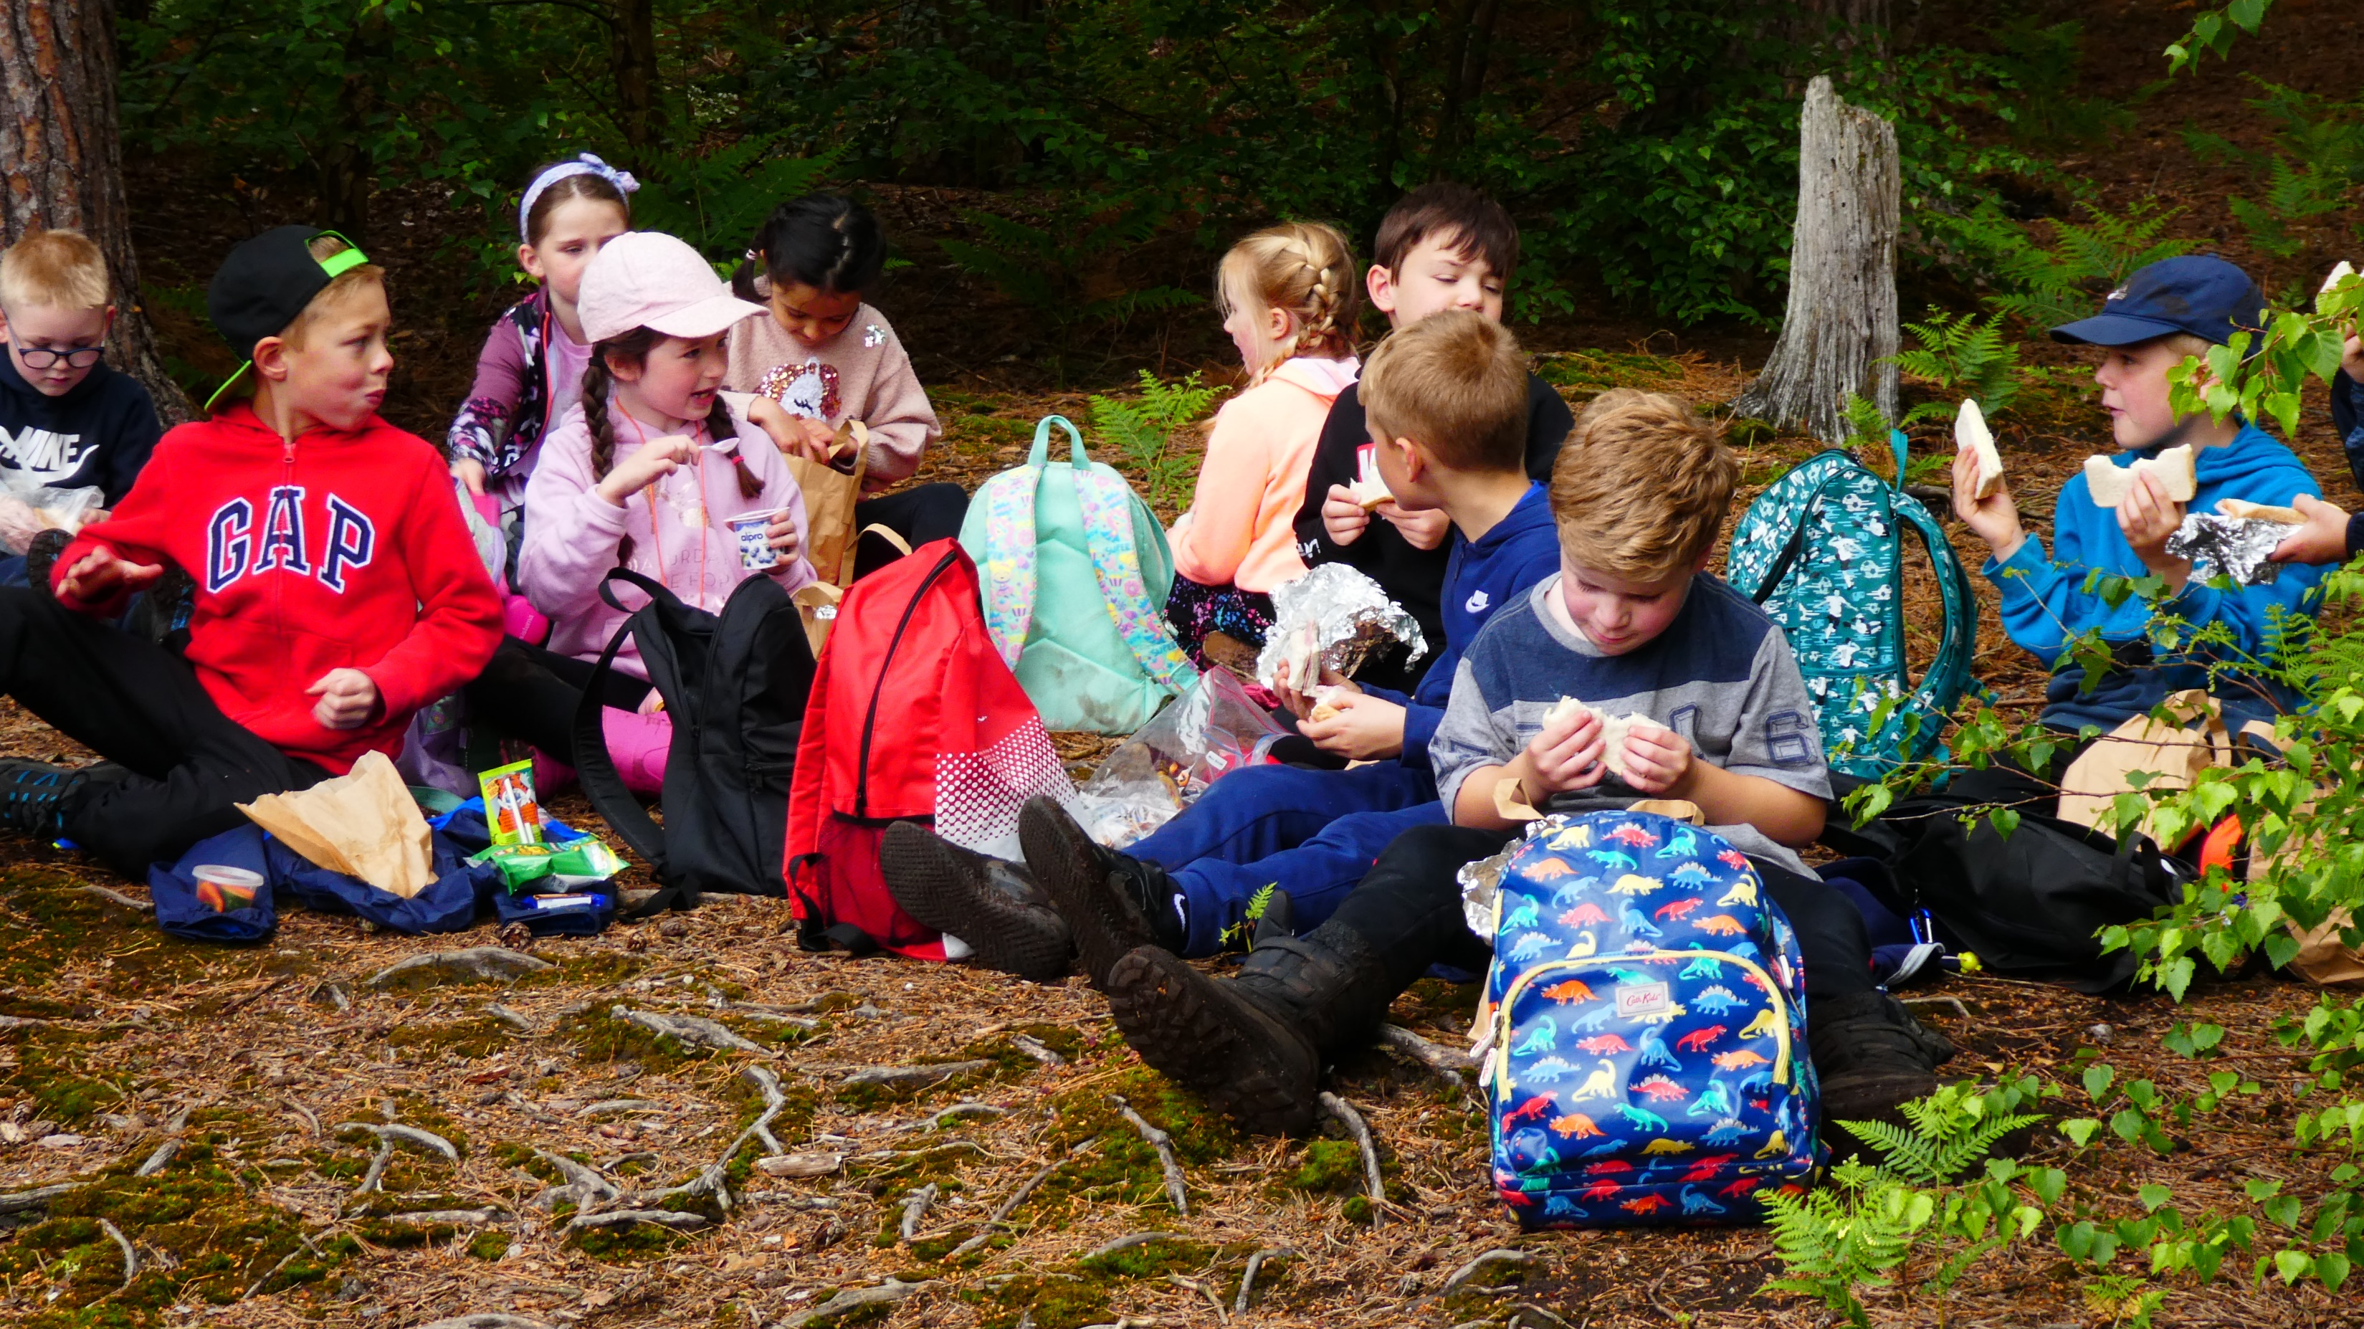

Slide 11
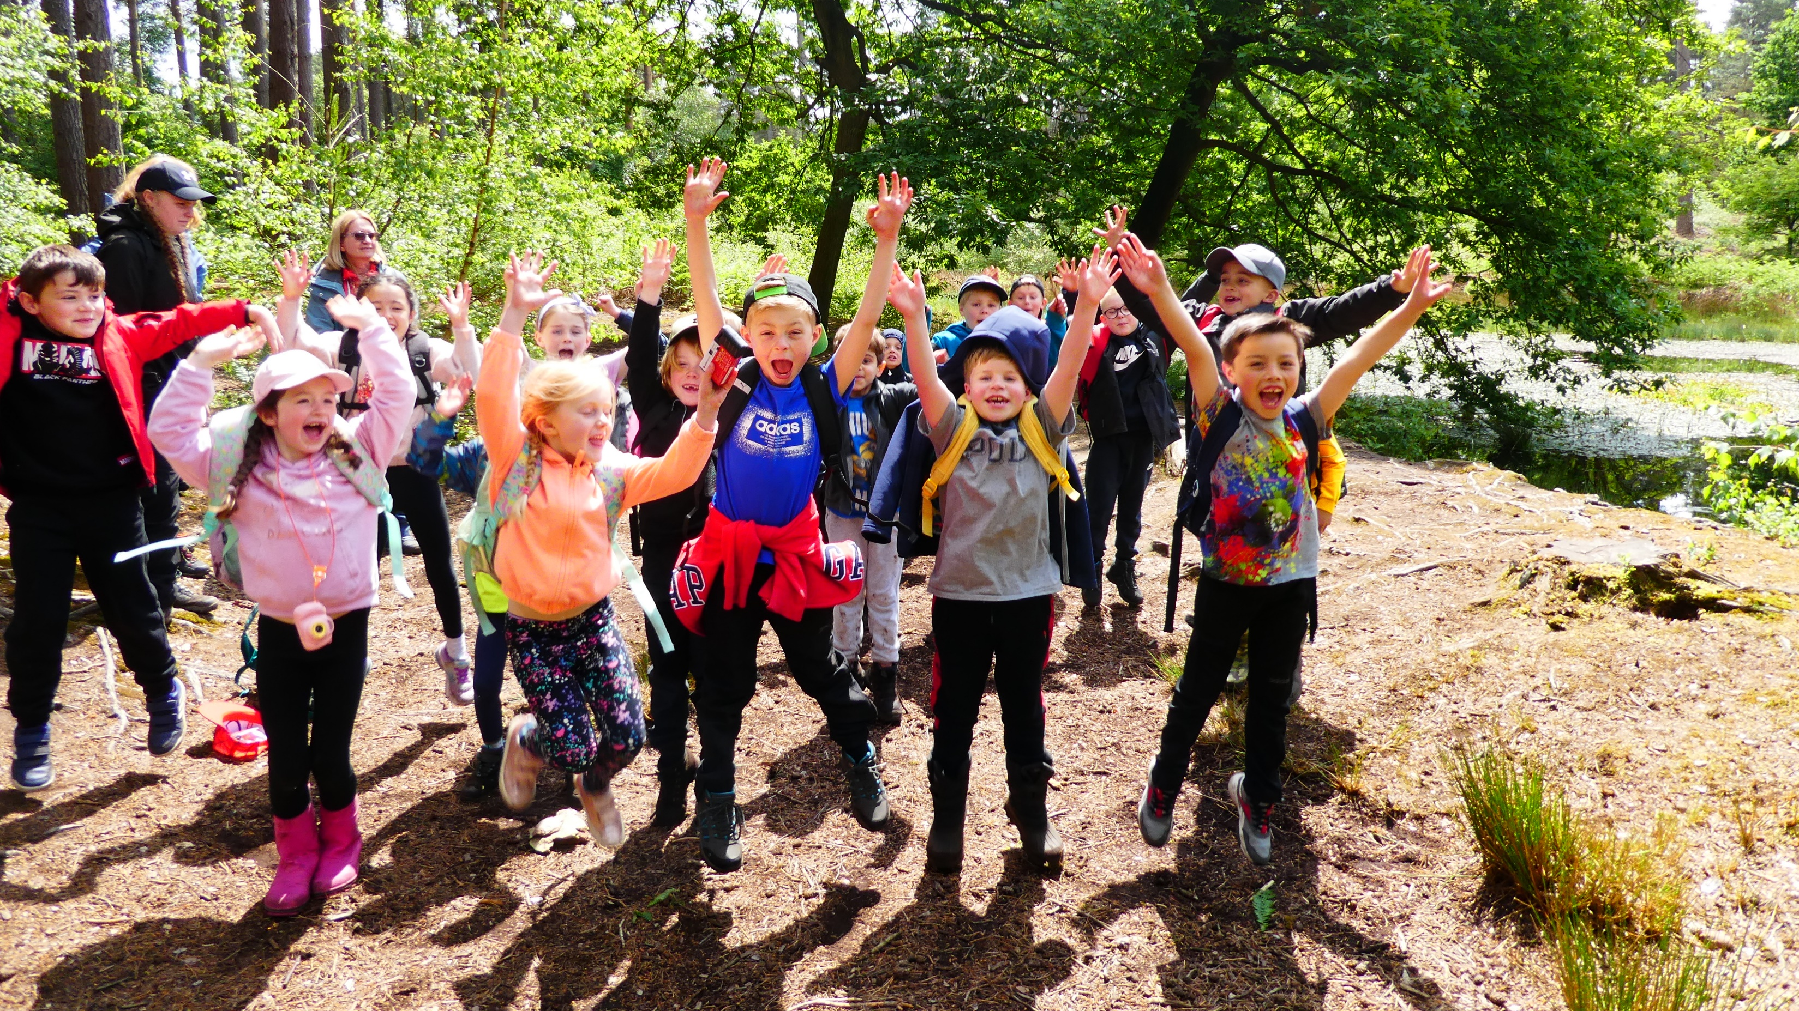

Slide 12
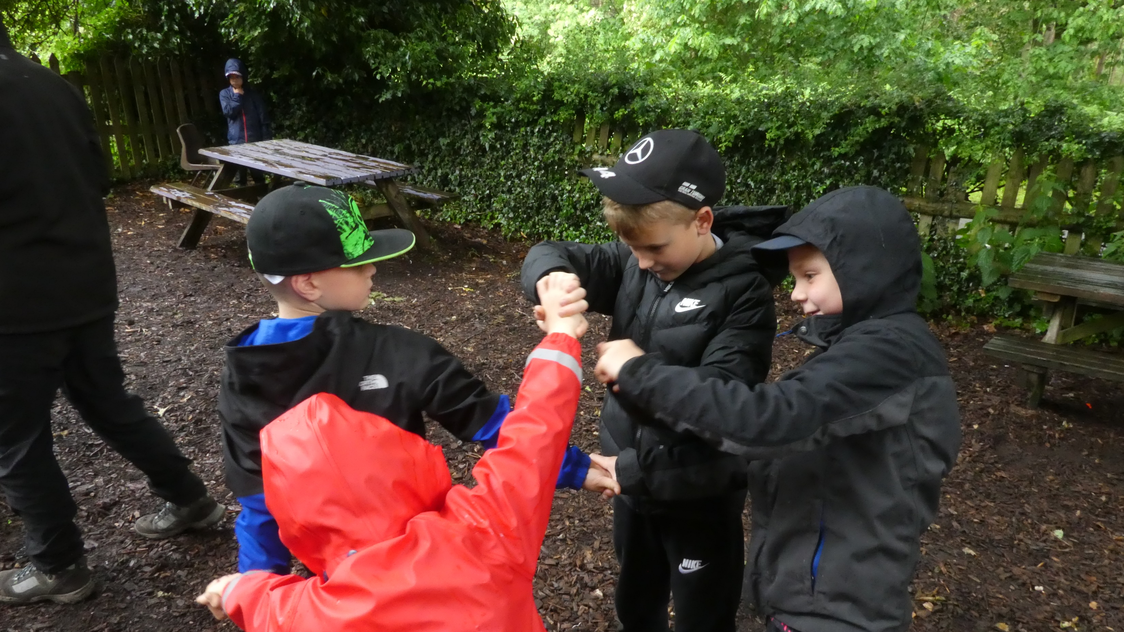

Slide 13
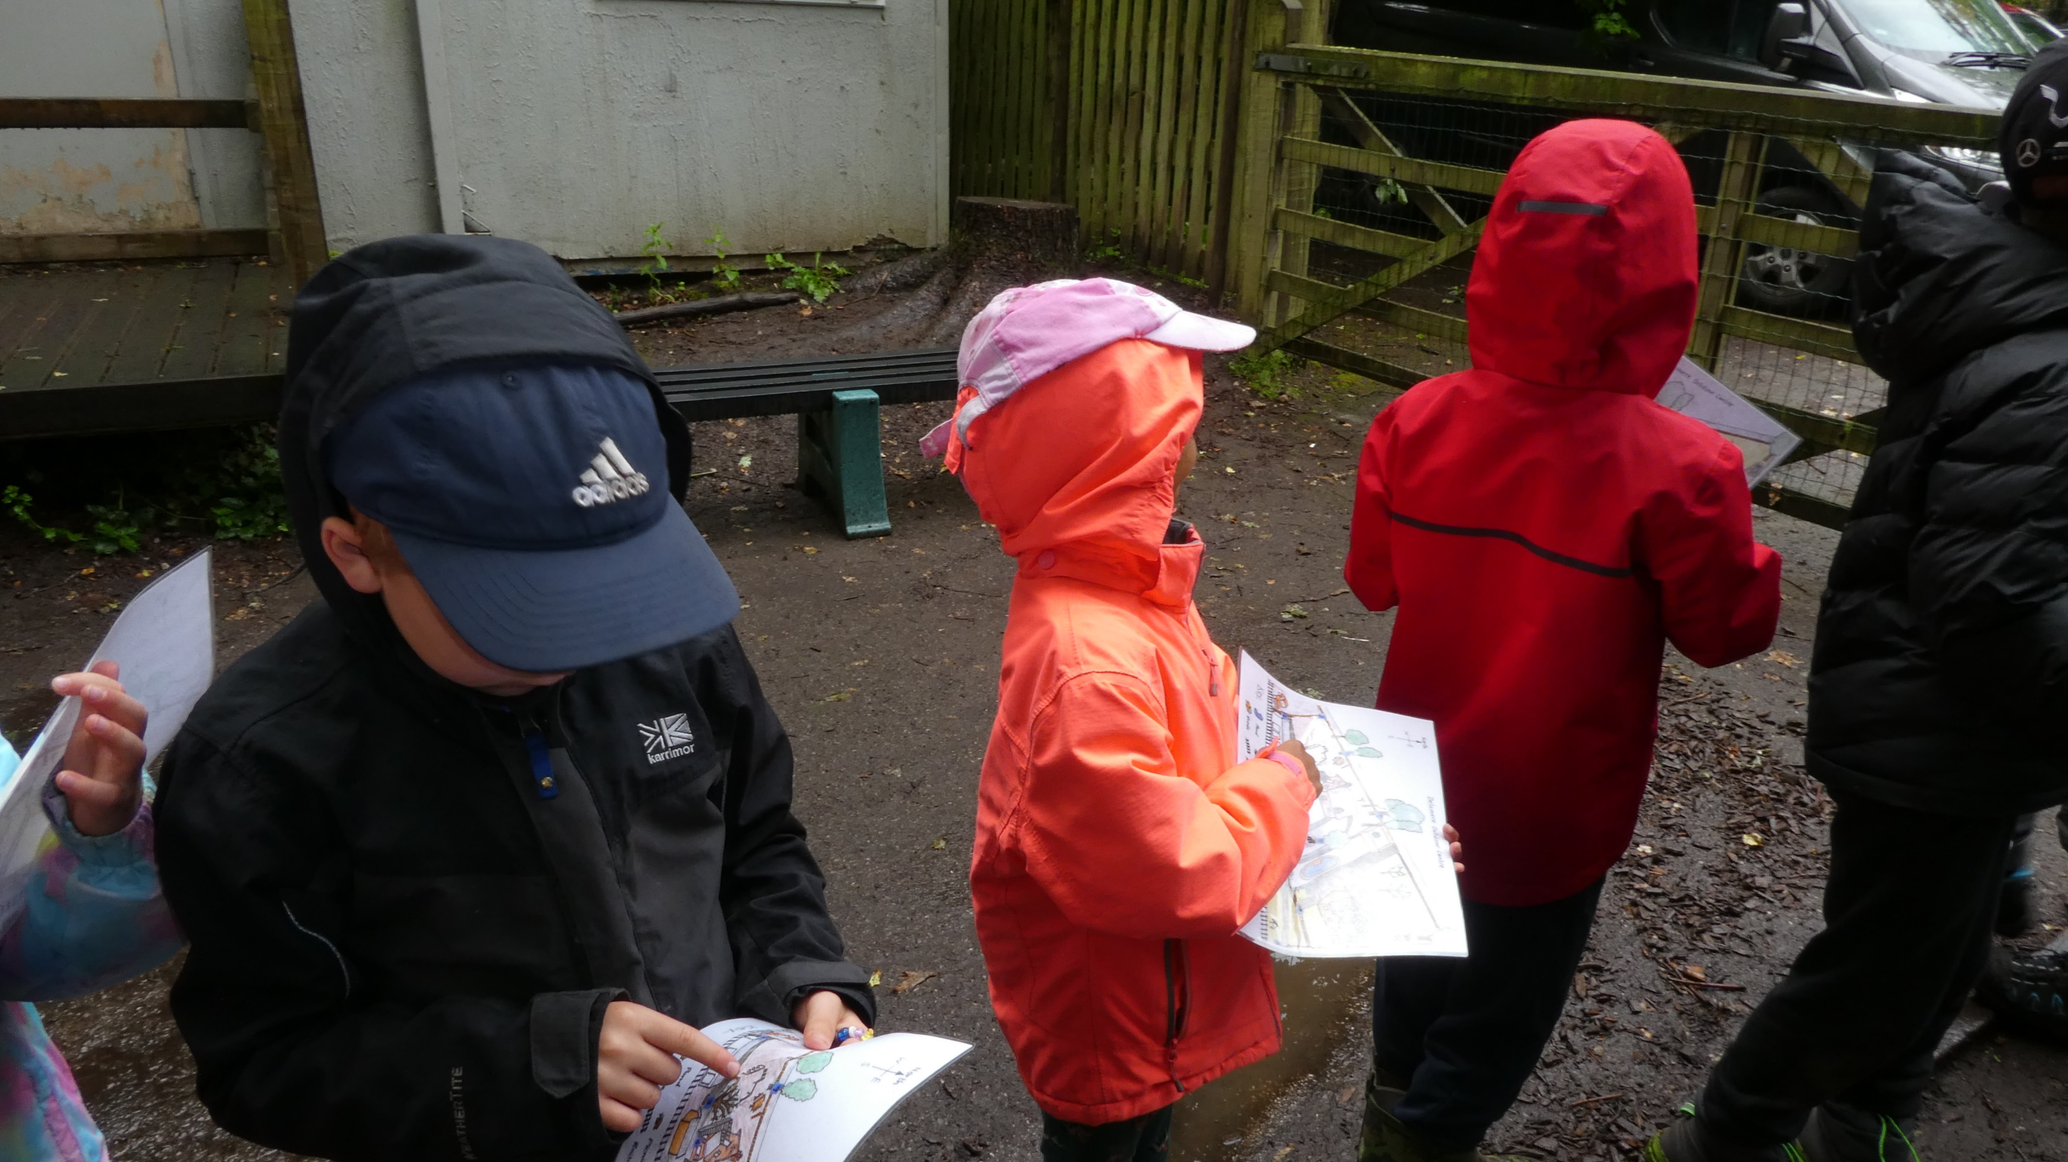

Slide 14
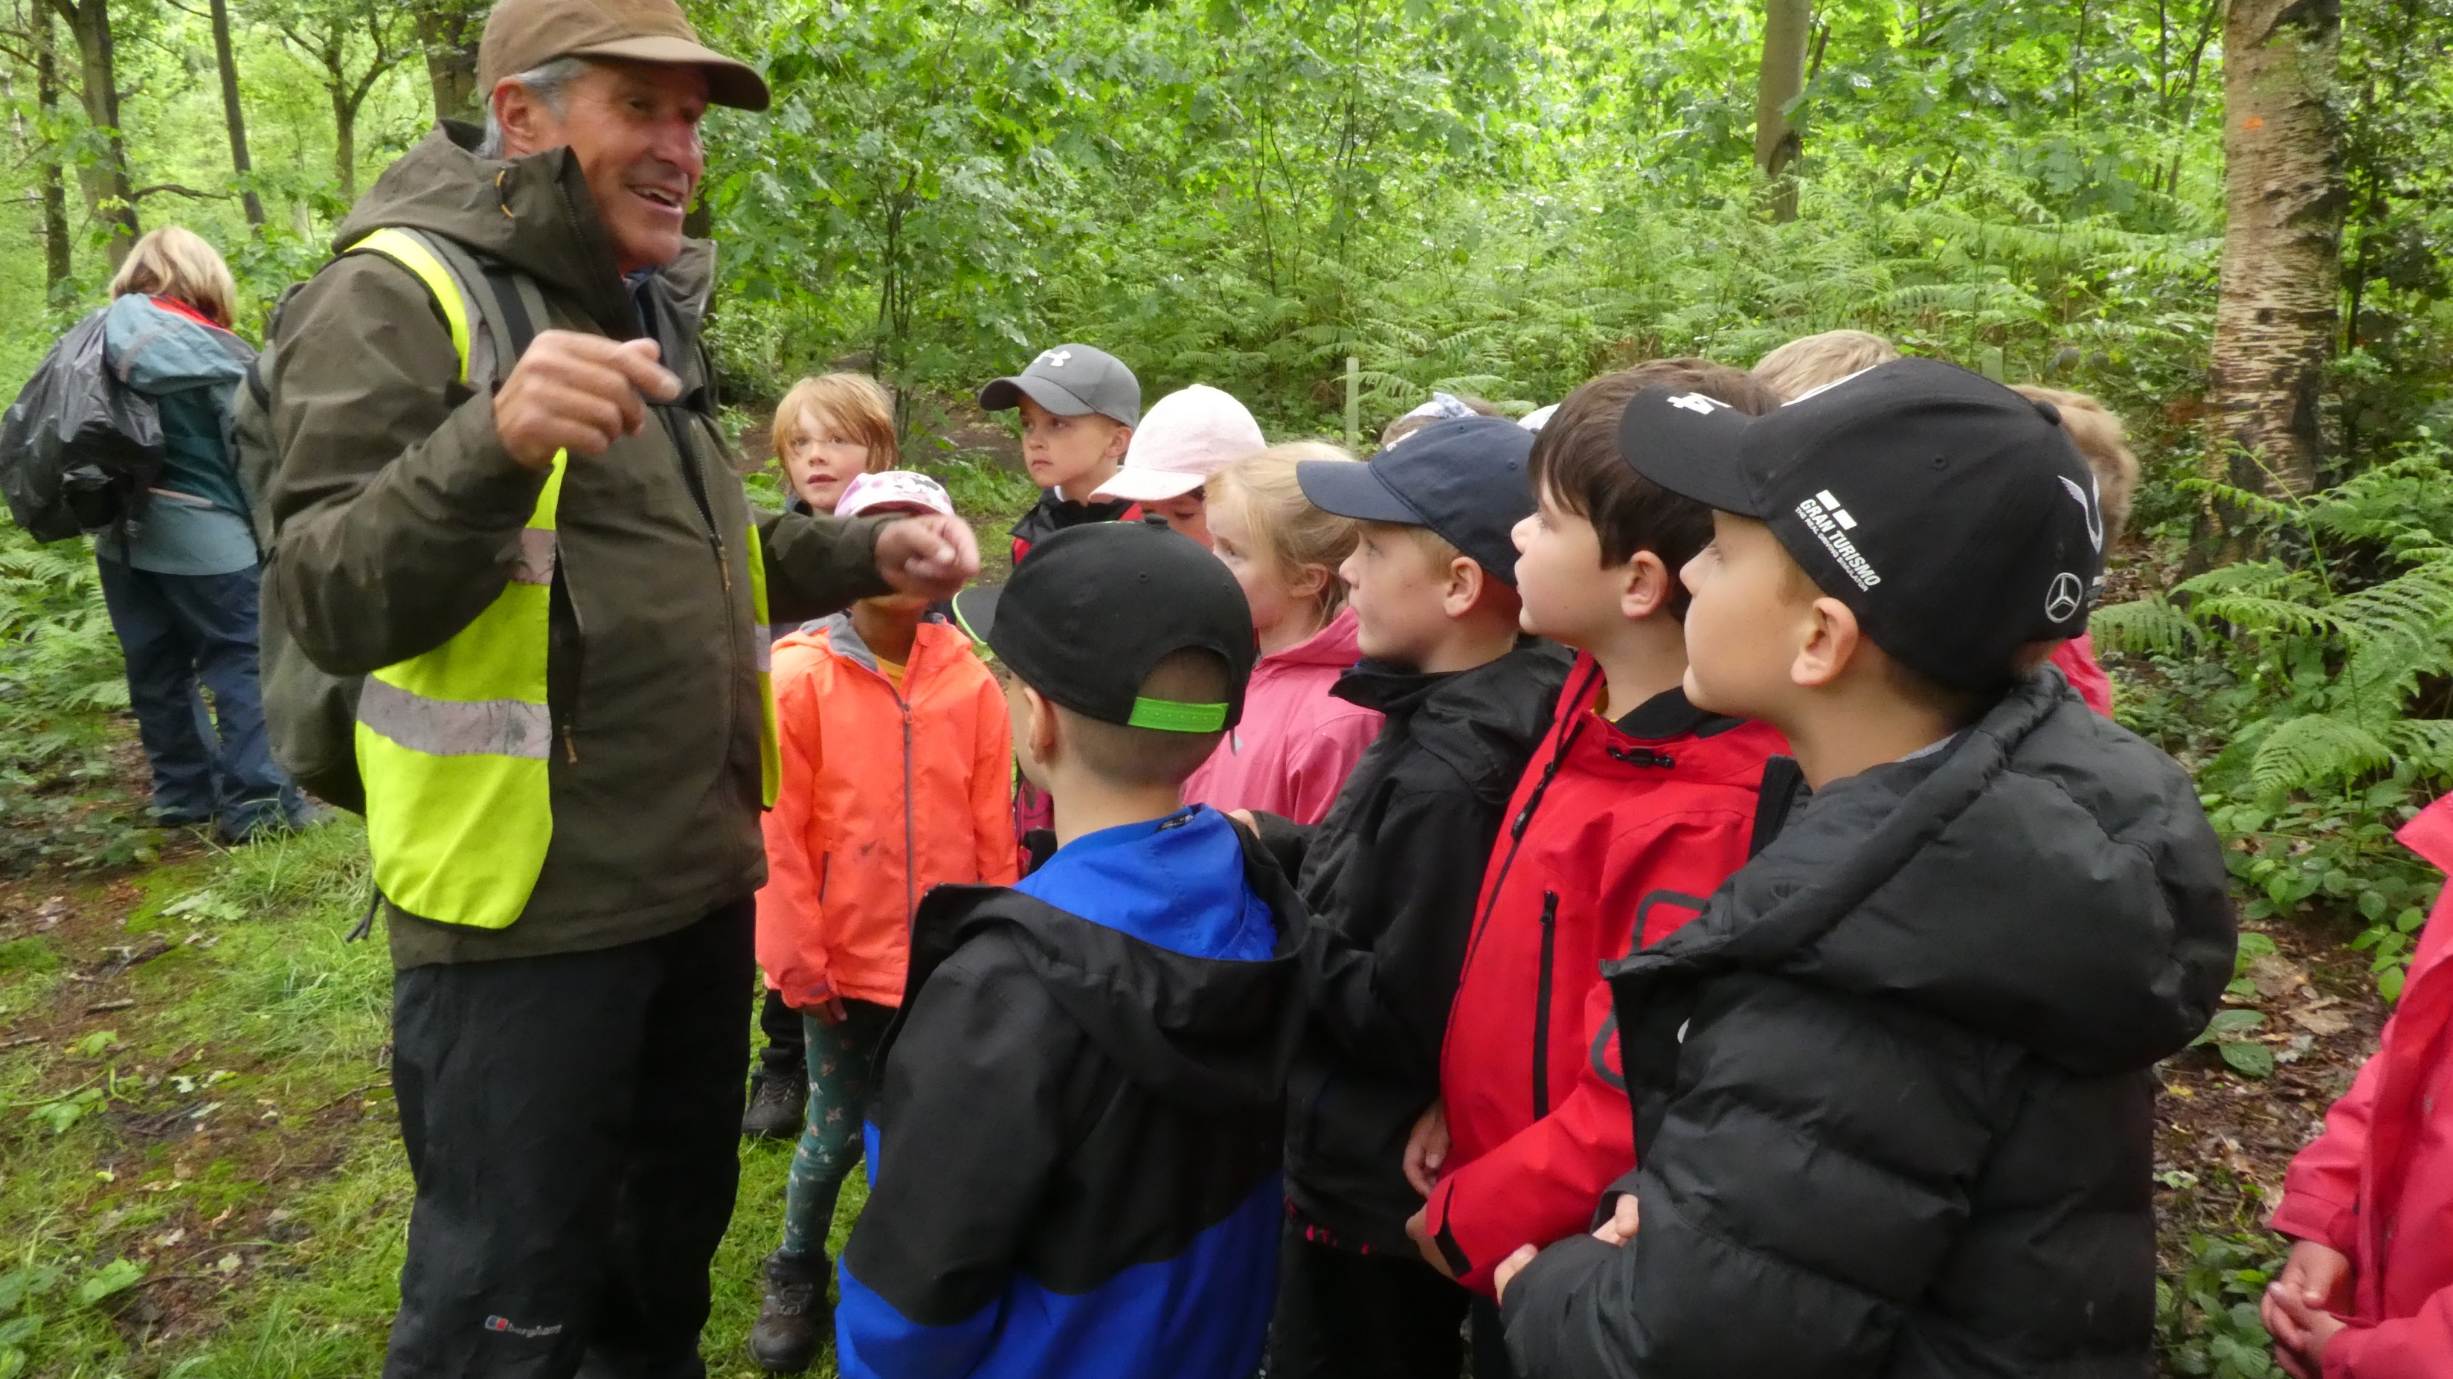

Slide 15
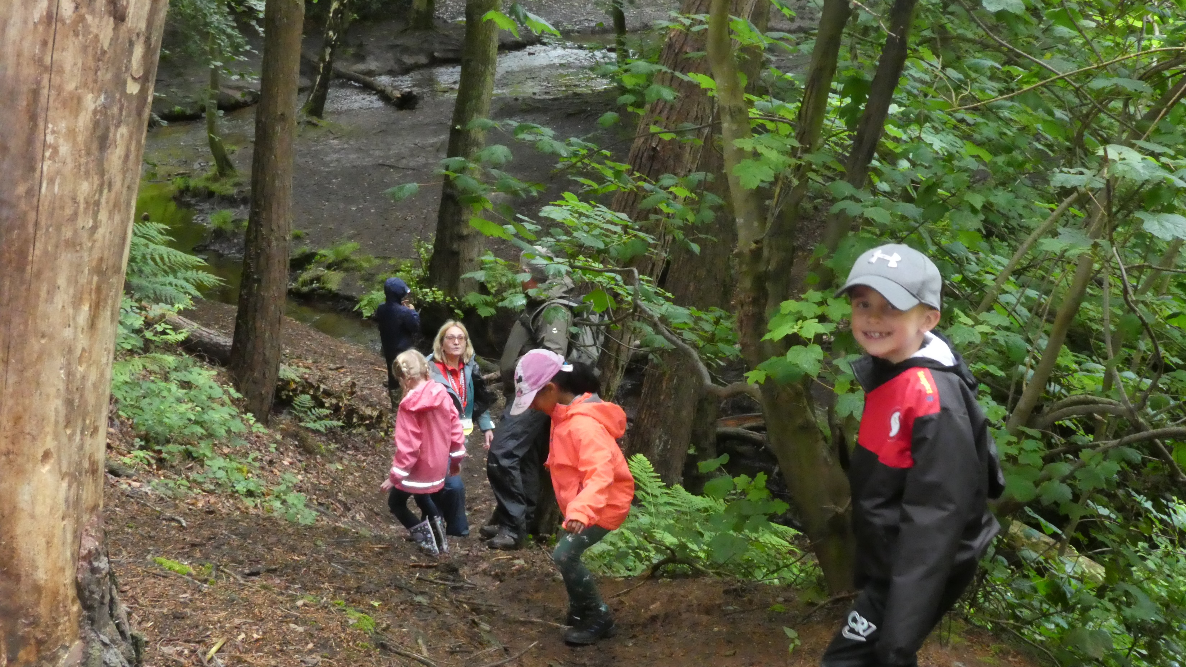

Slide 16
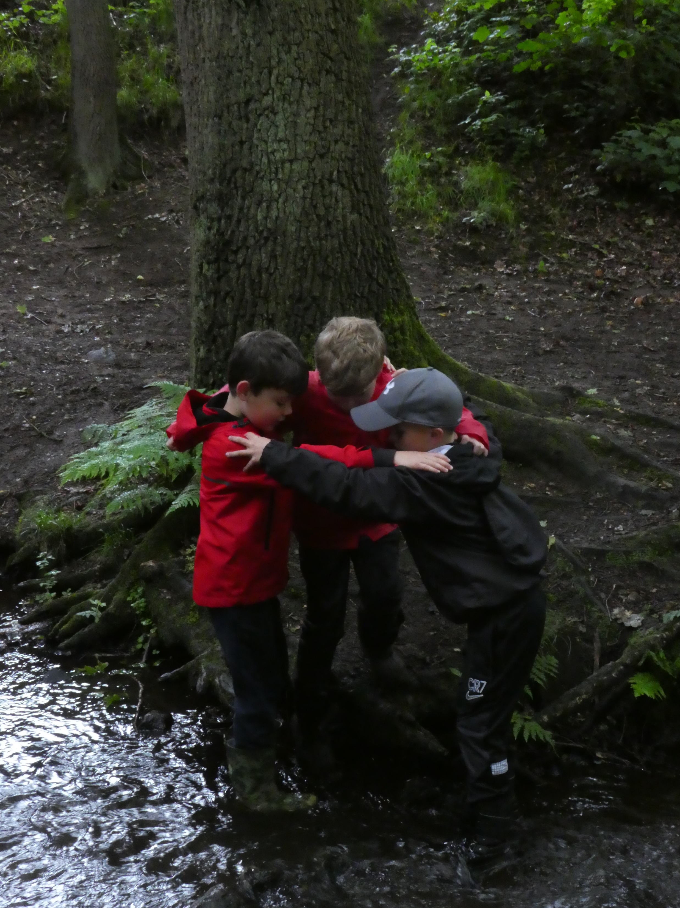

Slide 17
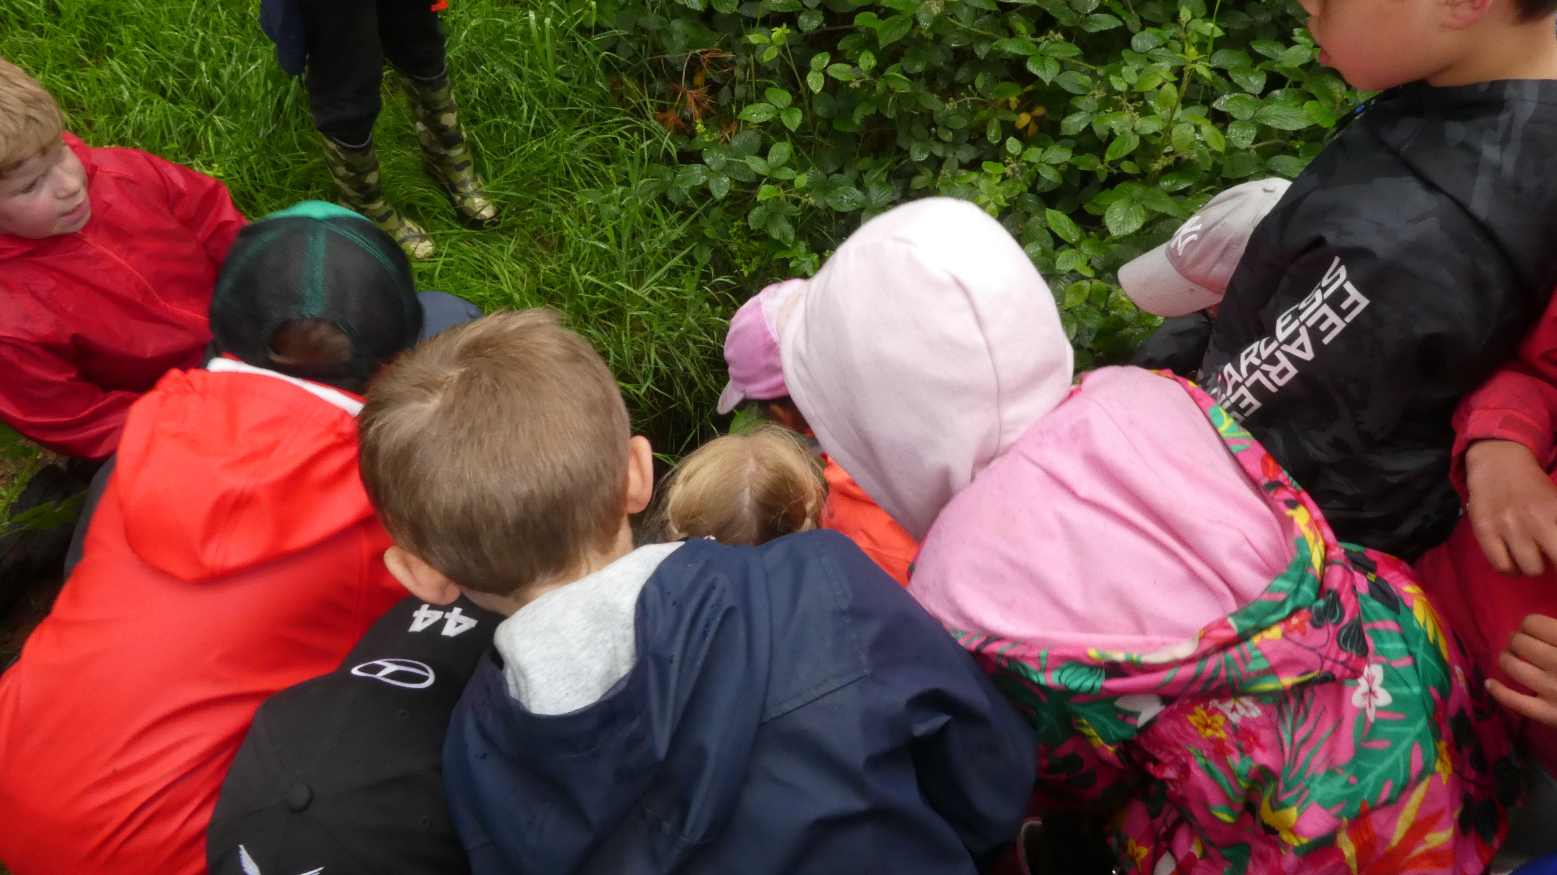

Slide 18
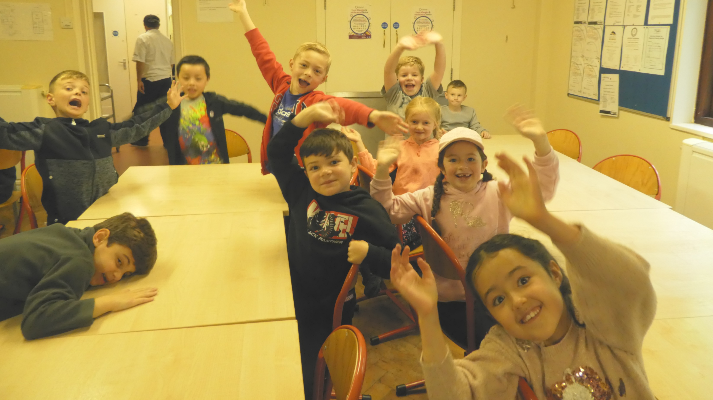

Slide 19
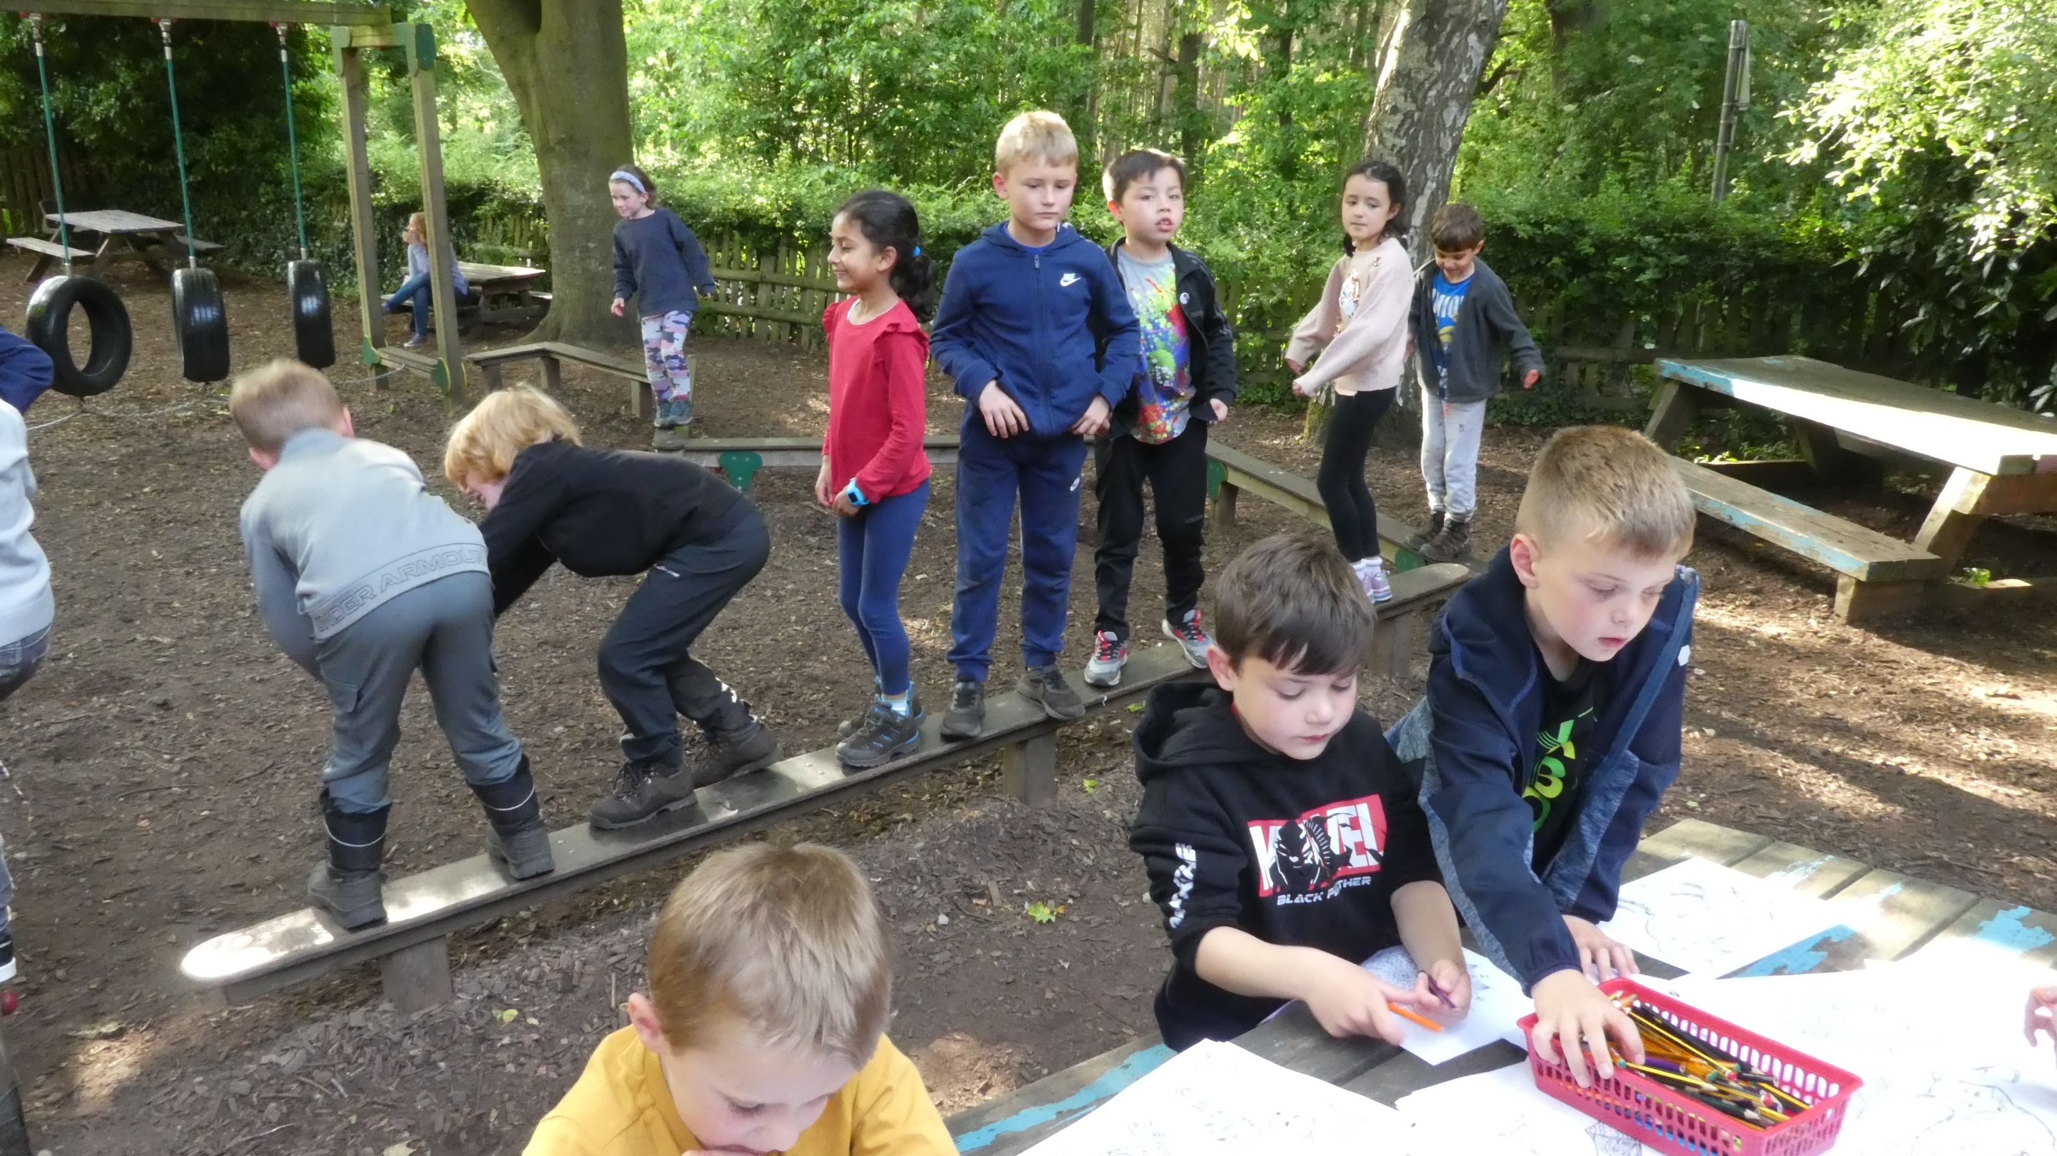

Slide 20
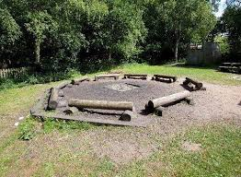

Slide 21
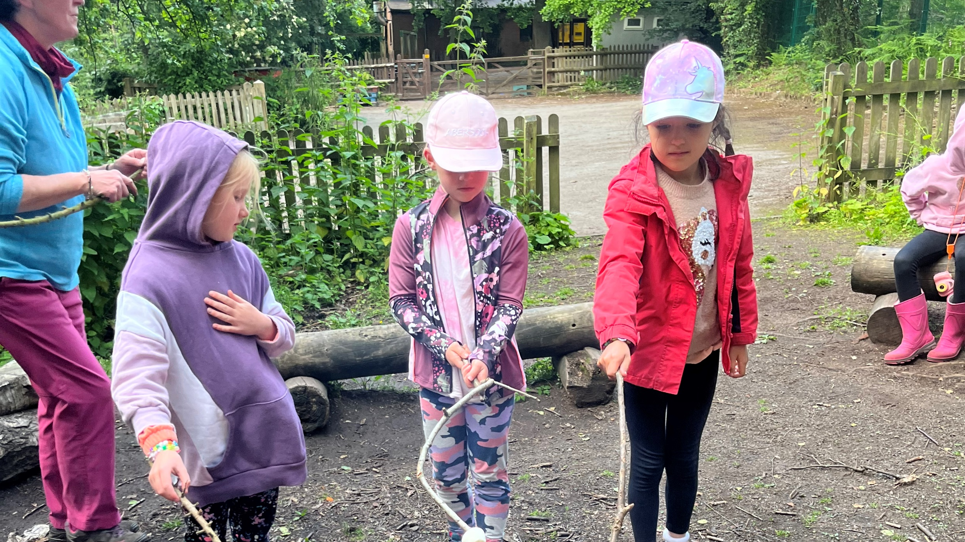

Slide 22
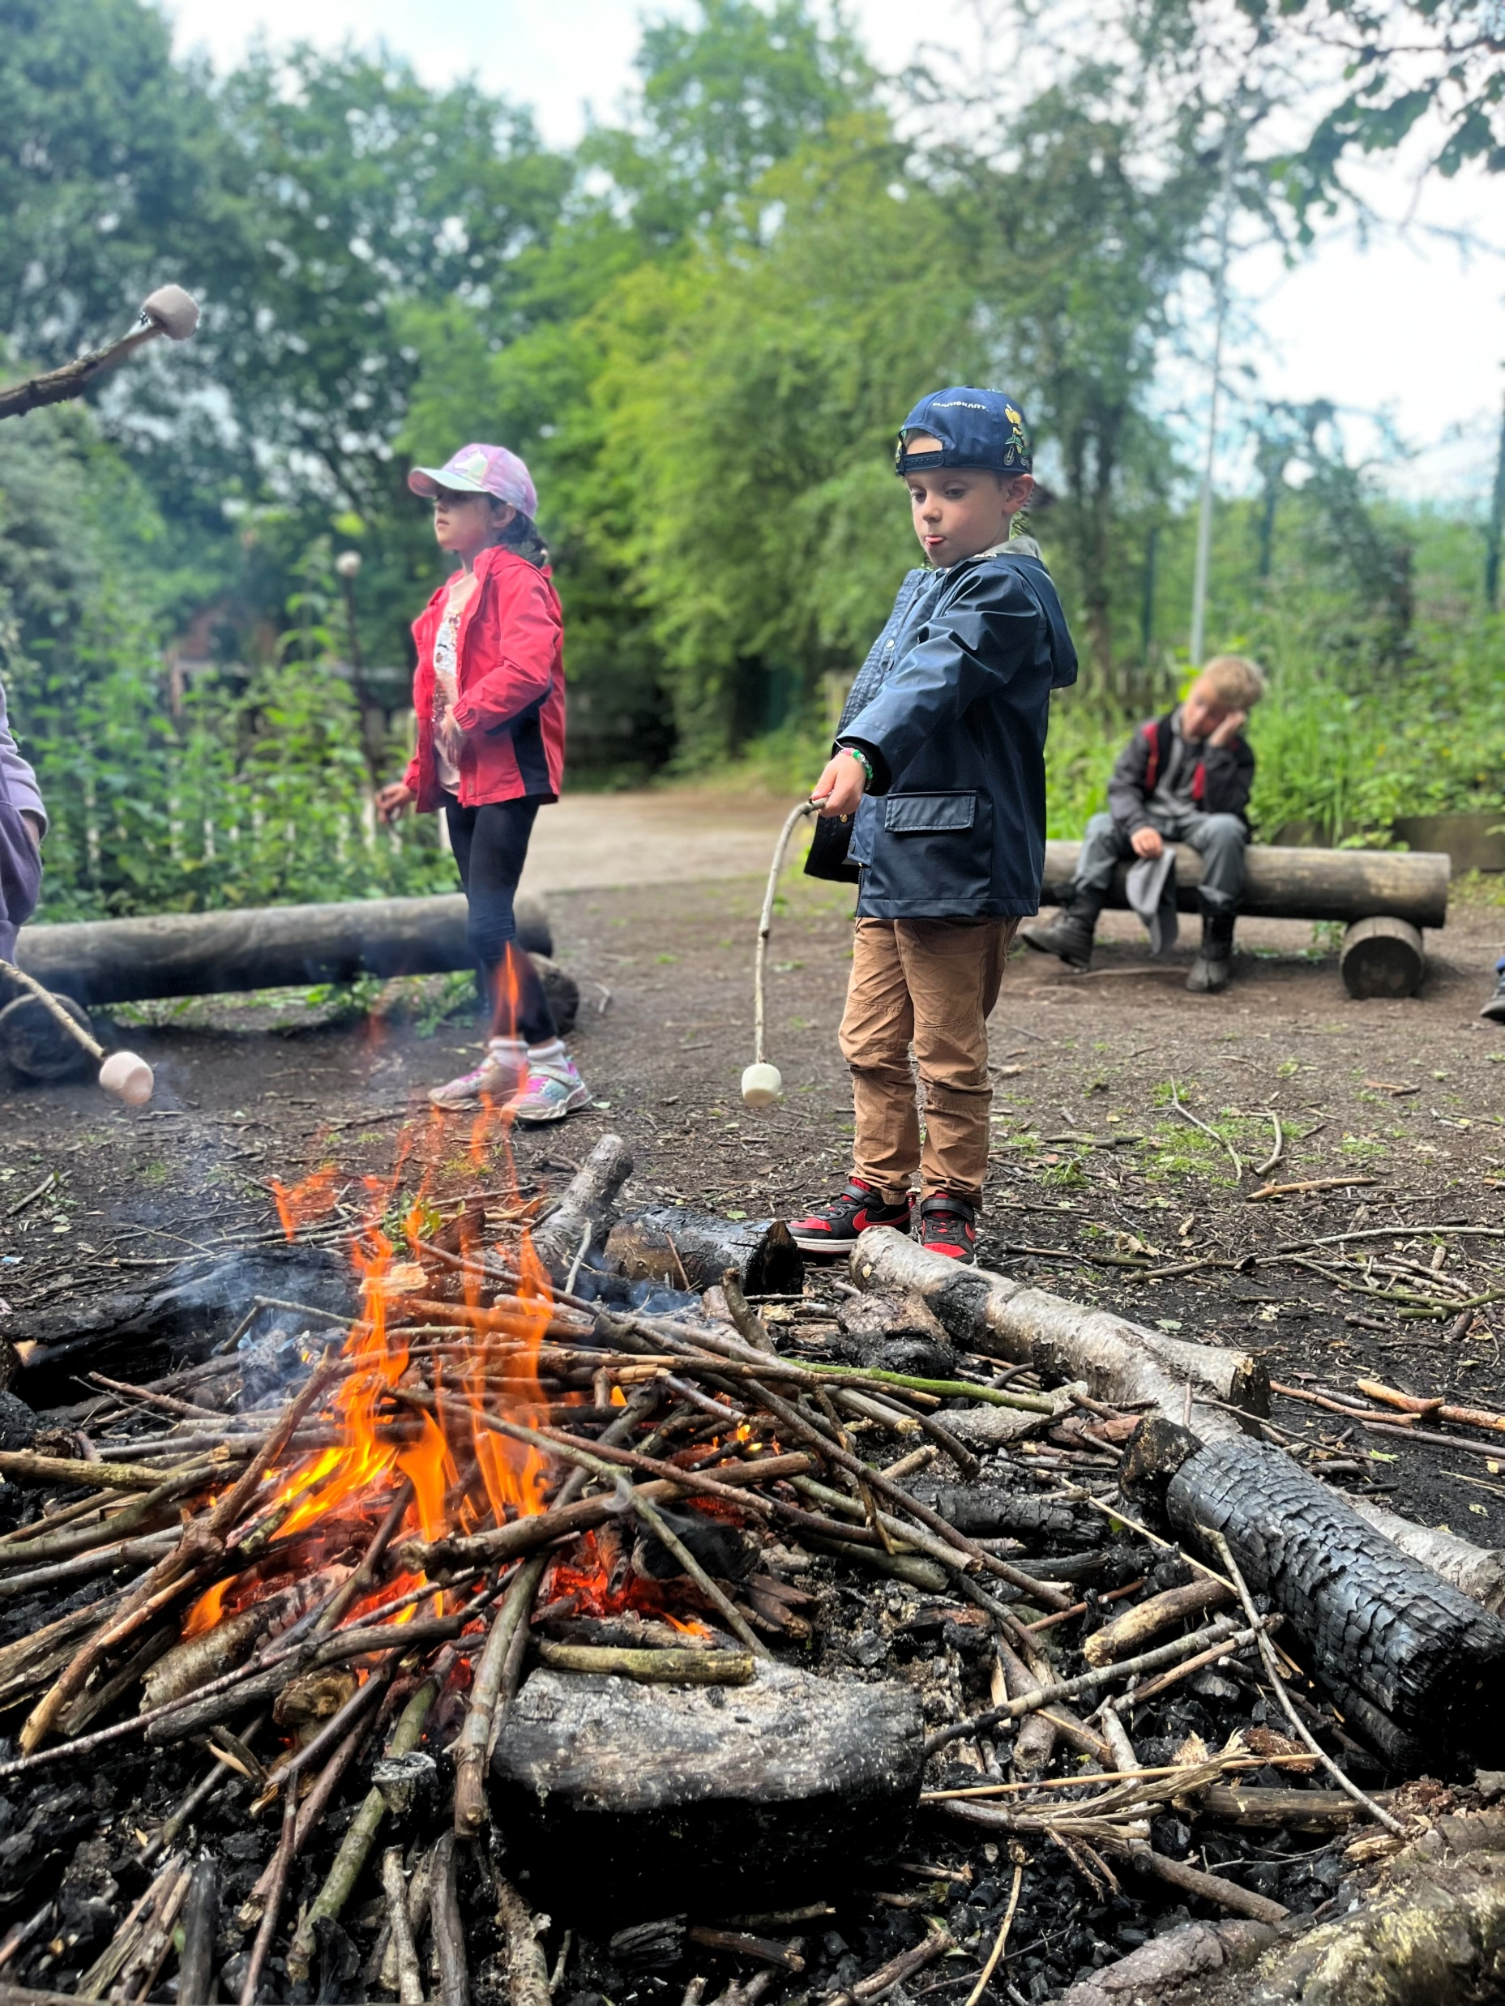

Slide 23
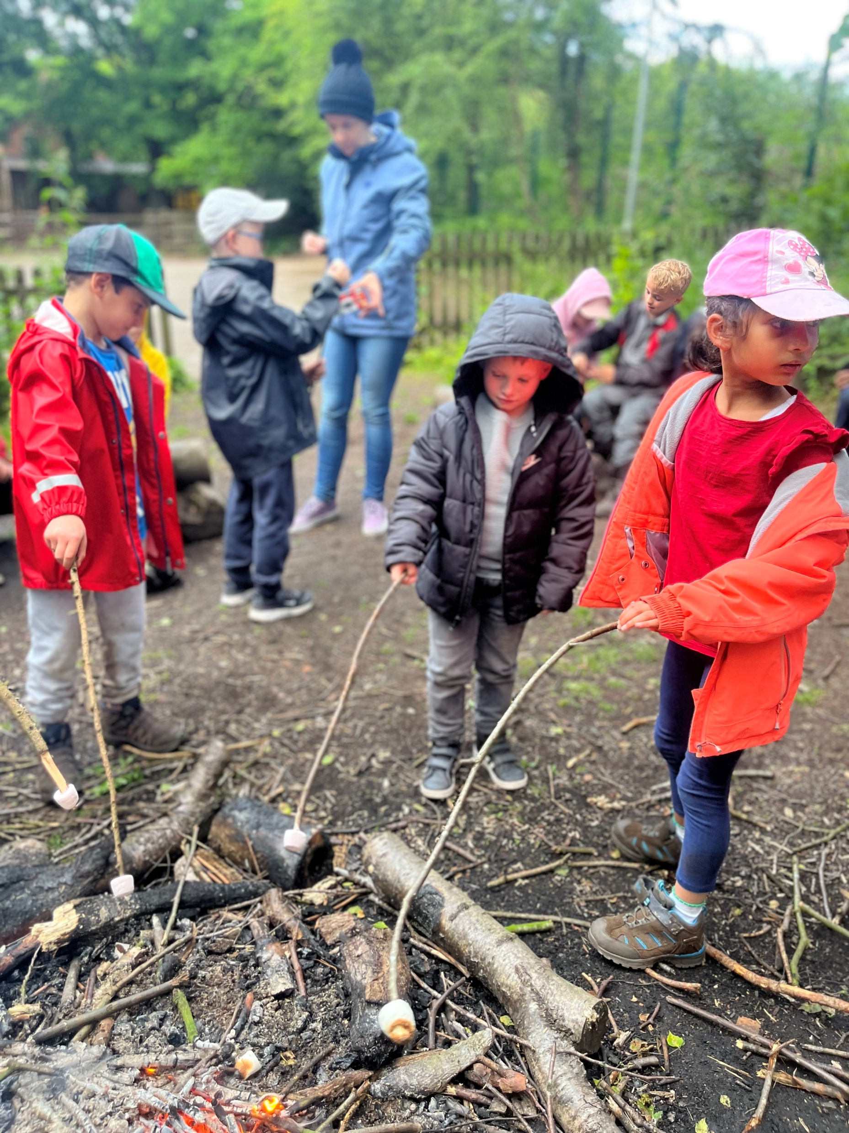

Slide 24
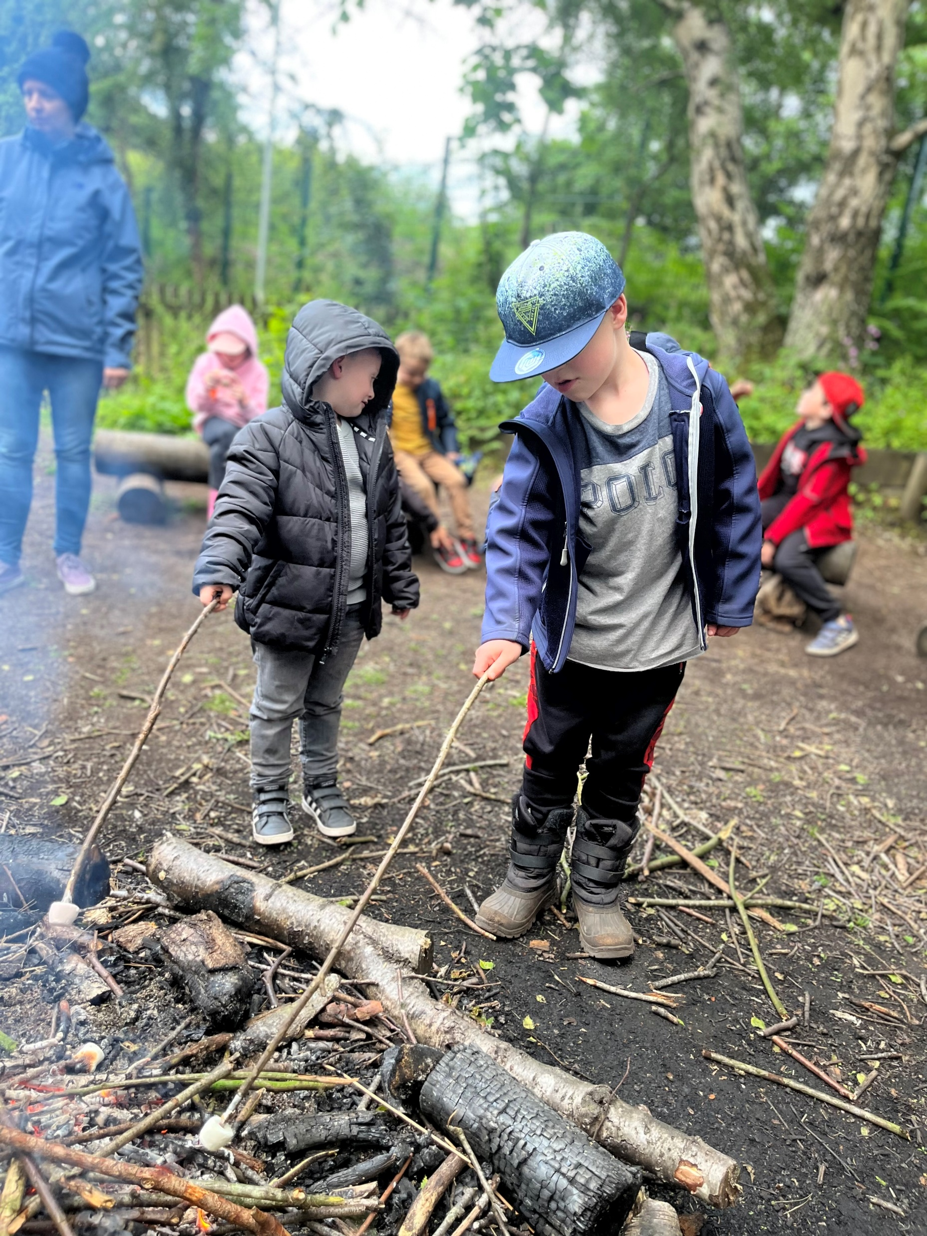

Slide 25
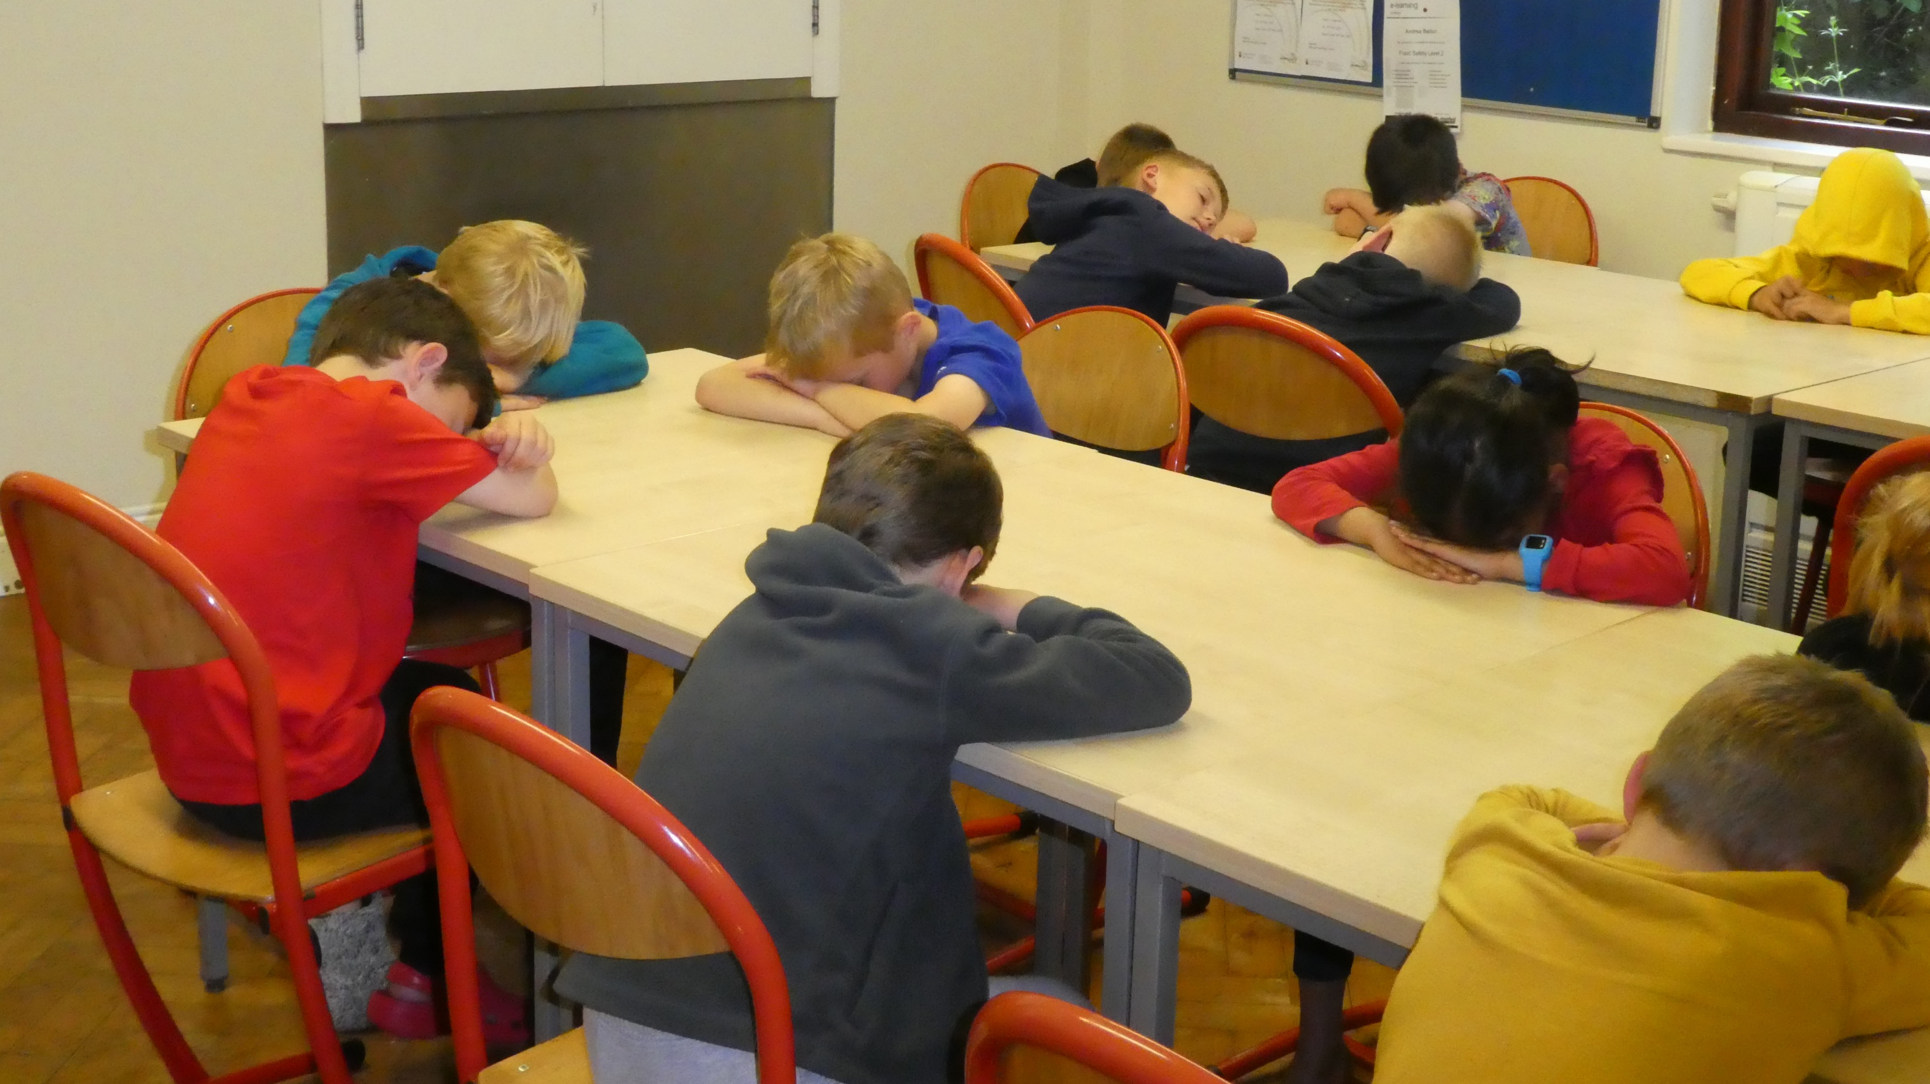

Slide 26
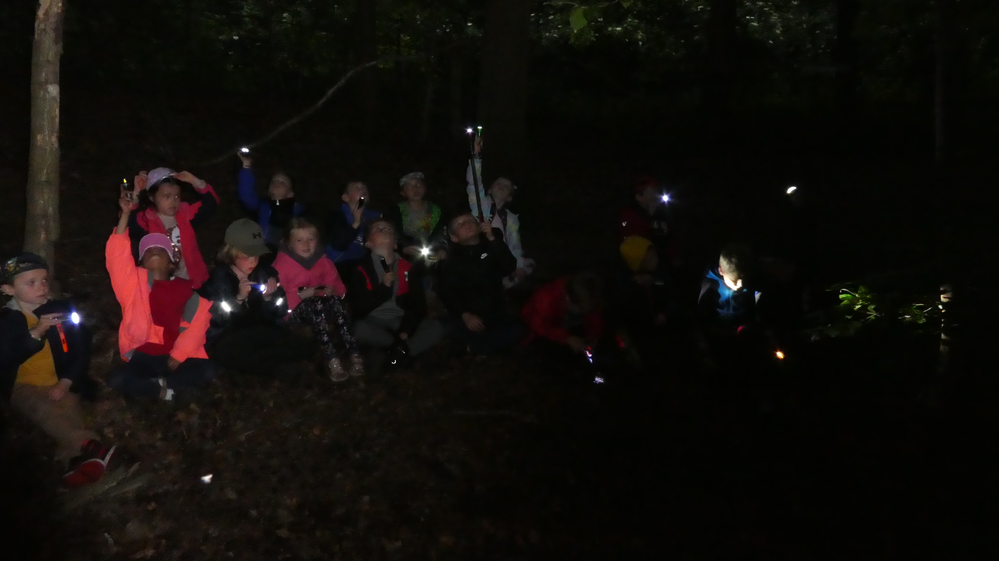

Slide 27
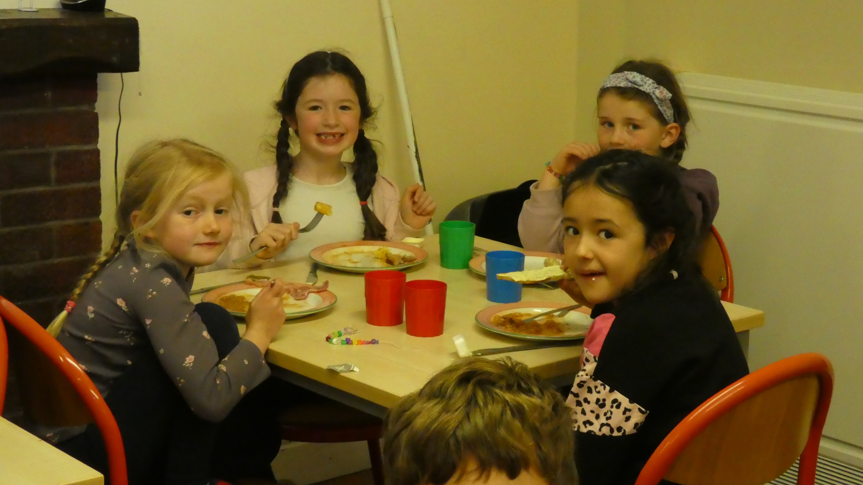

Slide 28
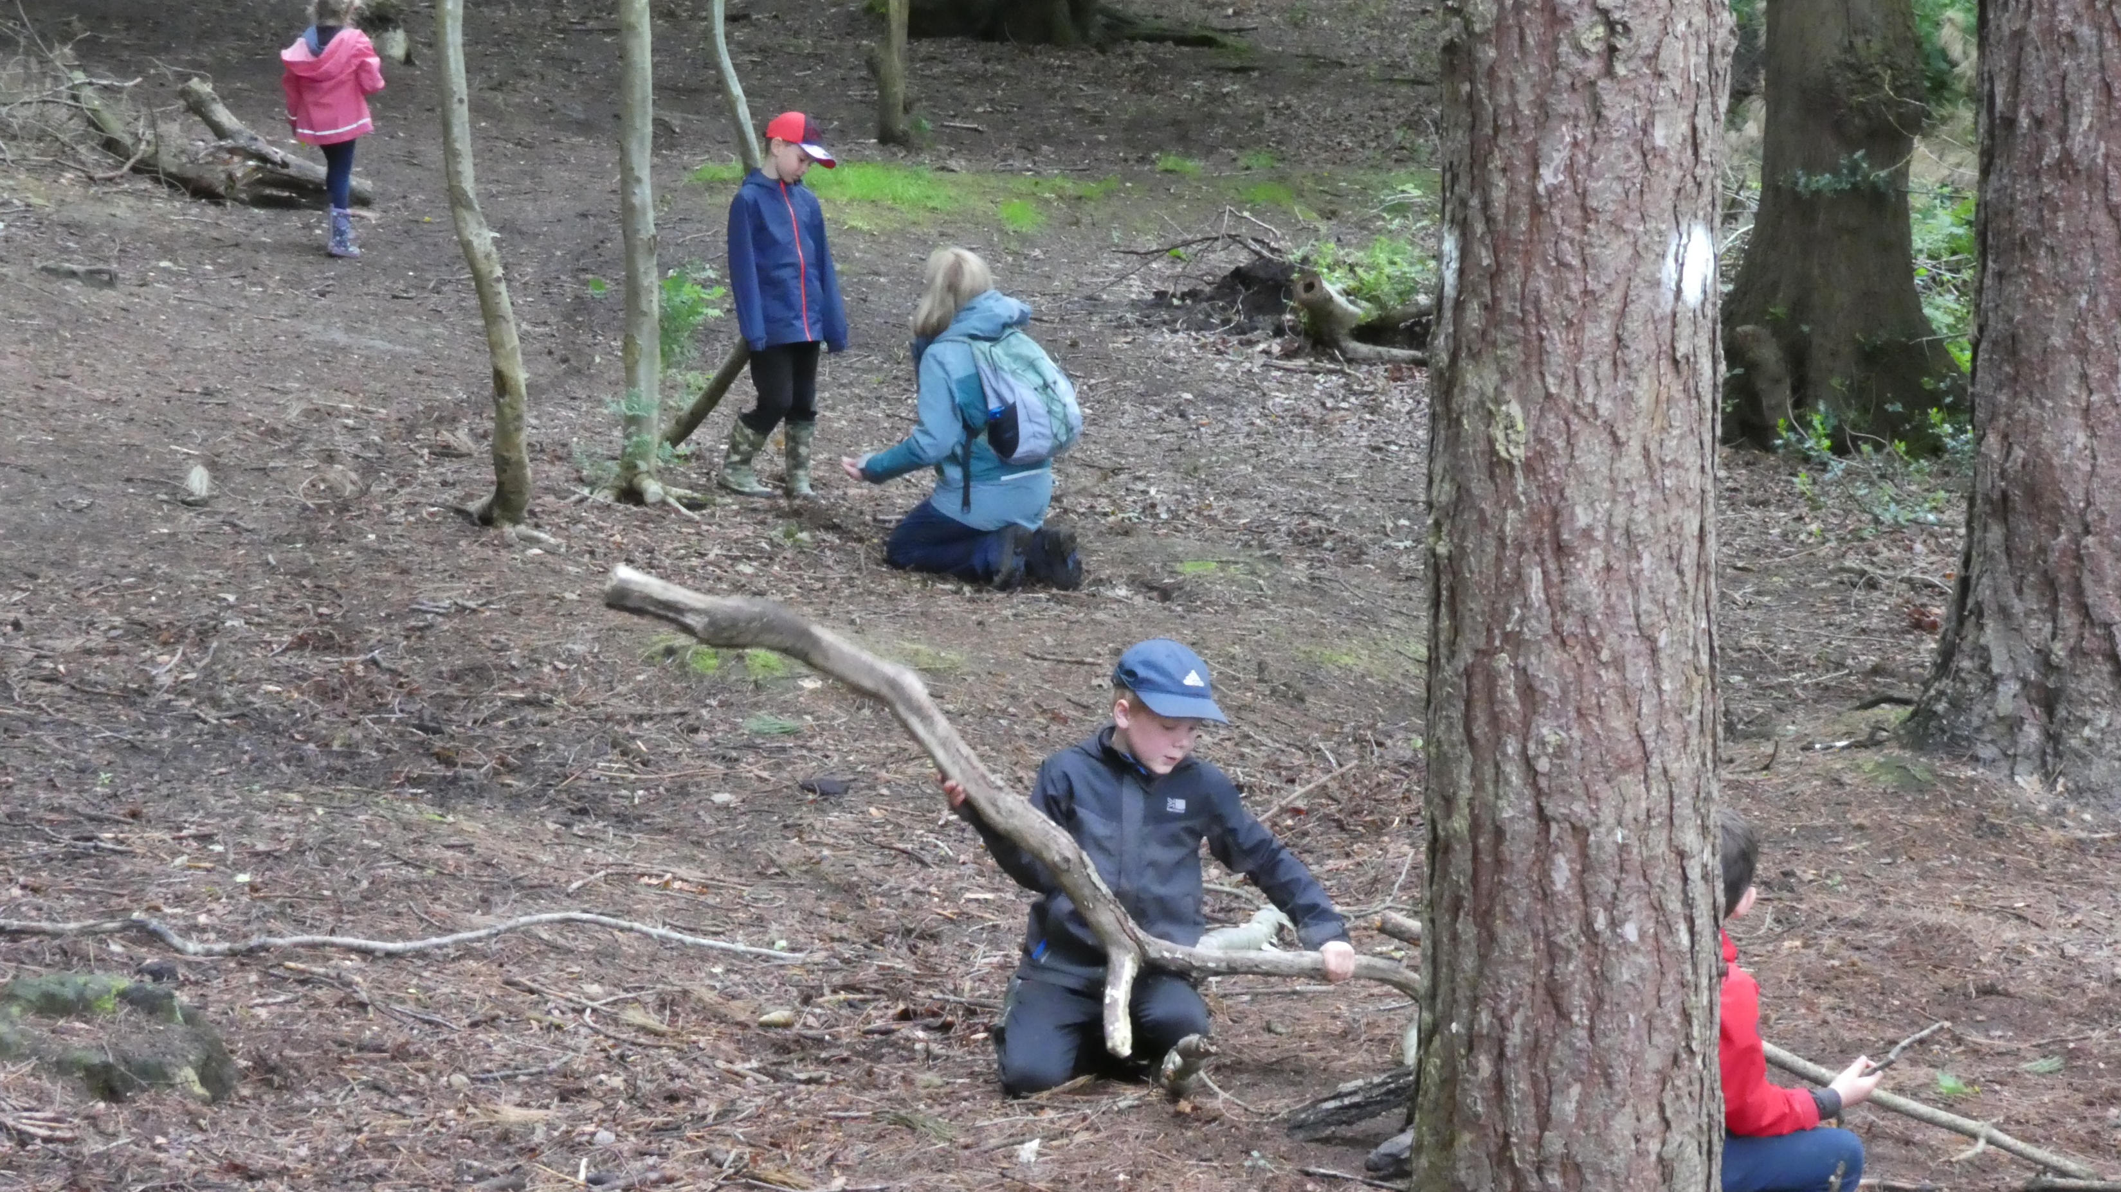

Slide 29
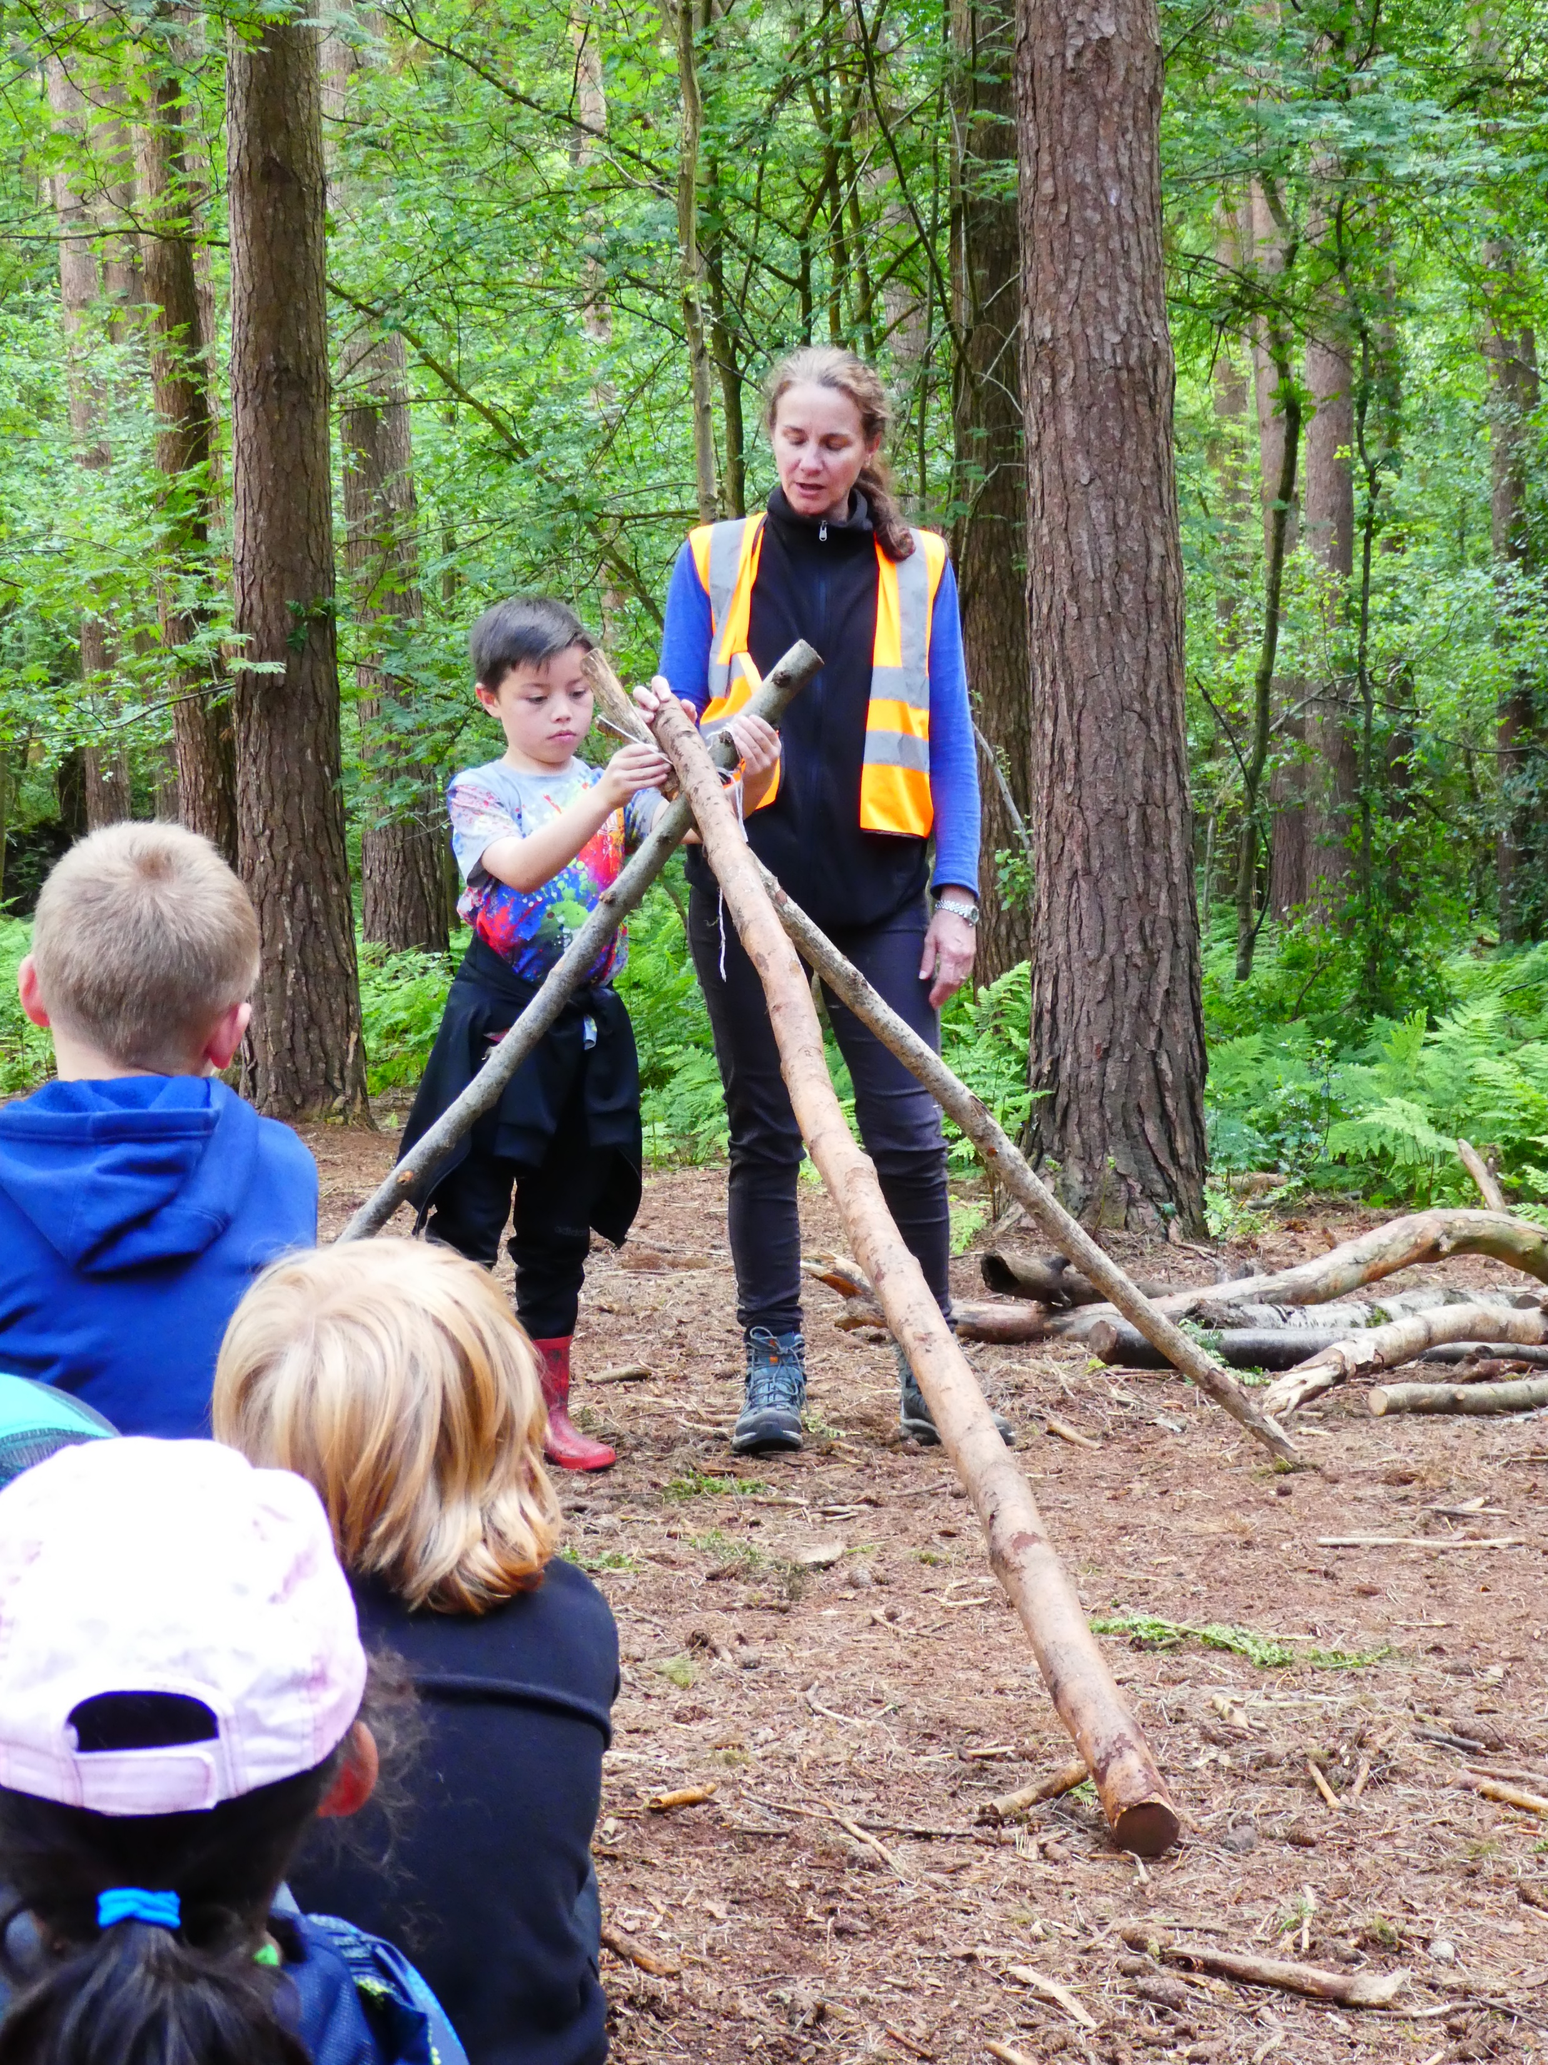

Slide 30
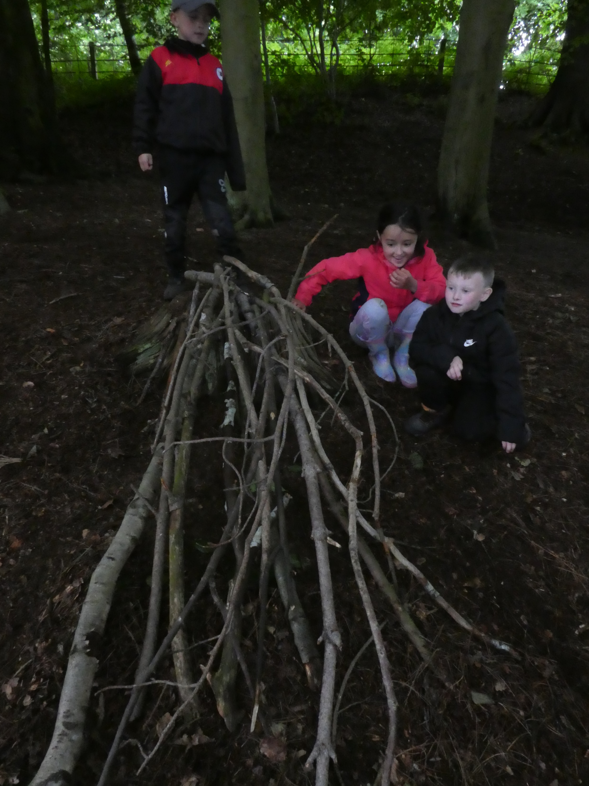

Slide 31
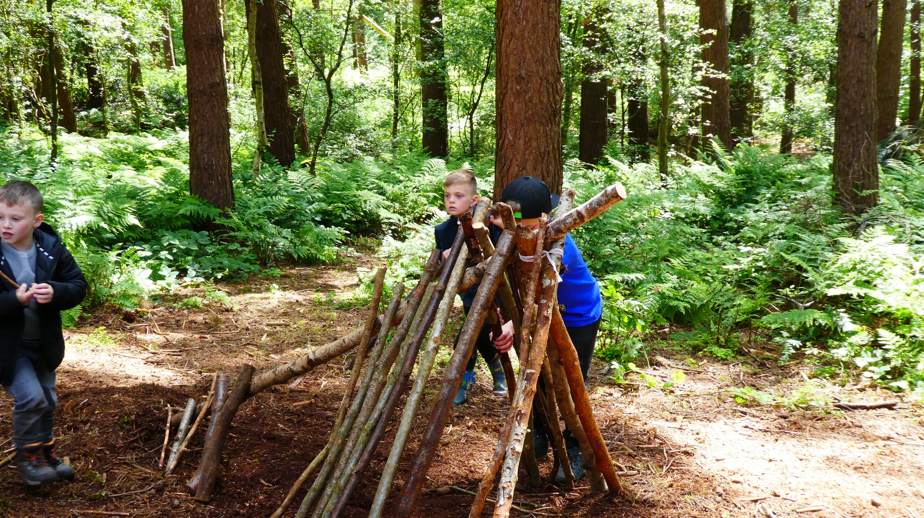

Slide 32
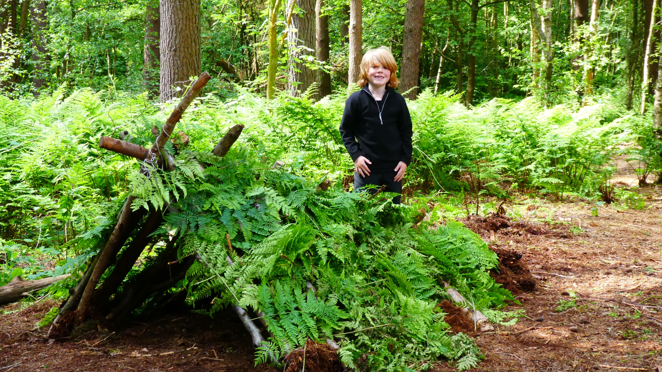

Slide 33
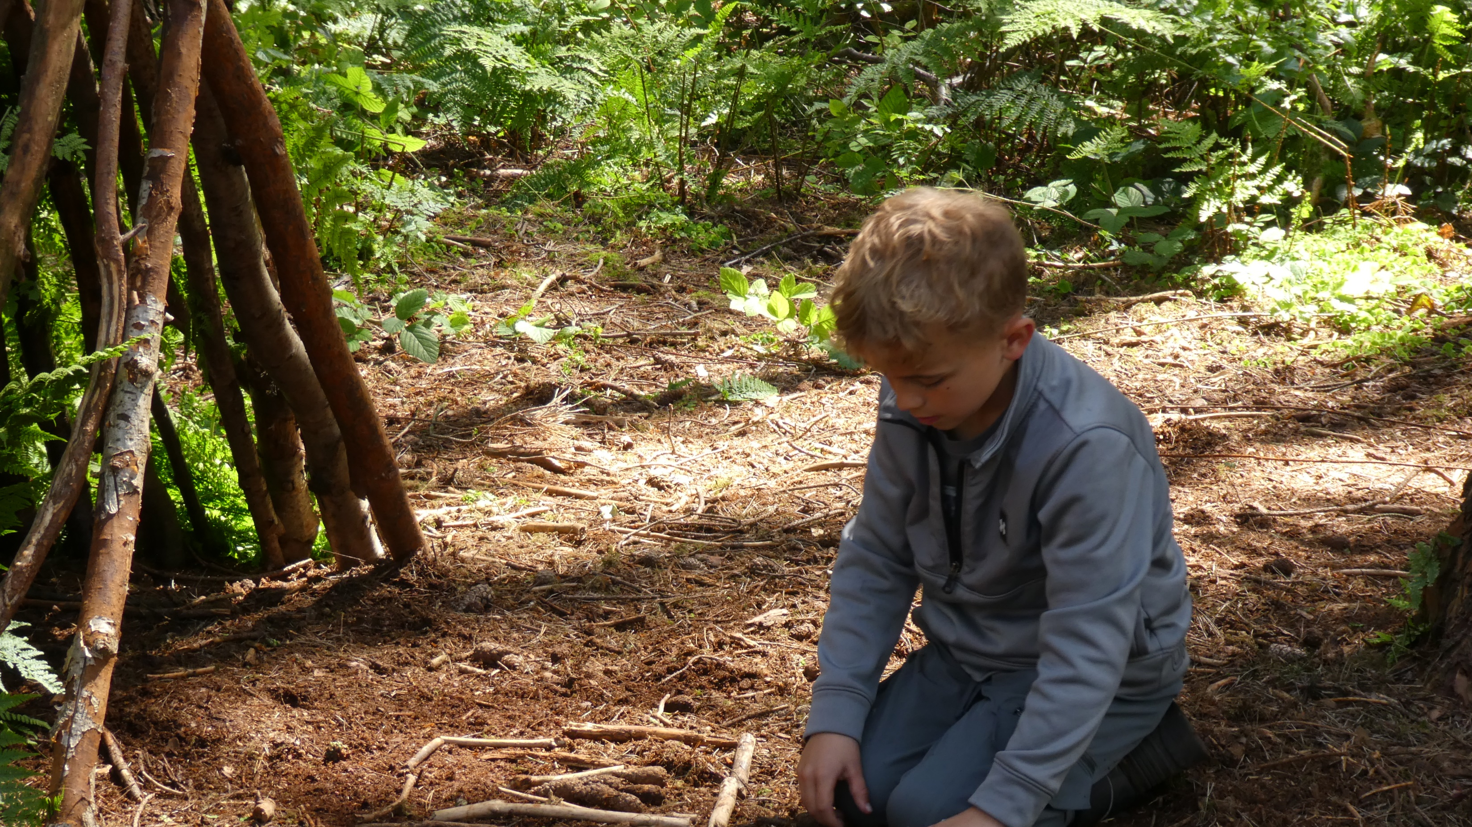

Slide 34
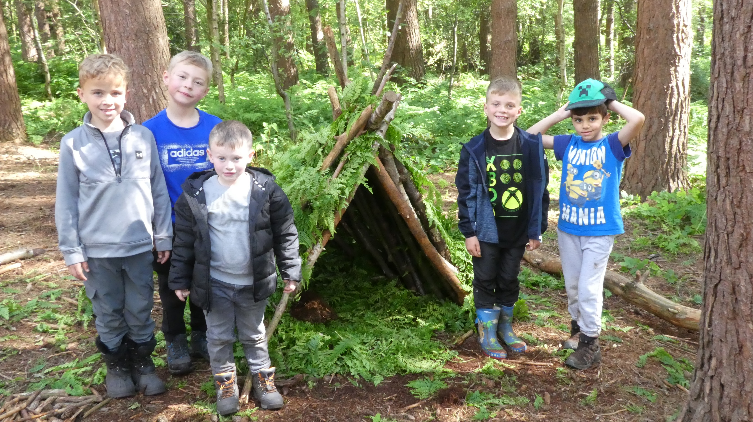

Slide 35
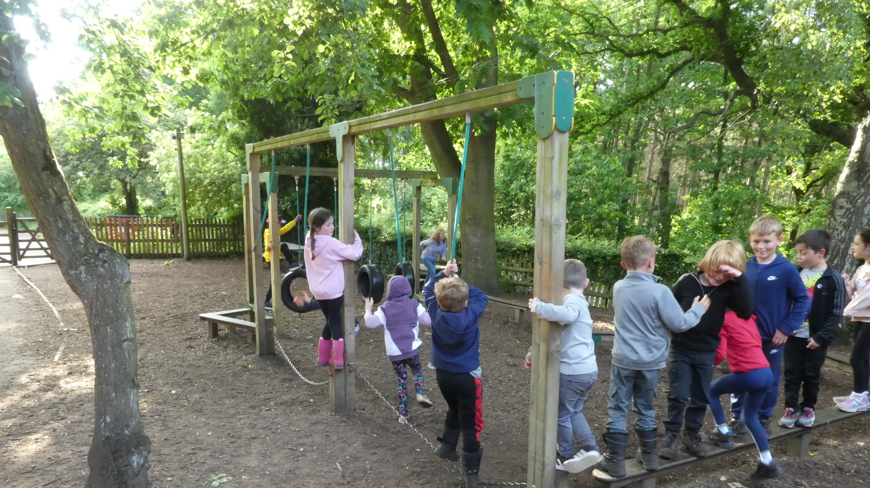

Slide 36
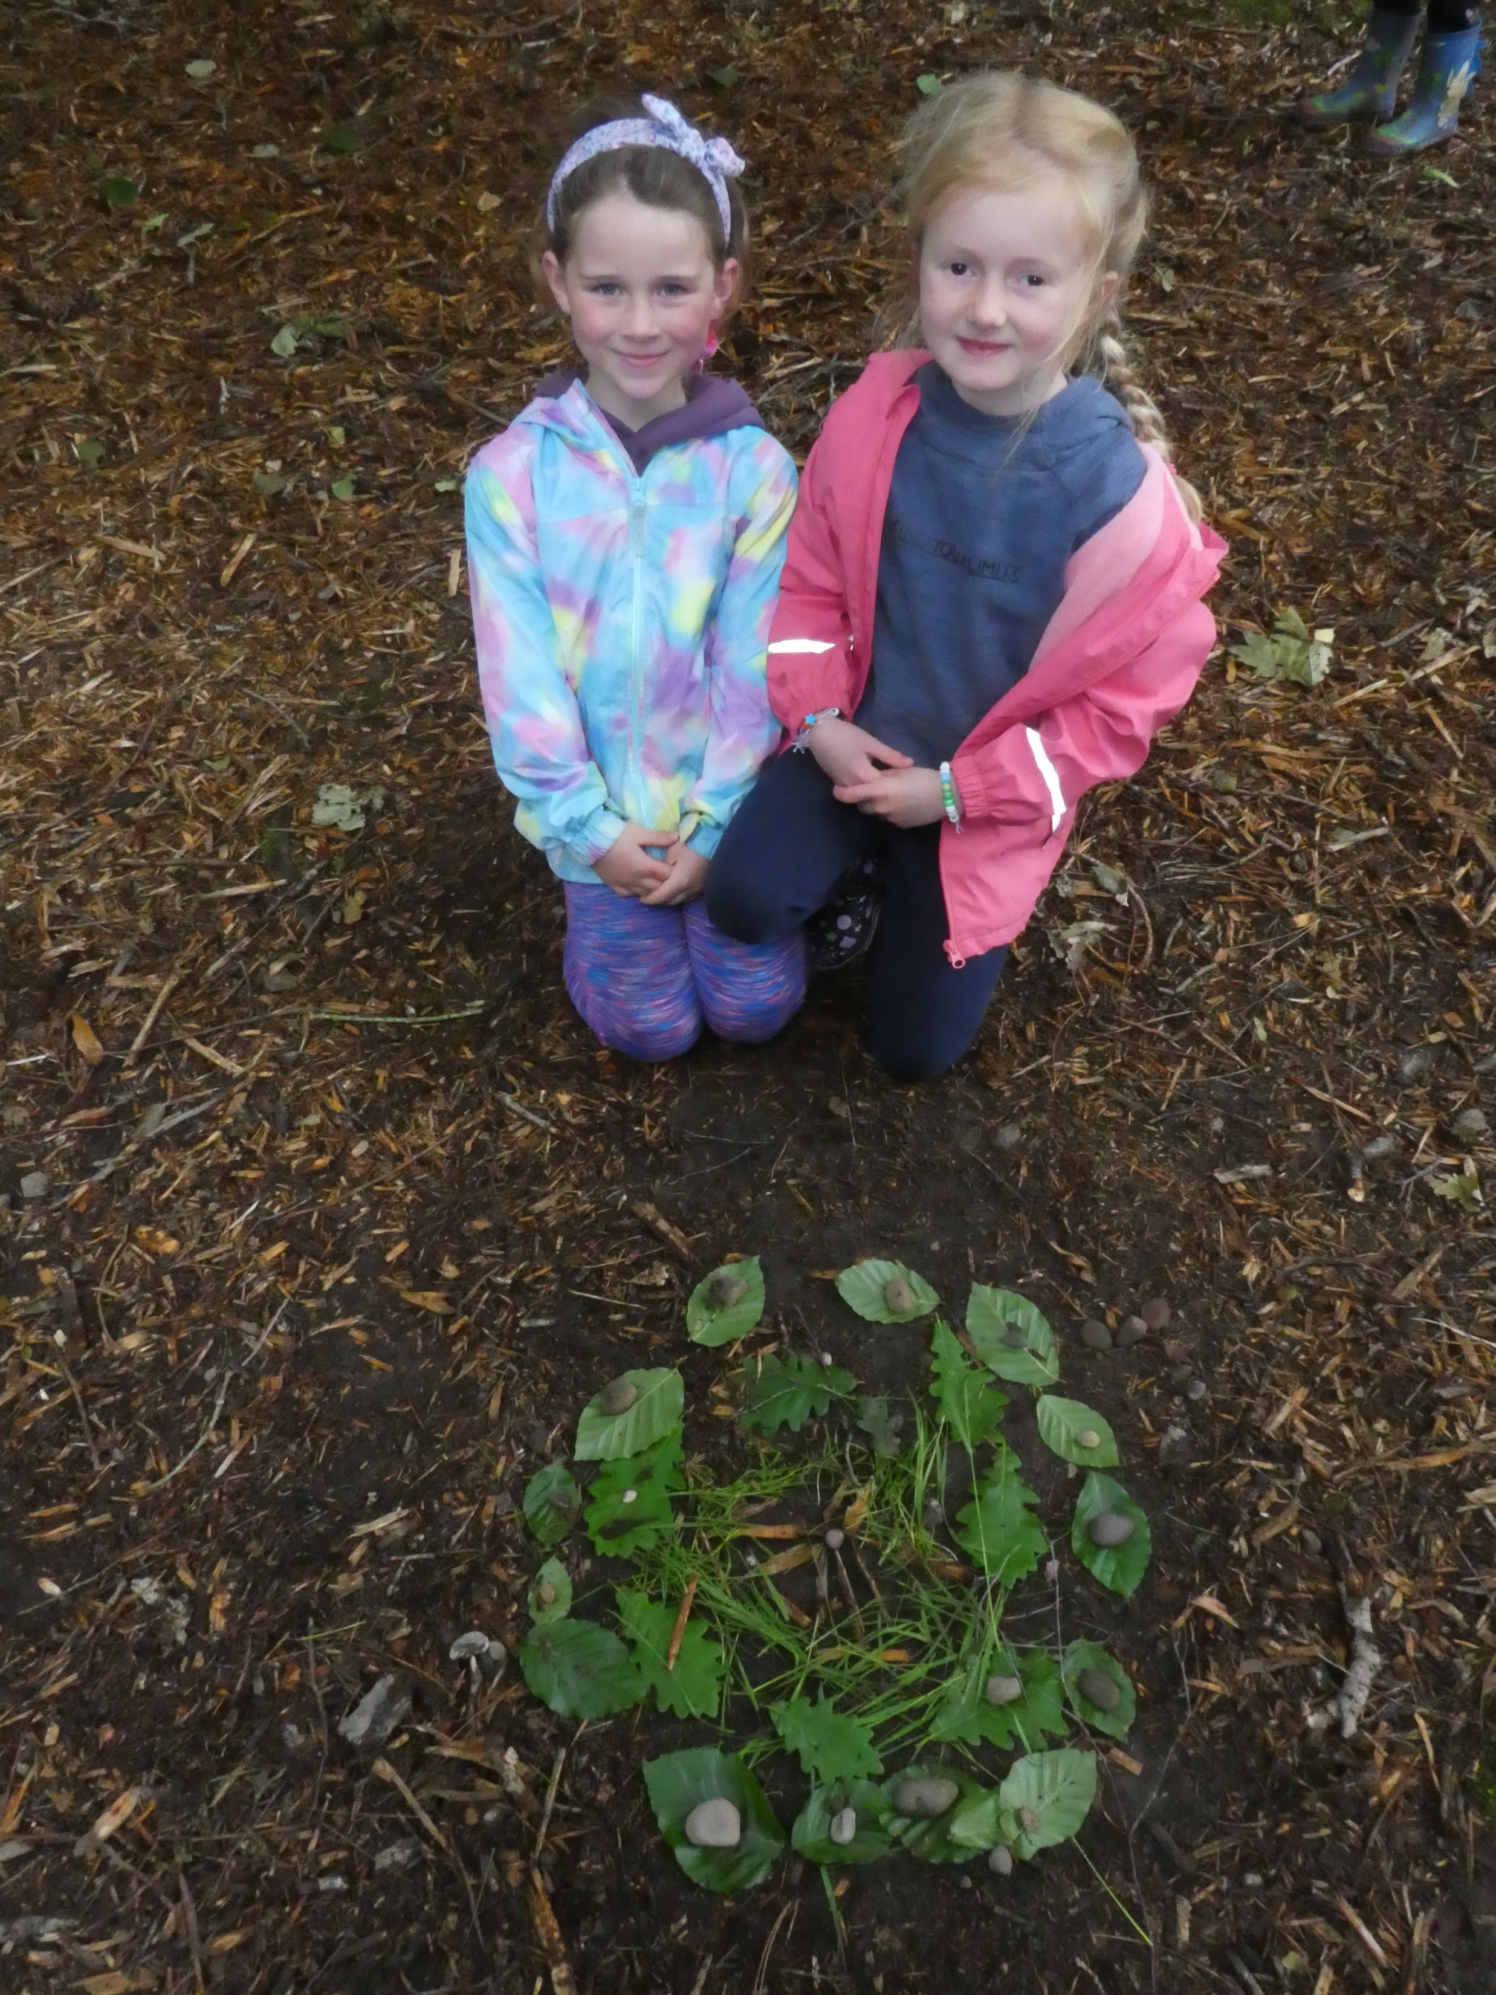

Slide 37
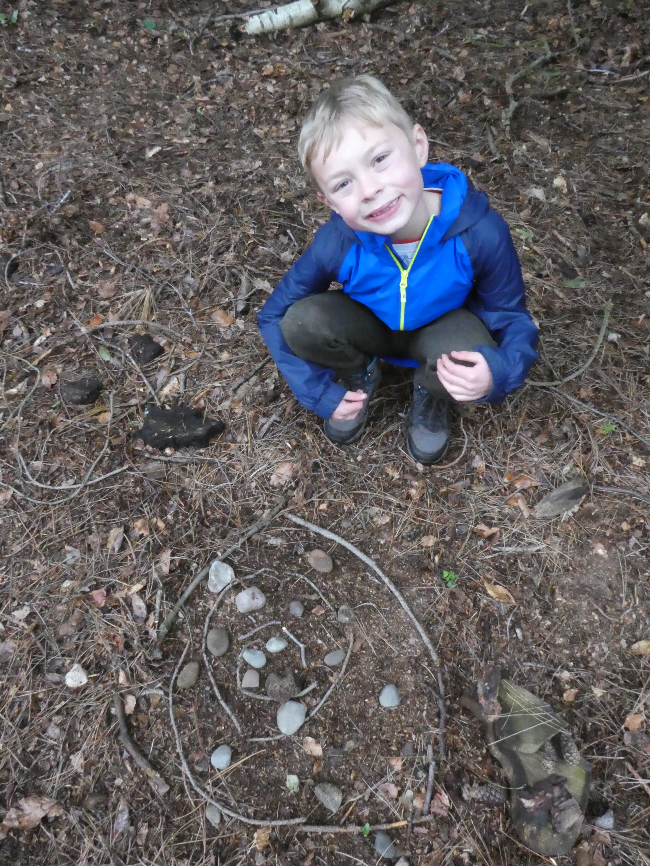

Slide 38
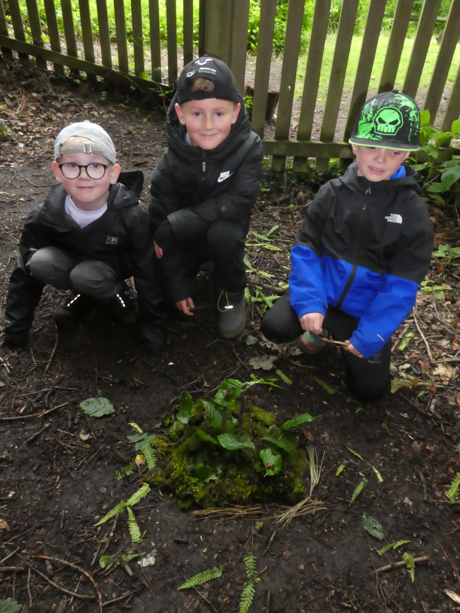

Slide 39
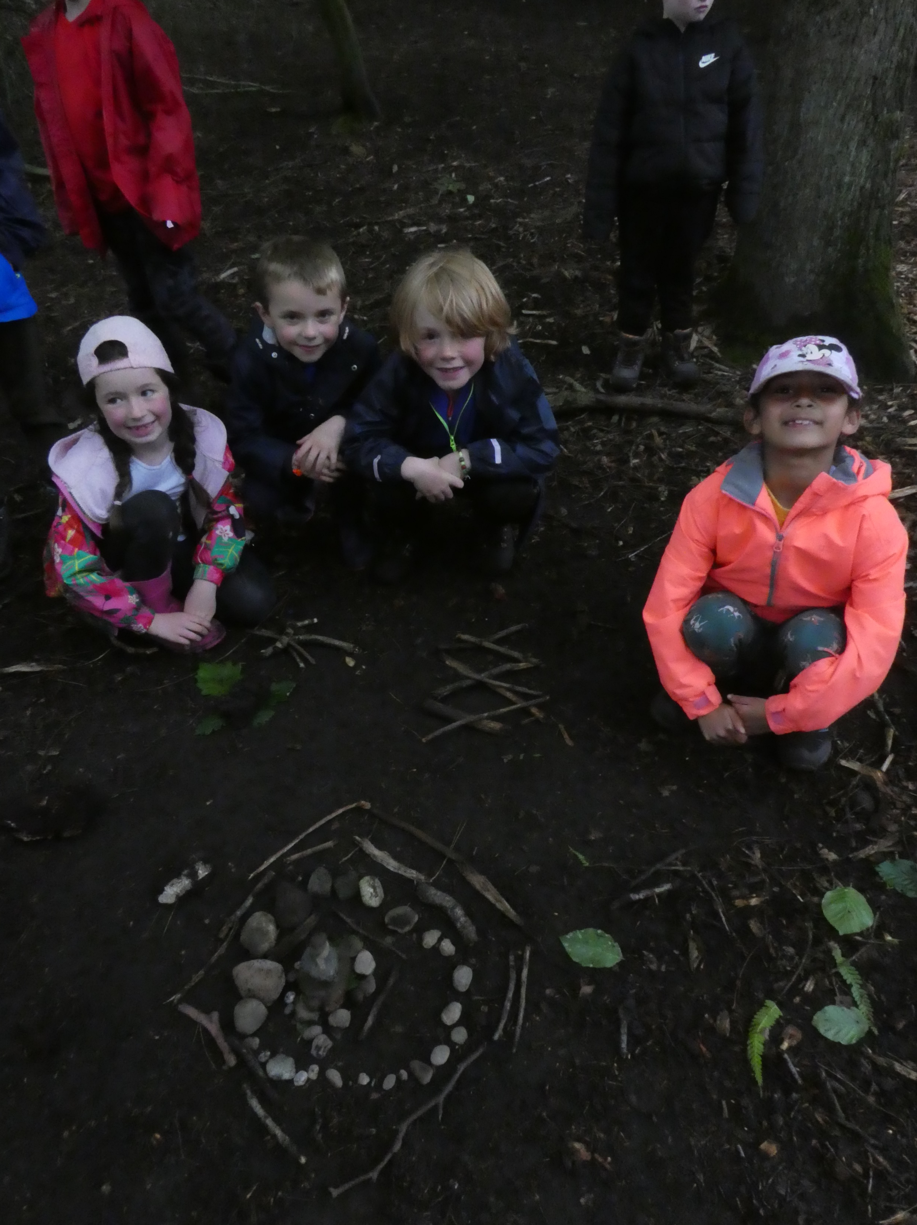

Slide 40
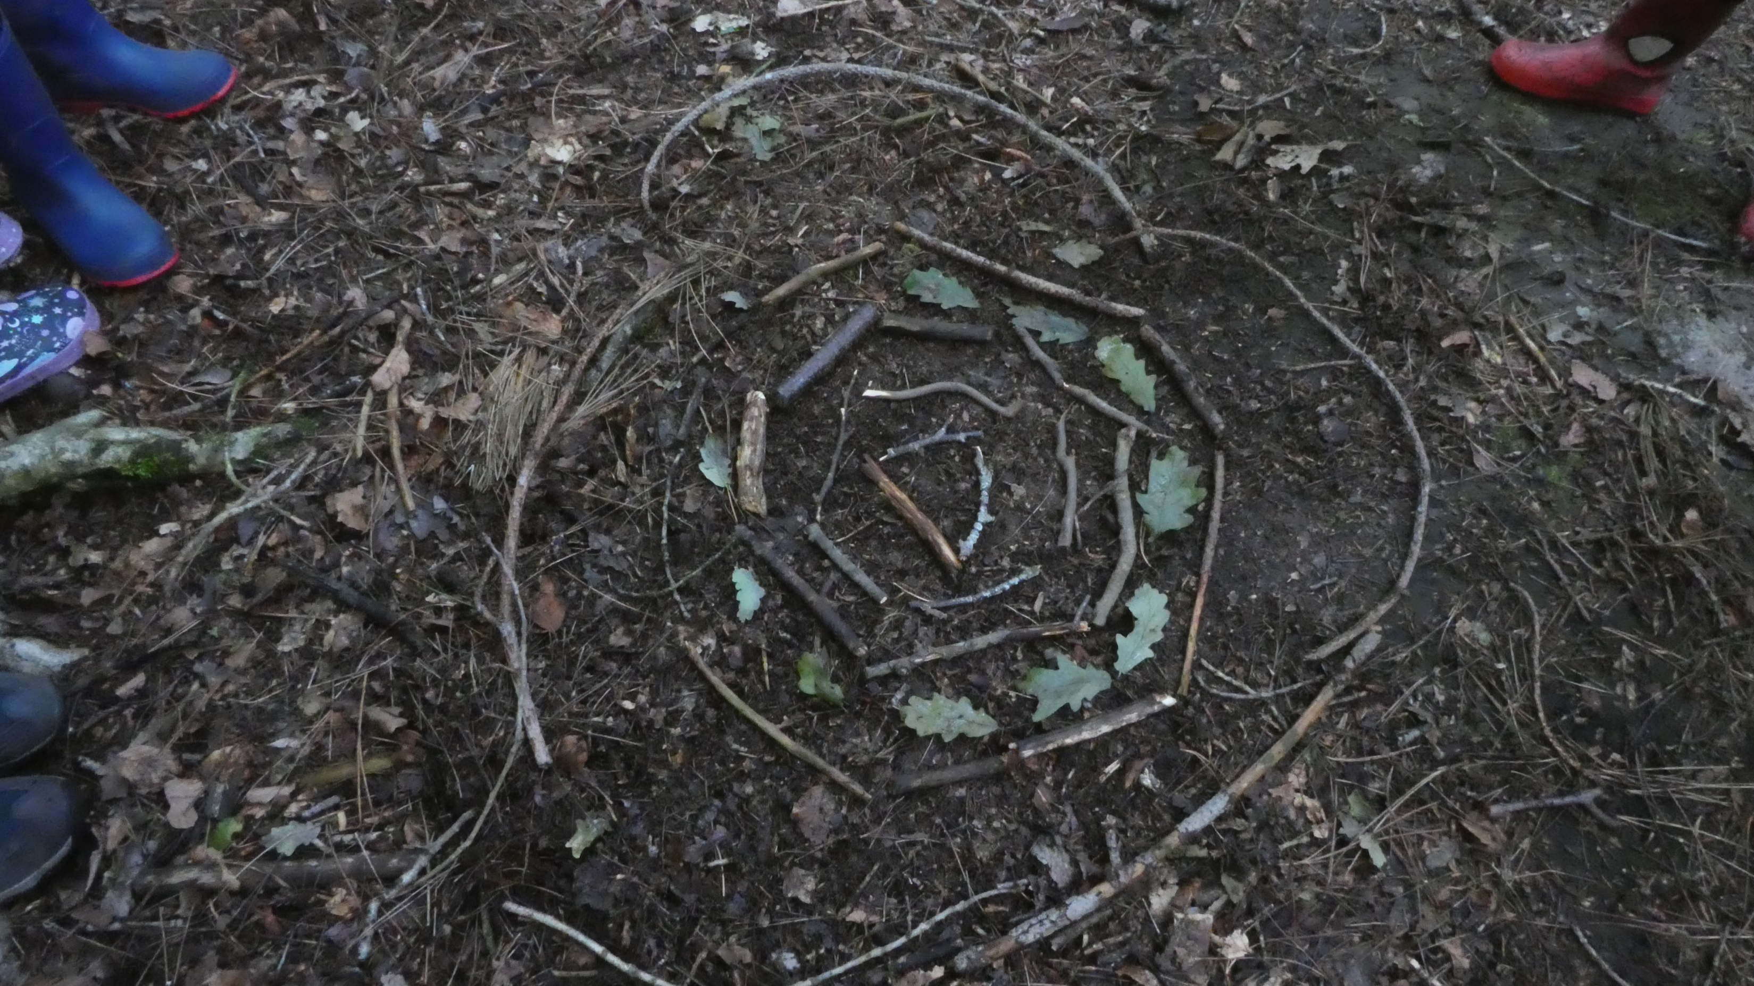

Slide 41
Thursday 4th June
Morning: Arrival at Fox Howl, explore the forest, and enjoy a picnic lunch.
Afternoon: Animal Habitats workshop led by a Fox Howl Warden.
Evening: Delicious evening meal, fun games, bonfire, night-time walk, bedtime snack, and lights out!
Friday 5th June
Morning: Breakfast, den building, and an Andy Goldsworthy-inspired forest art session.
Afternoon: Lunch followed by 3D Forest Art and Sculpture before we head home.
2:30pm: Depart Fox Howl.
3pm: Arrive back at school in time for collection as usual.

Slide 42

Packing List
Children will carry their own bags, so please pack light! All items should be labelled.
Must-haves:
• Wash bag (soap, toothbrush, toothpaste, hairbrush).
• Towel.
Water bottle.
Packed lunch (unless one has been ordered from school).
• Night clothes and dressing gown.
• Indoor shoes (slippers or trainers).
• Plastic bag for muddy clothes.
• Trainers/walking boots and wellies.
• Enough clothes for two days (including an extra set in case of wet weather).
• Waterproof jacket with a hood (waterproof trousers if available).
• Sun hat and sunblock (children must apply themselves).
• Insect repellent (again, self-applied).
• A small rucksack for day use.
• A named torch for our night-time walk (to be collected by staff).
Optional extras:
• A teddy.
• A book for bedtime reading.

Slide 43
Medication:
Any medicines must be clearly labelled with your child’s name, dosage, and times to be administered.
Please hand these to a staff member on Thursday morning.
Earrings: Only stud earrings are permitted, but ideally, no earrings should be worn.
Cameras: A disposable camera is allowed, but children will be responsible for it.
No electronic devices (phones, tablets, music players, etc.)

Slide 44
Sleep and wellbeing
We know that being away from home overnight can be a big step.
We will ensure that all children feel safe and comfortable.
Dormitory doors will be left open, and nightlights will be on.

Slide 45
In case of emergency
You can contact:
Fox Howl (via Tattenhall Head Office): 01829 770223
School Office: 01244 667993

Slide 46

Any questions?

