Slide 1
Year 6 SATs - 2026

Slide 2
In the summer term children in Year 6 will sit the SATs papers.
Year 6 SATs will take place the week beginning Monday 11th May.
The aim is to assess English and maths objectives from across the primary national curriculum.
They are externally marked.

Slide 3
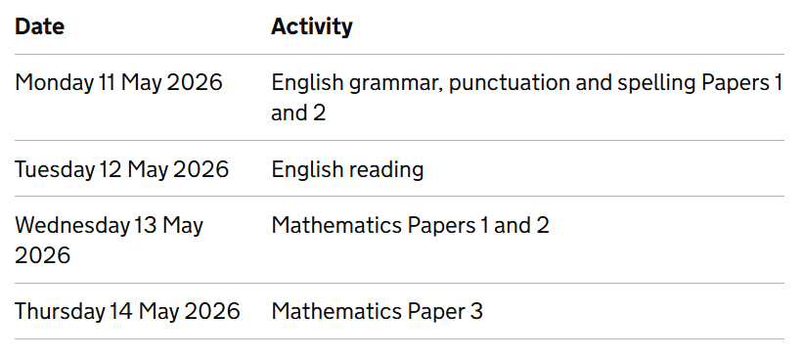

Slide 4
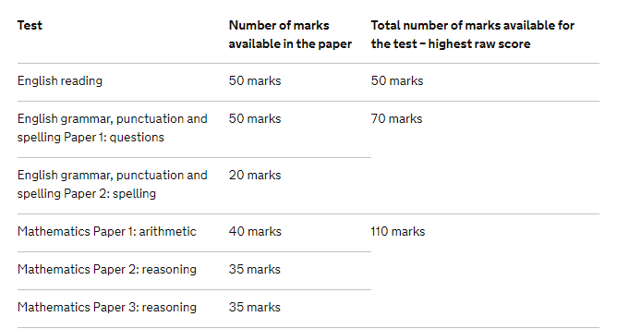
28 or more for EXS standard
35 or more for EXS standard
58 or more for EXS standard
Boundary for expected level depends on yearly average scores. These ones are based on last year’s.

Slide 5
Tuesday 7 July
You will be given your child’s raw score (the actual number of marks they get), alongside their scaled score and whether they have reached the national average.
The scaled score ranges from 80 – 120
The average score is 100, if a child doesn’t meet 100 they will be recorded as HNM (has not met the end of Key Stage Standard)
https://www.gov.uk/government/publications/key-stage-2-tests-2025-scaled-scores/2025-key-stage-2-scaled-score-conversion-tables

Slide 6
Grammar, Punctuation and Spelling
The grammar, punctuation and spelling test will consist of two parts: a grammar and punctuation paper requiring short answers, lasting 45 minutes and a spelling test of 20 words, lasting around 15 minutes.
The grammar and punctuation test will include two sub-types of questions:
Selected response, e.g. ‘Identify the adjectives in the sentence below’
Constructed response, e.g. ‘Correct/complete/rewrite the sentence below,’ or, ‘The sentence below has an apostrophe missing. Explain why it needs an apostrophe.’

Slide 7
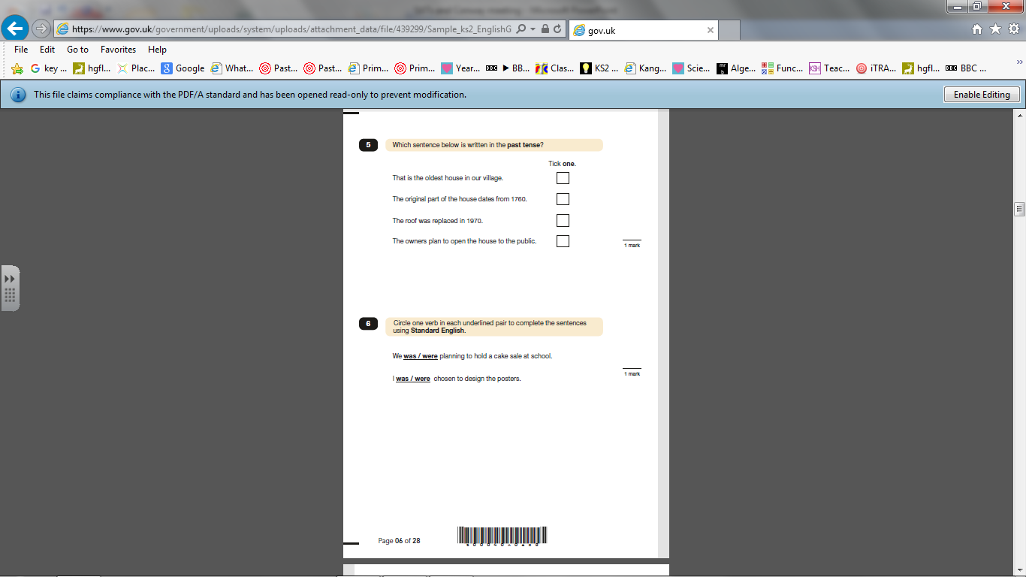
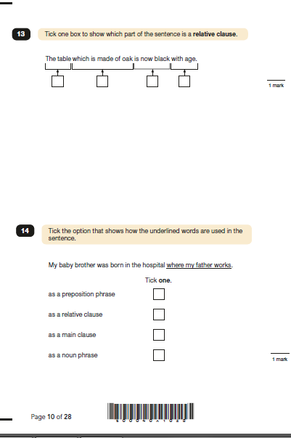
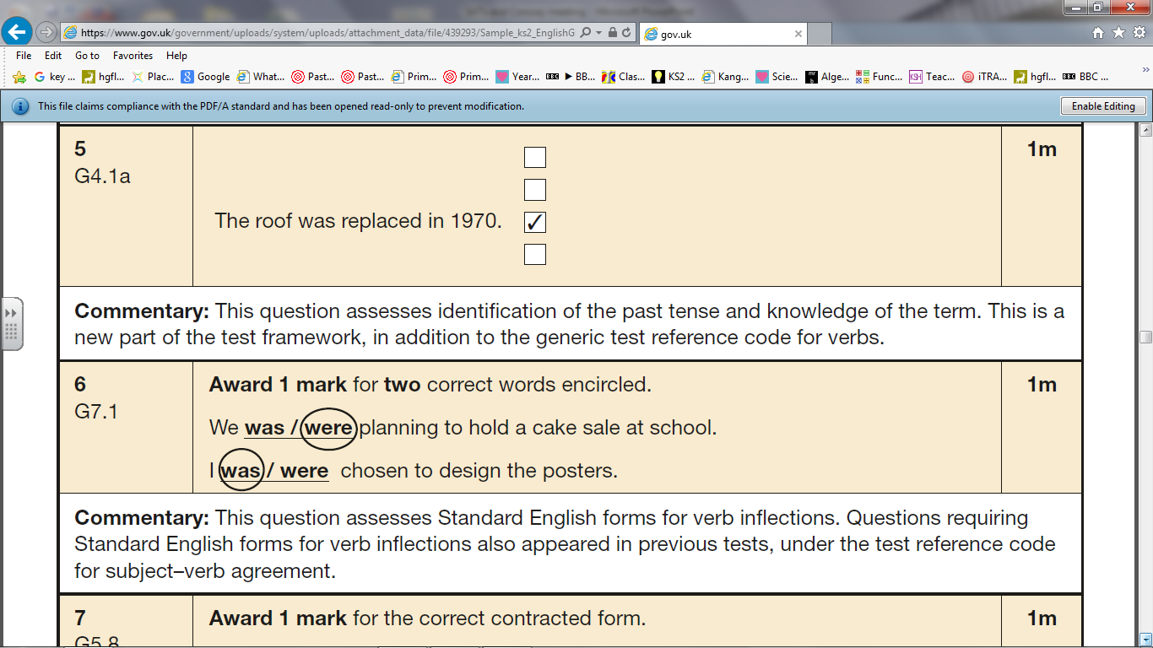
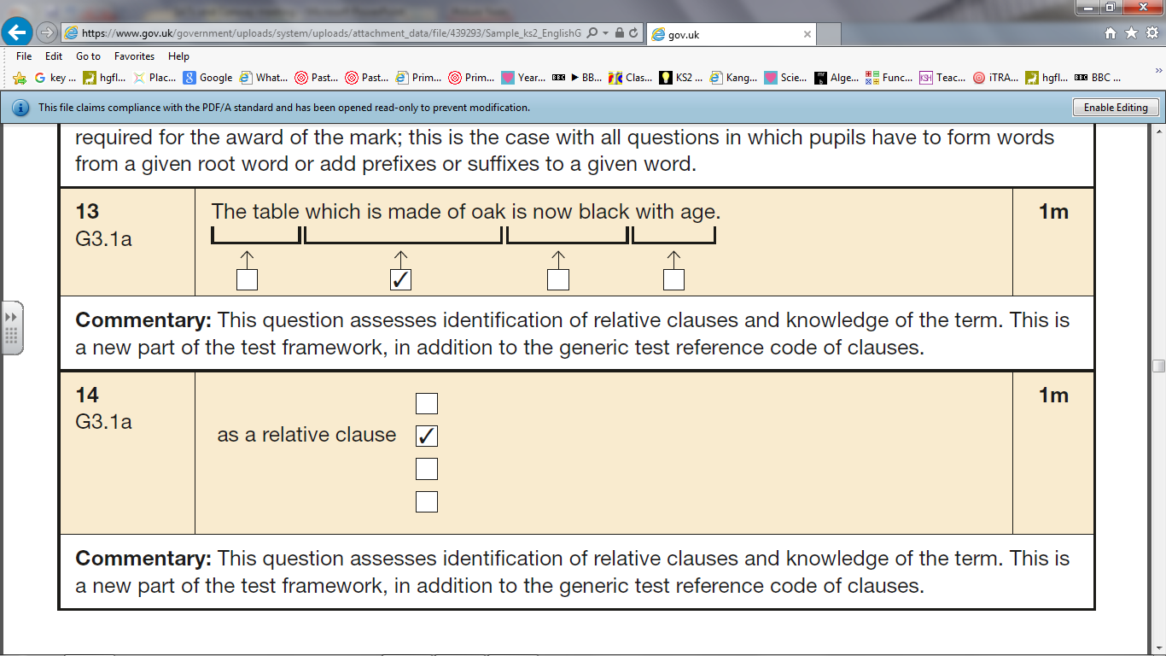

Slide 8
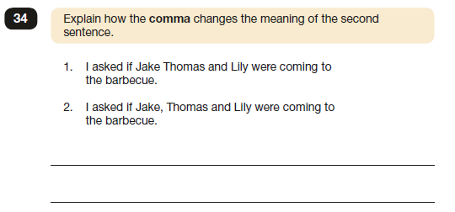
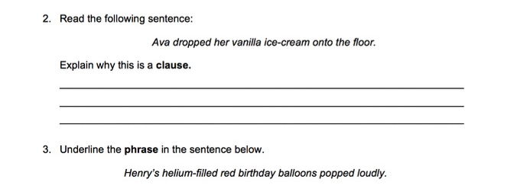

Slide 9
Reading Test
The reading test will be a single paper with questions based on three passages of text. Your child will have one hour, including reading time, to complete the test.
There will be a selection of question types, including:
-Ranking/ordering, e.g. ‘Number the events below to show the order in which they happen in the story’
-Labelling, e.g. ‘Label the text to show the title of the story’
Find and copy, e.g. ‘Find and copy one word that suggests what the weather is like in the story’
-Short constructed response, e.g. ‘What does the bear eat?’
Open-ended response, e.g. ‘Look at the sentence that begins Once upon a time. How does the writer increase the tension throughout this paragraph? Explain fully, referring to the text in your answer.’

Slide 10


Slide 11
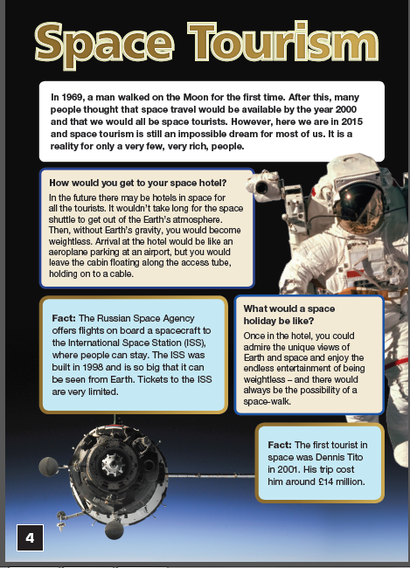
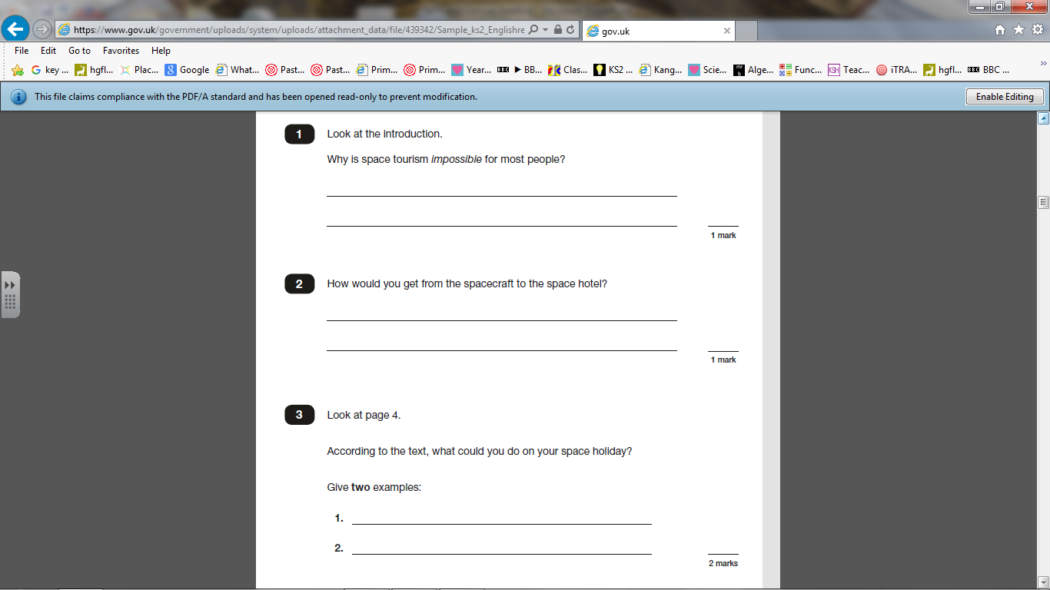

Slide 12
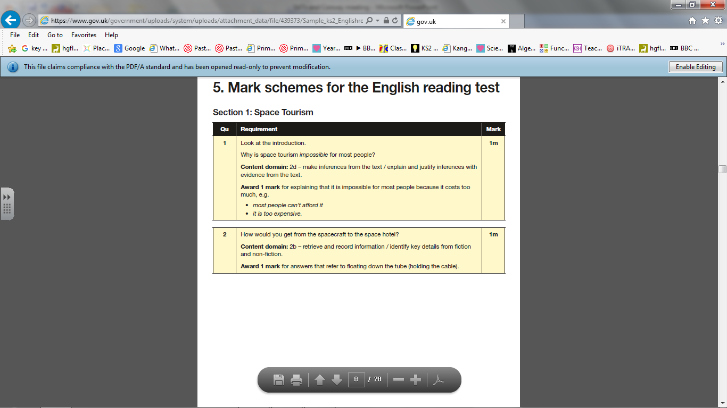
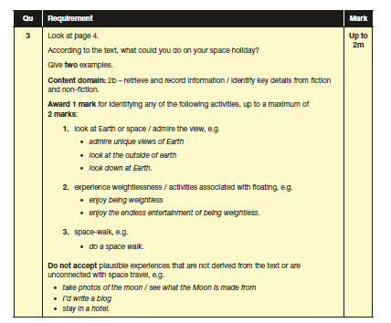

Slide 13
Writing
There is no test for writing, teacher assessments are made from writing in all subject areas, they have to consistently be achieving each objective.
Moderation takes place throughout the year between schools and some schools are moderated in May.
Feedback and marking is in line with the expected standard for where children are working.

Slide 14
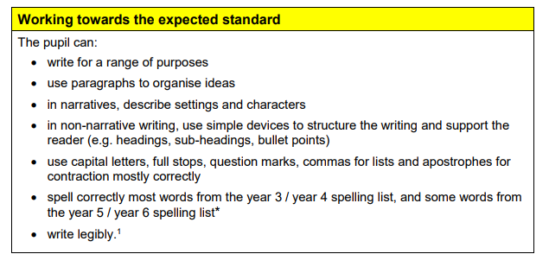

Slide 15
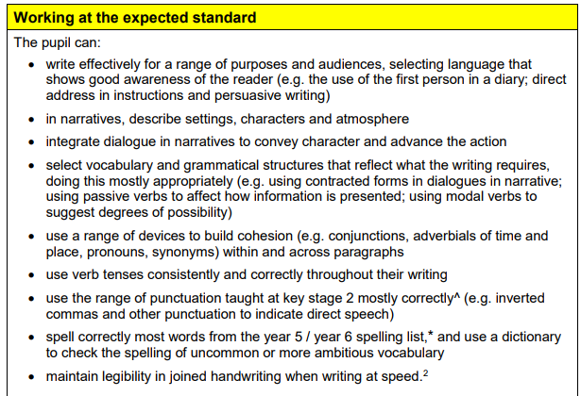

Slide 16
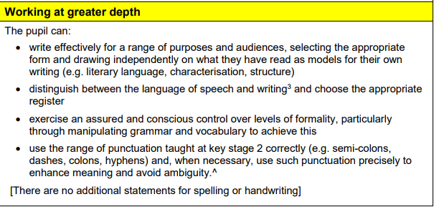

Slide 17
Maths Test
Children will sit three papers in maths:
Paper 1: arithmetic, 30 minutes
Papers 2 and 3: reasoning, 40 minutes per paper
Paper 1 will consist of fixed response questions, where children have to give the correct answer to calculations, including long multiplication and division.
Papers 2 and 3 will involve a number of question types, including:
multiple choice, true or false, giving the answer to a calculation, drawing a shape or completing a table or chart.
The children will have to explain their approach for solving a problem and in some cases explain how they know.

Slide 18
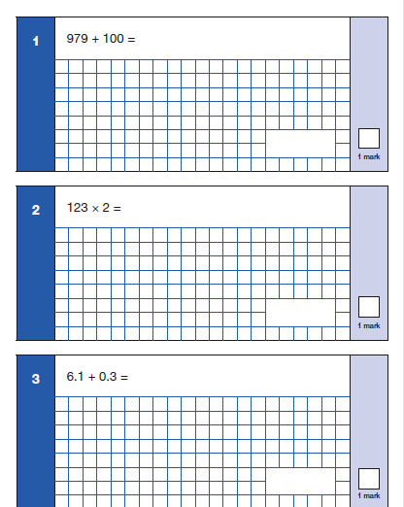
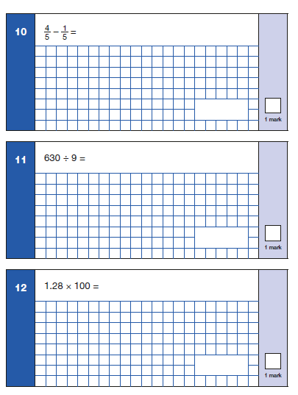
Because this is a timed test, knowing times tables will help (36 questions).

Slide 19
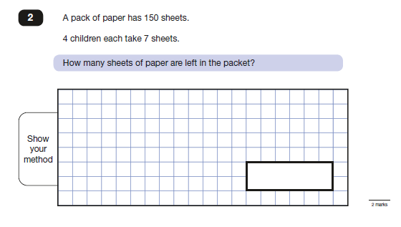
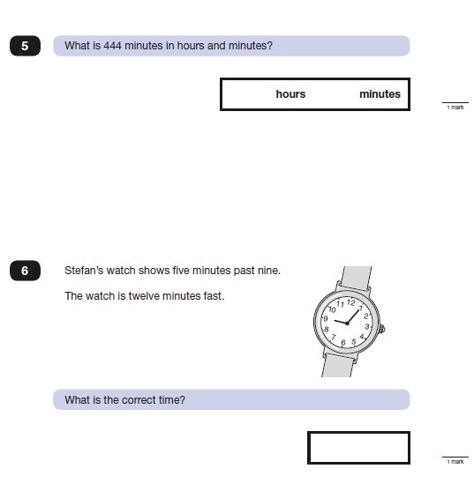
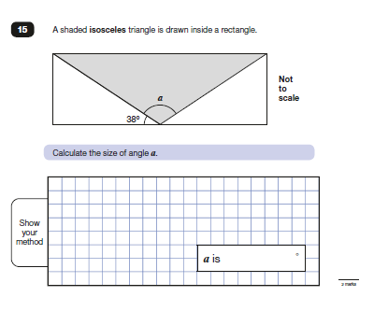

Slide 20

How can you help?
Support with homework.
Talk to the children about their learning.
As we get closer to May doing extra work at home (revision sheets on website).
Revision books

Slide 21
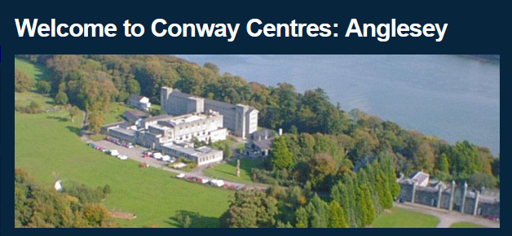
Monday 8th June – Friday 12th June

Slide 22
Generic BENEFITS - Why are we doing this? | Specific Outcomes
The children will take part in outdoor adventure activities. | In visiting the centre the children will have an opportunity to take part in outdoor adventurous activities that we are otherwise unavailable to provide in school.
The children will further develop their PSHE and citizenship skills. | The intended outcome is that the children will further develop their teamwork, leadership and problem solving skills by completing activities that challenge them in different ways. In addition, the children will learn to support their peers which will form a key part of their work in transition to high school.

Slide 23
 | Breakfast | Morning Session Approx 9.30am-12.30am | Lunch | Afternoon Session Approx 1.30pm-4.30pm | Evening Meal | Evening Session For hygiene reasons please ensure all beds are made
Monday |  | Estimated Arrival - 11.30pm (coach to leave @9.15) | Own Packed Lunch | Stand up Paddleboard Via ferrata Own Session (Art) | 5.45pm | Nightline (kelvin)
Tuesday |  | Canoe Adventure Day | Packed Lunch | Canoe Adventure Day | 5:45pm | Conway Quest
Wednesday |  | Adventure Day offsite | Packed Lunch | Adventure Day offsite | 5:45pm | Shop
Thursday |  | Via ferrata Stand up paddle board Via ferrata | Cooked Lunch | Own session (Art) High Level ropes Paddleboarding | 5:45pm | Disco
Friday |  | High level Ropes Own session (Art) High level ropes | Cooked Lunch | Estimated Departure – 1.30pm

Slide 24
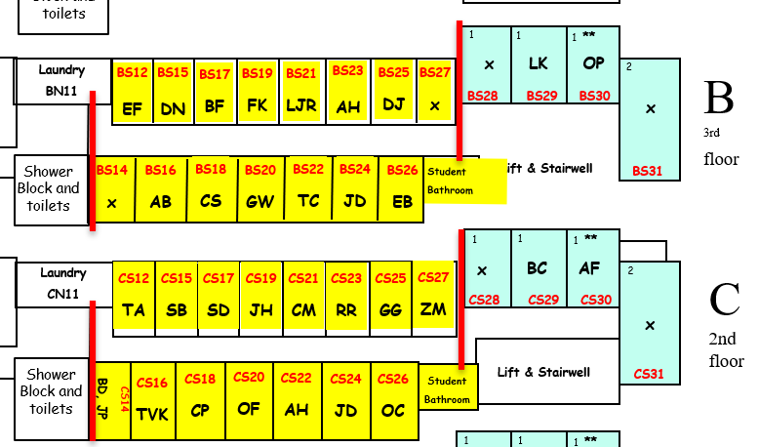
Dorm plan – Children do have individual rooms but will not be expected to be in individual rooms until bedtime. They can bring cuddly toy, blanket, battery night light etc.
Staff don’t go to bed until all children asleep.
Staff doors labelled and children made aware, so they know where to go if they need anything through the night.

Slide 25
Food
Own packed lunch first day
Multiple options for hot dinners and lunch (they are flexible with options)
Children will choose sandwich for day off site
Luggage
Suitcase works well so they don’t struggle carrying it themselves
Make sure they pack with you so know where their things are and what for
Plastic bags are a must!
The more layers the better as dry rooms do smell

