Slide 1

Meet the Teacher
Year 6 – Miss Cartwright

Slide 2
Year 6 Staff
Miss Cartwright
Mrs Gardiner (mornings and Tuesday pm)
Miss Forster (some afternoons)
Mrs Palfreyman – Science
Mrs Williams – PE

Slide 3

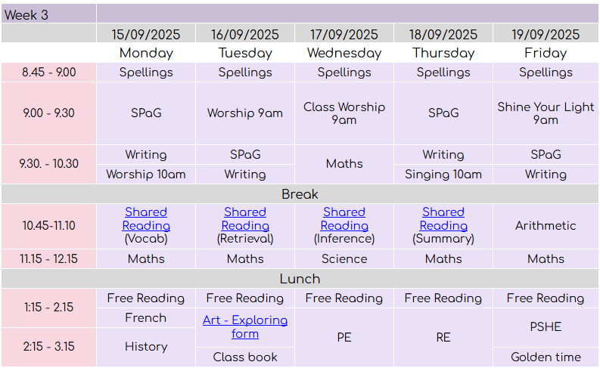

Slide 4

Routines
Morning spelling
Water bottles
Snacks
PE kits (Wednesday and clubs)
Reading books and diaries (Monday)

Slide 5

Homework
Personal spelling grid (practice little and often)
Maths and English homework (set Friday and due Wednesday)
TTRockstars practice
Reading

Slide 6
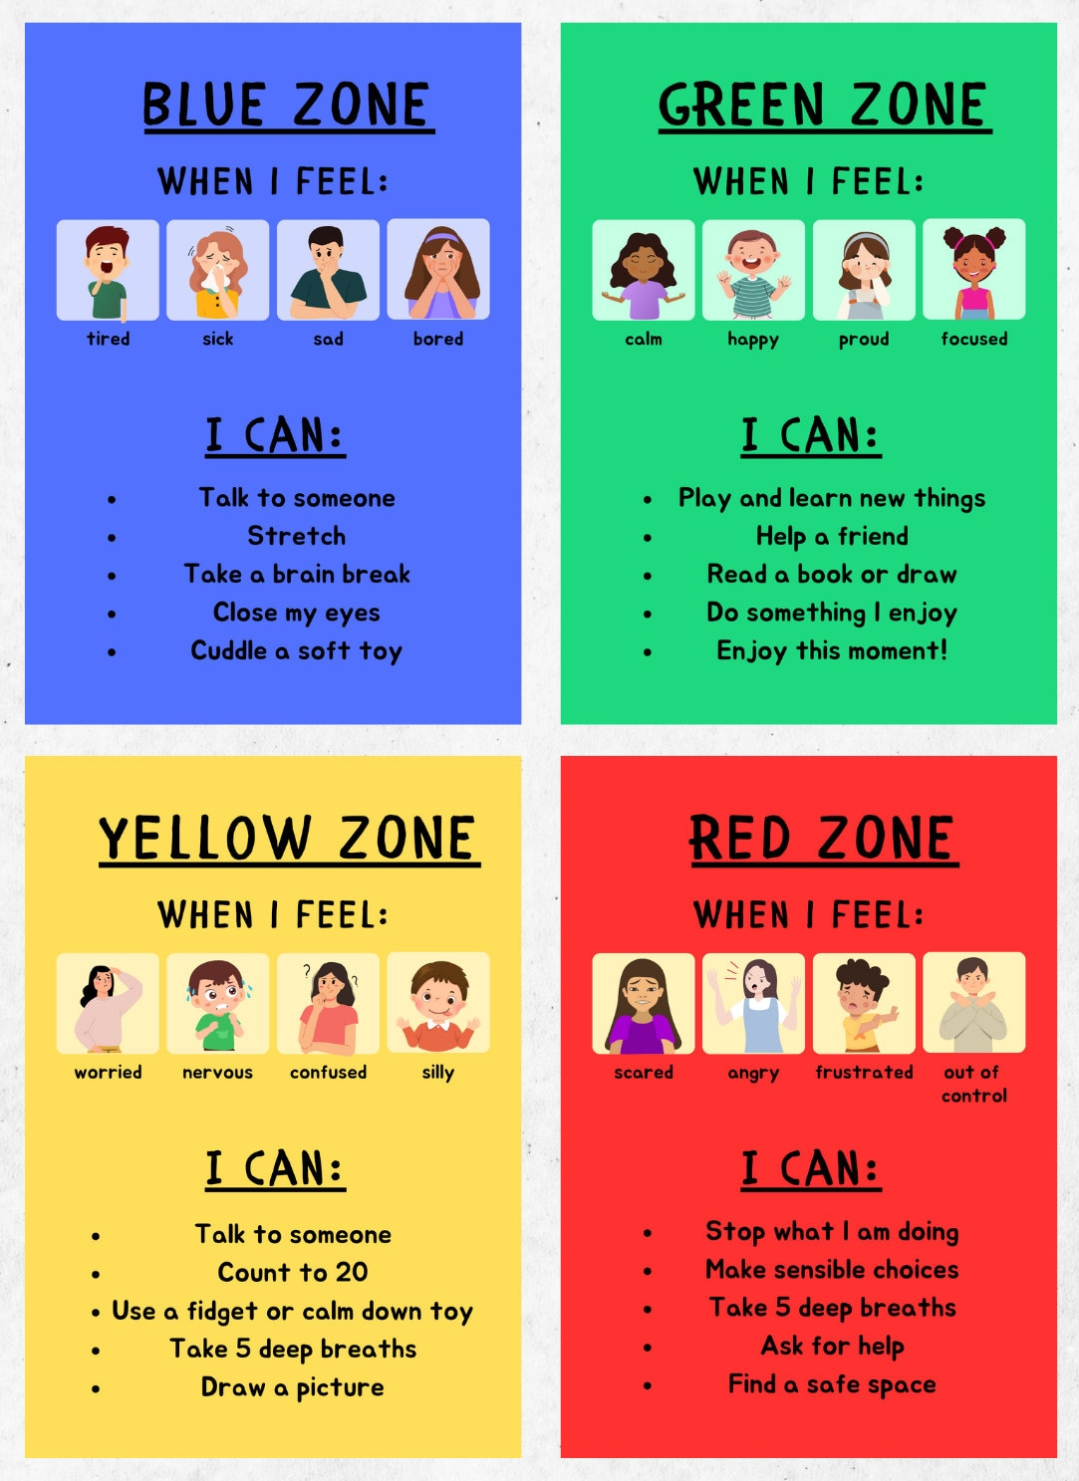
Behaviour
Simple, clear and consistent expectations
Ready. Respectful. Safe
Reminder, warning, consequence
Parent communication

Slide 7

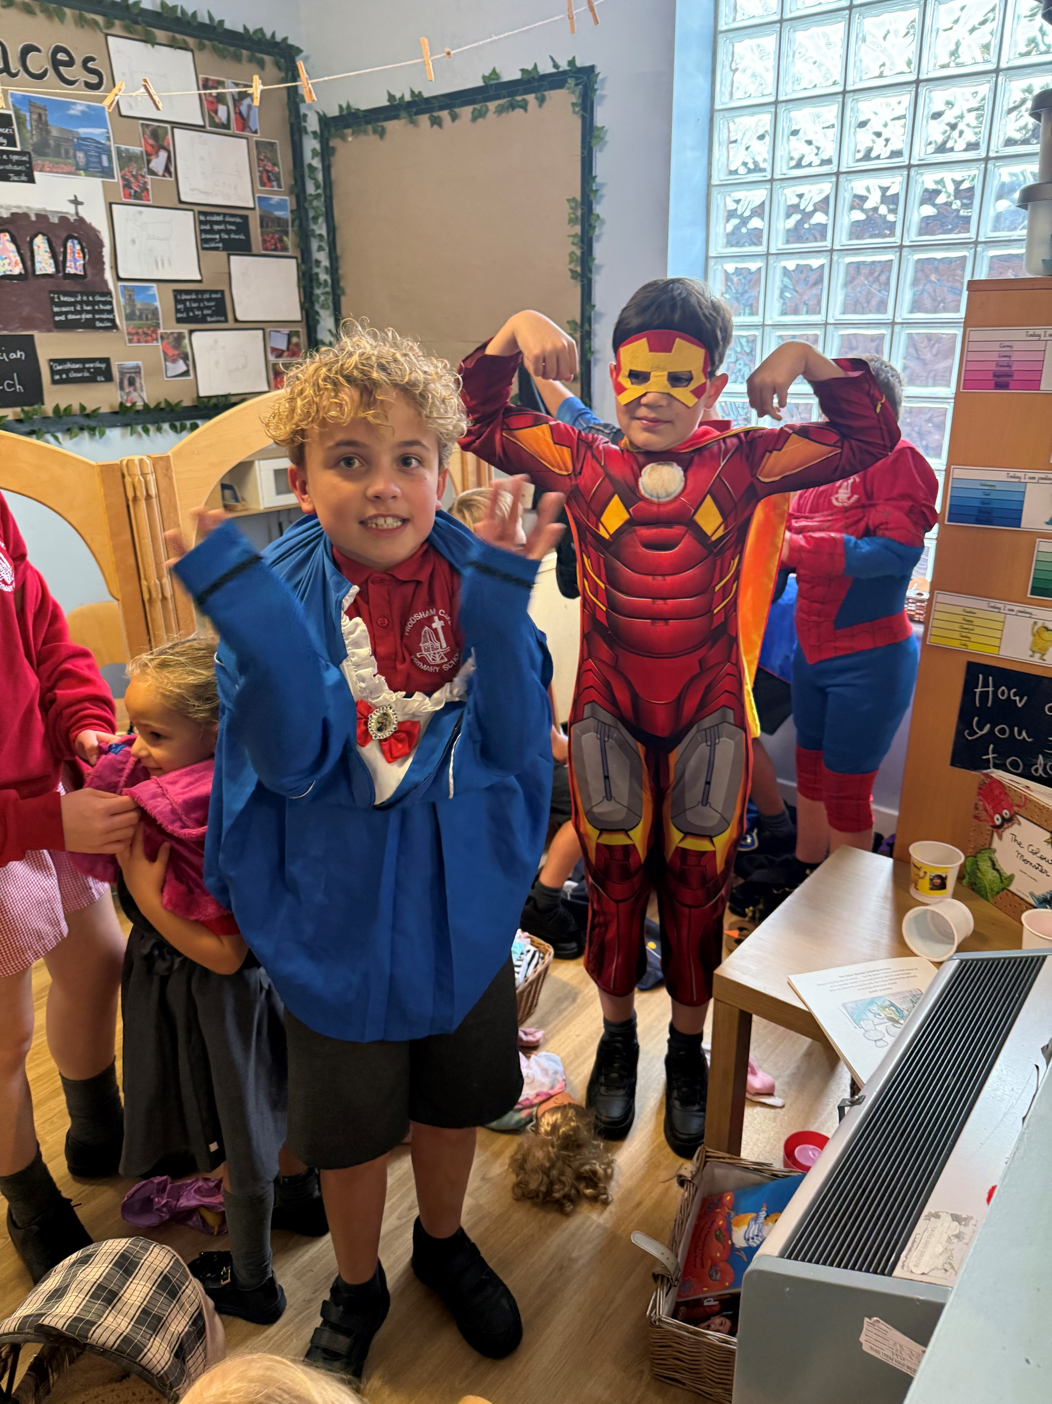
What makes Year 6 special?
Buddies and play leaders
Trips/visits (Western Approaches, Remembrance service, Greenacres, VR WW2 day, Gurdwara, Conway)
Broad curriculum
h
Year 6 show/leaving service
End of year transition to secondary school

Slide 8
Communication
School Spider/emails
Mrs Singer in the office
Termly class newsletters and topic webs
Fortnightly school newsletters
h
I will be on the playground after school, everyday except Wednesday

Slide 9

https://www.frodshamce.cheshire.sch.uk/class/year-6
I will update class page with dates relevant to Year 6.
European Day of Languages- 26th September
Harvest Service- 7th October 9.30am
Parents’ Evening- 15th & 16th October
Individual School Photos- 17th October
Half Term: Friday 24th October- Tuesday 4th November
Anti Bullying Week- 10th November- Odd Socks Day
Advent Spiral- 28th November
Frodsham Christmas Festival- 29th November
Year 6 Class Assembly – 5th December
Nativity Play- 10th December 2.00pm & 11th December 6pm
KS2 Carol Service- 15th December 6pm
Christmas Party Day- 17th December
Storyhouse Theatre Visit- 18th December
Christmas Holidays: Friday 19th- Monday 5th January

