Slide 1
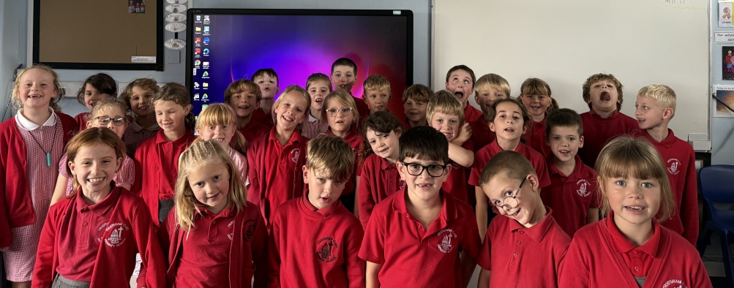
Meet the teacher information evening 2025-2026
Year 3

Slide 2
Who works with us…
We are very lucky to have Mrs. Barlow working with us throughout the week supporting small group learning and providing interventions, Mrs Barlow works in class every morning and 3 afternoons a week.
We also have Mrs. Williams lead our PE on Tuesday afternoons.

Slide 3
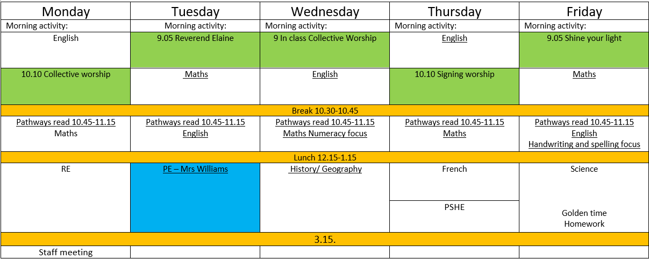
Our week

Slide 4
Routines
Every morning the children come in and are reminded to bring water bottles reading diaries and guided reading books into the classroom. All have a home in class and are used as and when needed.
We then do the register and the children select their lunches on the screen.
Whilst children are picking lunch we have a morning challenge that they complete independently everyday, this varies from numeracy/ spelling/ handwriting etc.
The children have all become very used to our routine and are excellent at coming in and getting themselves ready for the day.

Slide 5
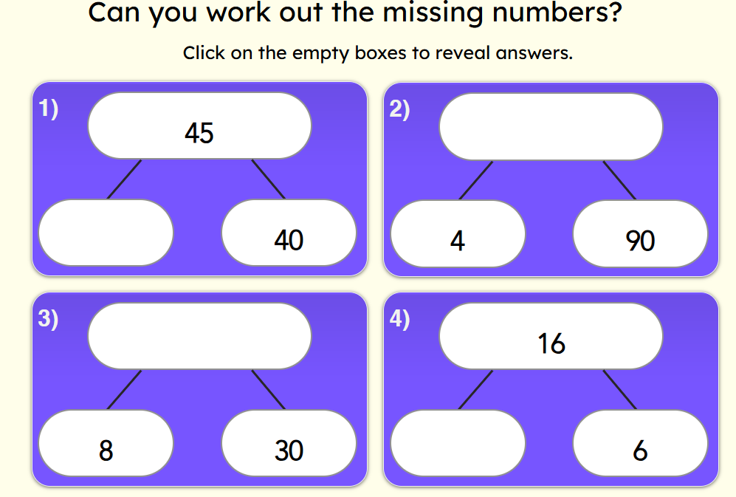
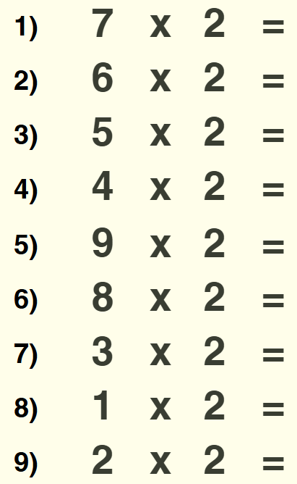
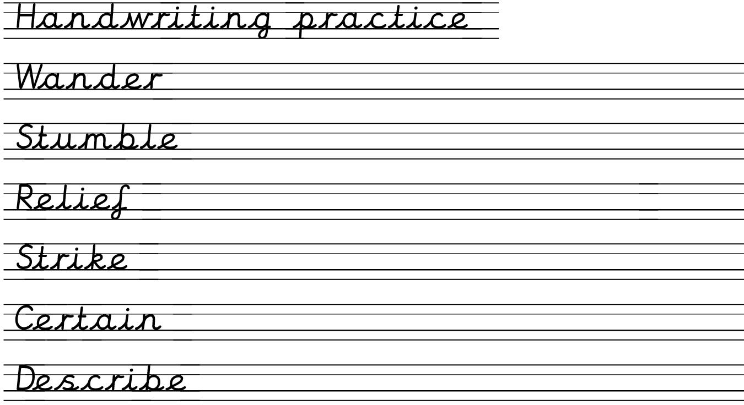
The morning challenge is an independent activity; the children may have a slightly differentiated activity based on key learning recap. This is a warm up for our day and is focused on revisiting key skills.

Slide 6
Homework
Homework will be set every Friday and returned the following Wednesday. We would like to ask for prompt and punctual hand-ins to help us mark and provide productive feedback before the next set is handed out.
Alongside formal homework there will be weekly spellings – these are tested on a Friday and given out at the start of the half term, in the back of the reading record.
When creative homework is set this will be the only ‘formal’ piece.
Timetables Rockstars is part of the homework expectation in Y3 and we encourage all children to be playing for a minimum of 20 minutes a week.
We really appreciate your ongoing support and if you ever need anything from us please don’t hesitate to get in contact.

Slide 7
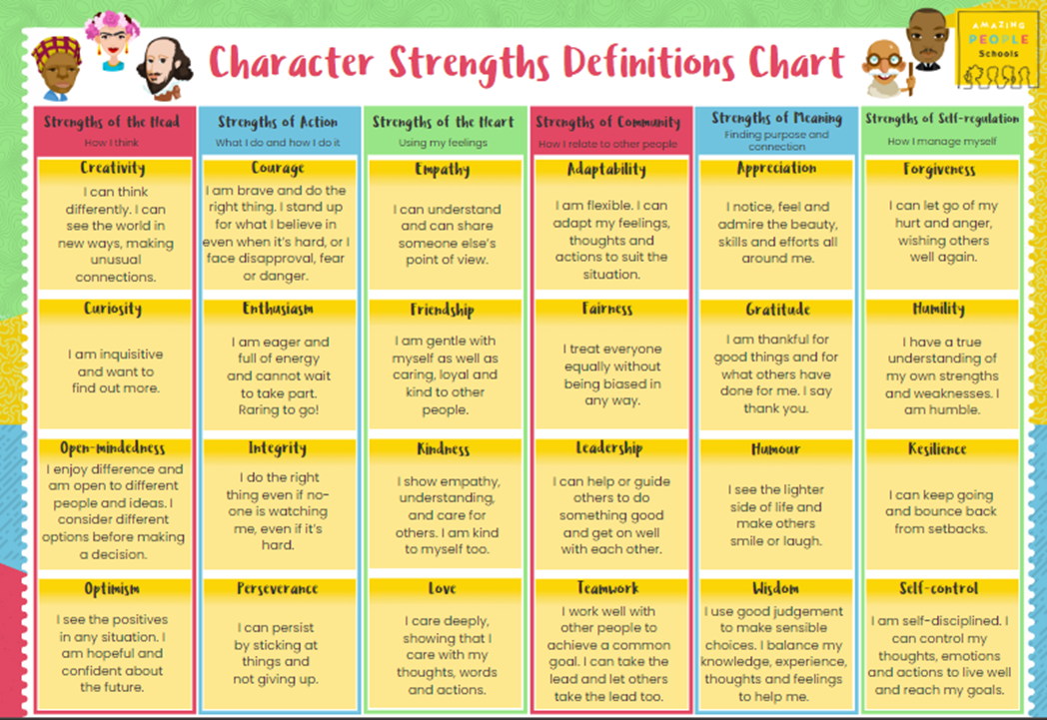
Behaviour and character traits
This year we are focusing on character traits and strengths and encourage the children to show these everyday – even when we aren’t looking for it!
The home school agreement..

Slide 8
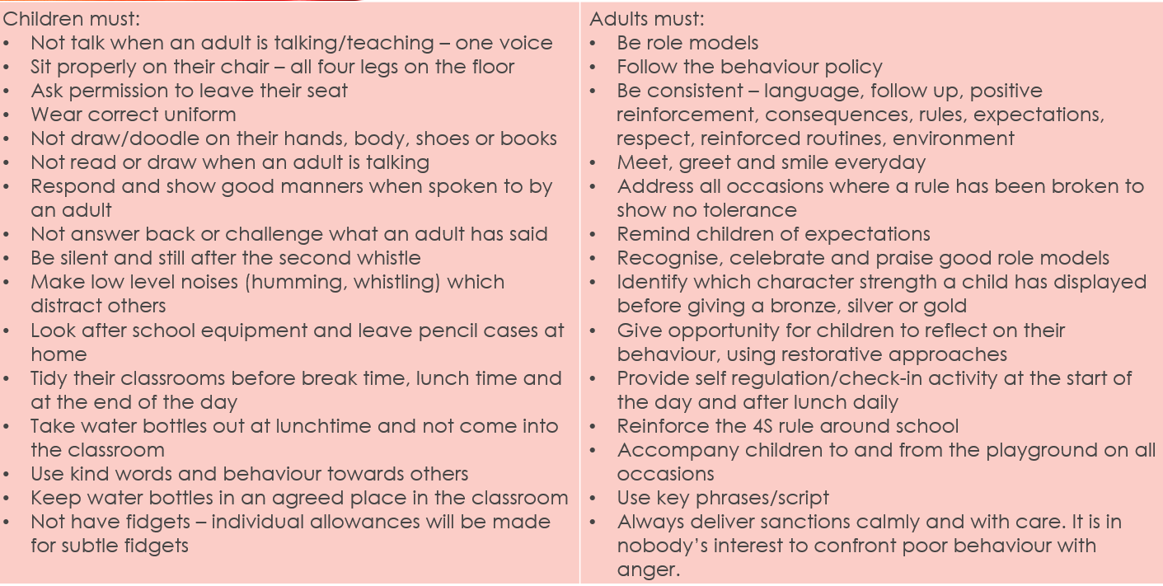

Slide 9
What makes Year 3 special
‘We get to learn French!’
‘Meeting a new teacher is fun’
‘ We get to have longer playtime because go out straight away at lunch’
’we get to earn golden time’
‘we learn about cave men on the stone age’
‘ I like year 3 because we learn about the stone age’

Slide 10
Communication
Any messages from myself will be sent via School Spider (text)
If you need to get in contact with myself – email via admin@frodshamce.Cheshire.sch.uk
The office pass on any emails, however if you could put your child’s name and year group in the subject line that would be great. e.g. J Kelly, Y3.
I usually try and check emails first thing, at lunch and once the children have gone home – if you have not heard back from me either in person, via spider or email within 2 days then it may have got lost and just remind me at pick up/ email again.
Any urgent messages can be passed on via the gate.
I am also happy to have a quick chat afterschool if anything has cropped up.

Slide 11
Dates
European Day of Languages- 26th September
Harvest Service- 7th October 9.30am
Parents’ Evening- 15th & 16th October
Individual School Photos- 17th October
Half Term: Friday 24th October- Tuesday 4th November
Anti Bullying Week- 10th November- Odd Socks Day
Advent Spiral- 28th November
Frodsham Christmas Festival- 29th November
Nativity Play- 10th December 2.00pm & 11th December 6pm
KS2 Carol Service- 15th December 6pm
Christmas Party Day- 17th December
Storyhouse Theatre Visit- 18th December
Christmas Holidays: Friday 19th- Monday 5th January
Deadline Reception applications- 15th January
Half Term: Friday 13th – Monday 23rd February
World Book Day- 5th March
Parents’ Evening 19th & 20th March
Easter Service- 31st March 9.15am
Spring Break: Thursday 2nd April- Monday 20th April
Class Photos- 8th May
Half Term: Friday 22nd May- Monday 1st June
Sports Day- 26th June (Reserve: 1st July)
Summer Holidays- Friday 17th July- Tuesday 1st September

Slide 12

Thank you
Any questions

