Slide 1
Meet the Teacher
Year 5

Slide 2
Year 5 staff
Mrs Edge
Mrs Fray – mornings
Miss Forster – some afternoons
Mrs Williams – PE
Mr Keelan

Slide 3
Timetable
Mornings – English and Maths, Worship
Afternoons – RE, Geography/History, Science, PE (usually Thursdays)
French, PSHE
Spellings, Guided Reading, Handwriting
Computing, Art, DT
Music
Forest school – twice a half term

Slide 4
Routines
Class equipment
Water bottles
Snacks
PE kits
Reading books and diaries
(Instruments)

Slide 5
Homework
Reading at home as often as possible – at least 3 times a week
Homework:
  Weekly: reading, spellings, TTRockstars, maths or English
  Monthly: TTRockstars gigs

Slide 6
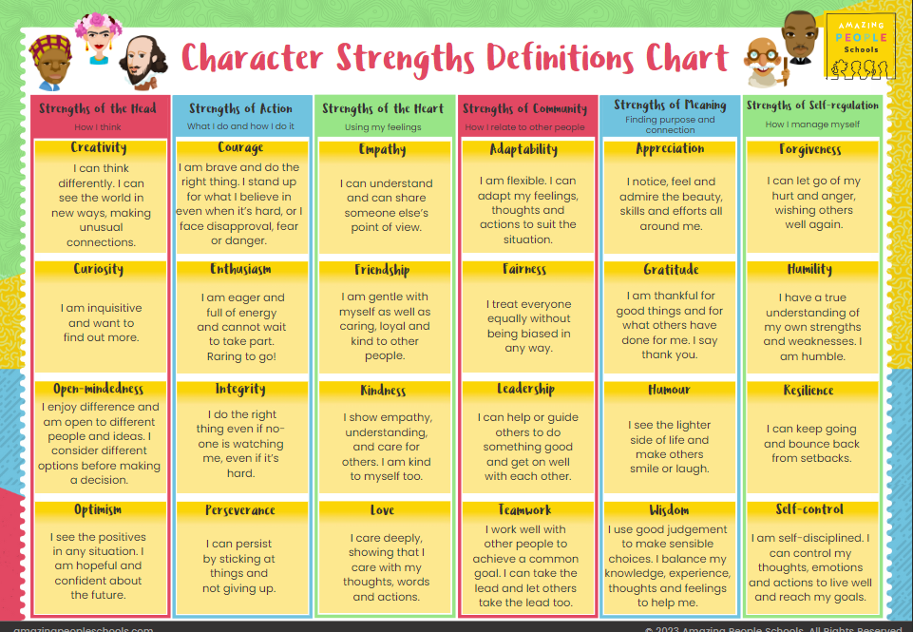
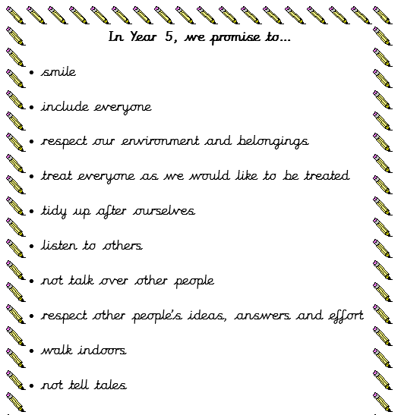
Behaviour

Slide 7
What makes Year 5 special?
All year strings tuition (hopefully!)
Trips/Visits such as VR day, Weaver Hall, special visitors, mosque, Bridgewater Hall
The big classroom!
Walking home
Preparing for our roles as Big Buddies at the end of the year

Slide 8
Communication
School Spider emails
Mrs Singer in the office
Termly class newsletters and topic webs
Fortnightly school newsletters

Slide 9
School Diary Dates
European Day of Languages- 26th September
Harvest Service- 7th October 9.30am
Parents’ Evening- 15th & 16th October
Individual School Photos- 17th October
Half Term: Friday 24th October- Tuesday 4th November
Anti Bullying Week- 10th November- Odd Socks Day
Advent Spiral- 28th November
Frodsham Christmas Festival- 29th November
Nativity Play- 10th December 2.00pm & 11th December 6pm
KS2 Carol Service- 15th December 6pm
Christmas Party Day- 17th December
Storyhouse Theatre Visit- 18th December
Christmas Holidays: Friday 19th- Monday 5th January
Deadline Reception applications- 15th January
Half Term: Friday 13th – Monday 23rd February
World Book Day- 5th March
Parents’ Evening 18th & 19th March
Easter Service- 31st March 9.15am
Spring Break: Thursday 2nd April- Monday 20th April
Class Photos- 8th May
Half Term: Friday 22nd May- Monday 1st June
Sports Day- 26th June (Reserve: 1st July)
Summer Holidays- Friday 17th July- Tuesday 1st September
Wednesday 24th September – Forest School
Thursday 2nd October – KS2 VR workshops
Tuesday 21st October – Life Education workshops
Wednesday 22nd October – Forest School
Friday 21st November – Y5 class worship

Slide 10
Questions?

