Slide 1
Meet the Teacher

Slide 2
Welcome to Nursery
We have a fantastic team….
Mrs Rogerson
Mrs Hunt Chambers
Mrs Ryder
Ms Osborne
Miss Parfett

Slide 3
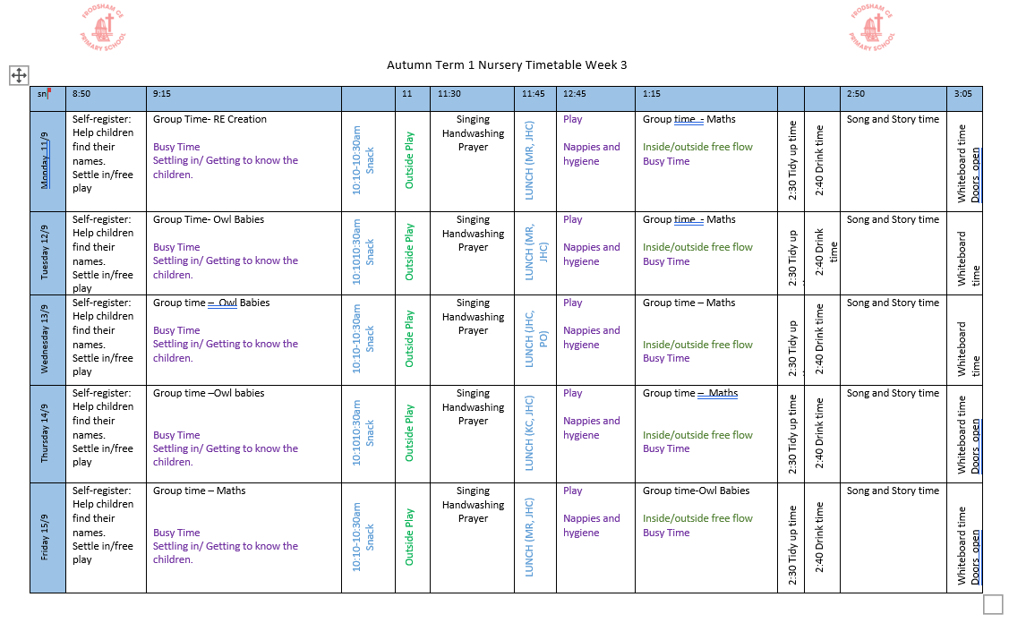
Our Weekly Timetable

Slide 4
Routines
Self Register
Group Time
Get Busy Time – inside or outside play
Snack
Playtime
Lunch
Afternoons follow the same routine.

Slide 5
Rules
We encourage positive behaviour and keeping ourselves safe with our 5 nursery rules…
Kind Hands and Feet
Kind Words
Good Sitting
Good Looking
Good Listening

Slide 6
What makes us special?
Our goal is to provide each child with the best possible start in life, laying the foundation for a joyful and successful educational journey.

Slide 7
Communication
The Nursery Team are always available to answer any concerns and enquires you may have. If you want to speak to a member of staff in private then this can be arranged.

Slide 8
Any Questions?

