Slide 1






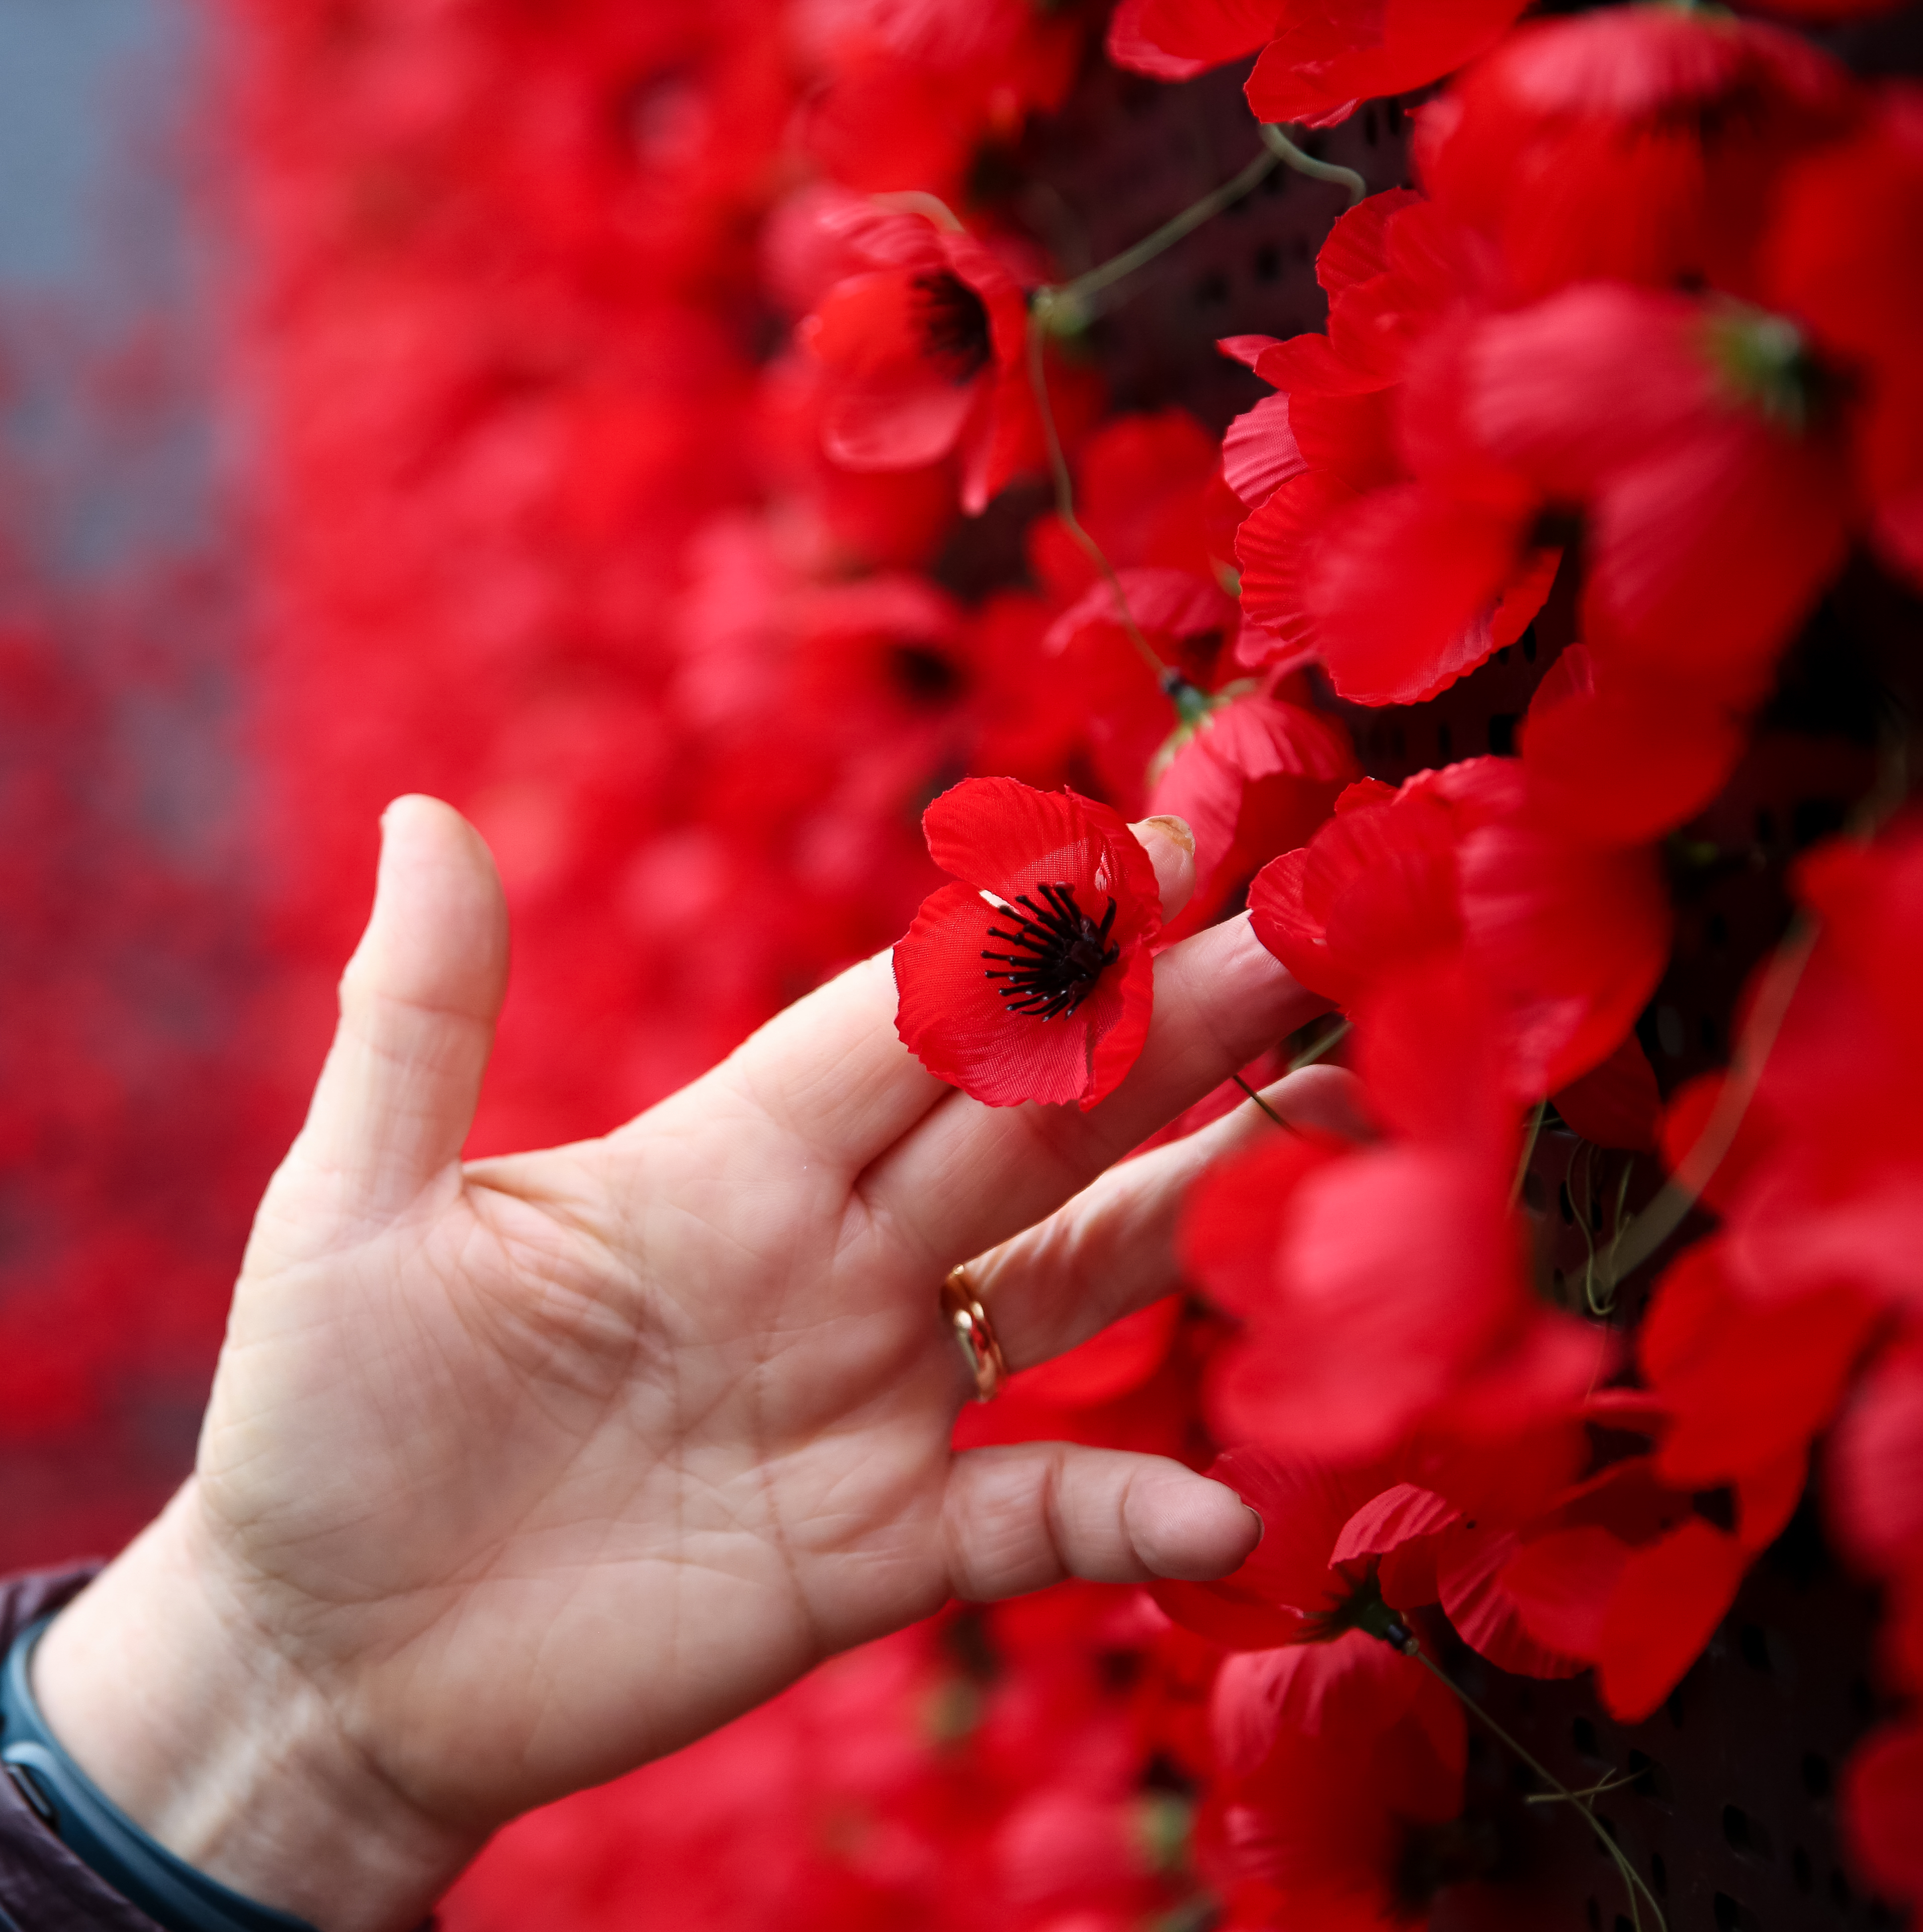
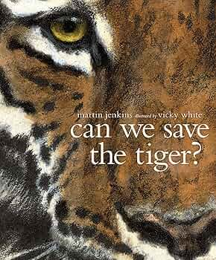

As Mathematicians:​
Number and place value​
Addition and Subtraction
Multiplication and Division​
Fractions​
Decimals and Percentages​
Ratio and Proportion
As Scientists:​
Animals including Humans​
Identify the main parts of the human circulatory system; describe the ways in which nutrients and water and transported; recognise the impact of diet, exercise, drugs and lifestyle.
Electricity
Identify and name the basic parts of a simple electric series circuit​; compare and give reasons for variations in how components function, including the brightness of bulbs, the loudness of buzzers and the on/off position of switches​.
In RE:
Love
What does the phrase ‘God is love’ mean?
Creation
How can we be advocates for God’s creation?
Does Science disprove Genesis?
In Art and DT:
Food Technology- WWll recipes​
Art - Mark making to create form, inspired by the work of Henry Moore.
Computing - Making a text-based adventure game; mastering algorithms for searching, sorting and mathematics.​
French - Review extended feelings from Y5; review numbers to 100; simple time phrases; daily routines; rooms in a house; describing a house; furniture; prepositions​
Music – Songs of WWII; film music.​
PSHE – Families and friendship; safe relationships; respecting ourselves and others, belonging to a community; media literacy and digital resilience; money and work.
As Writers:​
National curriculum skills: ​
• Identify the audience for and purpose of writing​
• Note and develop initial ideas, drawing on reading and research​
• Enhance meaning through selecting appropriate grammar and vocabulary​
• Describe settings, characters and atmosphere​
• Propose changes to vocabulary, grammar and punctuation to enhance effects and clarify meanings​
• Use consistent and correct tense​
• Précis longer passages ​
• Use organisational and presentational devices to structure text ​
• Proof-read for spelling and punctuation errors​
Start of Fear, Star of Hope​ by Jo Hoestlandt
Year group expectation:
🔑Use expanded noun phrases to convey complicated information concisely
🔑Use passive verbs
🔑Link ideas across paragraphs using a wider range of cohesive devices
🔑Integrate dialogue to convey character and advance the action
🔑 Use colons and bullet pints for a list (WW2 non-chronological report)
Can we save the Tiger? by Martin Jenkins
Year group expectation:
🔑Enhance meaning through selecting appropriate grammar
and vocabulary
🔑Use modal verbs and adverbs to indicate degrees of possibility
🔑Use brackets, dashes or commas to indicate parenthesis
​
​
​
What are we learning about in Year 6 this term?​
As Athletes:​
Tag Rugby ​
Use passing and moving, to create attacking opportunities to score a try. Pass and move forwards with the ball, and create successful scoring opportunities.
OAA: Challenging Collaboration
Understand what makes an effective team with the focus on collaboration.
Dance: Carnival
Create group movements selecting and applying choreography into a routine; perform technical movements with control and rhythm.
Netball
Consolidate attacking skills to effectively pass and move, to progress the ball forwards and create successful shooting opportunities.
As Historians:​
If the first world war was so horrific, why did Britain go to war just 20 years later?
Why was it necessary for children to be evacuated and what was evacuation really like?
How was Britain able to stand firm against the German threat?
How did people manage to carry on normal life during the war and how do we know?
What was the role of propaganda?
Why is it so difficult to be sure what life on the Home Front was really like?
What was VE day really like?

