Slide 1


Slide 2


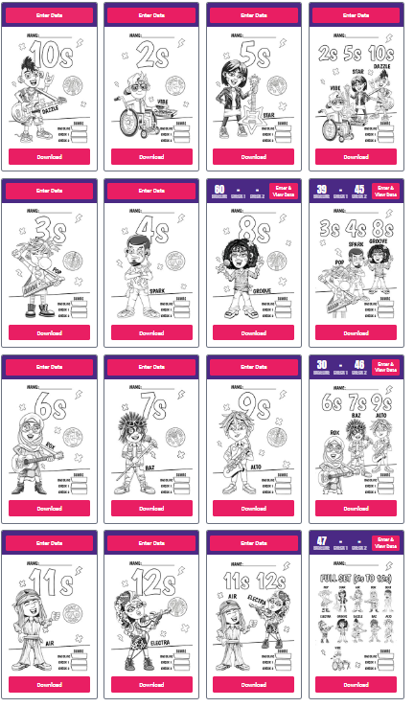
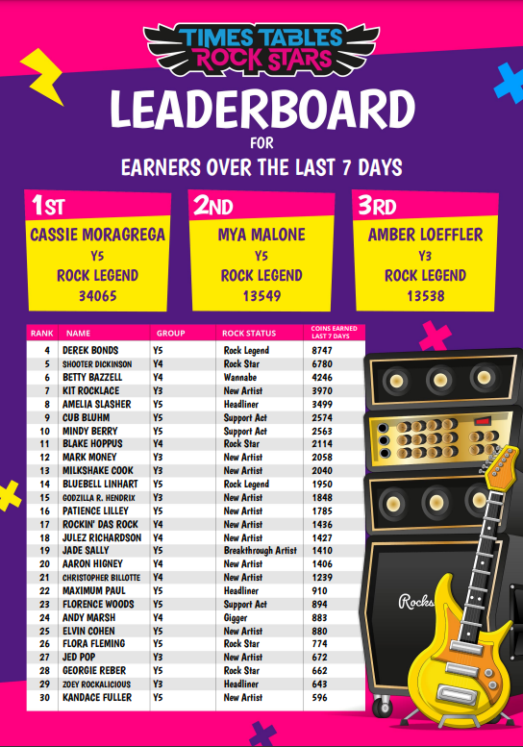
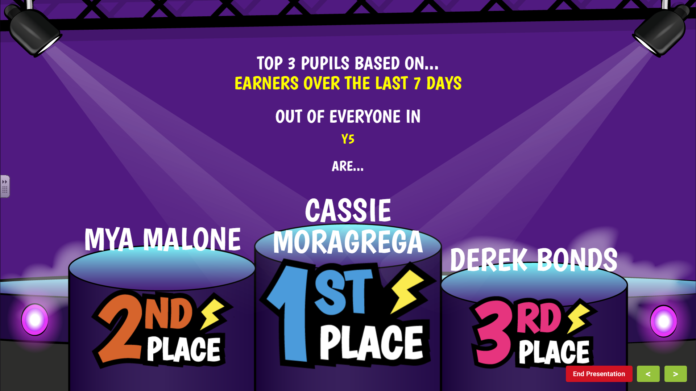

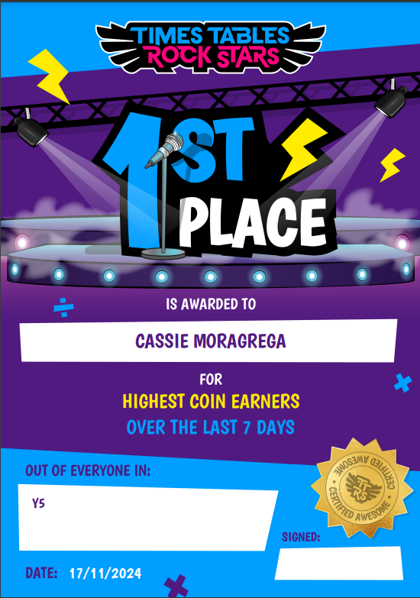
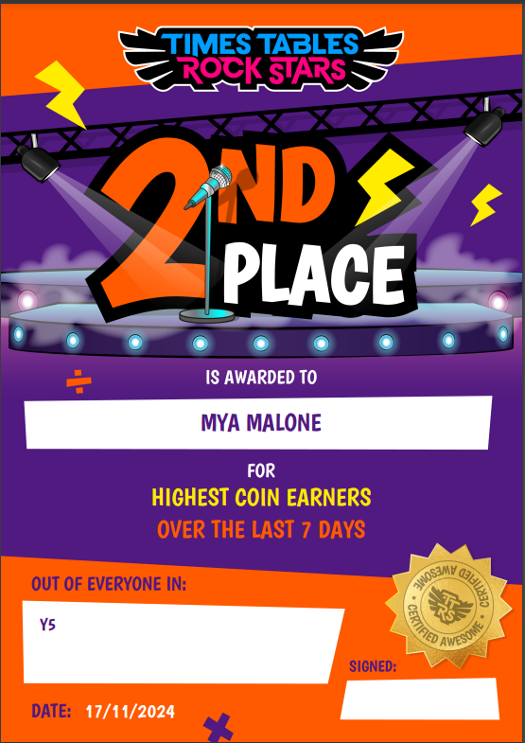
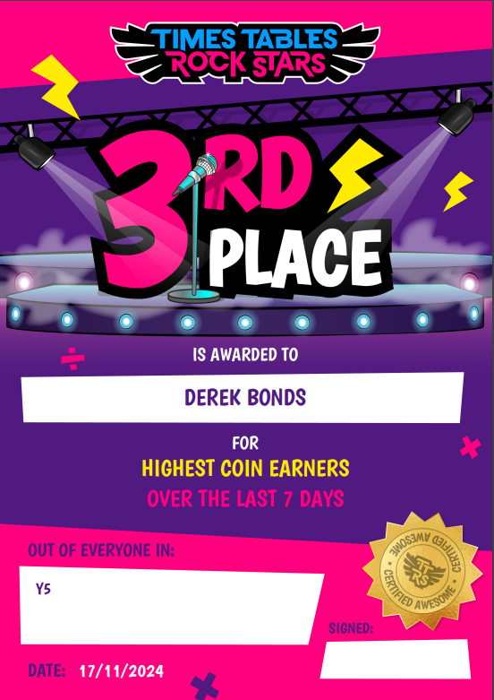
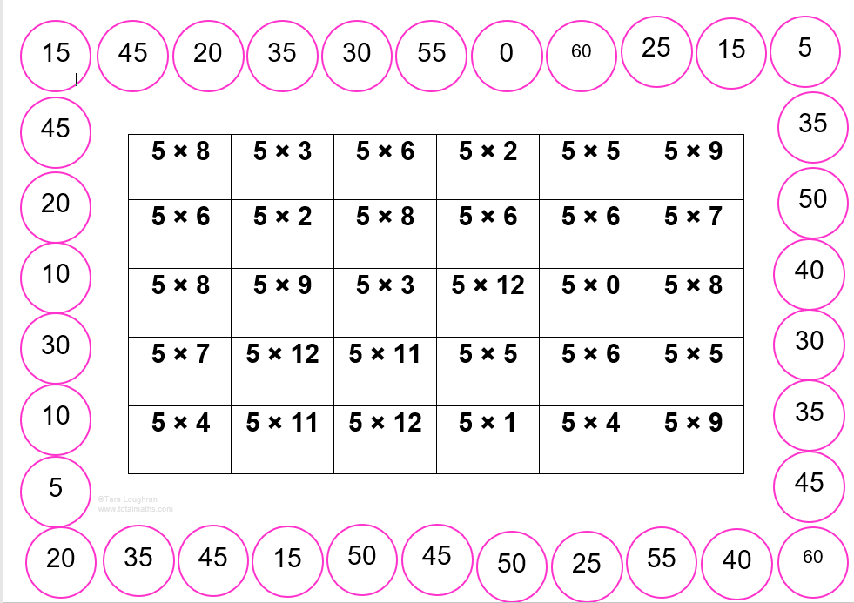

What are we doing as a school?
Notes:
Garage
Tables set by teacher
10 coins per correct answer
Studio
All tables
Set a Rock Status
1 coin per correct answers
Jamming
Tables set by children
10 questions, no timer
8 coins per correct answer
Soundcheck
25 questions
6 second timer per question
5 coins per correct answer
Festival
Play against others around the world
All tables
1 coin per correct answer
Arena
Play against others in your class
Tables set by teacher
1 coin per correct answer
Rock Slam
Challenge friends in the school to beat your score
1 coin per correct answer

Slide 3
Times tables order:
Year 1: Counting in steps of 2 and 10
Year 2: Counting in steps of 2, 10 and 5
Year 3: 4x, 8x, 3x
Year 4: 6x, 12x, 9x, 7x, 11x
Year 5: 2x – 12x
Year 6: 2x – 12x
Notes:
Garage
Tables set by teacher
10 coins per correct answer
Studio
All tables
Set a Rock Status
1 coin per correct answers
Jamming
Tables set by children
10 questions, no timer
8 coins per correct answer
Soundcheck
25 questions
6 second timer per question
5 coins per correct answer
Festival
Play against others around the world
All tables
1 coin per correct answer
Arena
Play against others in your class
Tables set by teacher
1 coin per correct answer
Rock Slam
Challenge friends in the school to beat your score
1 coin per correct answer

Slide 4

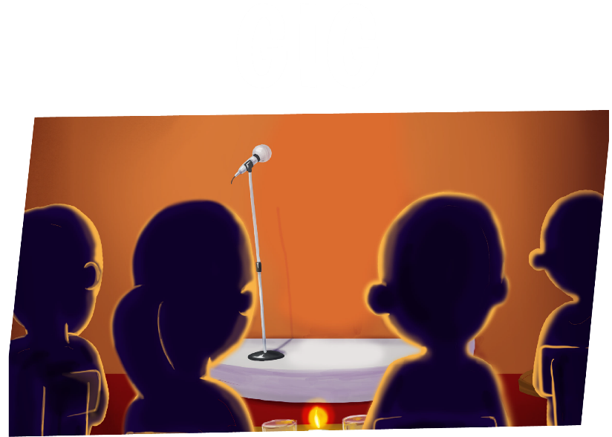
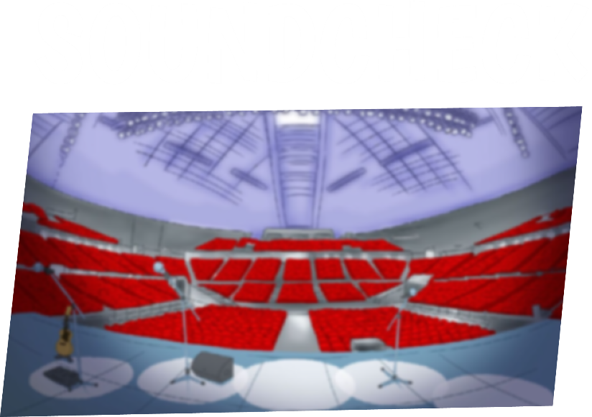
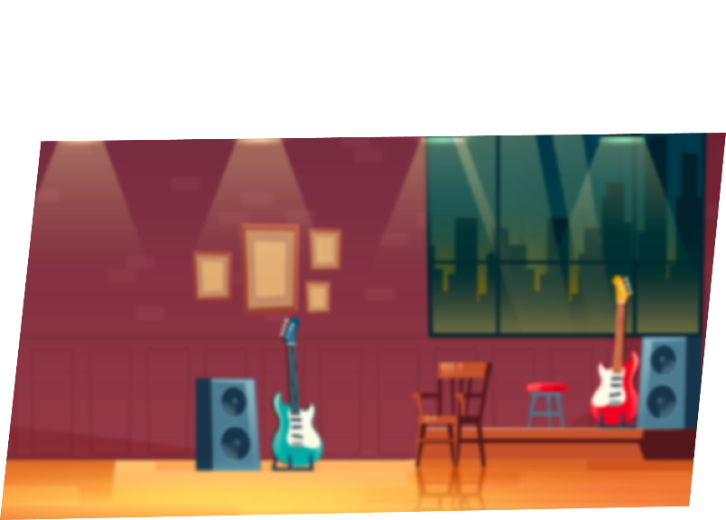
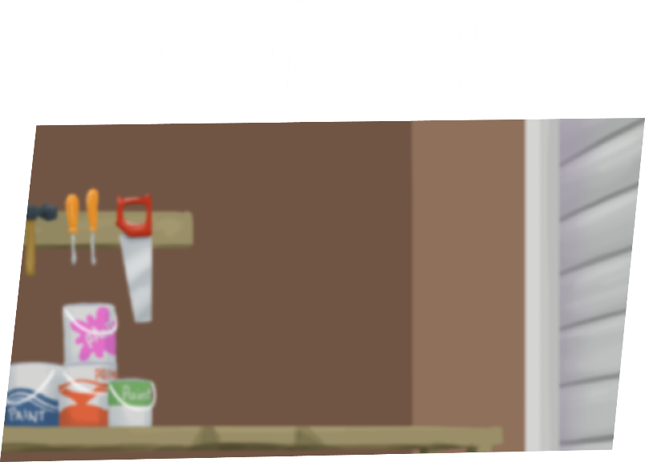

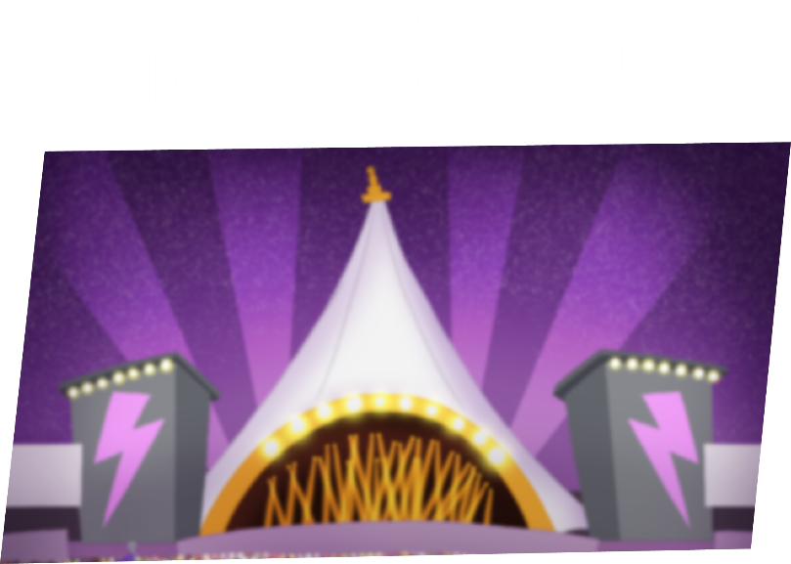
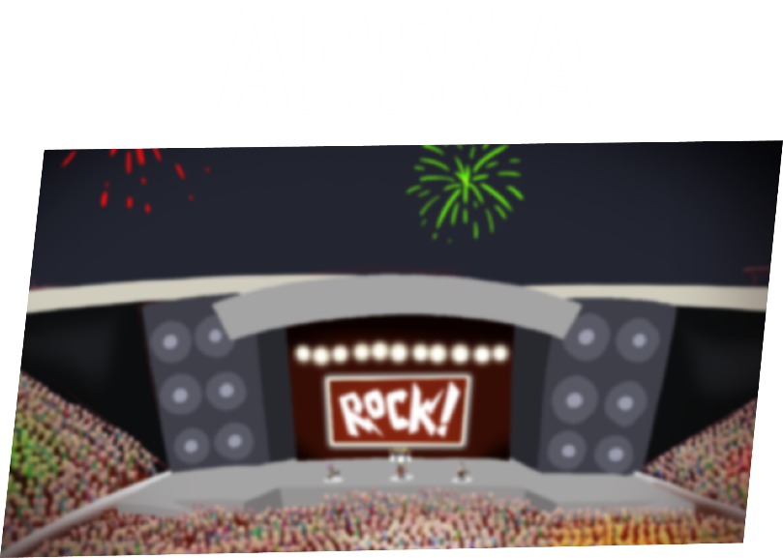
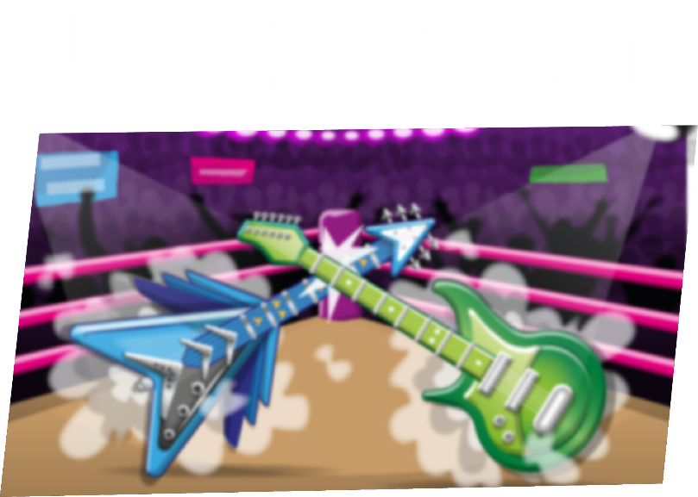
PLAY IN 8 DIFFERENT GAME MODES!
BEST FOR ONE GREAT PERFORMANCE EACH MONTH.
BEST FOR ANSWERING 25 QUESTIONS,
6 SECONDS EACH.
BEST FOR TAKING YOUR TIME TO GET THE RIGHT ANSWER.
BEST FOR COMPLETING YOUR HEATMAP.
BEST FOR GETTING A ROCK STATUS.
BEST FOR RACING PLAYERS AROUND THE WORLD.
BEST FOR RACING PLAYERS IN YOUR CLASS.
BEST FOR CHALLENGING A FRIEND OR TEACHER.
Notes:
Garage
Tables set by teacher
10 coins per correct answer
Studio
All tables
Set a Rock Status
1 coin per correct answers
Jamming
Tables set by children
10 questions, no timer
8 coins per correct answer
Soundcheck
25 questions
6 second timer per question
5 coins per correct answer
Festival
Play against others around the world
All tables
1 coin per correct answer
Arena
Play against others in your class
Tables set by teacher
1 coin per correct answer
Rock Slam
Challenge friends in the school to beat your score
1 coin per correct answer

Slide 5
SET A ROCK STATUS

Slide 6






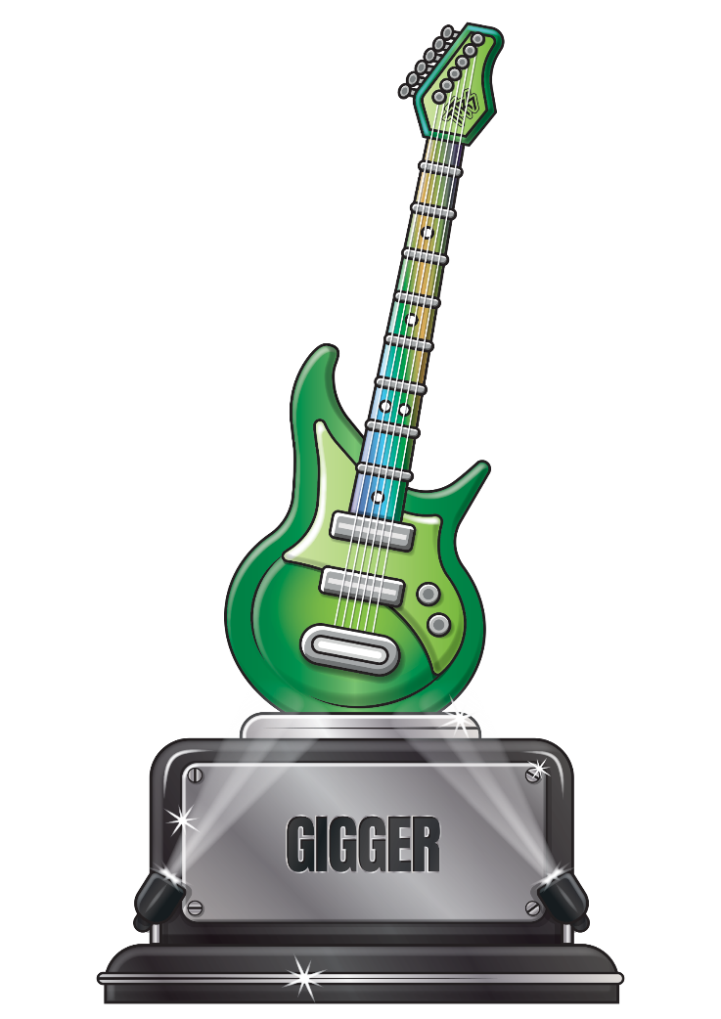


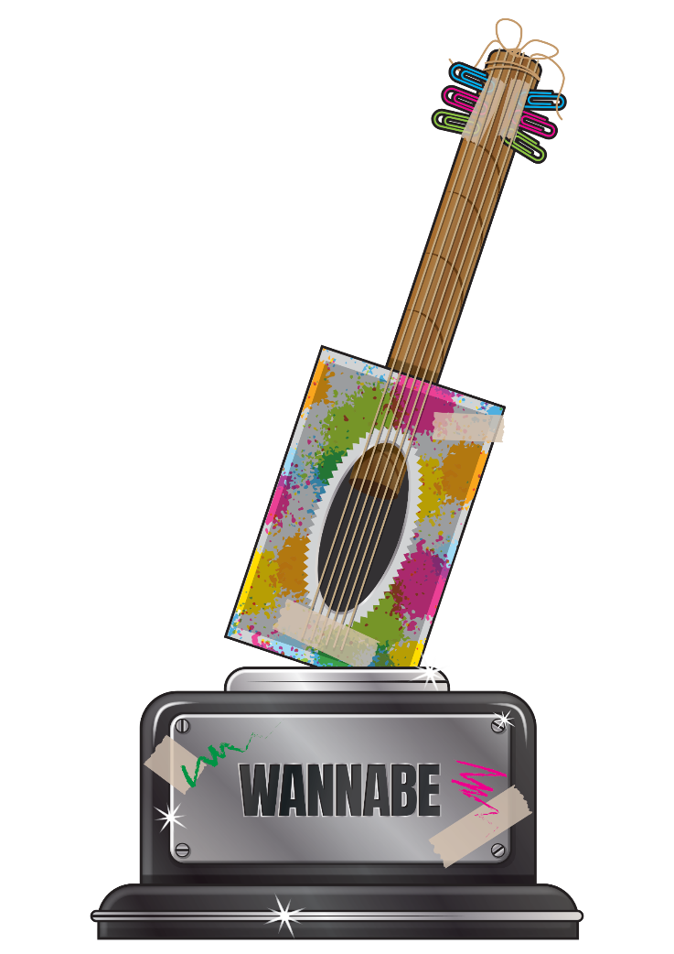

GARAGE ROCKER
UNDER 10 SECONDS PER QUESTION
UNSIGNED ACT
UNDER 7 SECONDS PER QUESTION
ROCK LEGEND
UNDER 2 SECONDS PER QUESTION
BREAKTHROUGH ARTIST
UNDER 6 SECONDS PER QUESTION
ROCK HERO
UNDER 1 SECOND PER QUESTION
HEADLINER
UNDER 4 SECONDS PER QUESTION
WANNABE
OVER 10 SECONDS PER QUESTION
ROCK STAR
UNDER 3 SECONDS PER QUESTION
SUPPORT ACT
UNDER 5 SECONDS PER QUESTION
GIGGER
UNDER 8 SECONDS PER QUESTION
BUSKER
UNDER 9 SECONDS PER QUESTION

Slide 7
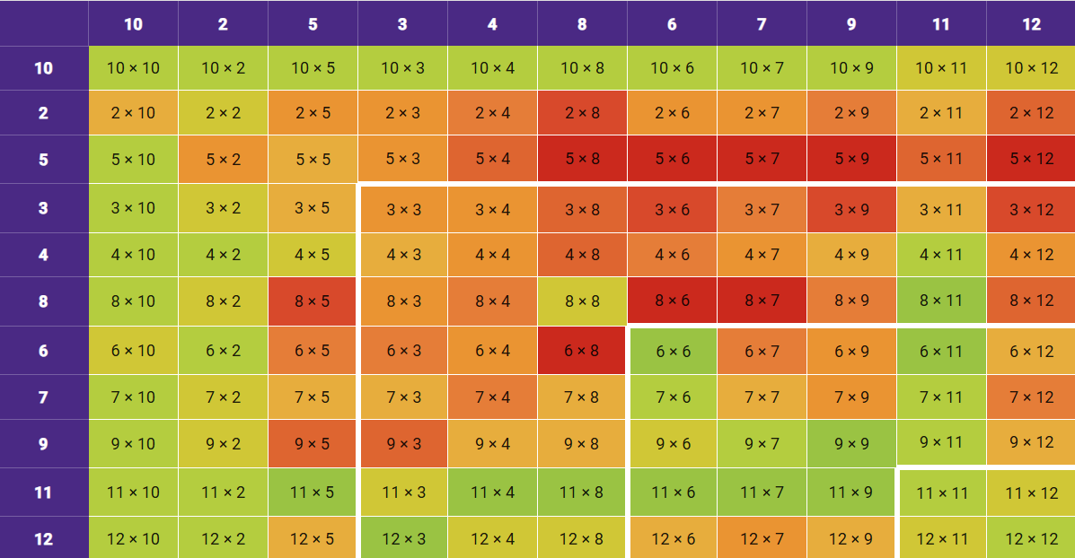
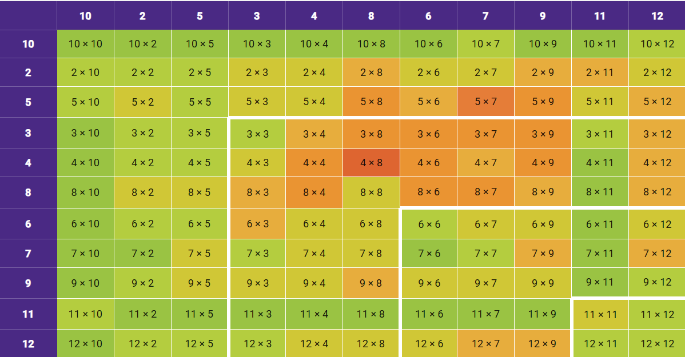
Heatmaps
Name/My Stats/Fluency/Heat map
Time slider shows progression each child makes
Notes:
Garage
Tables set by teacher
10 coins per correct answer
Studio
All tables
Set a Rock Status
1 coin per correct answers
Jamming
Tables set by children
10 questions, no timer
8 coins per correct answer
Soundcheck
25 questions
6 second timer per question
5 coins per correct answer
Festival
Play against others around the world
All tables
1 coin per correct answer
Arena
Play against others in your class
Tables set by teacher
1 coin per correct answer
Rock Slam
Challenge friends in the school to beat your score
1 coin per correct answer

Slide 8
Little and often approach
5 minutes per night Monday – Friday
Reading records
Children record how many minutes they have spent each night on TT Rockstars as well as reading in records. (We ask that these are signed each day by parents.)
Notes:
Garage
Tables set by teacher
10 coins per correct answer
Studio
All tables
Set a Rock Status
1 coin per correct answers
Jamming
Tables set by children
10 questions, no timer
8 coins per correct answer
Soundcheck
25 questions
6 second timer per question
5 coins per correct answer
Festival
Play against others around the world
All tables
1 coin per correct answer
Arena
Play against others in your class
Tables set by teacher
1 coin per correct answer
Rock Slam
Challenge friends in the school to beat your score
1 coin per correct answer

Slide 9




