Slide 1

Times Tables
at Home

Slide 2

TT Rockstars
5-10 minutes regularly throughout the week.
Timed activities in preparation for end of Year 4 times tables test.
Multiplication and Division
Arithmetic

Slide 3
Anchor Numbers
1x – The number itself
2x – Double the number
3x – double the number and add itself
4x – Double the double
5x – ANCHOR NUMBER
6x – Anchor add itself
7x – Anchor add the double
8x – Double, double, double
9x – Anchor subtract itself
10x – ANCHOR NUMBER
11x – Anchor add itself
12x – Anchor add the double

Slide 4
Anchor Numbers
1x – The number itself - 7
2x – Double the number – Double 7 = 14
3x – double the number and add itself – 14 + 7 = 21
4x – Double the double – 14 + 14 = 28
5x – ANCHOR NUMBER - 35
6x – Anchor add itself – 35 + 7 = 42
7x – Anchor add the double - 35 + 14 = 49
8x – Double, double, double – 14, 28, 56
9x – Anchor subtract itself – 70 – 7 = 63
10x – ANCHOR NUMBER - 70
11x – Anchor add itself – 70 + 7 = 77
12x – Anchor add the double – 70 + 14 = 84

Slide 5
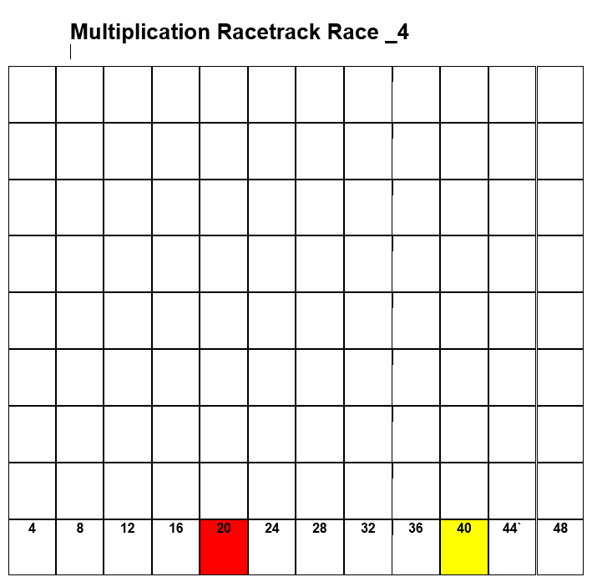
Racetrack
Arithmetic knowledge and mental
multiplication
Encourages reading out of
calculations to support long
term memory.
Can be played in a variety of ways.

Slide 6
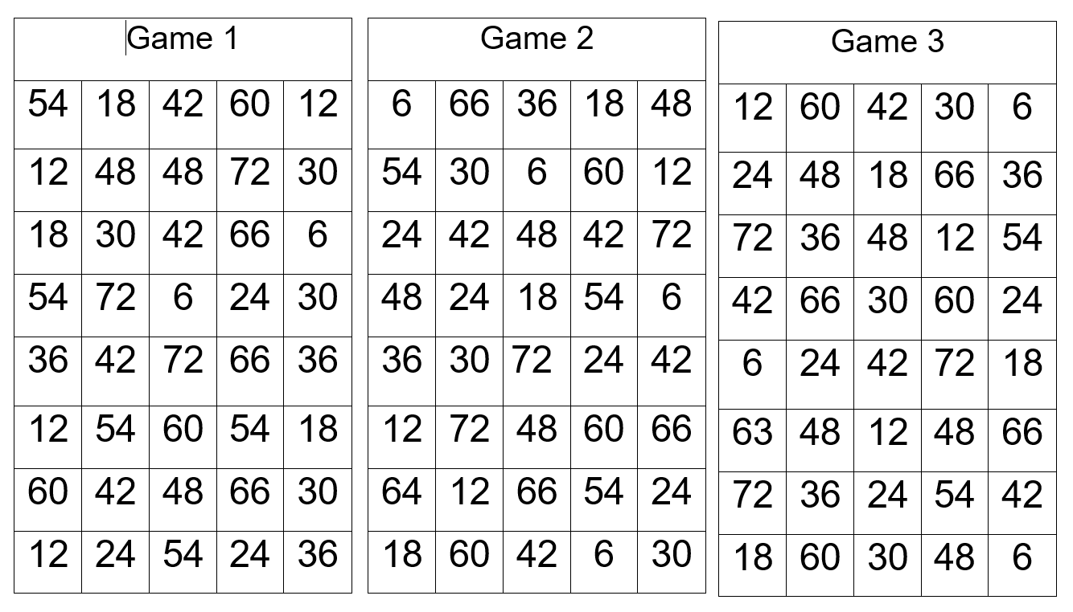
Connect 4
Mental arithmetic
Mathematical Vocabulary –
Factors and Multiples
Encourages reasoning skills
by thinking about what factor
might be needed to win.

Slide 7
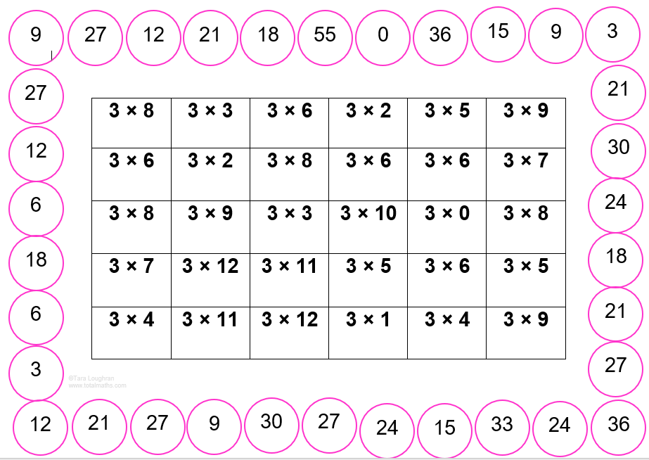
Find the Calculation
Player starts at a chosen number on the outside
of the grid.
Roll a 1-12 dice or two standard and add these.
Find the calculation to the answer.
Encourage use of multiples Eg. “They are all multiples
of 3. 24 is a multiple of 3 and 8.
Variety of ways to play in a row.
Choose direction to support reasoning skills.
Supports knowledge of missing digit calculations
E.g. 3 x ? = 33

Slide 8
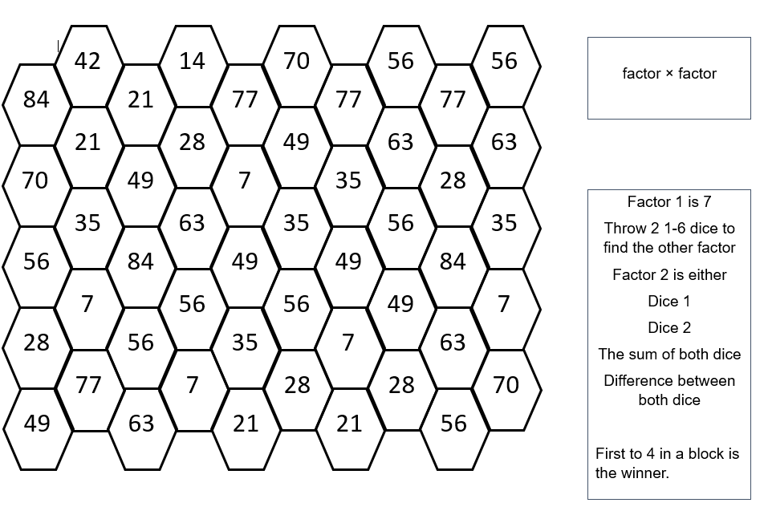
Side Move
Reasoning involving simple addition and subtraction.
Encourages vocabulary of multiples and factors.
Choose whether to add dice together, find the
difference between them or choose one.
Encourage vocabulary – “I’m going to find the difference by subtracting,” or “I’m going to take away 2 from 5 because 3 is the factor of 21 that I need.”

Slide 9
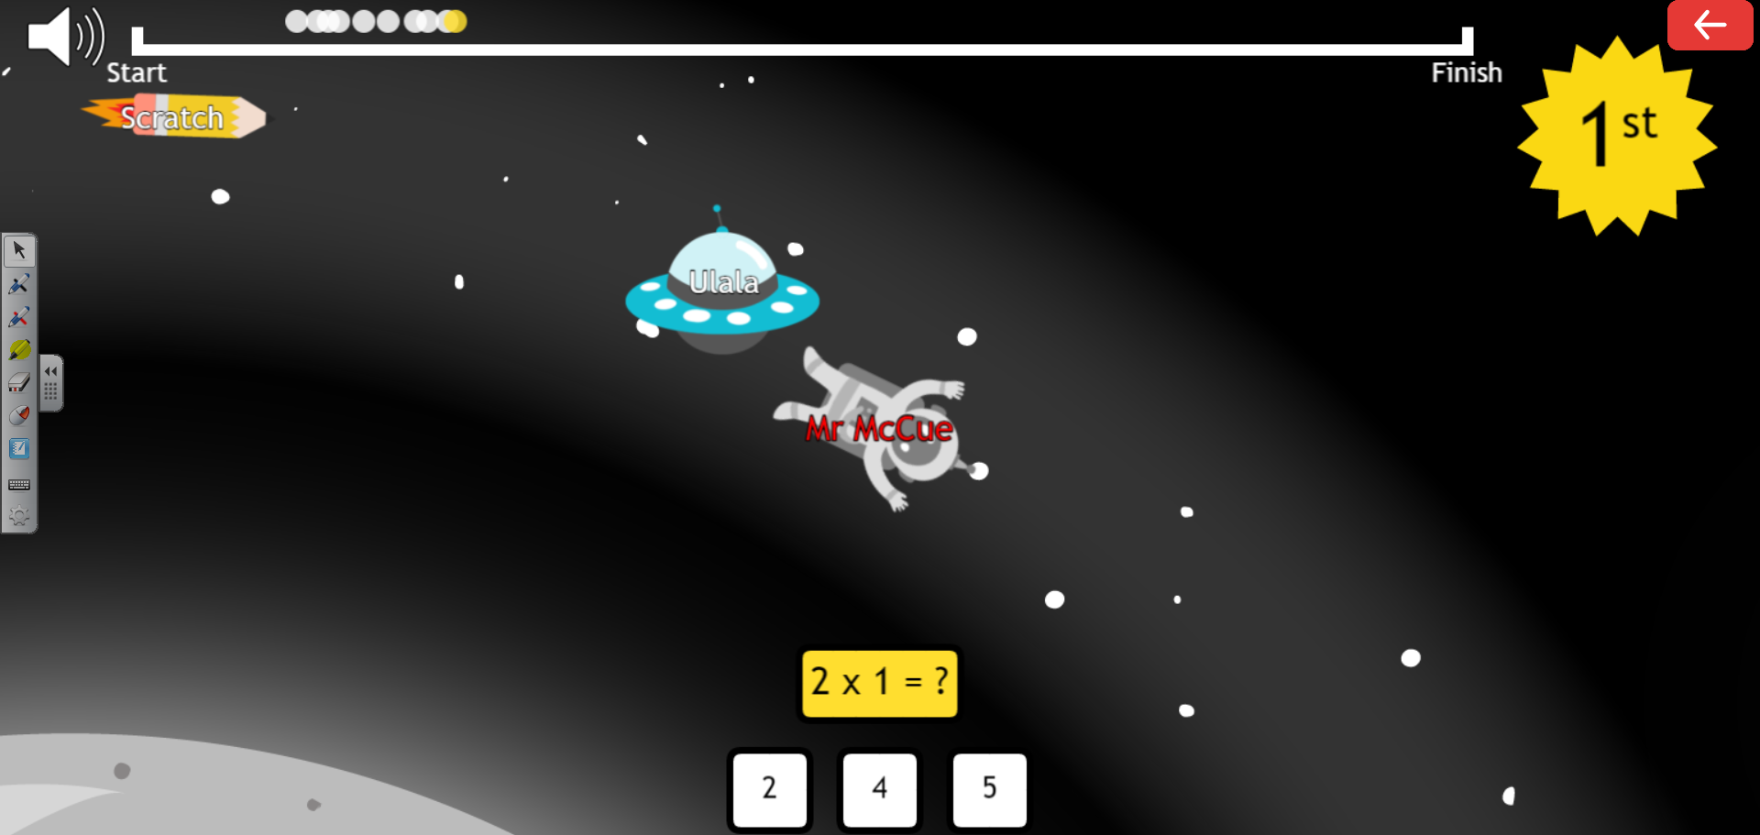
PurpleMash
2Race
Play against friends online.
Create your own game room.
Supports Arithmetic and Reasoning.
Covers four operations as well as number bonds.

Slide 10
Questions

