Slide 1
Supporting Early Writing in Reception
Drawing Club, Motor Skills & Read Write Inc
Notes:
Explain that writing is a journey. We focus on building strong foundations first, so children are confident, capable writers later.

Slide 2
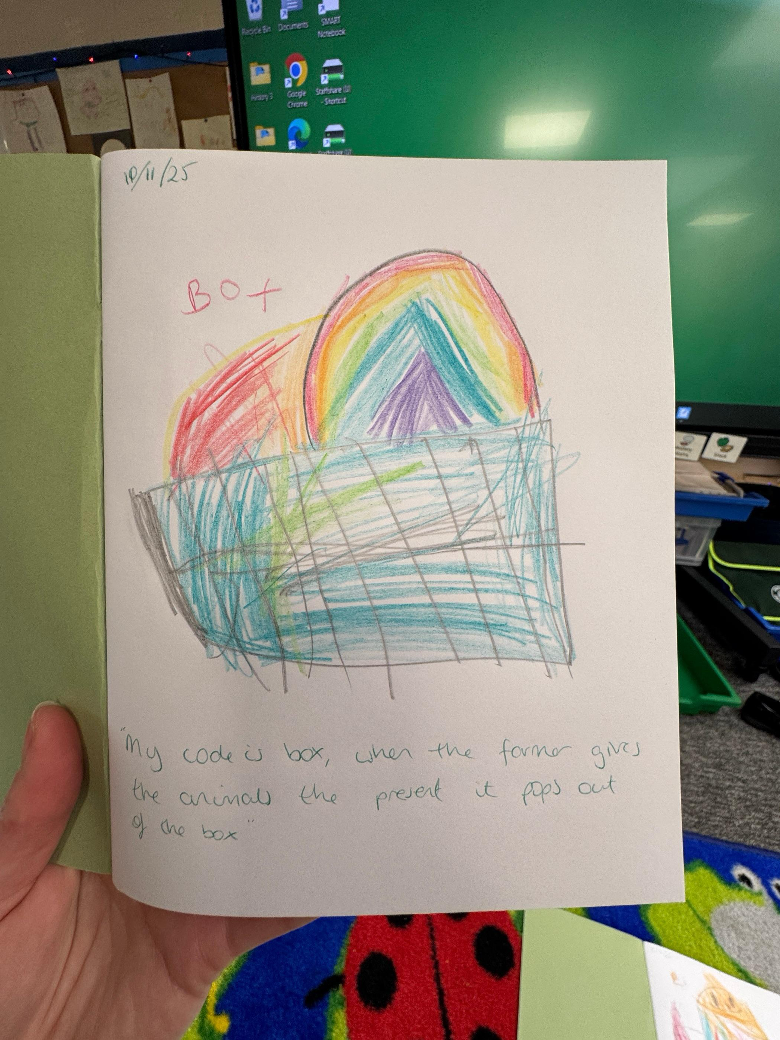
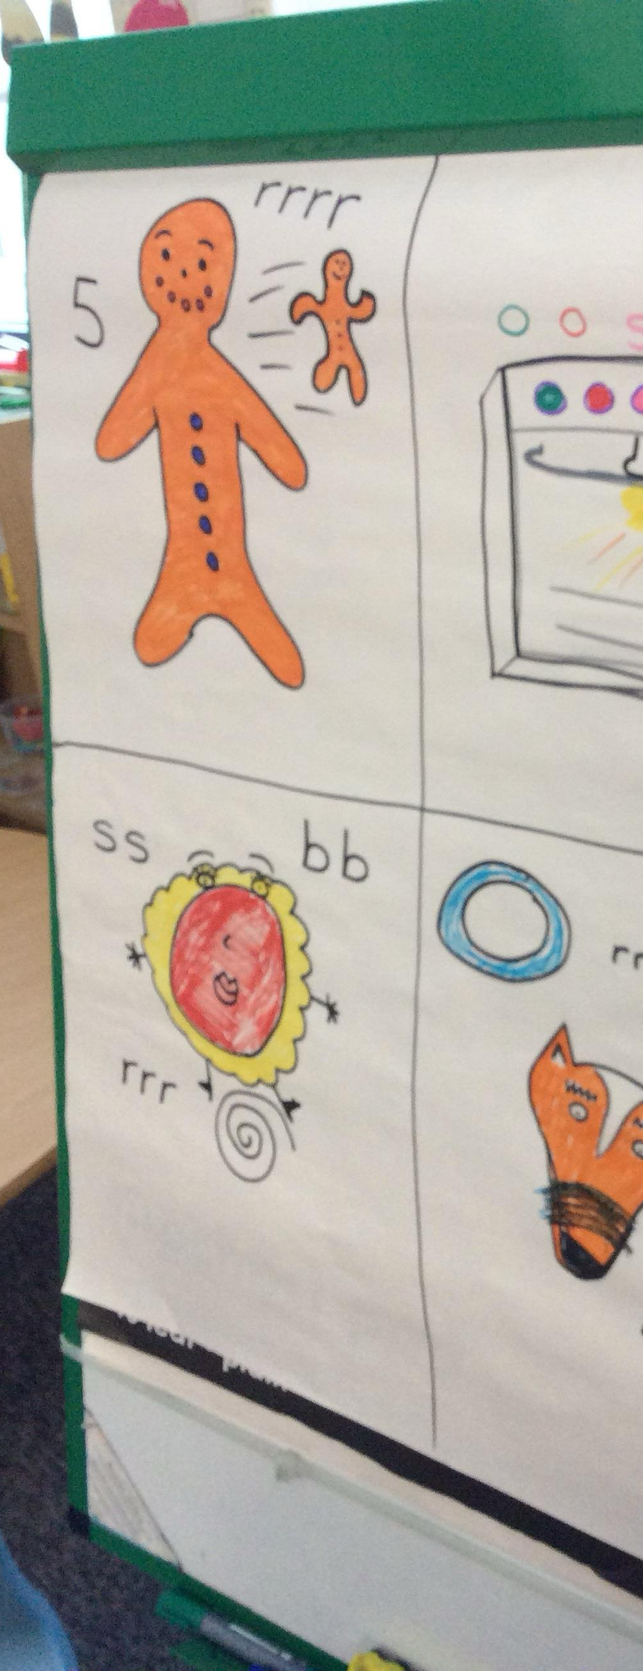
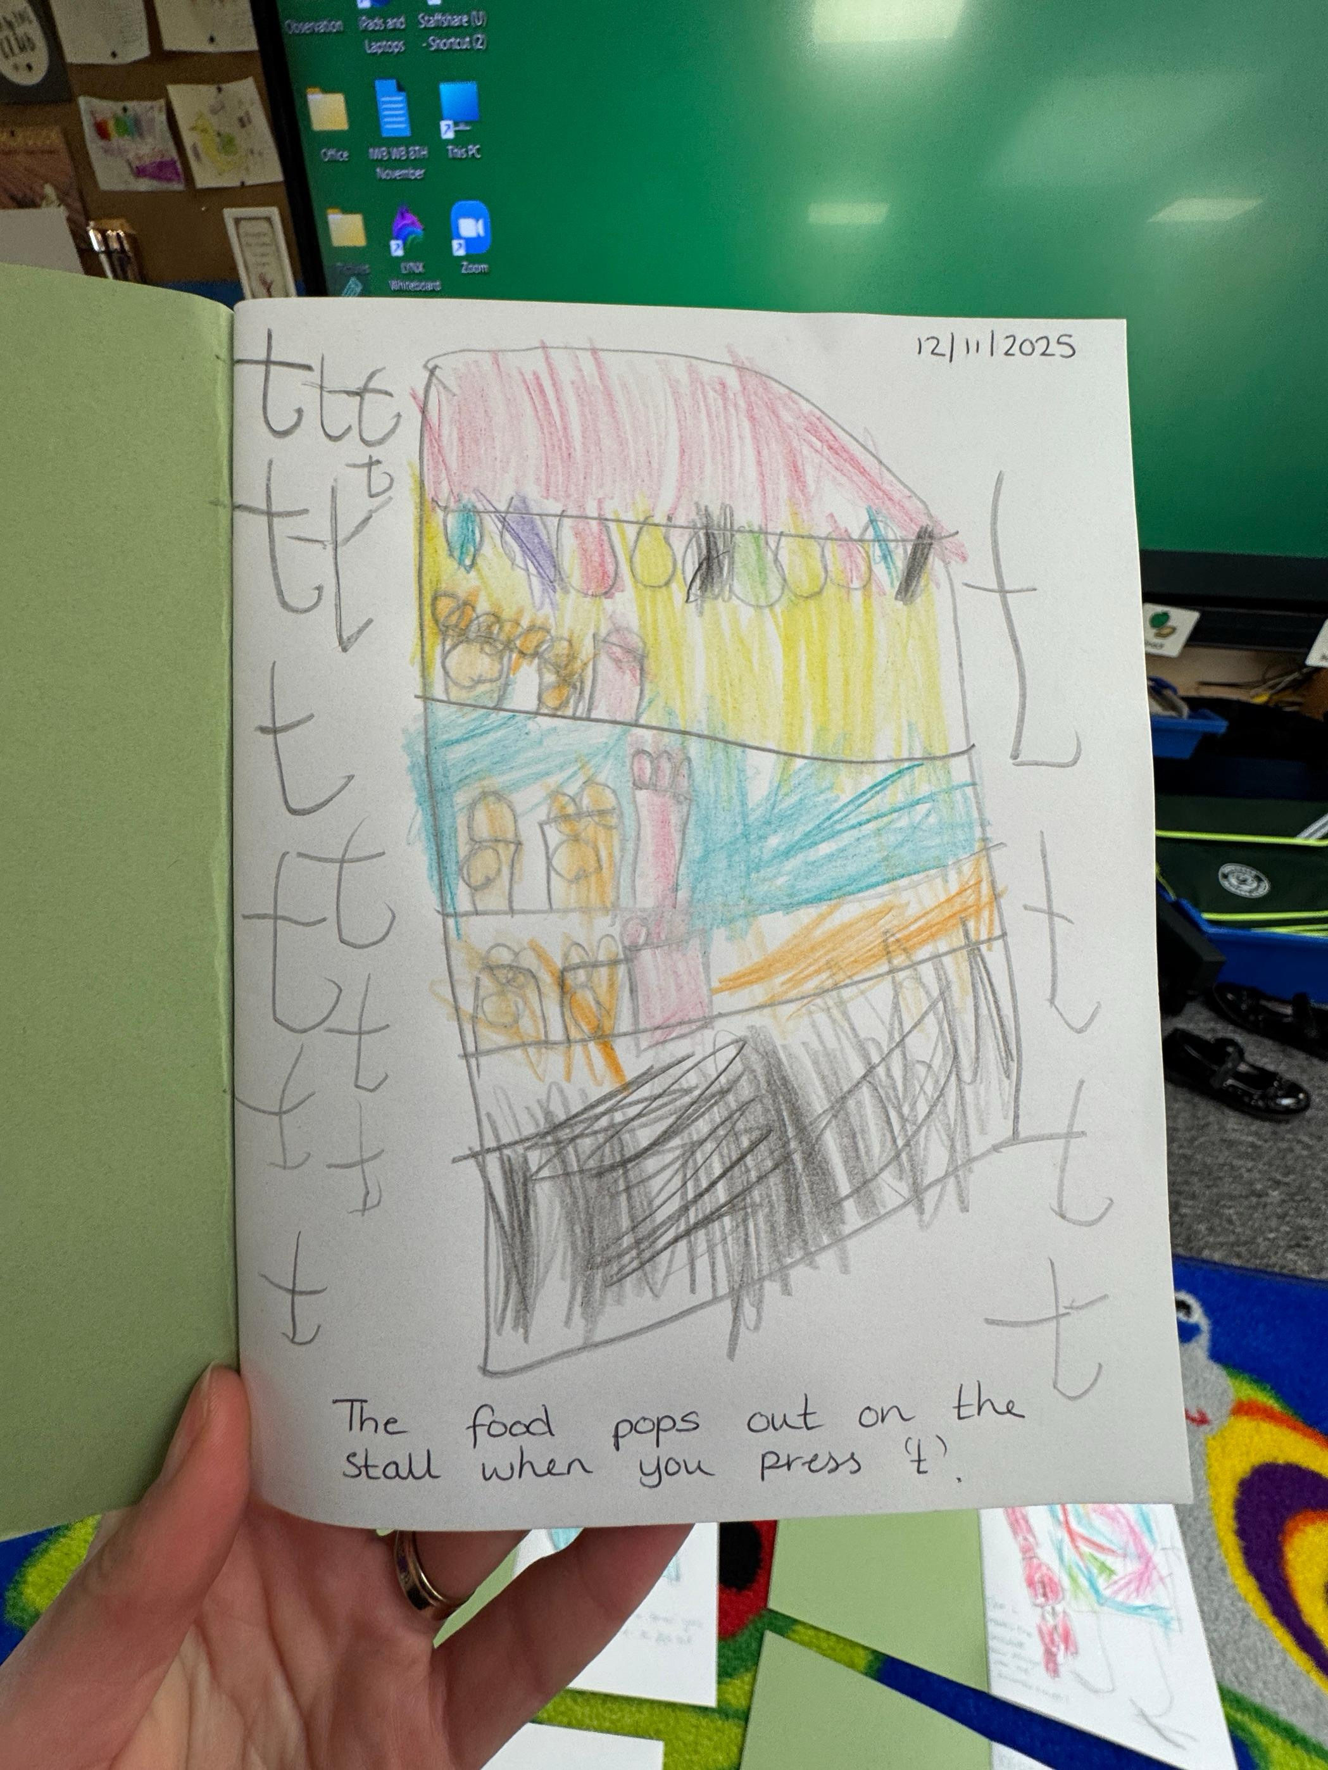
What is Drawing Club?
A daily approach built around stories and imagination
  Children draw characters, settings and adventures
  Adults model vocabulary and talk about ideas
Notes:
Emphasise enjoyment. Children are not expected to write sentences. Drawing Club builds language, confidence and meaning first.

Slide 3
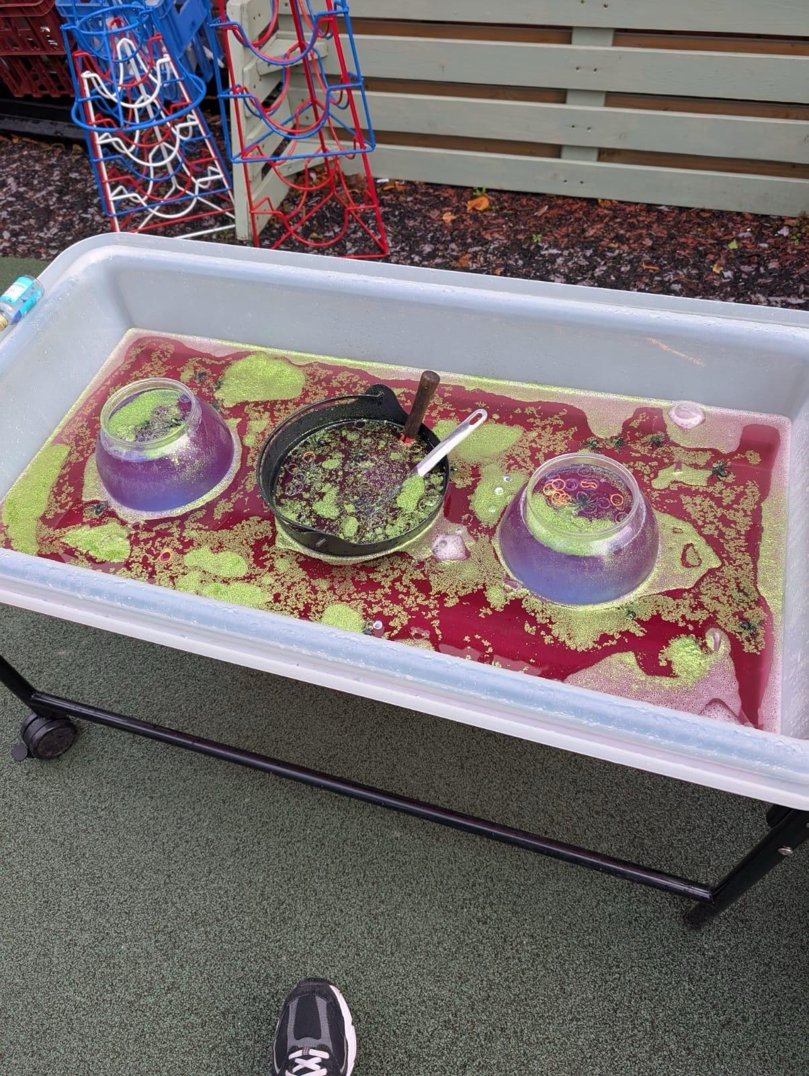
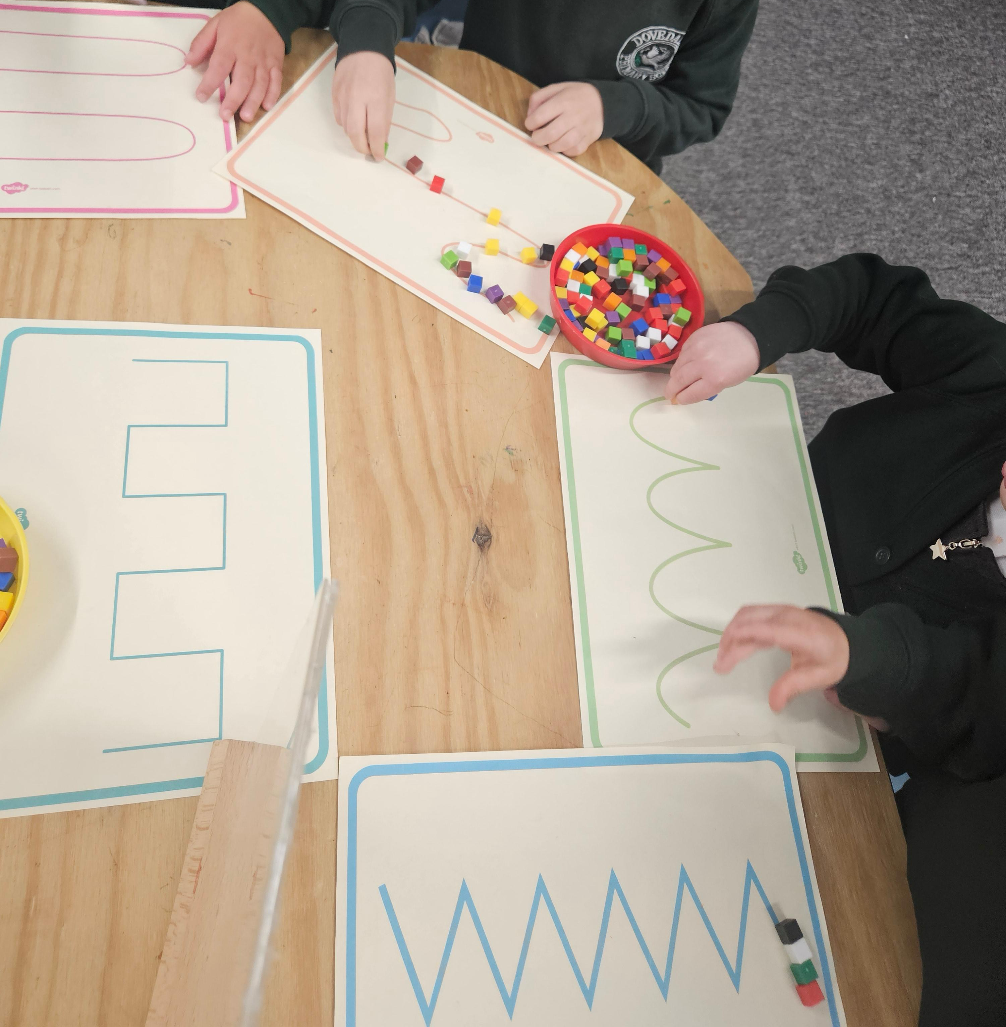
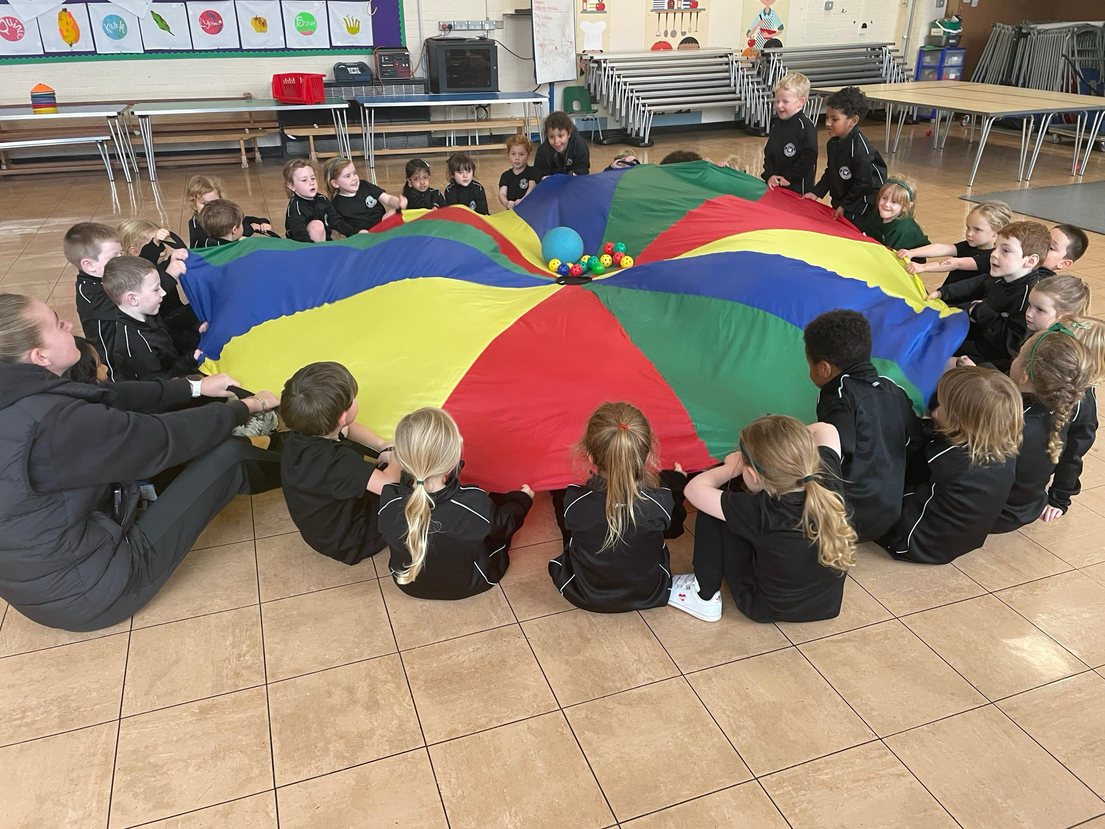
Gross & Fine Motor Skills
Writing depends on strong bodies and hands
  Gross motor = big movements (arms, shoulders, core)
  Fine motor = small, controlled finger movements
Notes:
Use this slide to reassure parents that play is purposeful and essential.

Slide 4
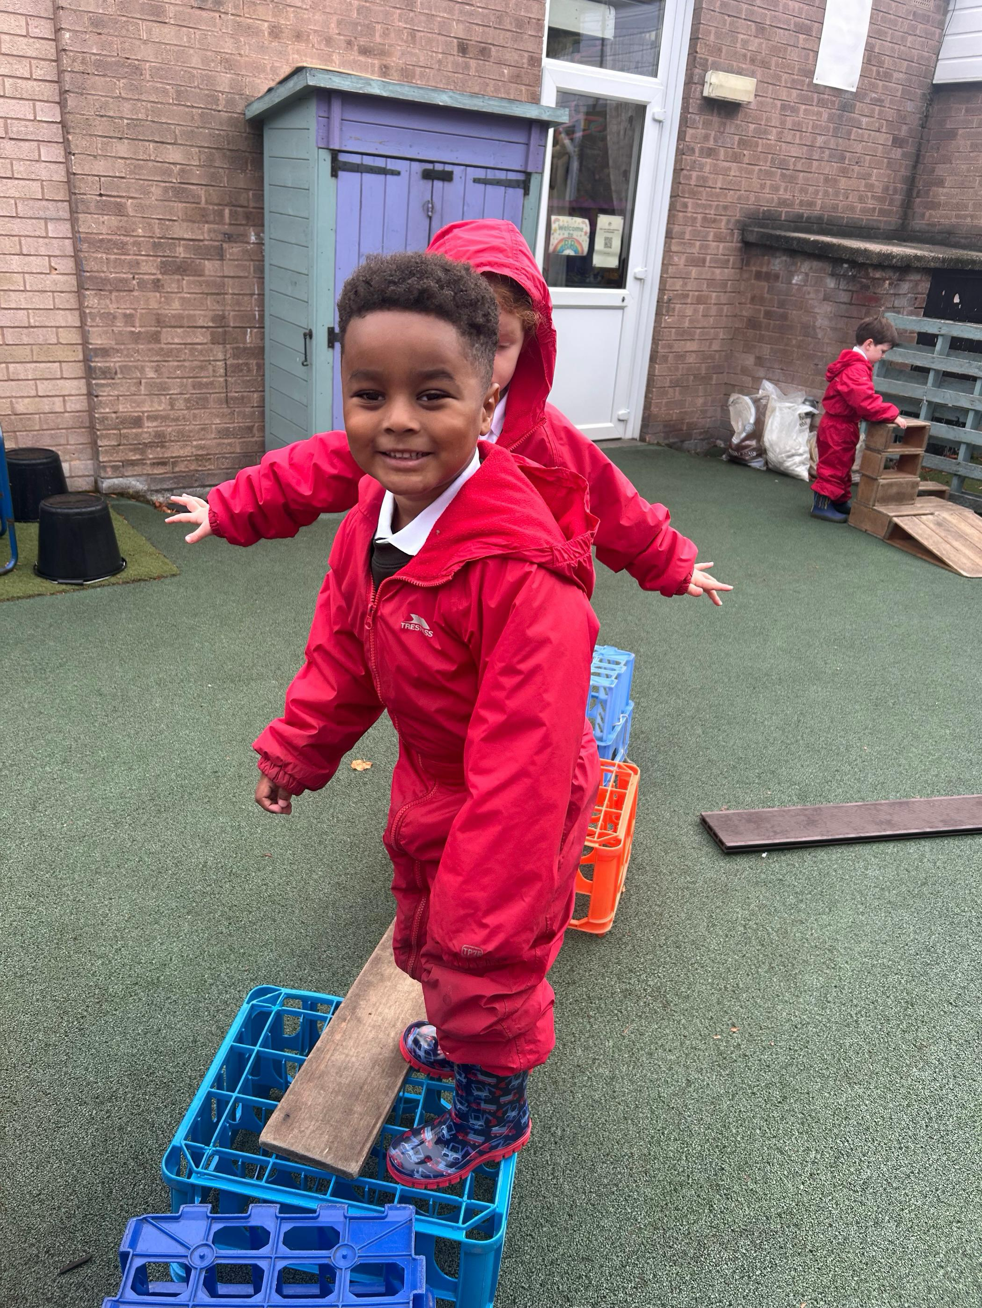
Gross Motor Activities
Climbing, crawling and balancing
  Throwing, catching and large-scale mark making
  Supports posture and stamina for writing
Notes:
Children need strong shoulders and core muscles to sit and write comfortably.

Slide 5
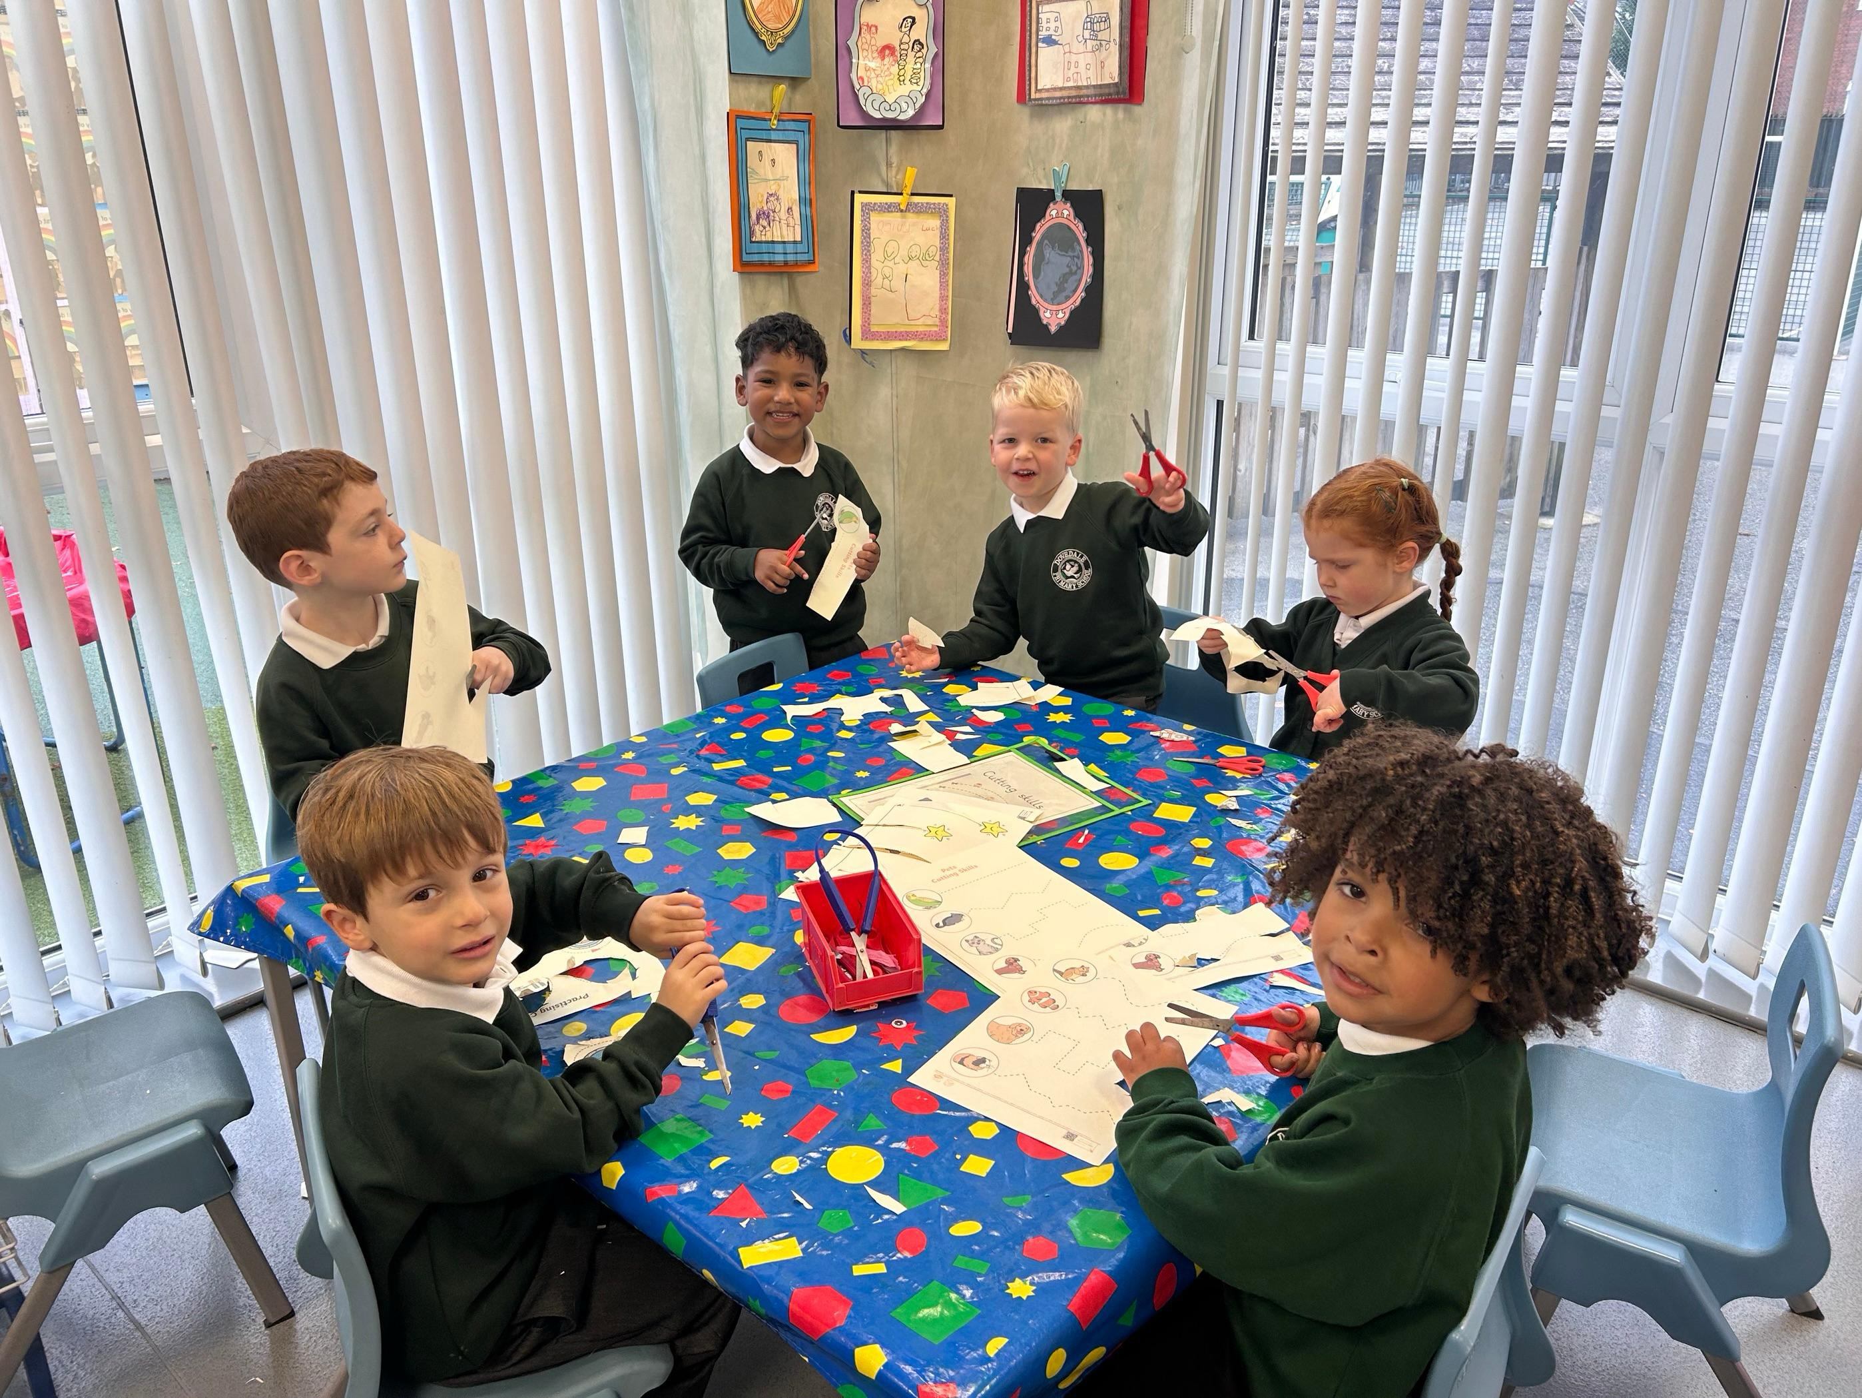
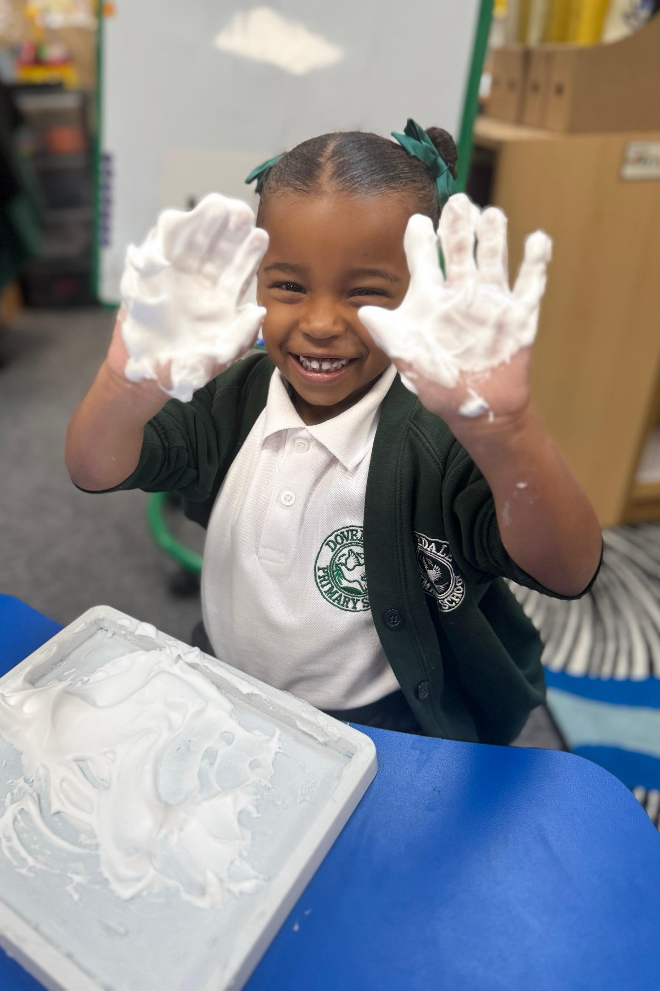
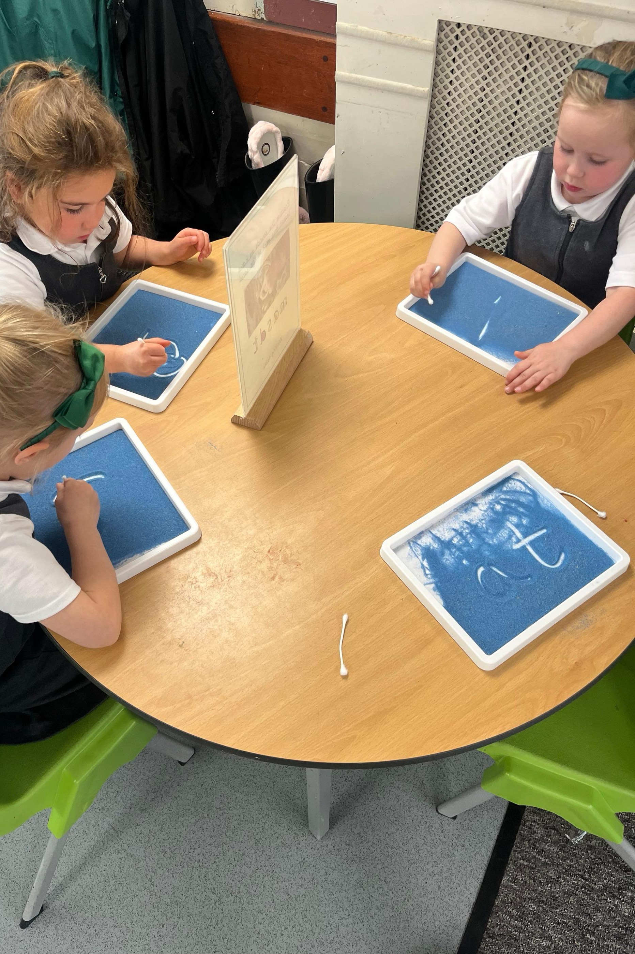
Fine Motor Activities
Playdough, tweezers, threading and pegs
  Cutting, squeezing and building
  Develops pencil control and grip
Notes:
These activities strengthen the small muscles in the hands and fingers.

Slide 6
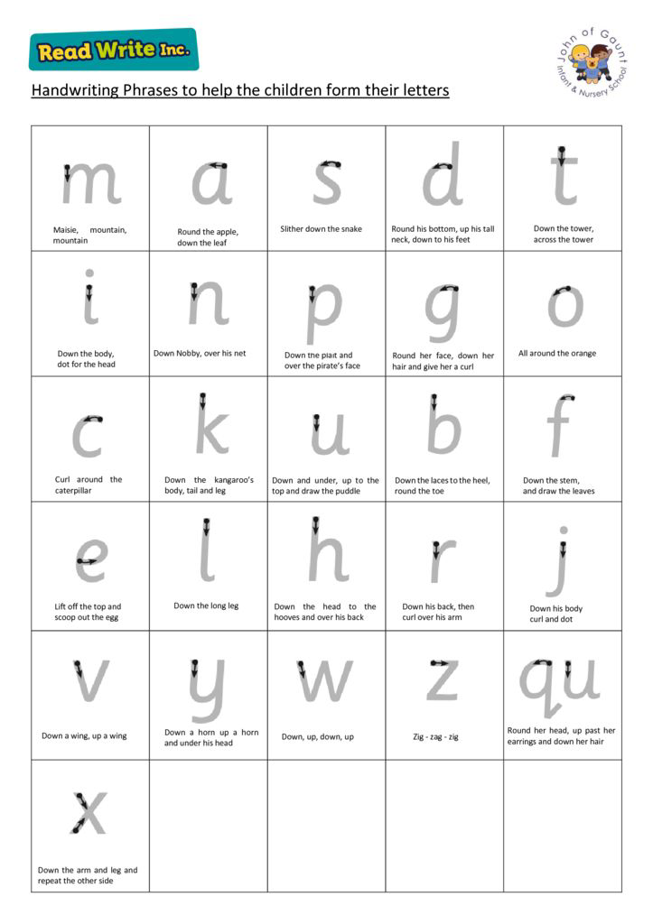
Read Write Inc Letter Formation
Clear, consistent rhymes for each letter
Teaches correct starting points and direction
Supports confident, fluent handwriting
Notes:
Explain that correct formation early prevents difficulties later.

Slide 7
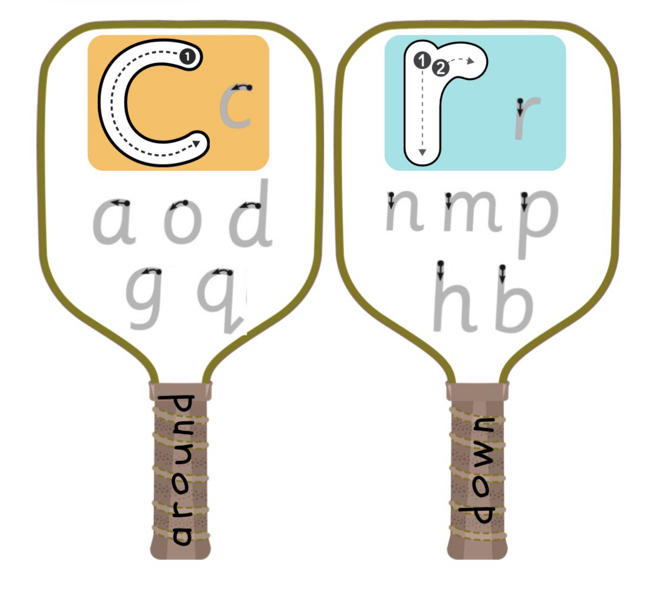
Read Write Inc Letter Families
Around letters: c a d g o q
Down letters: r n m p b h k t i j u y
Zig Zag : v w x z
Notes:
Children learn movement patterns rather than individual letters in isolation.

Slide 8
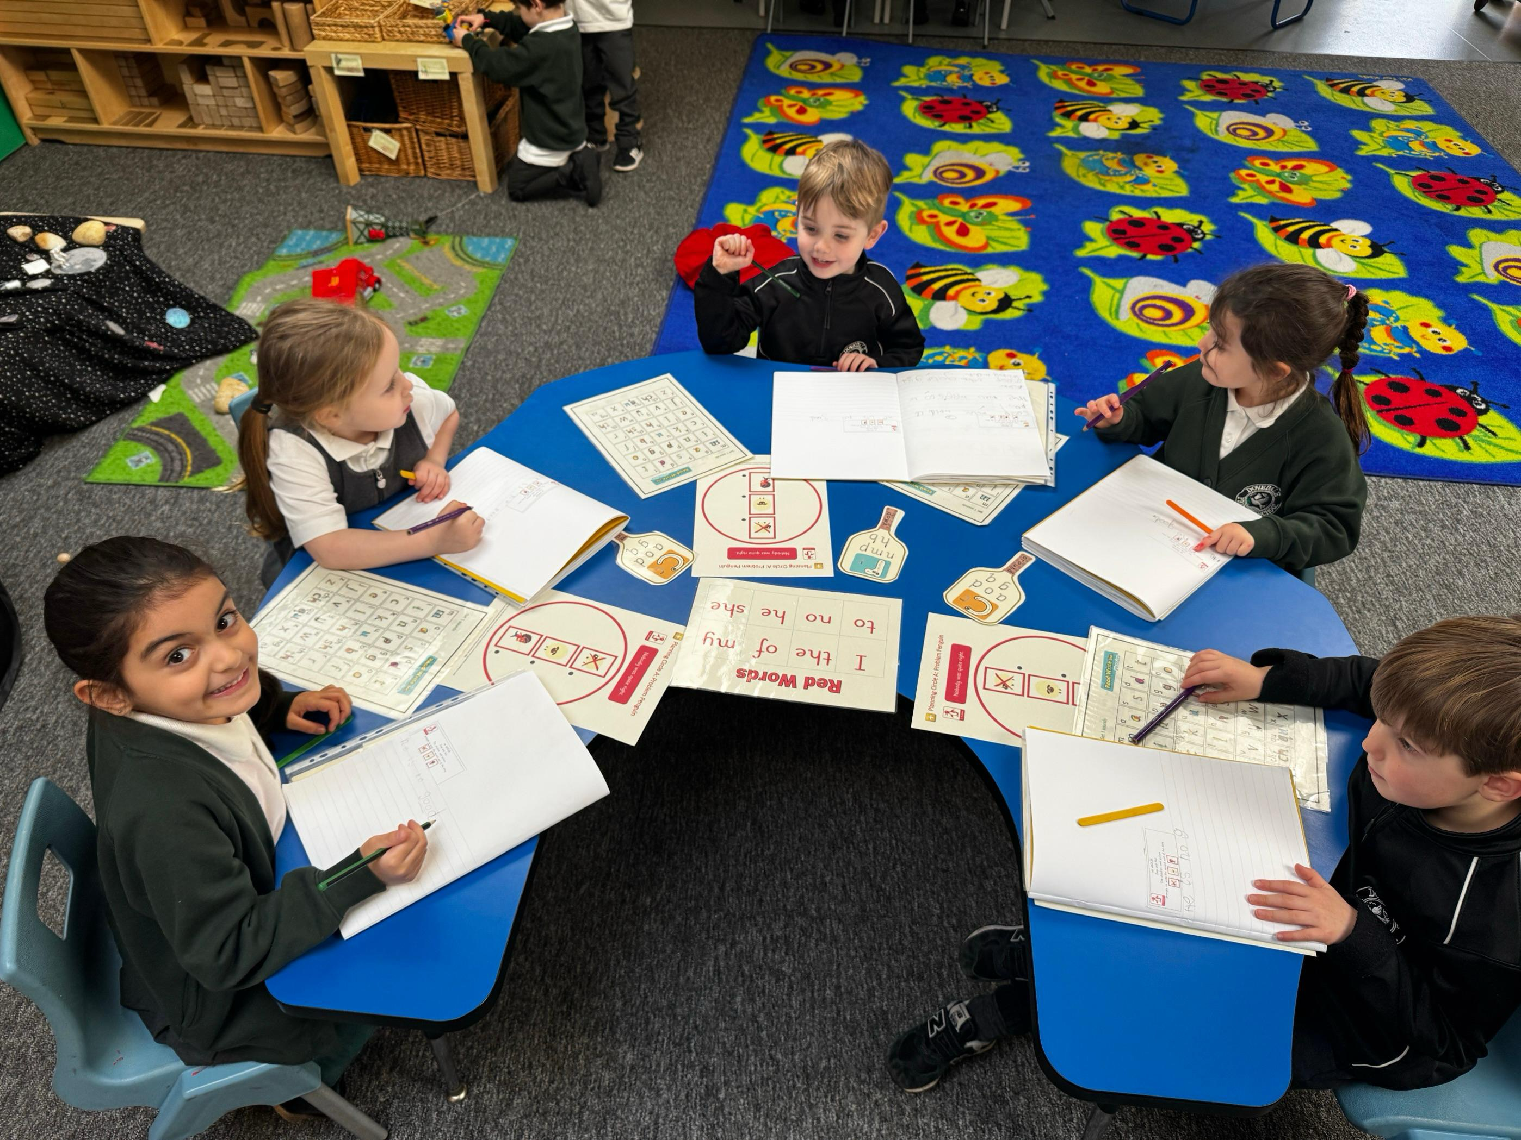
Ready Steady Write
Prepares children for writing
Focus on posture, pencil grip and control
Builds correct habits from the start
Structure of stories and comprehension
Notes:
We do not rush children into writing letters before they are ready.

Slide 9
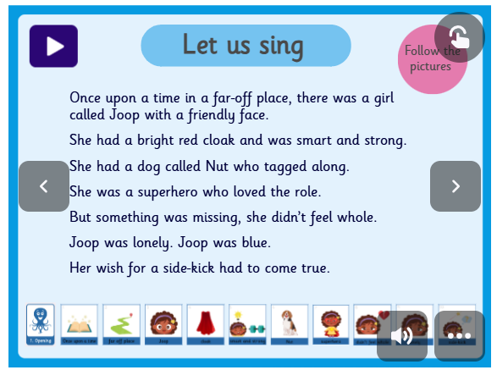
Ready Steady Write
Notes:
We learn the story through song.

Slide 10
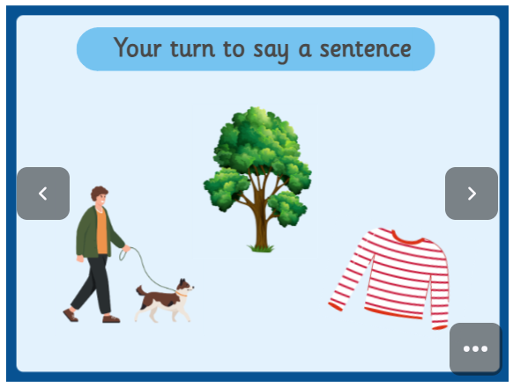
Ready Steady Write
Notes:
Children practise orally composing sentences.

Slide 11
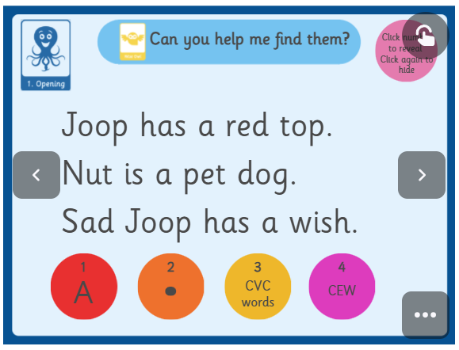
Ready Steady Write
Notes:
Wise Owl teaches us what we need to include to write a good sentence.

Slide 12
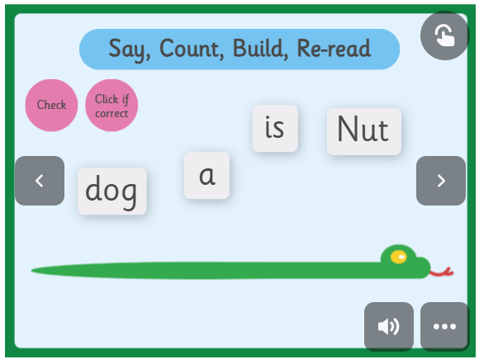
Ready Steady Write
Notes:
Sentence snakes help us to think about the order of words in a sentence.

Slide 13
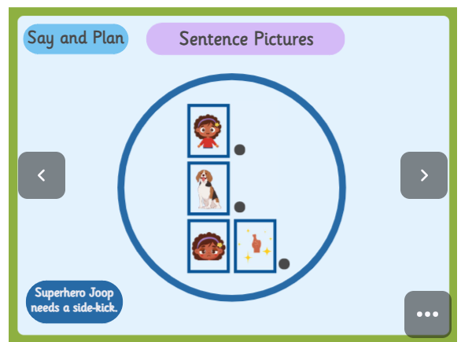
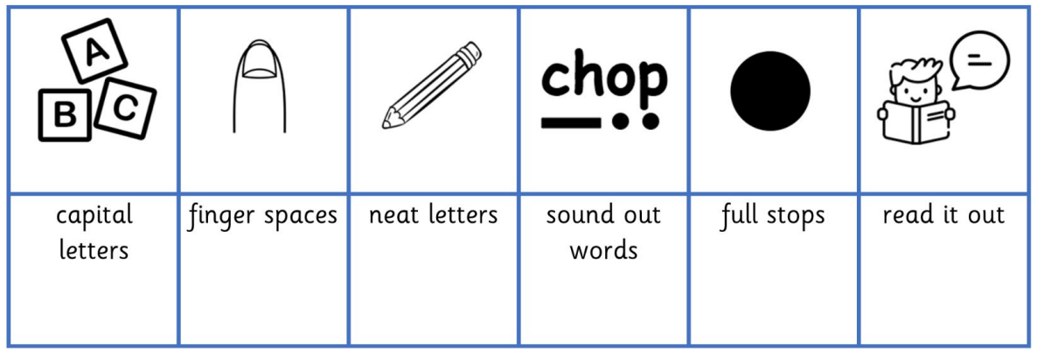
Notes:
Picture prompts represent sentences.

Slide 14



Popcorn Sentences
Notes:
We do not rush children into writing letters before they are ready.

