Slide 1


Welcome to EYFS
Mrs Ellison & Mrs Wright (Oak Class)
Miss Allenden (Elm Class)
Additional Adults – Mrs Bell, Mr Biddle,
Ms Williams, Mrs Gould

Slide 2
Wednesday 18th October
School Day
School Assessments
Phonics
Reading Books
How you can help at home
Q&A

Slide 3
School Day
Drop off and Pick Up
Snack Time
Dough Disco
Adventure Time – Rainbow Challenges
Maths
Talk for Writing

Slide 4
School Assessments
Teacher Judgements
Statutory Reception Baseline – on entry
Wellcomm – on entry and again as needed
Read, Write Inc (Phonics) – half termly
NELI

Slide 5
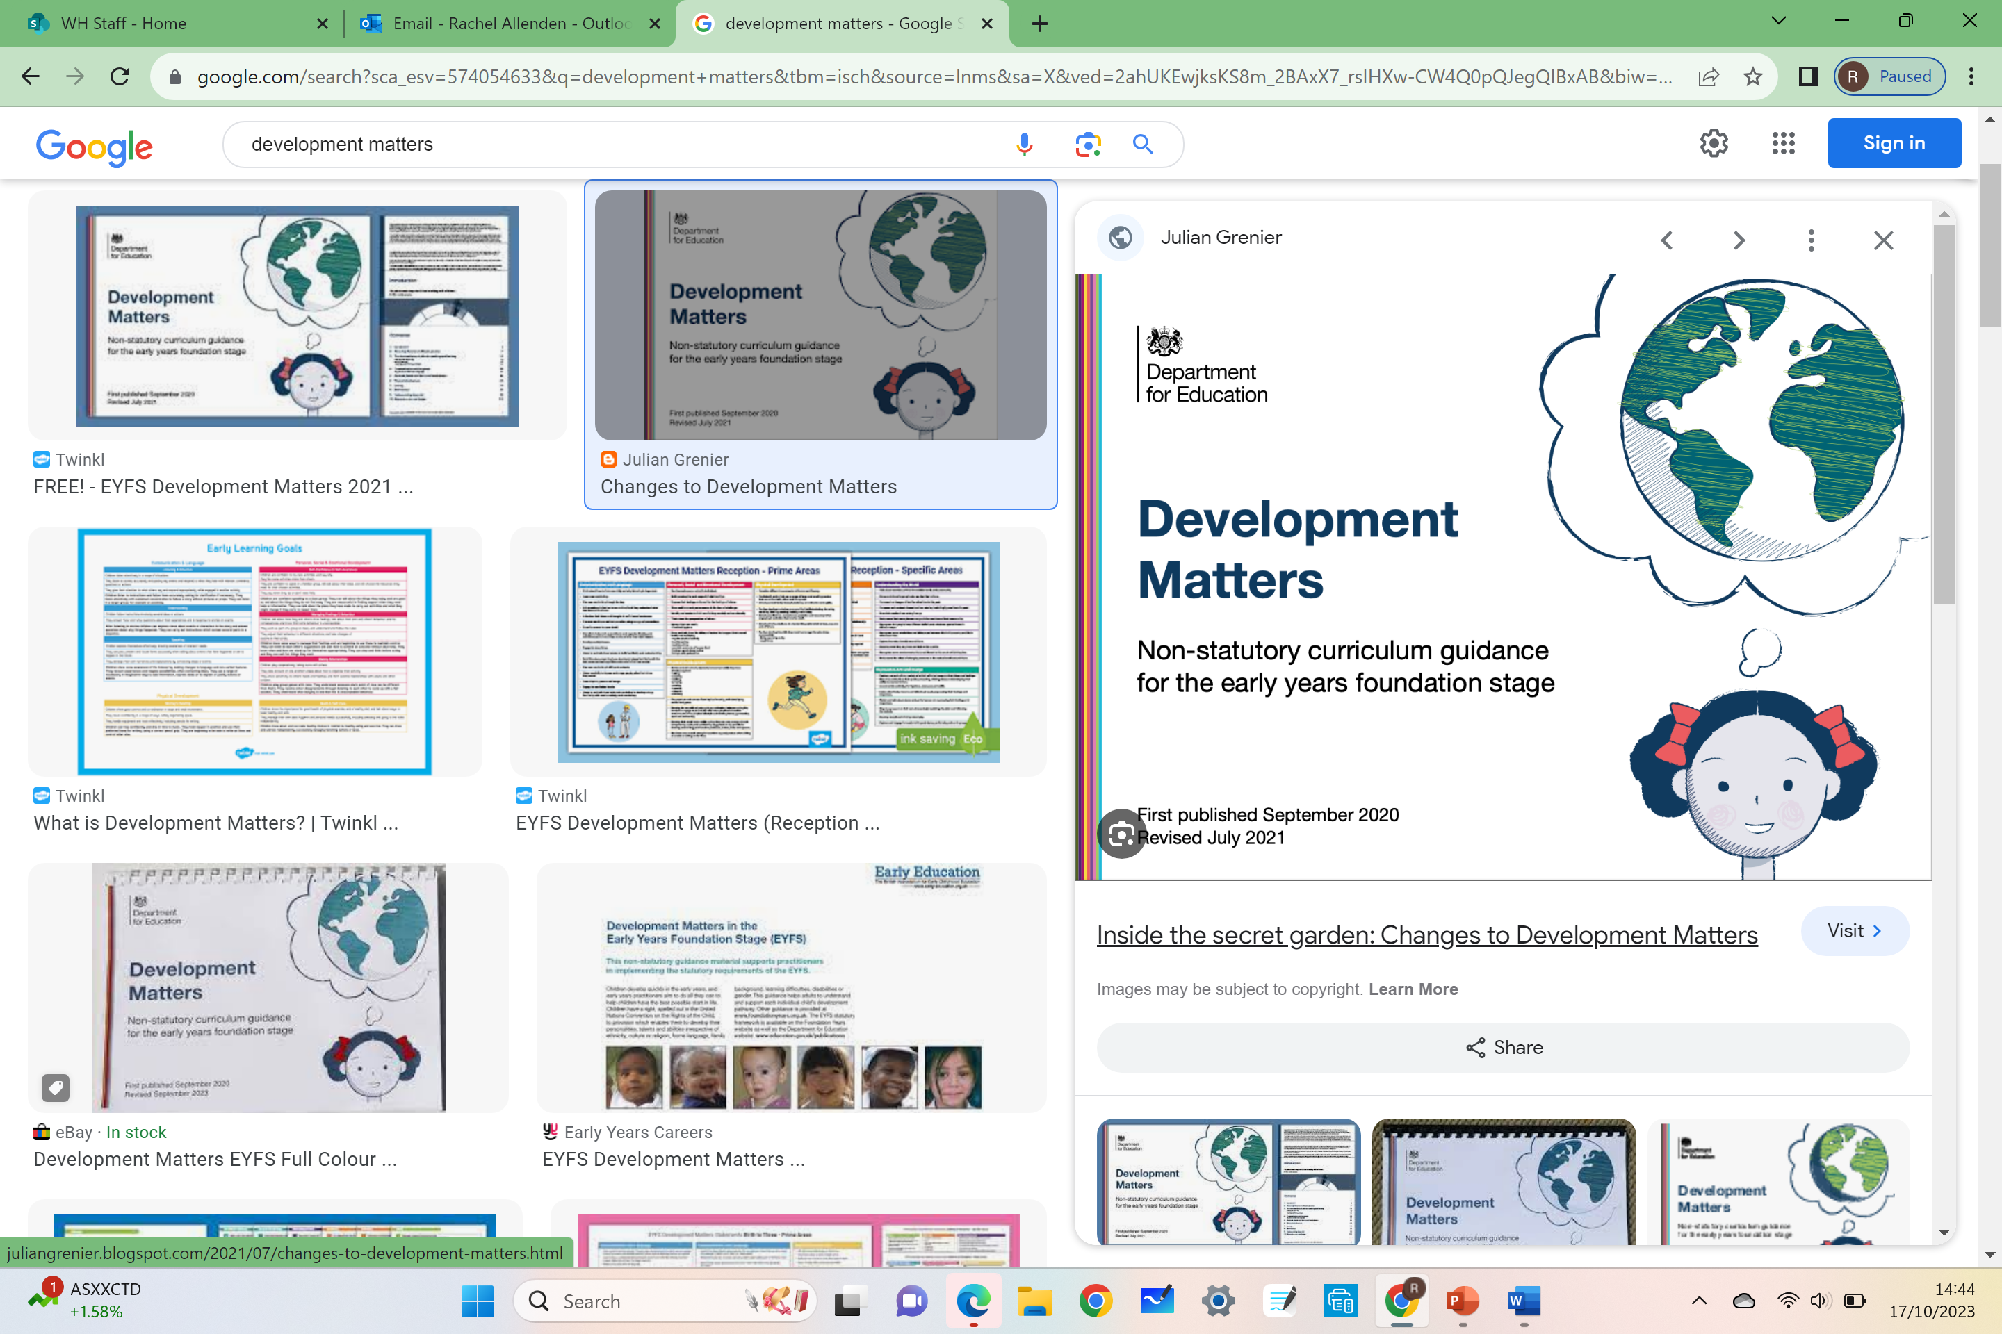
Our Curriculum
Until the end of Reception, the curriculum overlaps and matches the age of your child (0-3 Years, 3-4 Years, Reception, Early Learning Goals)
At the end of Reception, teachers will look at the areas of learning and assess whether they have met or are working towards the 17 Early Learning Goals. We then use this to say whether they have achieved a ‘Good Level of Development’ (GLD).
Our curriculum follows the children’s interests, but aims to develop the skills outlined in ‘Development Matters’ which gives a broad picture of skills your child needs to acquire to achieve GLD.

Slide 6
Areas of Learning and Development
Prime Areas
Personal, Social and Emotional Development |  | Physical Development |  | Communication and Language
Self-regulation Managing self Building relationships |  | Gross motor skill Fine motor skills |  | Listening, attention and understanding Speaking
Specific Areas
Literacy | Mathematics |  | Understanding the World |  | Expressive Arts & Design
Comprehension Word reading Writing | Numbers Numerical patterns |  | Past and present People, culture and communities The natural world |  | Creating with materials Being imaginative and expressive

Slide 7
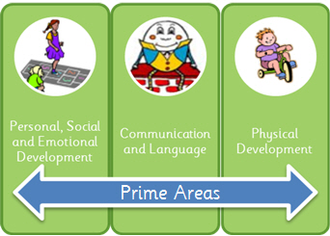
The Prime Areas
These are the core basis for EYFS children and their development. The areas are all interconnected - without achieving these, the children will be unable to access their specific area learning.
These areas are;
Personal, Social and Emotional Development (PSED)
Communication and Language
Physical Development
For example, without the correct fine motor skills to hold a pencil correctly, they would not have the skill to apply their phonics knowledge in their writing.

Slide 8
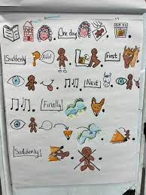


T4W – Our Literacy Approach
T4W orally retelling
Based in Communication and Language
Faye’s Video

Slide 9

Phonics
Phonics is the process of teaching children to read using letter sounds (not names).
Encouraging ‘blending’ of letter sounds together to hear and read words.
Daily focussed sessions teaching speed sounds as well as words at the correct
level to build reading confidence.
Red and green words.
Accuracy AND fluency.
Read, Write, Inc is the programme of Phonics that we teach here at Whitby Heath. More details of this are on the website, including a glossary of terms and blending game ideas.

Slide 10

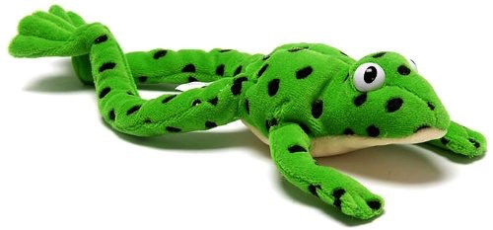
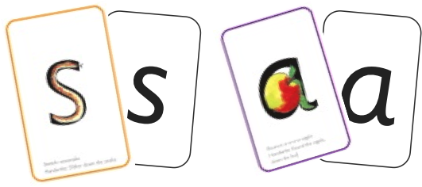




Phonics – What does a lesson look like?

Slide 11




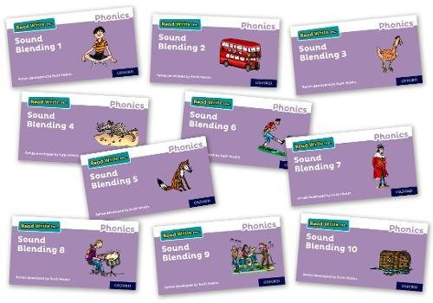


What should my child bring home?
+
+
OR
OR
The average child who is read to every day, will have heard 290,000 more words than those who don’t, by the time they are 5.
1) Reading Diaries – for you to comment in (use reading wheel for help), school staff will also acknowledge when they read.
2) Reading for pleasure book – to listen to (not read) and retell orally
3) Learning to read – starts with sound cards, then CVC word books and then a reading book matched to their correct phonics group level.
These need to be in their book bag EVERY day to allow staff to read with them. They will be changed each week once we have seen that they have been read and dojo points awarded accordingly.

Slide 12

How you can help at home?
Keep checking your child’s profile on Class Dojo and uploading their letter formation homework, as well as any photos or videos of other achievements for us to celebrate in school ☺
Always use the correct letter sounds – no shwaring!
Play lots of Fred Talk games to help them ‘tune in’ to sounds.
Strive for 5 with home reading – sharing bedtime stories then own book
Work on independence – own coats, organising own things etc
Ask questions!

Slide 13
Q&A

