Slide 1



Seahorses and Starfish Reception Classes
Curriculum Meeting September 2026
Miss Morris and Miss Coles

Slide 2
Early Years Foundation Stage (EYFS)
The EYFS gives children secure foundations for later learning.
What does it involve?
There are 7 areas of learning in the EYFS. These consist of 3 prime areas and 4 specific areas:
Personal, Social and Emotional Development (Prime Area)
Developing skills of self-regulation, managing self and building relationships with others
Communication and Language (Prime Area)
Developing skills in speaking, listening, attention and understanding.
Physical Development (Prime Area)
Developing control and coordination of the body in large and small movements such as climbing, running and using tools such as pencils and scissors.
Literacy (Specific Area)
Developing early word reading, comprehension and writing skills.
Maths (Specific Area)
Developing understanding of number and numerical patterns. We will have a Maths Workshop in the Spring Term.
Understanding the World (Specific Area)
Investigating and beginning to understand the things, places and people around them, including culture, past and present and the natural world.
Expressive Arts and Design (Specific Area)
Using imagination by performing and creating with a variety of media and materials

Slide 3
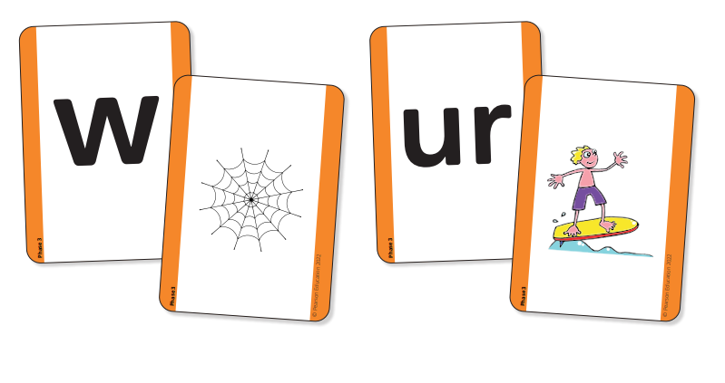

Phonics
Did you know that the English language has:
26 letters
44 sounds
and over 100 ways of spelling these sounds!
Phonics is how we make sense of all of these.
Systematic Synthetic Phonics – the teaching of reading and spelling by
breaking down words into the smallest unit of sound.
It’s all about hearing, recognising and using sounds enabling us to break down and build up words (segmenting and blending).
Notes:
SSP – preferred method for teaching phonics in the UK
All schools must follow a DFE approved scheme – ours is called Bug Club
This scheme provides us with the structure, routine and progression we need for teaching phonics as well as providing resources/books to use alongside our teaching.

Slide 4

Reading and Phonics at Meole Brace
The teaching of phonics and reading will take place every day in Reception.
Our phonics teaching follows the DfE approved Bug Club scheme. This scheme entails daily sessions within which we will teach the children a new phoneme, practise applying it in reading and writing and explore how to form letters correctly.
We teach Pure Phonics for reading which means we teach the children to say the sounds letters make. Alongside, we will teach children the letter names.
As well as learning the different sounds (phonemes) across the phases of Bug Club, the children will also learn High Frequency Words, such as ‘dad, mum, but’ and Irregular Tricky Words, such as ‘they, the, all.’
Notes:
Phonics forms one of the most fundamental parts of our curriculum – building block of teaching chn. to read and write.
Follow the Bug Club scheme which entails a taught session every day in which we will teach the chn. a new sound, practise applying it in reading and writing and explore how to form letters correctly.
Active repetition to ensure rapid recall of GPC’s, irregular and common exception words
Fully decodable reading books which are tightly linked to children’s progress through the scheme and match to sounds being taught in lessons
Each phoneme is accompanied by an action and an image and we use these to help the children recall the sounds and to link them to a letter – demo videos available on school website.
Pure Phonics – sounds rather than letter names. We do teach letter names, but within phonics, reading and writing it is important to use the pure sound to enable segmenting and blending for reading and writing. Names wont work.
Within phonics we teach phonemes (sounds), high frequency words (words we use often) and tricky words (words we can’t sound out and just need to recognise).
Tricky words in back of reading diaries.

Slide 5
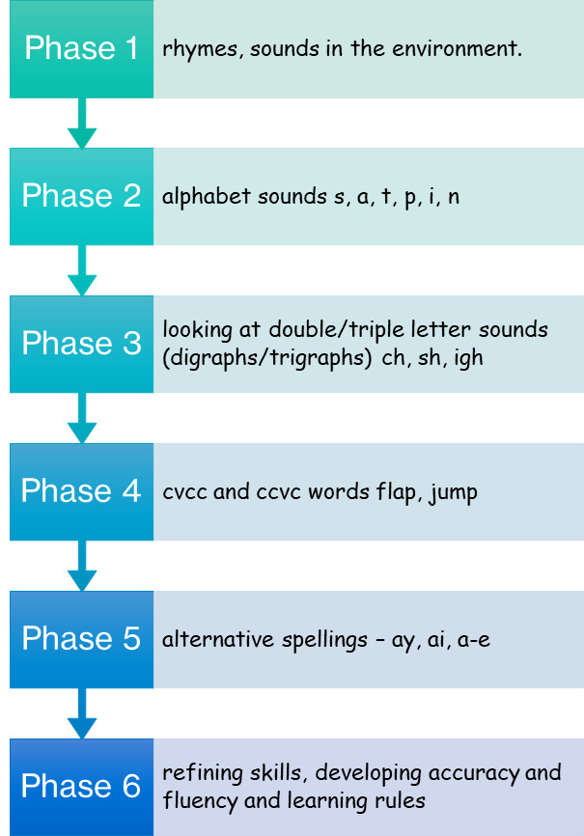
What is a phoneme?
All words are reducible to units of sounds called ‘phonemes’ which we write down using letters or small groups of letters called ‘graphemes’.
You can have:
Single letter sounds such as; s, a, t
Digraphs such as; ch, sh, ai
Trigraphs such as; igh, air, ear
These are the building blocks for reading and writing and your children will start by learning single letter sounds at the start of Phase 2, before being introduced to digraphs and trigraphs as they move through the phases.
Nursery
Reception
Reception
Reception
Year 1
Year 2
Notes:
Continuum of sounds which we track through according to where your child is achieving
Phase 1 – has 7 aspects with a focus on listening skills, environmental sounds, instrumental sounds, body percussion, rhythm and rhyme, alliteration, voice sounds, oral blending and segmenting – nursery focus but important throughout all phases
Phase 6 – reading independently and fluently, greater focus on comprehension, develop strategies for learning spellings
Sounds aren’t taught in alphabetical order but in an order which helps chn. get reading and spelling words as quickly as possible
Key Vocab – Phoneme, grapheme, single letter sounds, digraphs and trigraphs

Slide 6

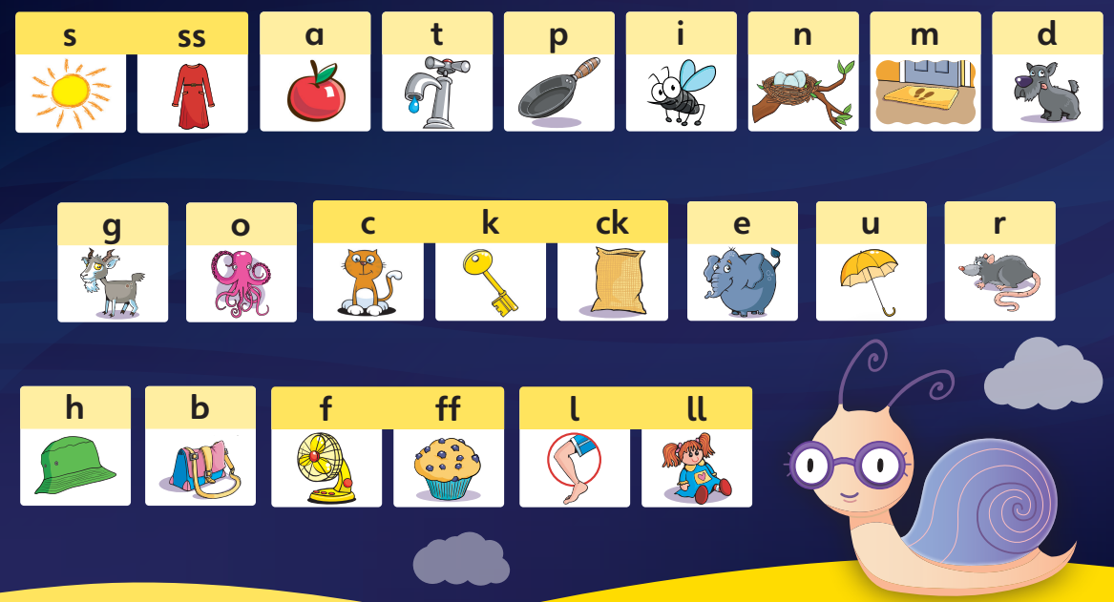
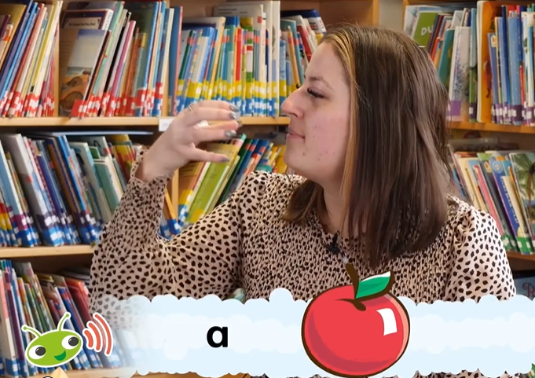
Phase 2
Demonstration videos of how to say each phoneme and of the action and image which corresponds to each one are available on the ‘Supporting Your Child at Home’ page in the English Curriculum section of our school website.
We use pure sounds meaning we pronounce each letter sound clearly and distinctly without adding additional sounds to the end.
Notes:
Phase 2 is where we first encounter phonemes and graphemes
Phoneme – we hear – smallest unit of sound within a word
Grapheme – we see – how you write the sound down
Pure sounds is essential – we do teach letter names alongside but when we’re segmenting and blending it is the pure sound we need to use
Single letter sounds and early digraphs – friendly letters – never at the beginning of a word

Slide 7
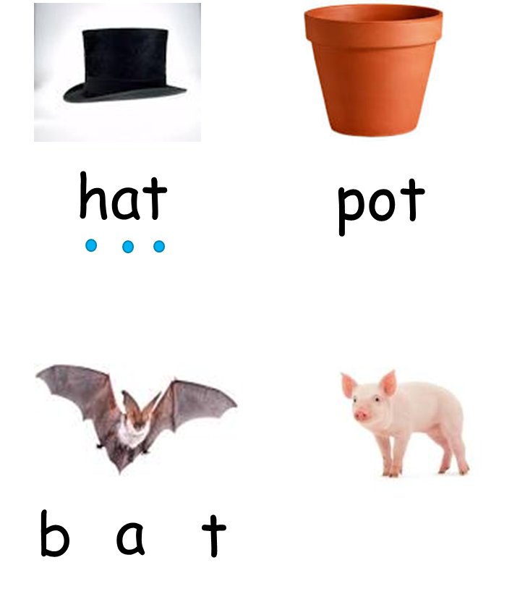
How do we use our phonics to help us learn to read and spell?
After learning their first few sounds, your children will be ready to start using these to help them segment to spell and blend to read.
Segmenting
Identifying and splitting a word up into individual sounds
Blending
Combining the individual sounds we can hear together to make a word
Strategies
Sound talking – robot talk and sounding out arms
Sound buttons
Phoneme frames
Notes:
Once we’ve learnt our first 8 sounds, we can crack on with learning how to use them to help us segment and blend
Segment to spell, blend to read.
-When we segment we split a word into its units of sound
-When we blend, we bring those units of sound together to make a word
Segment into sounds not syllables – be really careful of the difference
Eg’s of robot arms, sounding out arms, sound fingers – get them to do it
Use of sound buttons to check sounds and phoneme frames – sound in each box

Slide 8
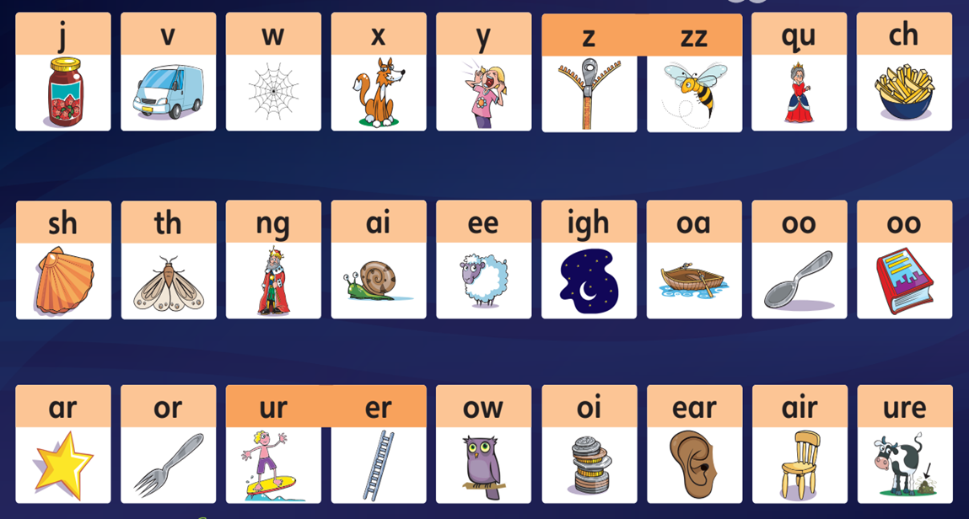
Digraphs
2 letters which make one phoneme (sound)
Friendly letters – zz
Common digraphs sh, ch, th, ng
Vowel digraph – contains at least 1 vowel ar, or, ur, ow
Long vowel digraphs – Two vowels which together make the vowel letter name – ai, ee, ie, oa, oo
Trigraphs
3 letters which make 1 phoneme (sound) – igh, air, ear, ure
Not as common
Phase 3
Notes:
Remaining single letter sounds and then into the meaty digraphs and trigraphs
Children’s progress with segmenting and blending may stall a bit here – adjustment to segmenting into digraphs rather than single letter sounds.
When we segment into digraphs/trigraphs we need to remember to segment into the unit of sound rather than the letters (trickiest part to learn)
Also need to record the letters that make up the different digraphs and trigraphs to accurately write sounds down

Slide 9


Segmenting and Blending Digraphs and Trigraphs
goat night
Phase 4
When children start Phase 4 they will know a grapheme for each of the 44 phonemes. They will be able to blend phonemes to read CVC (consonant-vowel-consonant) words, and segment in order to spell them.
Children will also have begun reading straightforward two-syllable words and simple captions, as well as reading and spelling some tricky words.
In Phase 4, no new graphemes are introduced. The main aim of this phase is to consolidate the children’s knowledge and to help them learn to read and spell words which have adjacent consonants, such as trap, string and milk
Notes:
Sound tiles for digraphs
As we get into longer words we have to segment really carefully – think carefully about whether it’s a single sound or a digraph
Phoneme frame – both letters go in a box – box per phoneme not box per letter
Phase 4 is all about application of sounds previously learnt, consolidate knowledge and explore longer word forms

Slide 10
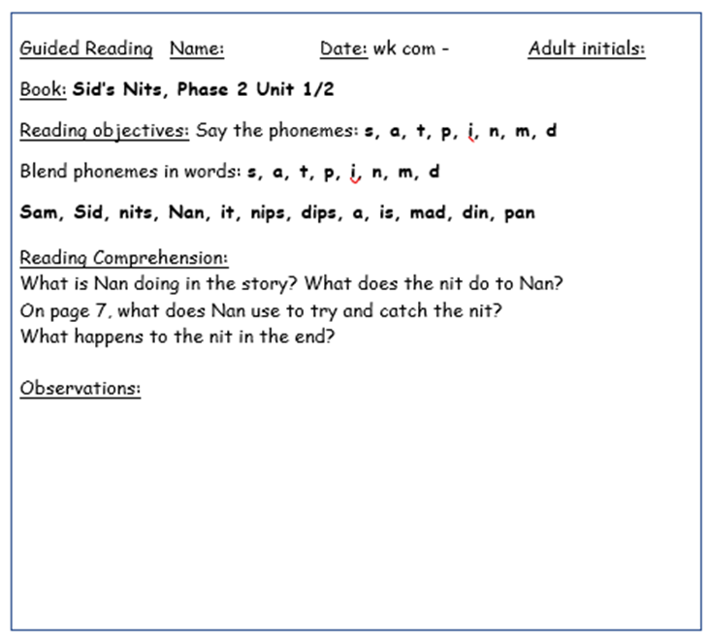

Reading in School
Your child will have group Guided Reading and/or an individual reading session in school, led by the Class Teacher or the Teaching Assistant. These session take place every day for different groups of children so we ask that Reading Diaries and books are in school every day ready for us to use whenever we might need them.
Reading books will be changed once a week on a Friday and are carefully matched to the sounds your child will have been learning in school in phonics.
We will have one session each week in our school library (Starfish Tuesday, Seahorses Friday) where your child will be able to select a book to bring home to share. A new one can be chosen each week when the old one is returned.
Notes:
-GR X 2 a week – rotate through different groups each day so book bags in all week
-Ind. Reading whenever we can
-Library session – 1 a week, book to share rather than decode, swap when old one is returned

Slide 11
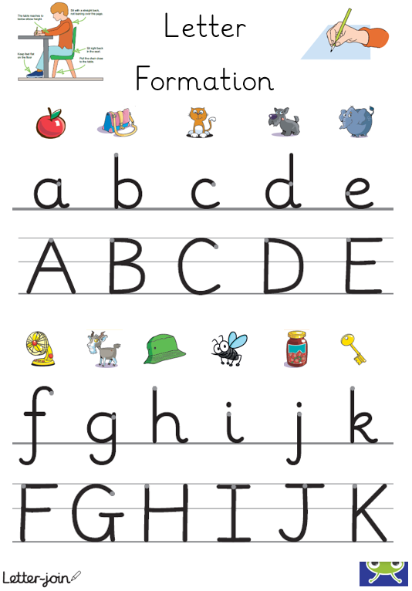
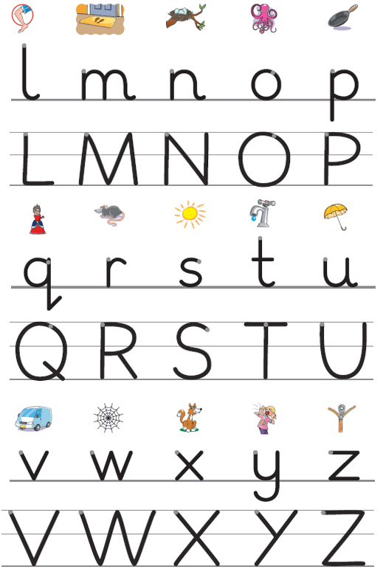
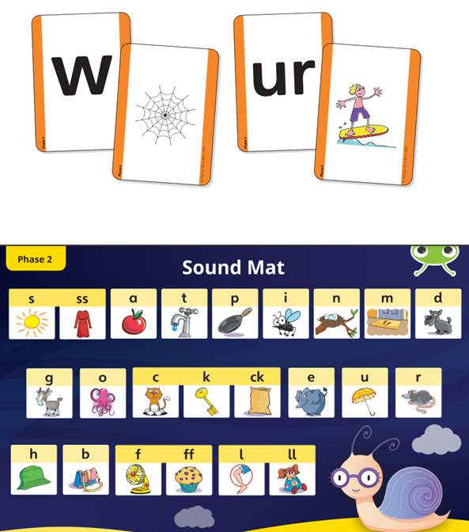
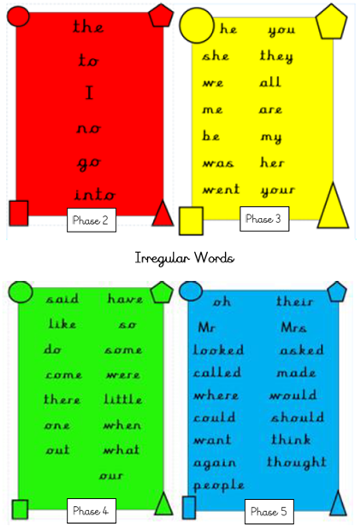
Resources to Support Recall
All of these resources are available to download on the ‘Supporting Your Child at Home’ page in the English Curriculum section of our school website.
Notes:
All of these are available in the packs provided – use as little incidental bits of practise – flashcards, matching games to aide recall etc.

Slide 12


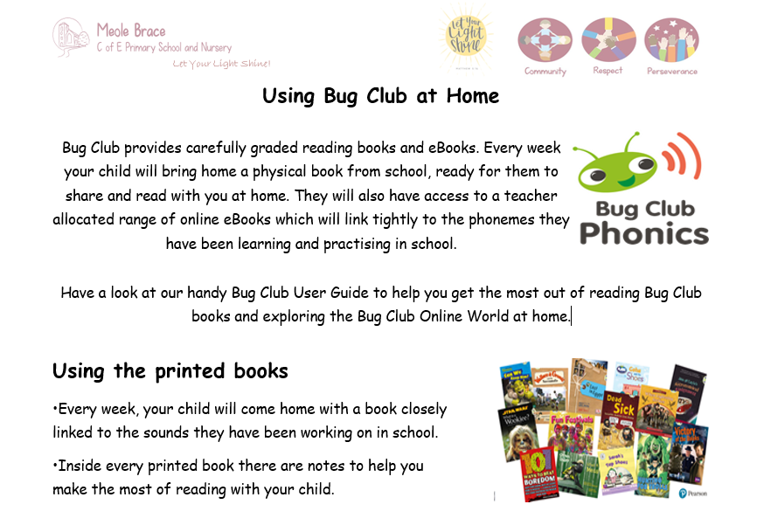
How can you help at home?
Research has shown that, once social and economic factors are removed, parental engagement has a more significant impact on attainment than almost everything else.
The younger a child is, the stronger the impact. At age 5 it is some 5 x greater than the impact of school.
Please make a note in Reading Diaries to show whenever you have shared a book with your child at home so we know we can change the book.
Reading books will be changed once a week on a Friday and are carefully matched to the sounds your child will have been learning in school in phonics.
Explore the inside covers of their reading books for an outline of the sounds each book covers, some practice words to segment and blend and some possible questions for you
to ask about the story you have shared.
Little and often is the best way to help your children whilst they are learning to read.
Even as little as 5 minutes at a time, encouraging them to read to you or you sharing a
story with them will have a massive impact on their ability to read.
Notes:
-Reading diaries for you to log reading with chn in – doesn't need to be detailed, just the date and your initials or details on anything tricky so we can pick up and support in sessions in school
-Decodable book matched to the sounds learnt in school – 1 a week changed every Friday – lots of repetition and building familiarity is invaluable
-Explore sounds on front cover and comp. q’s on back cover – book talk is invaluable – what’s happened, predictions, feelings etc. See Bug Club User Guide for more info in terms of using their books and the Online Bug Club World
-Little and often and make it as enjoyable as possible – don’t want it to be a chore. Want to encourage a love and enjoyment of books – read to them and discuss, take it in turns, listen to school books, explore books from home.

Slide 13
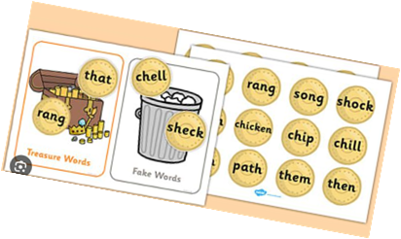

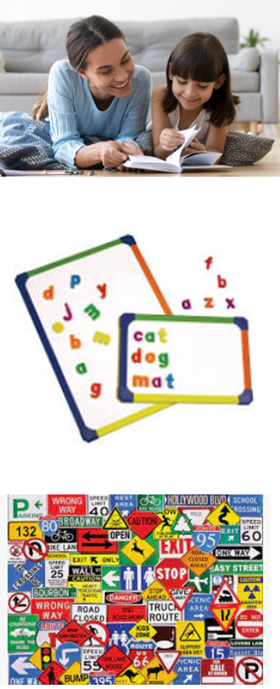
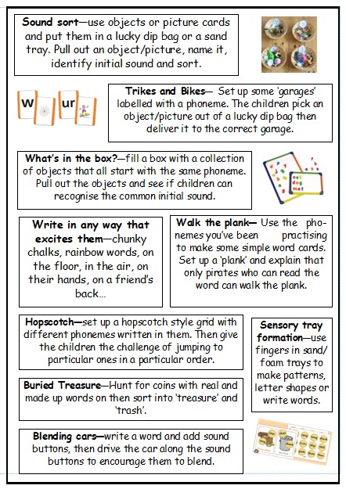
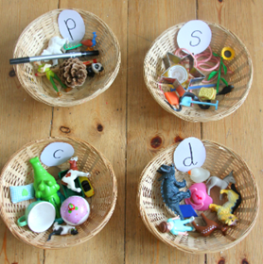
How can you help at home?
Provide opportunities for reading and writing at home.
Play games.
Share your own love of books and words.
Make it fun – it doesn’t have to be a chore.
Think about the building blocks – it doesn’t always have to be reading a book.
Repetition leads to fluency.
Actions, songs and rhymes aide memory.
Give your children a model to follow.
Notes:
Remember it’s not just about reading their books
So many ways you can support them without them even realising their reading – don’t make it a chore or a challenge, use the strategies they engage with the most
Record anything you do in diaries even if it’s not reading their books
Activity bank to refer to and hopefully inspire you with some ideas and games to complete at home

Slide 14

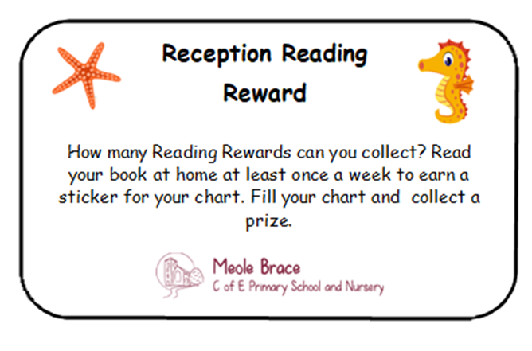
Reading Rewards
Notes:
Resources on website including a EYFS Reading and phonics powerpoint which goes over everything we’ve discussed this morning

Slide 15

Handwriting
We follow the Letter-join scheme to help us learn how to form letters.
To begin we will focus on patterns and basic letter shapes linked to the sounds we
will be working on in our Bug Club phonic sessions.
Please see our letter formation mats available on the school website for details on how to form each letter accurately.

Slide 16

Forest School
In Reception we will be exploring and learning in schools’ outdoor Forest School area each Tuesday morning for Seahorses and every Thursday morning for Starfish. Sessions will begin on Tuesday 13th October for Seahorses and Thursday 15th October for Starfish. We will go out for these sessions in all weathers except high winds/storms. On these days, school uniform is not needed. Children need to come to school dressed ready for their Forest School session, including their waterproofs and wellies, and will then stay in their Forest School clothes for the rest of the day. Children will need a clean pair of shoes to change into and a named bag to put their wellies and waterproofs in. Please ensure all items are named.
Recommended outdoor clothing for Autumn/Winter/Spring term:
Wellington boots (brought to school in a named carrier bag please)
Clean shoes
Warm, thick socks
Thick trousers or jogging bottoms for both boys and girls (leggings underneath are a good idea if it is really cold)
Vest
Long sleeved top
Fleece or wool jumper
Waterproof jacket and trousers or an all-in-one waterproof suit
Hat, gloves and scarf
Recommended outdoor clothing for Summer term:
Wellington boots
Clean shoes
Full length (to protect legs) leggings, jogging bottoms or jeans
Long sleeved top (to protect arms)
Waterproof jacket
Sun hat/cap
Sun lotion (Please apply some once-a-day sun lotion on your child before coming to school)

Slide 17
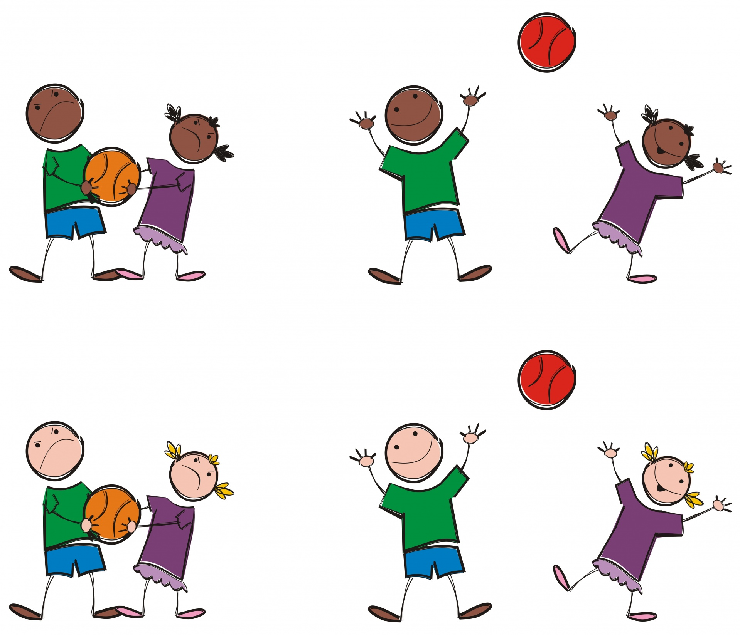
P.E.
P.E will be outside whenever possible.
As it will be weather dependent with no set day,
your child will need their P.E. kit in school all week.
Your child will need a P.E. t-shirt (in plain white or a house colour that can be purchased from school), black/navy shorts and jogging bottoms/leggings, a hoody/jacket or sweatshirt, plus a pair of trainers.
P.E kits can be kept on your child’s coat peg in the cloakroom. We will send them home to be washed at the end of each half-term.

Slide 18


Learning Journeys and books
In school, your child will have 3 different books for their work to go into;
Writing, Maths and a Learning Journey.
One way you can contribute is by completing ‘Wow Stars’ for whenever your child does something special or achieves something at home. For example; you might like to tell us if they have been particularly helpful, attended their first swimming lesson or managed to stay in their own bed all night, etc. Write their achievement on the star and send it into school with them. We will then share and celebrate this with the rest of the class and put them up on display on our class ‘Wow Wall’. At the end of each term, we will transfer the Wow Stars into your child’s Learning Journey. A set of Wow Stars will be coming home in your child’s book bag soon. Should you need any further stars, just let us know and we can send some more home.
We have some ‘drop-in’ sessions for each Reception class, beginning with our Phonics Friday sessions, where you can visit the classroom and do some activities with your child.
The first session for Seahorses is Friday 18th September and for Starfish Friday 25th September. These sessions are 9:00- 9:30am.

Slide 19


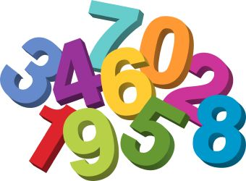
Profiles
We will record your child’s progress and development throughout their Reception year in a Profile. The profile is a statutory document that we are required to keep. The profile is passed onto your child’s next teacher and forms an important part of the transition to Year 1.
In June, we will decide and record your child’s attainment against the Reception Early Learning Goals (ELGs). Details of these ELGs are to be found on the next slides.

Slide 20
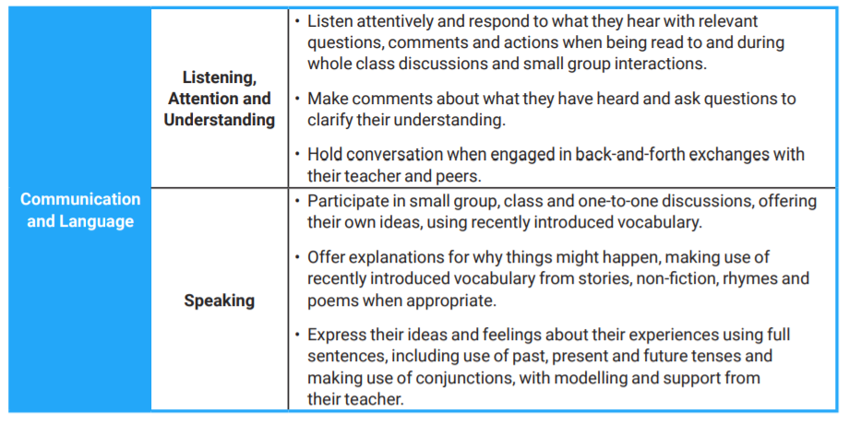
Early Learning Goals

Slide 21
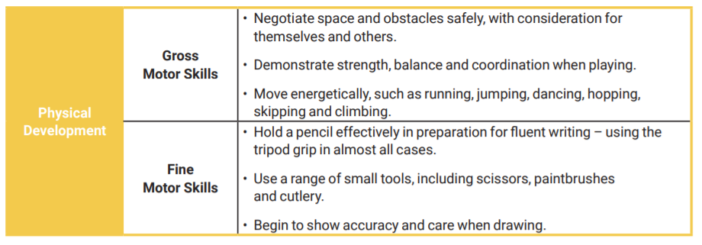

Slide 22
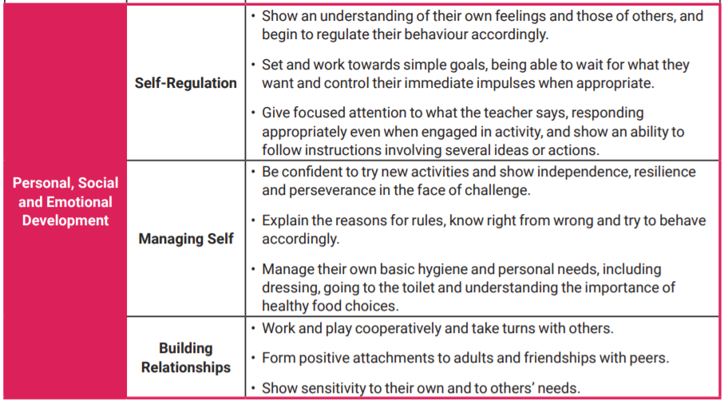

Slide 23
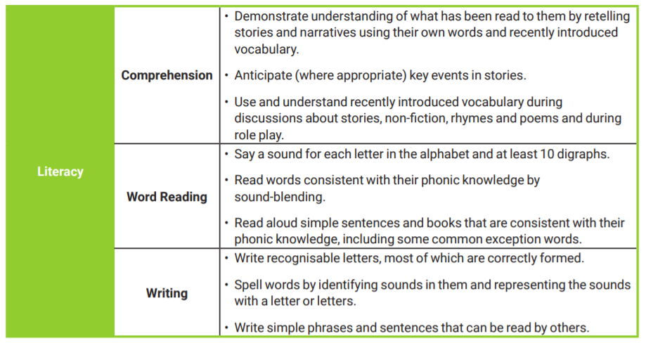

Slide 24
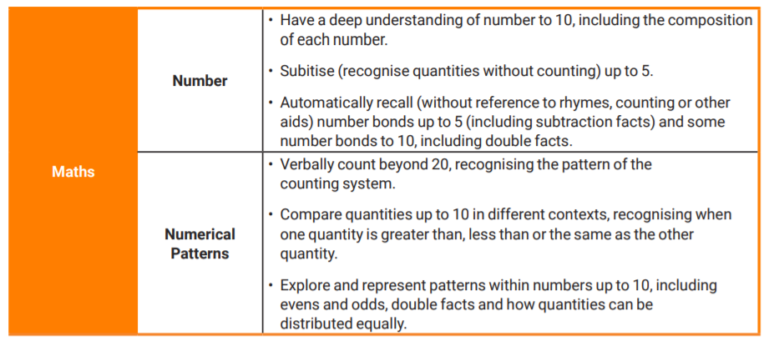

Slide 25
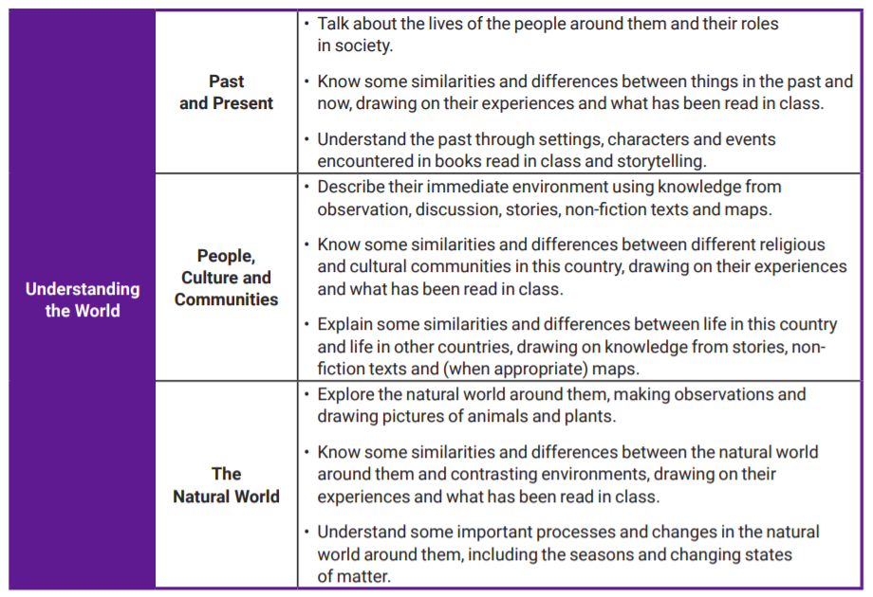

Slide 26
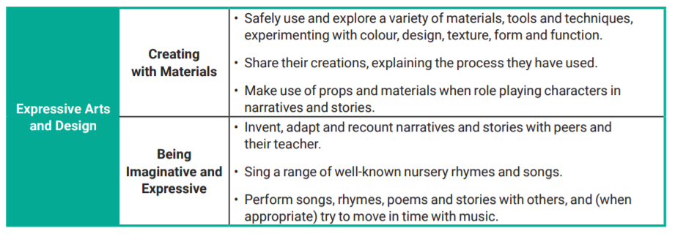

Slide 27
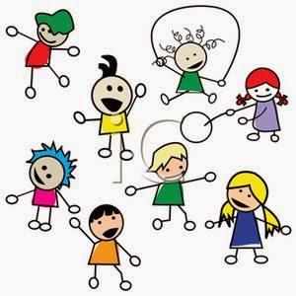
Please put your child’s name onto all of their belongings!
Thank you for listening and reading.
We hope you have found this information useful.

