Slide 1

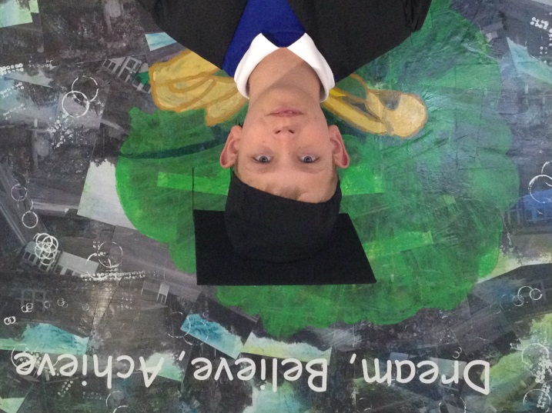
Gorsewood Primary
Class of 2016
Congratulations
Will

Slide 2
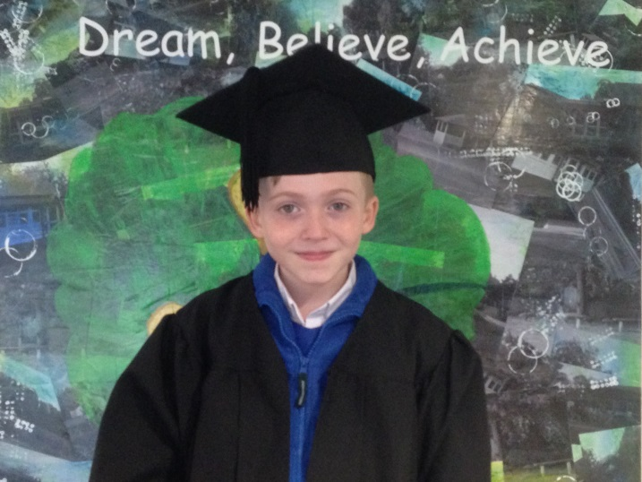
Gorsewood Primary
Class of 2016
Congratulations
William

Slide 3
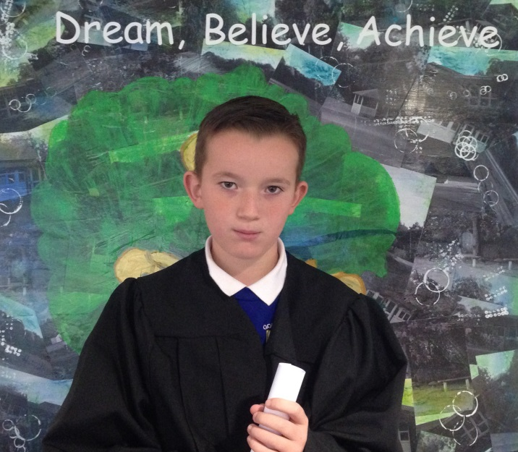
Gorsewood Primary
Class of 2016
Congratulations
Frankie

Slide 4
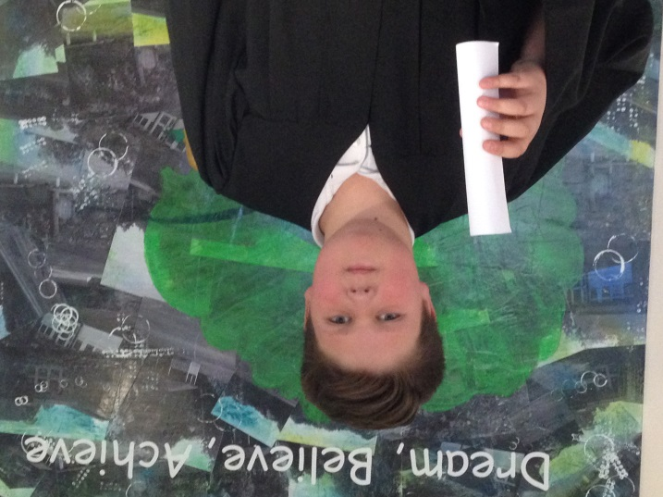
Gorsewood Primary
Class of 2016
Congratulations
Jack

Slide 5
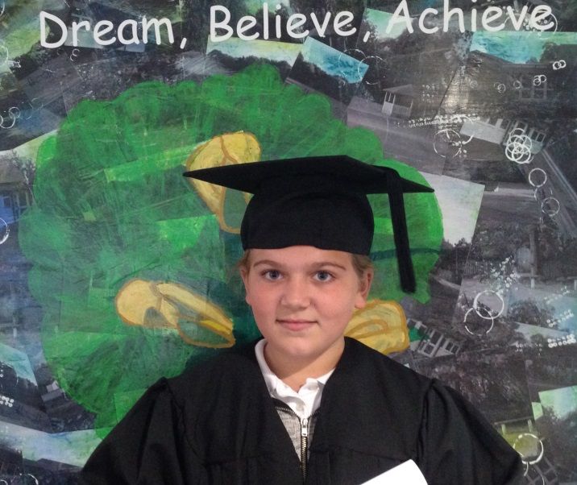
Gorsewood Primary
Class of 2016
Congratulations
Emmie

Slide 6
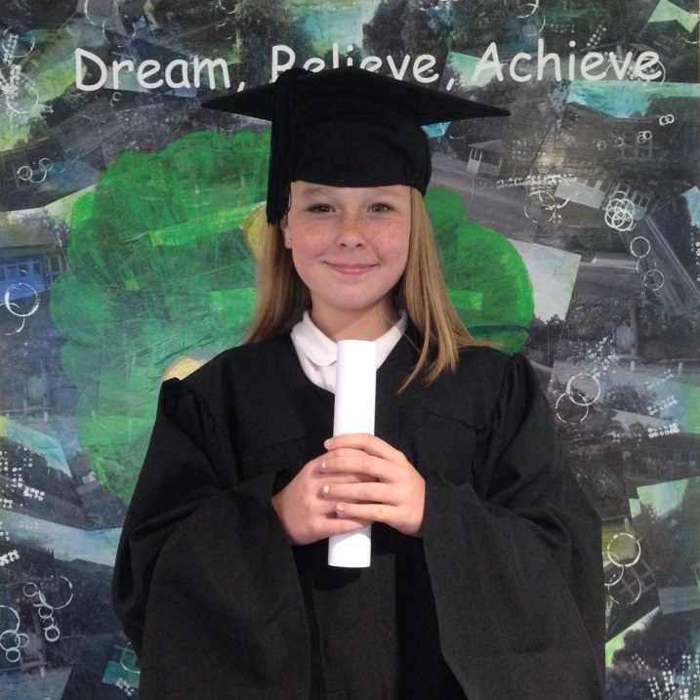
Gorsewood Primary
Class of 2016
Congratulations
Caitlin

Slide 7
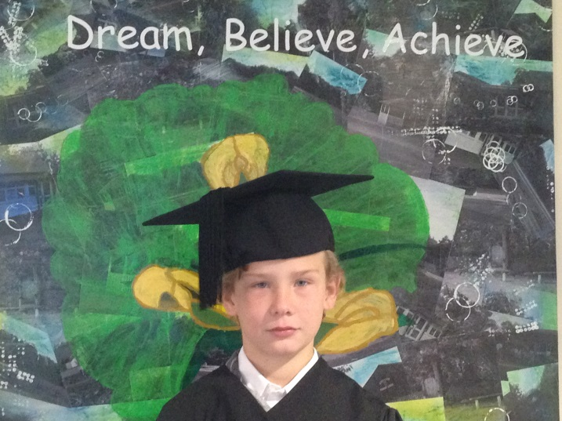
Gorsewood Primary
Class of 2016
Congratulations
tyler

Slide 8
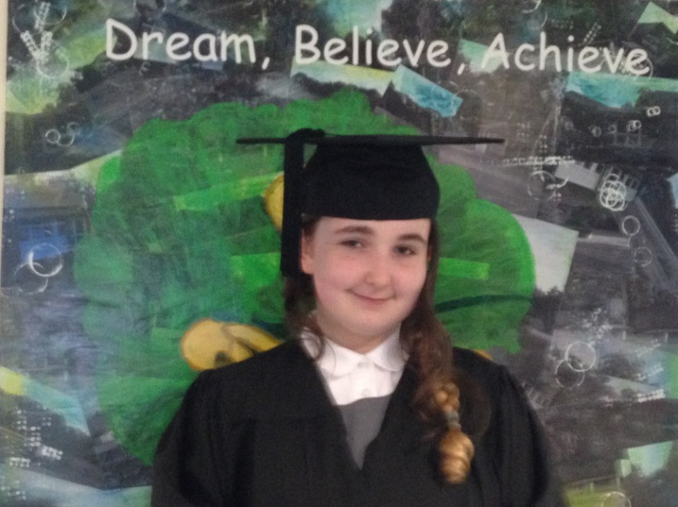
Gorsewood Primary
Class of 2016
Congratulations
charlie

Slide 9
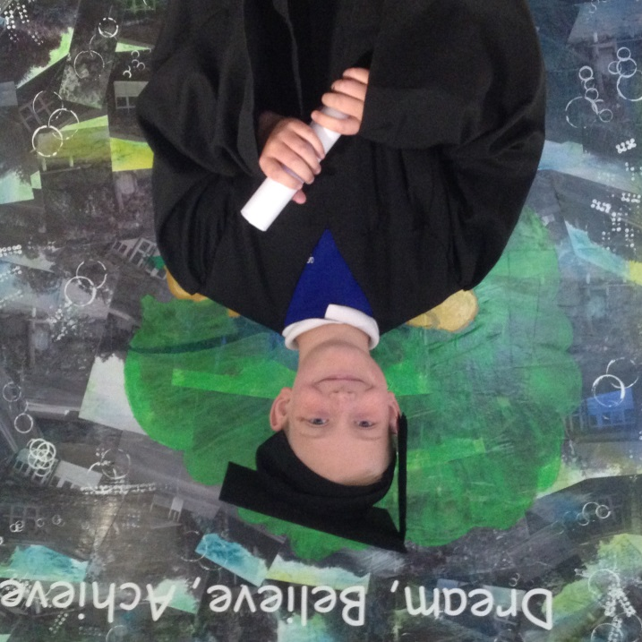
Gorsewood Primary
Class of 2016
Congratulations
jack

Slide 10
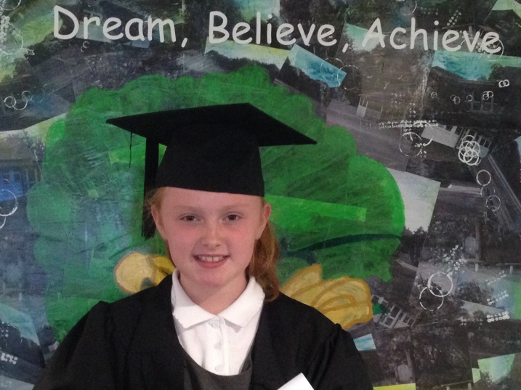
Gorsewood Primary
Class of 2016
Congratulations
freya

Slide 11
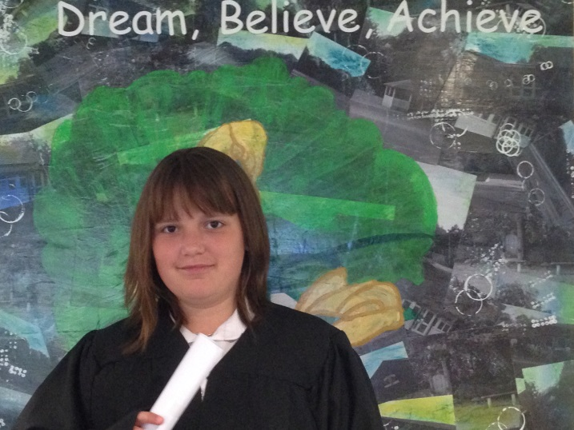
Gorsewood Primary
Class of 2016
Congratulations
wendy

Slide 12
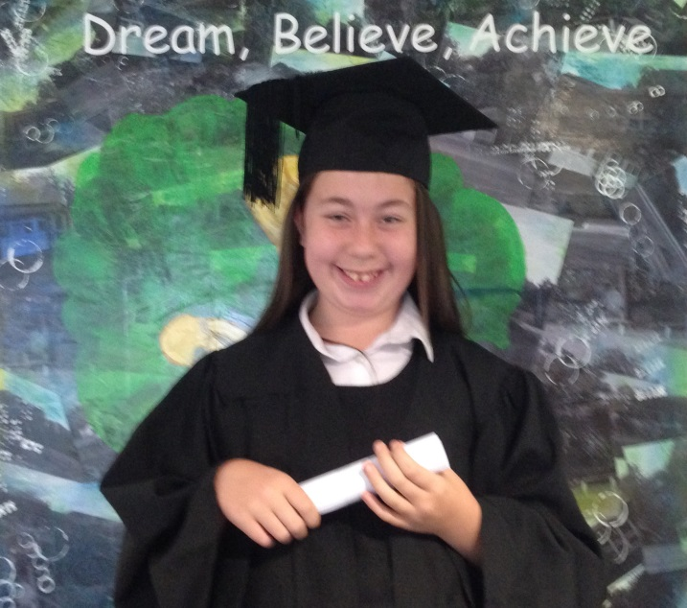
Gorsewood Primary
Class of 2016
Congratulations
sophie

Slide 13
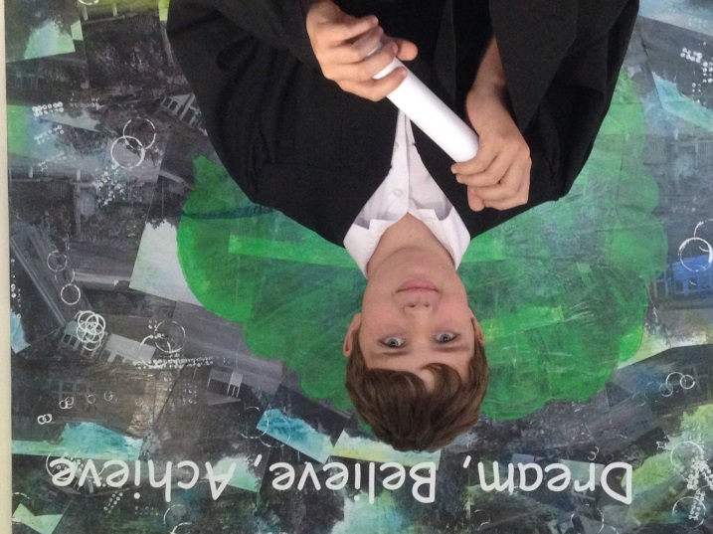
Gorsewood Primary
Class of 2016
Congratulations
harvey

Slide 14
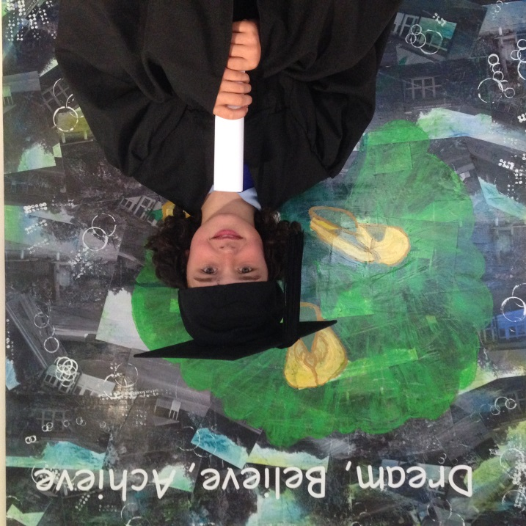
Gorsewood Primary
Class of 2016
Congratulations
logan

Slide 15
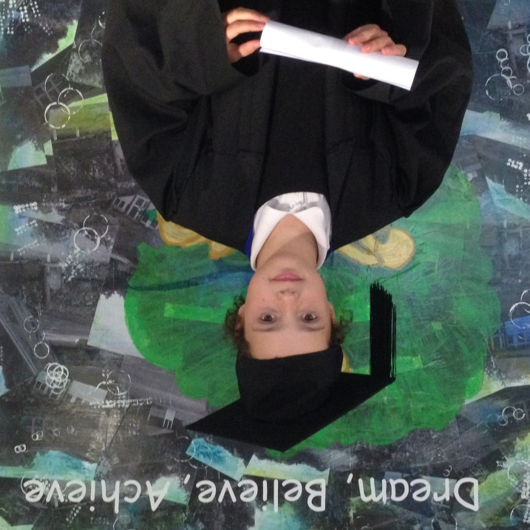
Gorsewood Primary
Class of 2016
Congratulations
tamikka

Slide 16
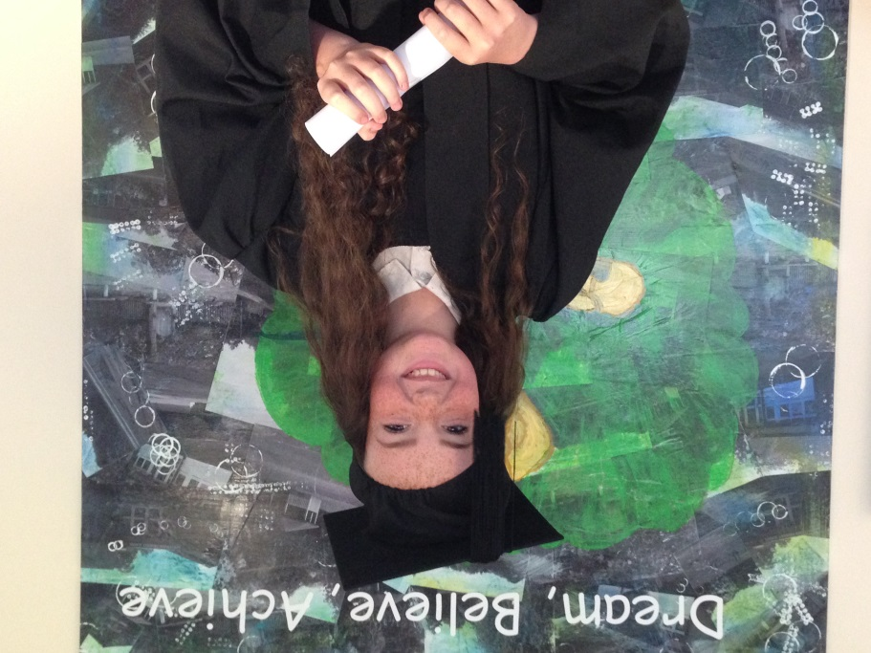
Gorsewood Primary
Class of 2016
Congratulations
teegan

Slide 17
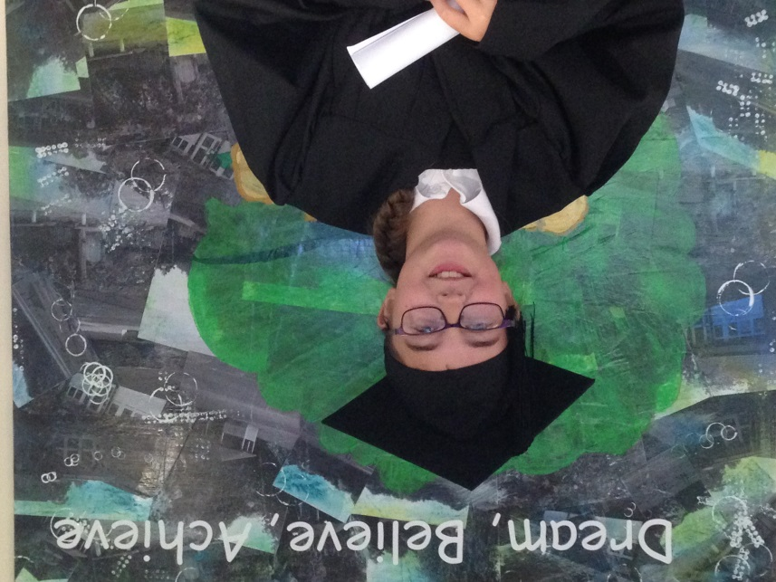
Gorsewood Primary
Class of 2016
Congratulations
bethany

Slide 18
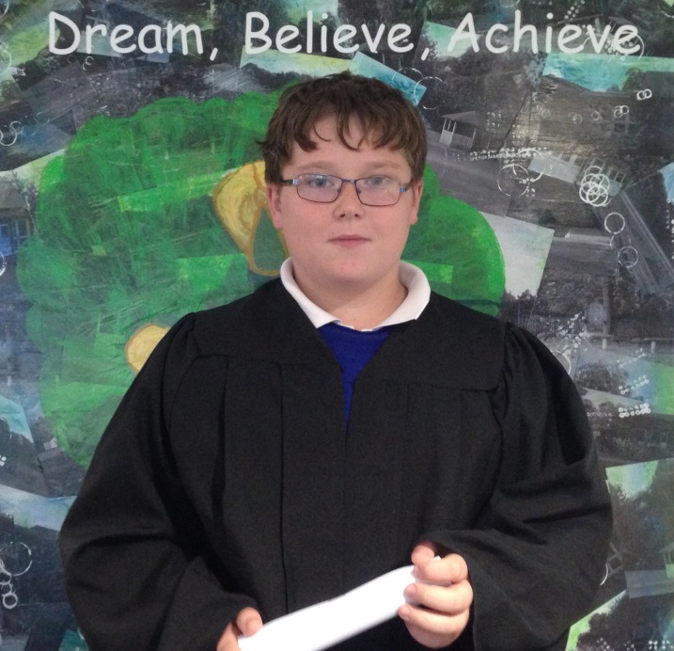
Gorsewood Primary
Class of 2016
Congratulations
Dylan

Slide 19
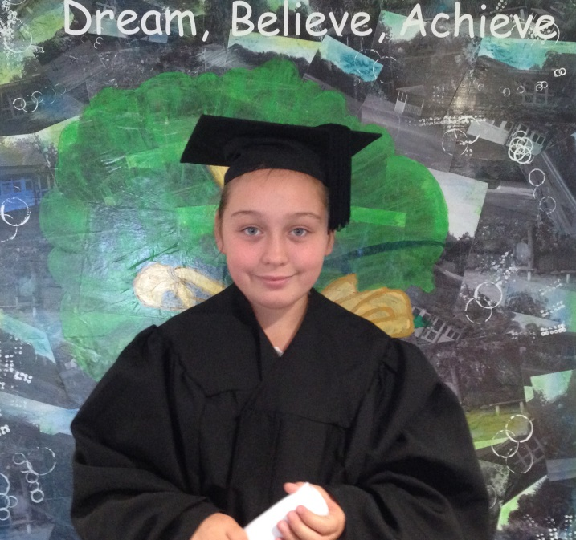
Gorsewood Primary
Class of 2016
Congratulations
maddison

Slide 20
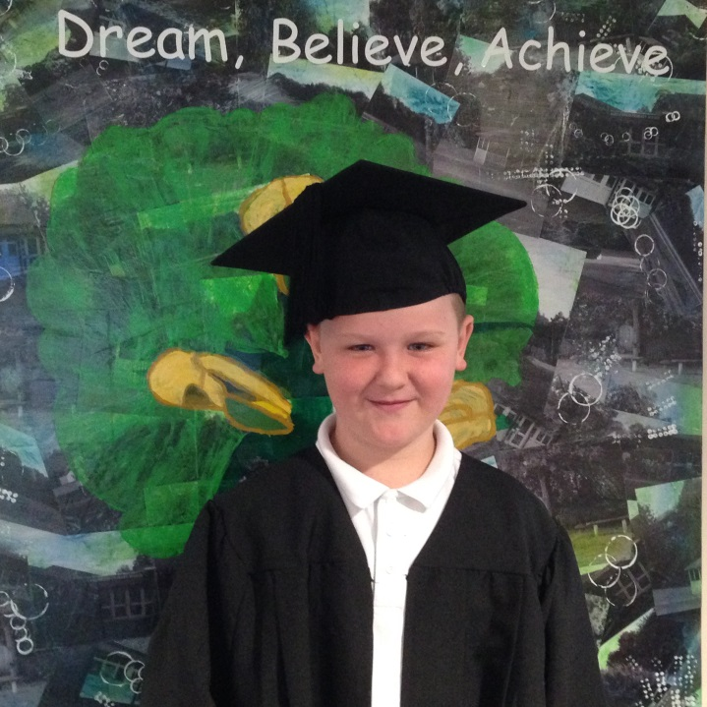
Gorsewood Primary
Class of 2016
Congratulations
jack

Slide 21
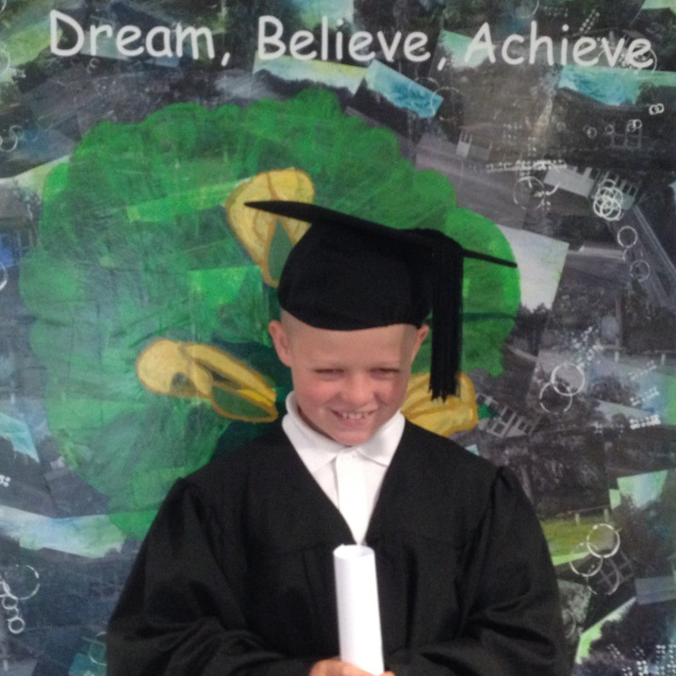
Gorsewood Primary
Class of 2016
Congratulations
rhys

Slide 22
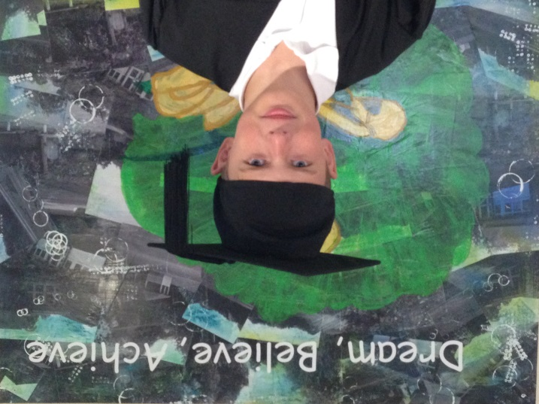
Gorsewood Primary
Class of 2016
Congratulations
Leon

Slide 23
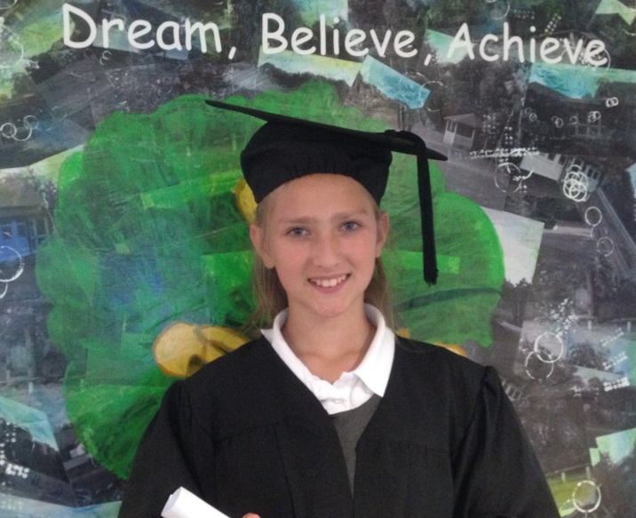
Gorsewood Primary
Class of 2016
Congratulations
Marissa

Slide 24
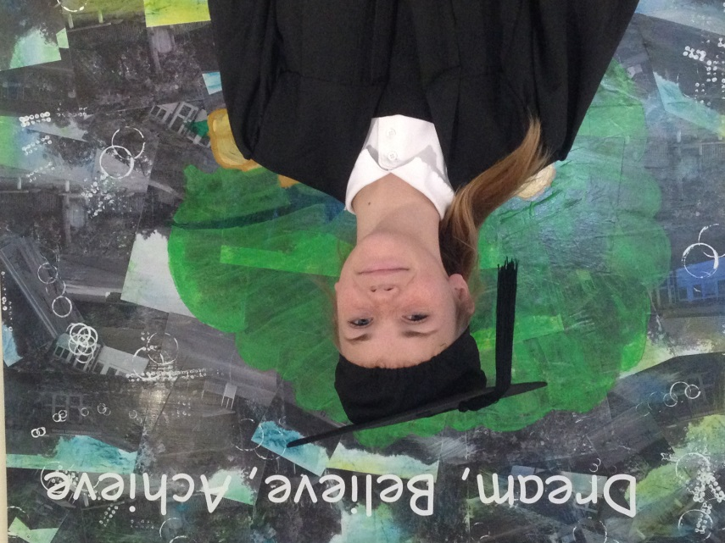
Gorsewood Primary
Class of 2016
Congratulations
macey

Slide 25
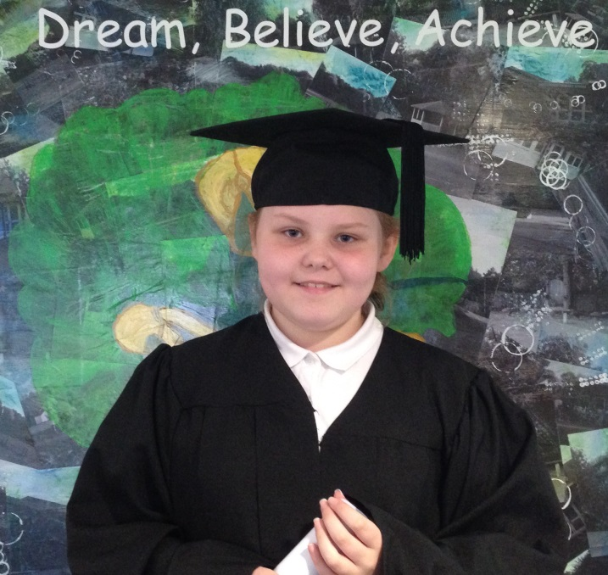
Gorsewood Primary
Class of 2016
Congratulations
libbie

Slide 26
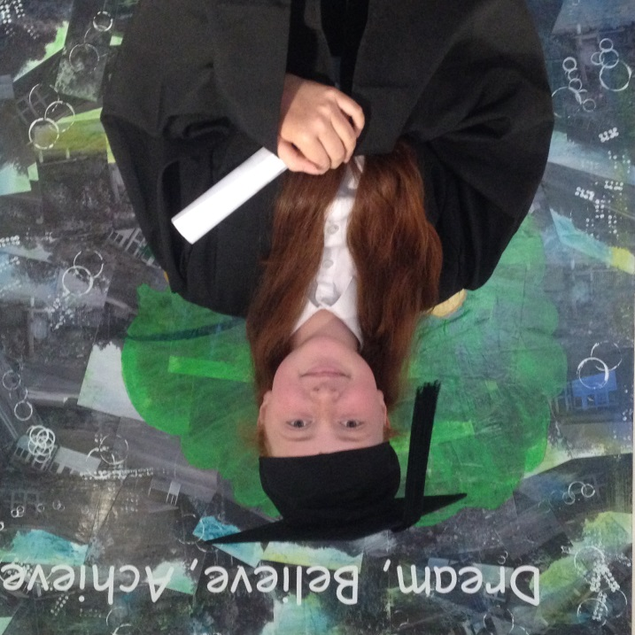
Gorsewood Primary
Class of 2016
Congratulations
abby

Slide 27
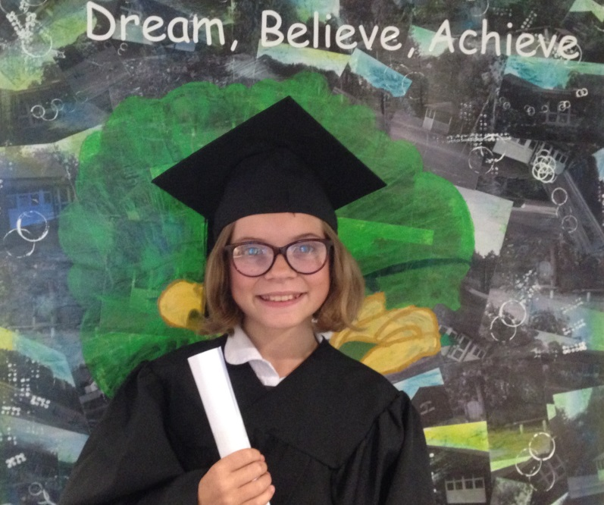
Gorsewood Primary
Class of 2016
Congratulations
alice

