Slide 1

The Wonderful World of Books
Reading with your children

Slide 2
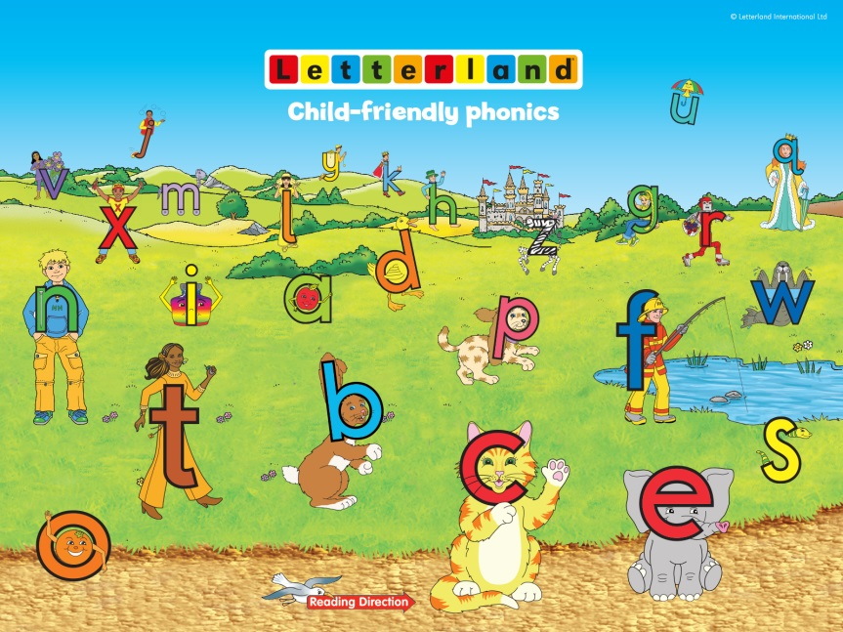

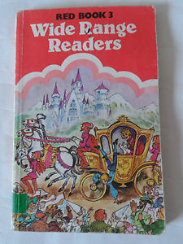
Reading has changed a lot in a short space of time,
it’s a bit less like this…

Slide 3
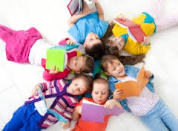
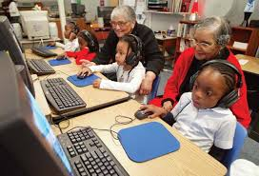

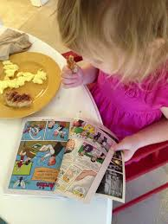
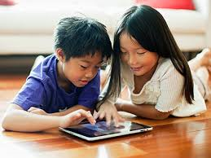
And a bit more like this!

Slide 4
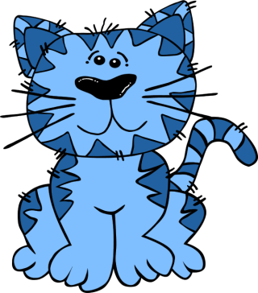
What is Phonics?
Children begin learning phonics (sounds) in Early Years and by the end of Year 1 they should be confident with the majority of these.
By knowing sounds children are able to blend together words accurately.
c-a-t is cat

Slide 5
What is Phonics?
The children are taught pure sounds:
https://www.youtube.com/watch?v=yln6PpV1G1I
Here is how children are taught new sounds:
View video on drive

Slide 6
What Reading looks like in school
Reception, Year 1 and Year 2 RWInc Phonics daily for 40 mins - when they have completed RWInc they move on to a comprehension programme.
Every child does Individual Reading weekly in class 1:1 - this is always a phonics book carefully matched to their level.

Slide 7
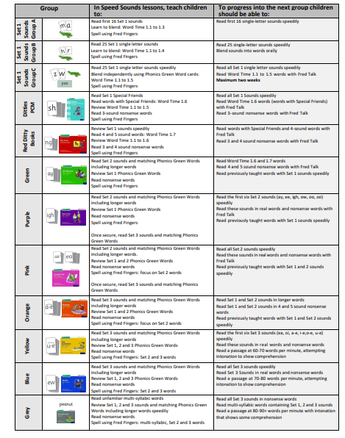
RWInc Groups

Slide 8
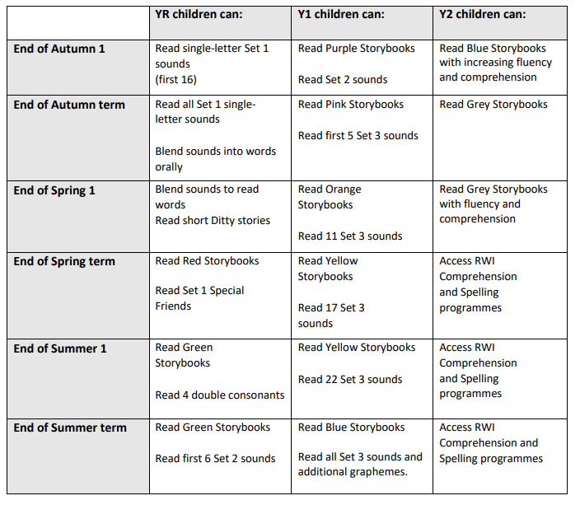
Expected
Progress

Slide 9
Reading and Re-reading with your child at home
https://www.youtube.com/watch?v=FjJD1UDwVKg
Repeat the book
Engage and Enjoy
Ask Questions
Do More

Slide 10
Book Bags
Children working from the start of RWInc programme to the Yellow level should be reading their book bag books daily at home.
Here is why:
The strategy of re-reading has proven benefits for the development of early reading. If your child re- reads a book three times a week, we would expect to see progression that looks similar to this:
1st read - sounds out words and starting to understand what is happening by using pictures and talking with a grown up.
2nd read - children will gain a fuller understanding of the story and the characters through reading and talking about their reading with a grown up.
3rd read - children will read at a greater speed by recognising common words. They will read with less mistakes and might start to add some expression.

Slide 11
Book Bags
When children get to Blue and Grey Level we are less focused on the teaching of phonics as that is becoming secure, we are building their fluency and comprehension skills.
At this point your child’s book will be changed more regularly - if it is brought in to school and the diary has been signed.
We are looking into further enhancing their reading experience and evidencing their understanding before we change their books.

Slide 12
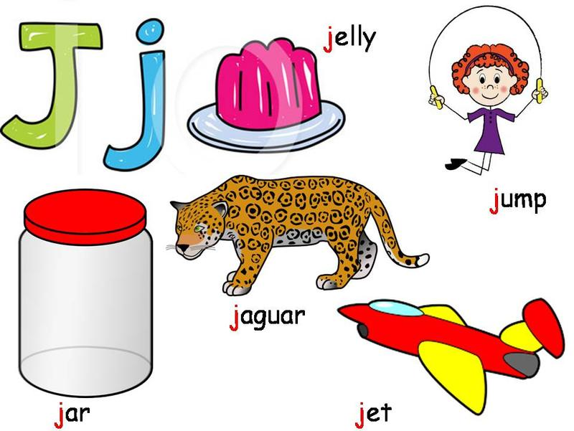
How can I help my child at home?
Read as often as possible.
Play lots of sound and listening games (eye spy etc.)
Encourage and praise “good guesses!”
Discuss the meanings of words they do not come across regularly.
Websites and Games
Google Classrooms - have lots of links and
videos

Slide 13
Thank you for coming
We look forward to hearing all about the wonderful reading experiences you have had with your child.
Please feel free to contact us if you have any questions.

