Slide 1

The Wonderful World of Books
Reading with your children

Slide 2
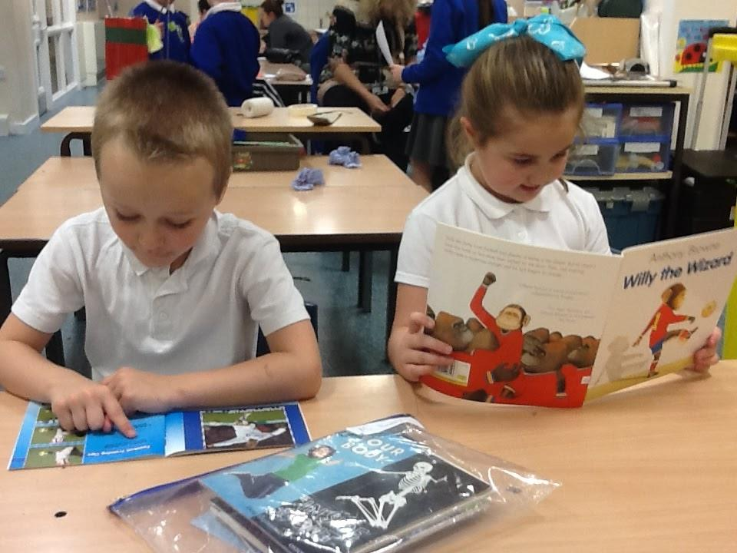
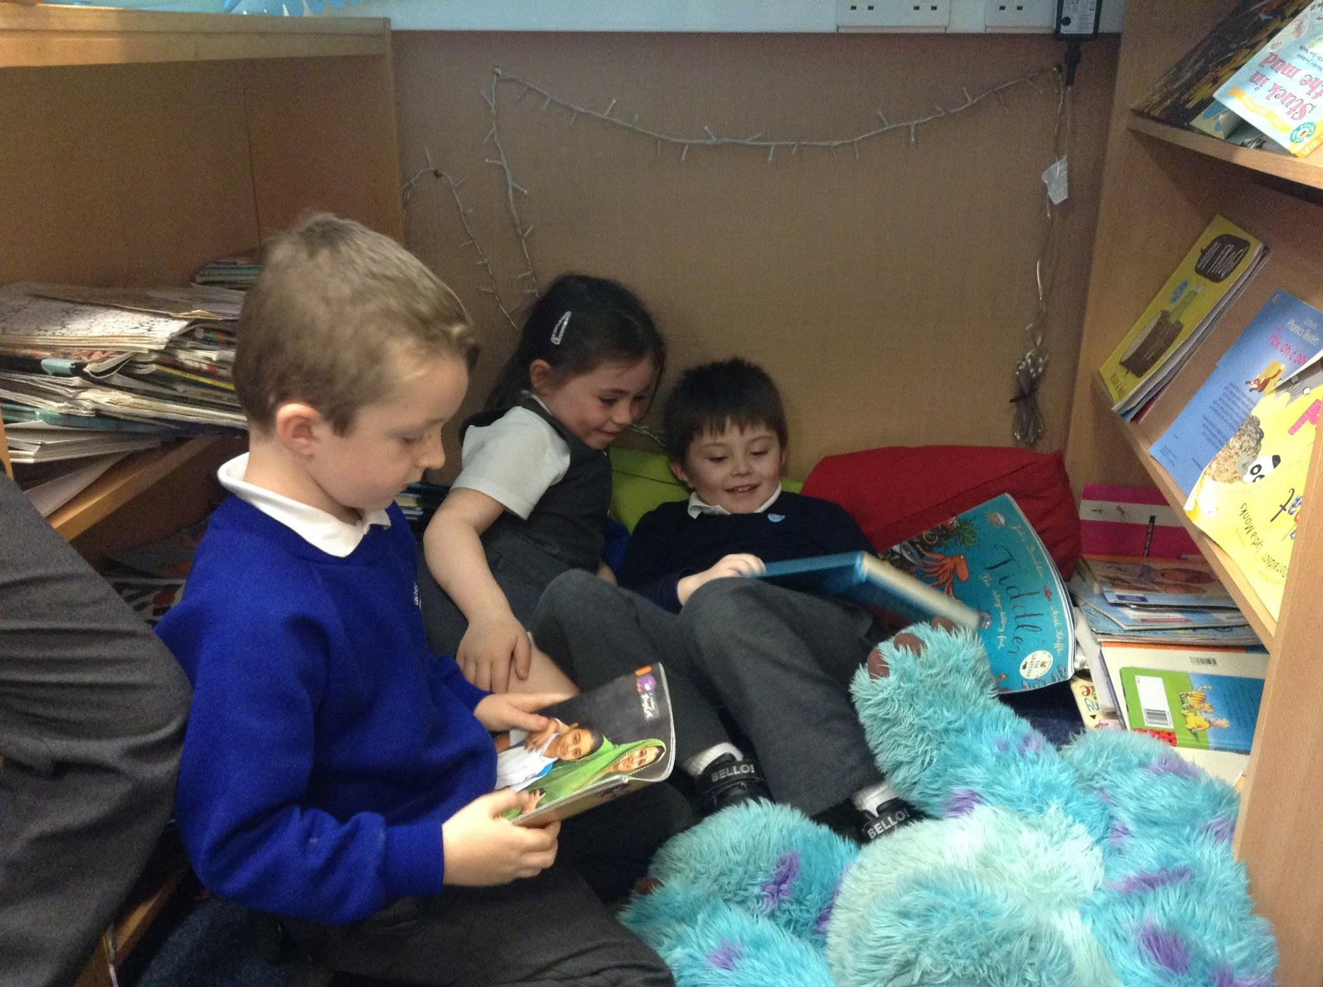
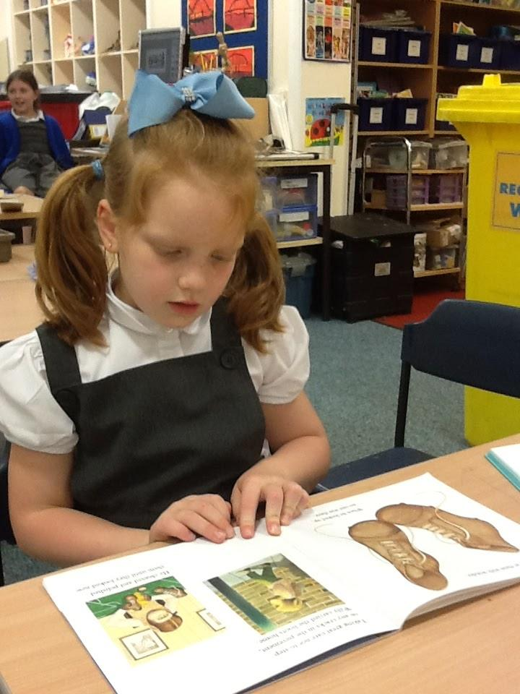
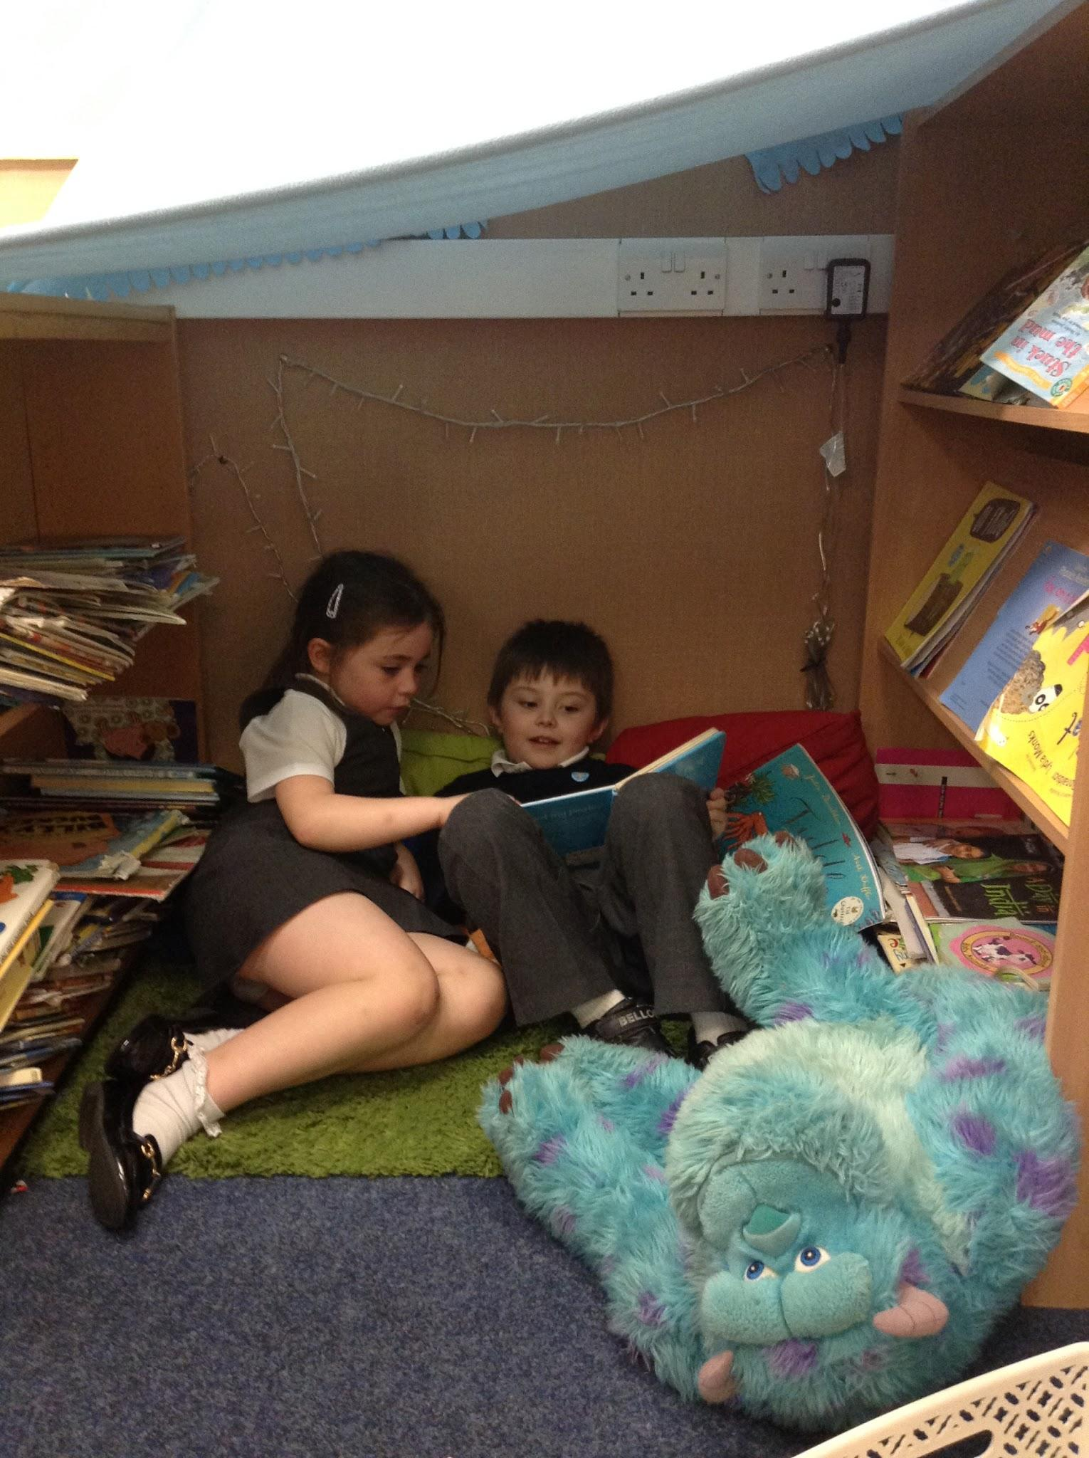
“I enjoy reading stories about superheroes with my Mum and Dad” Kayden
“I enjoy reading about owl and butterflies.”
Alesha
“I like it when teachers read stories to me because they make it fun. My favourite stories are about insects.” Grace
“My favourite time of the day is when I read at bedtime. I like talking about the pictures.” Heidi

Slide 3
Reading with your child at home
https://www.youtube.com/watch?v=FjJD1UDwVKg
Repeat the book
Engage and Enjoy
Ask Questions
Do More

Slide 4
What Reading looks like in school
Reception, Year 1 and Year 2 RWInc Phonics daily for 1 hour
Year 3,4,5 and 6 Language and Literacy daily for 1 hour
Every child does Guided Reading and Individual Reading weekly in class
Useful RWInc clips
https://www.youtube.com/user/ruthmiskintraining

Slide 5
Thank you for coming
We look forward to hearing all about the wonderful reading experiences you have had with your child
This information will be uploaded to the school website, check the Year 1 and Year 2 pages.
Keep an eye out on the literacy page for regular updates and information.

