Slide 1

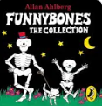
The Wonderful World of Reading

Slide 2
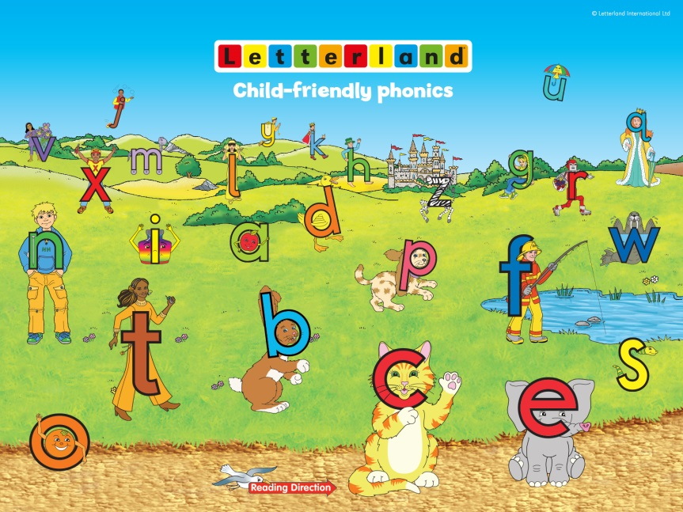
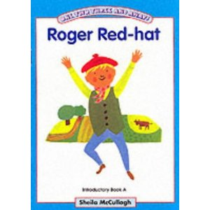
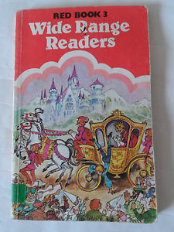
Reading has changed a lot in a short space of time,
it’s a bit less like this…

Slide 3
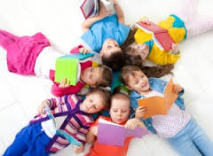
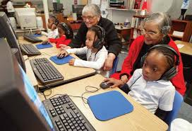
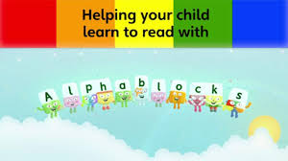
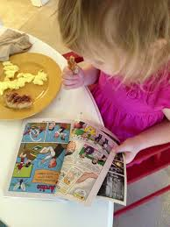
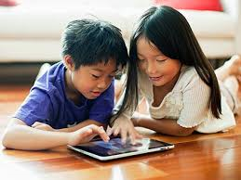
And a bit more like this!

Slide 4
Where do we begin?
1. Listening and Sound Awareness
Goal: Help children notice and distinguish sounds in the environment and speech.
Activities:
  Listening games (e.g., “What sound do you hear?”)
  Identifying environmental sounds (birds, cars, drums)
  Clapping or tapping rhythms and syllable

Slide 5
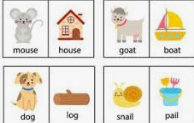
Where do we begin?
2. Rhyme and Alliteration Awareness
Goal: Build sensitivity to patterns in sounds.
Activities:
  Rhyming songs and poems (e.g., “cat–hat–bat”)
  Finding words that start with the same sound (“Silly snake sings softly”)

Slide 6
Where do we begin?
3. Word Awareness
Goal: Understand that sentences are made up of separate words.
Activities:
  Counting words in a simple sentence (“I like dogs” → 3 words)
  Rearranging word cards to make sentences

Slide 7
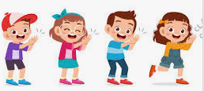
Preschool
4. Syllable Awareness
Goal: Recognize that words can be broken into parts (syllables).
Activities:
  Clapping or tapping syllables (“ba-na-na” → 3 claps)
  Sorting pictures by number of syllables

Slide 8
Preschool
5. Beginning Phonemic Awareness (Individual Sounds)
Goal: Begin to hear and isolate individual phonemes (sounds) in words.
Activities:
  Identifying the first sound in a word (“sun” starts with /s/)
  Matching pictures with the same beginning sound

Slide 9
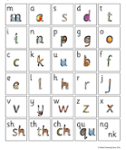
Preschool - Reception
6. Letter–Sound Recognition
Goal: Connect some letters with their sounds — the start of true phonics.
Activities:
  Introducing letters one at a time (especially high-utility ones like S, A, T, P)
  Practicing letter–sound correspondence (“M says /m/ like in ‘mum’”)
  Using songs, letter tracing, and sensory play (sand, playdough, etc.)

Slide 10
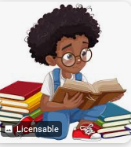
Preschool - Reception
7. Blending and Segmenting
Goal: Begin putting sounds together (blending) and taking them apart (segmenting).
Activities:
  Oral blending (“/c/–/a/–/t/ — what’s the word?” → cat)
  Independent blending
  Simple segmenting (“dog” → /d/–/o/–/g/)

Slide 11
How to help with Phonics?
The children are taught pure sounds:
https://www.youtube.com/watch?v=yln6PpV1G1I
They are supported to blend - oral blending
Independent blending = independent reading

Slide 12
Book Bags - Picture only books
These books build the foundation of reading for meaning and pleasure.
These books teach children how to tell a story from pictures, this is why it’s key to let your child lead the way.
Here’s how you can help:
Let them tell you all about the front cover before you read the title.
Ask questions about the pictures;
Once you’ve looked through the book, ask your child what they can remember. If they are struggling, ask about specific events or people.
These books can be looked over more than once and it’s really normal if your child tells a different story than the first time.
Our school expectation is that children read/share a school book AT LEAST THREE TIMES A WEEK.

Slide 13
Book Bags
Children working from the start of RWInc programme to the Yellow level should be reading their book bag books daily at home.
Here is why:
The strategy of re-reading has proven benefits for the development of early reading. If your child re- reads a book three times a week, we would expect to see progression that looks similar to this:
1st read - sounds out words and starting to understand what is happening by using pictures and talking with a grown up.
2nd read - children will gain a fuller understanding of the story and the characters through reading and talking about their reading with a grown up.
3rd read - children will read at a greater speed by recognising common words. They will read with less mistakes and might start to add some expression.

Slide 14
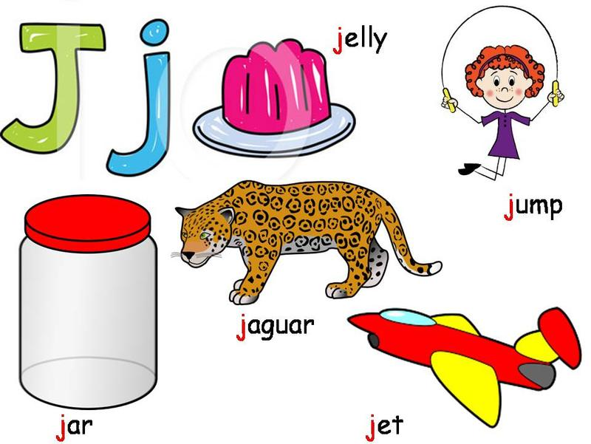
How can I help my child at home?
Read as often as possible.
Play lots of sound and listening games (eye spy etc.)
Encourage and praise “good guesses!”
Discuss the meanings of words they do not come across regularly.
Websites and Games

Slide 15
Thank you

