Slide 1
Maths in EYFS

Slide 2
Early Learning Goals
Number
• Have a deep understanding of numbers to 10, including the composition of each number.
• Subitise (recognise quantities without counting) up to 5.
• Automatically recall (without reference to rhymes, counting or other aids) number bonds up to 5 (including subtraction facts) and some number bonds to 10, including double facts.
Numerical Patterns
• Verbally count beyond 20, recognising the pattern of the counting system.
• Compare quantities up to 10 in different contexts, recognising when one quantity is greater than, less than or the same as the other quantity.
• Explore and represent patterns within numbers up to 10, including evens and odds, double facts and how quantities can be distributed equally.

Slide 3
Have a deep understanding of numbers to 10, including the composition of each number.
Regonsising (reading) numbers 0-10
Knowing all the ways to make all numbers to 10 for example: 4 is 1+1+1+1, 3+1, 1+3, 2+2
Practicing this at every opportunity is so important, real life examples can really help consolidate this learning

Slide 4

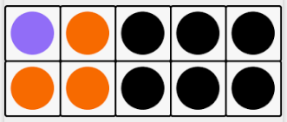
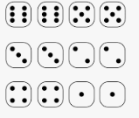
Subitise (recognise quantities without counting) up to 5.

Slide 5
Automatically recall (without reference to rhymes, counting or other aids) number bonds up to 5 (including subtraction facts) and some number bonds to 10, including double facts.
Linked to 1st goal: Have a deep understanding of numbers to 10, including the composition of each number.
Here we are looking for the recall:
2+3=5 4-2=2 2+1=3 5-1=4 5+5=10 3+3=6 5+2=7
Again allowing children to use and see what this maths looks like in the real world makes such a difference

Slide 6
Verbally count beyond 20, recognising the pattern of the counting system.
Counting 11-19 is the anomaly
Once you get to 20 it makes sense and we are looking for the understanding that 23 comes after 22, and 33 comes after 32 ect
This is just orally counting there is no expectation that the children can read these numbers - however showing them what the numbers look like when you see them never does any harm. Page numbers, dates, bus/train numbers, weights on scales while cooking

Slide 7
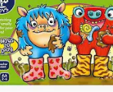
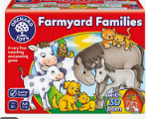
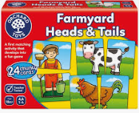
Compare quantities up to 10 in different contexts, recognising when one quantity is greater than, less than or the same as the other quantity.
Good opportunities to practice this are games where you have to get more/less than the other person

Slide 8
Explore and represent patterns within numbers up to 10, including evens and odds, double facts and how quantities can be distributed equally.
Counting patterns — noticing that numbers go up by 1 each time (1, 2, 3…) or down by 1.
Odd and even patterns — even numbers can be paired, odd numbers have “one left over”.
Visual patterns — recognising amounts without counting (e.g., dice patterns, ten frames).
Repeating patterns using numbers — like 2, 4, 2, 4… or 1, 2, 3, 1, 2, 3…
Comparing patterns — noticing that 8 is “2 more than 6”, or that 10 is the “biggest number in the set”.
Real world examples and practice!!!!

Slide 9
Extras
Days of the week - in order and understanding yesterday and tomorrow
Months of the year - in order
Units of time - minutes, hours, grams, KG, meters, degrees
Right and left
Forward, backwards, infront, behind, on top of etc

Slide 10
Take away message
Why do we learn maths in school… so we can use it in real life!
The more they can experience maths in everyday life the more meaning it has and that’s when secure learning happens.

