Slide 1

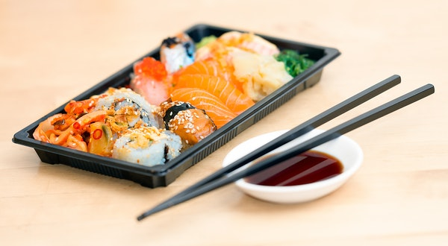


RESI THEME NIGHTS 25-26
Slovakian Theme
Japanese Theme
St Georges Day
World Cup
Celebration of world foods
17th November
19th January
20TH April
15th June
Theme nights are on every night of the above weeks so everyone can join in.

