Slide 1
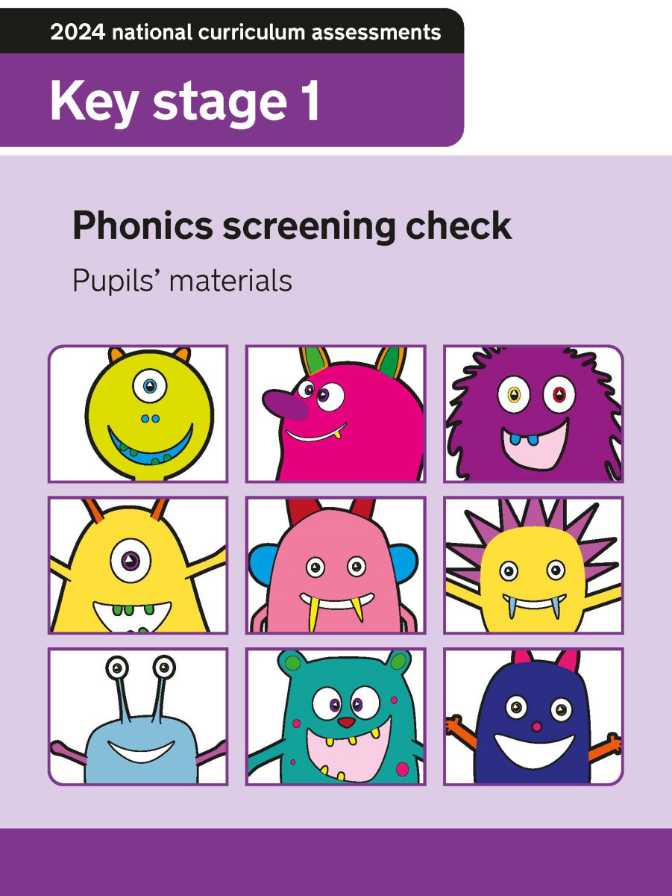
Phonics Screening Parent’s Information Meeting

Slide 2
What is the Phonics Screening Check?
The Year 1 Phonics Screening Check was introduced in 2012 as part of a policy to strengthen Phonics teaching in Primary Schools and reflect the emphasis on teaching it synthetically and systematically.

Slide 3
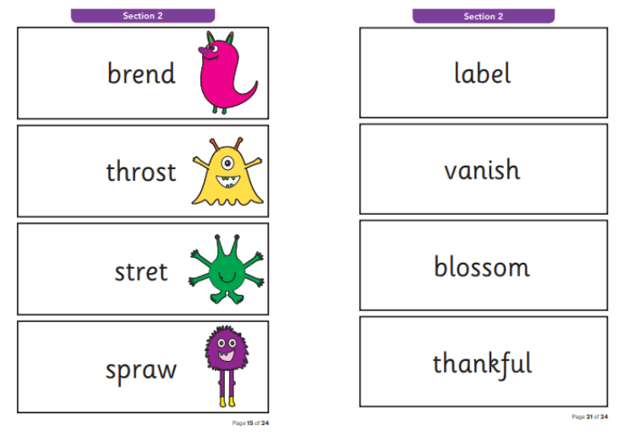
During the screening children will be asked to read a list of 40 words to check their grapheme recognition and decoding skills.
The words are made up of real words and non-words (alien words)
There are 2 sections to the check
Section 1: words using graphemes from earlier phases of Phonics including Phase 3 digraphs and adjacent consonants.
Section 2: words that contain Phase 5 alterative graphemes and split digraphs

Slide 4
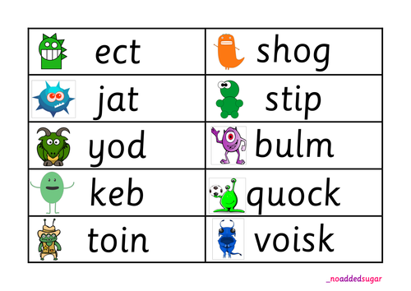
Why alien words?
Reading non-words can act as a useful tool to check whether children are secure in their phonic knowledge and can apply it to read any word. They check their decoding skills rather than relying on memorising words.

Slide 5

How is the check held?
The check will be administered by Miss Davies in a familiar environment. In the weeks leading up to the assessment the children become very familiar with the structure and expectations.
The check usually takes up to 10 minutes or less, there is no time limit so if children need more time they can have it.

Slide 6
Each year the score that children need to achieve in order to pass the screening isn’t announced until after the check has been administered.
For the past, several years the score has remained at 32/40, however this could change.
If children don’t achieve the pass score, there is nothing to worry about. We will be able to use their results to fill any gaps in the children’s learning and offer additional support as the progress through the rest of the year.
Those children who don’t pass the check will take it again in the Summer of Year 2.
We have begun a baseline assessment of the check in Rowan at the beginning of this half term to identify any gaps we need to support the children with.

Slide 7
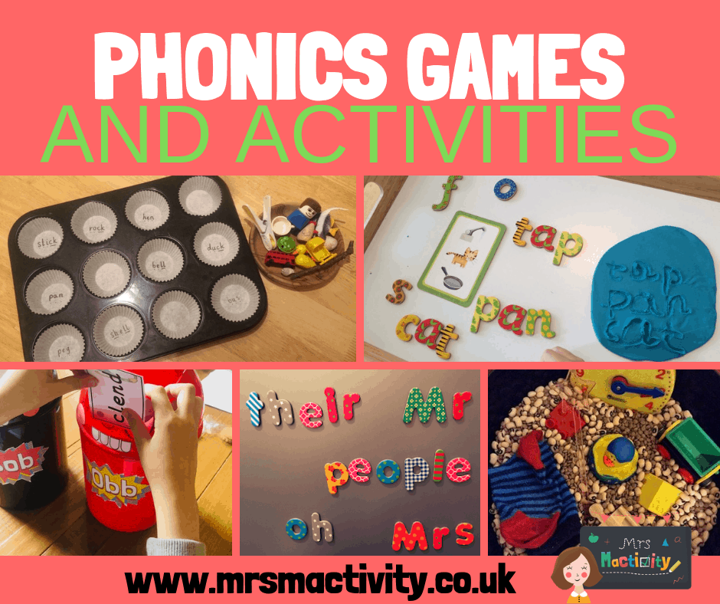
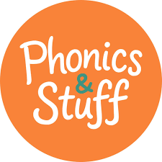
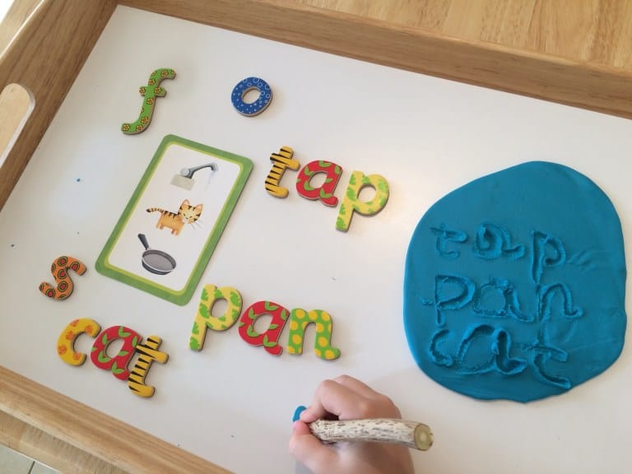
How can you help your child prepare?
Reading current and previous QR coded books at least 4 times a week encouraging them to segment and blend words.
Play fun and practical games where they can practise reading real and non-real words.
https://www.phonicsplay.co.uk/
https://phonicsandstuff.com/

