Slide 1

Welcome
Acorns curriculum evening
With thankful hearts, we trust in God as we grow in his love
which shines through us. We aim to live our faith and grow in wisdom.

Slide 2
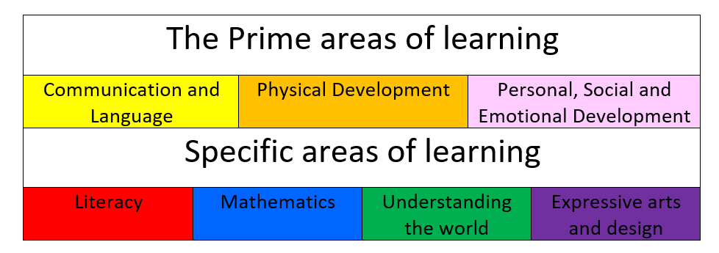
Early Years Curriculum
Train up a child in the way they should go and when they are old they will not depart from it. Proverbs 22:6

Slide 3


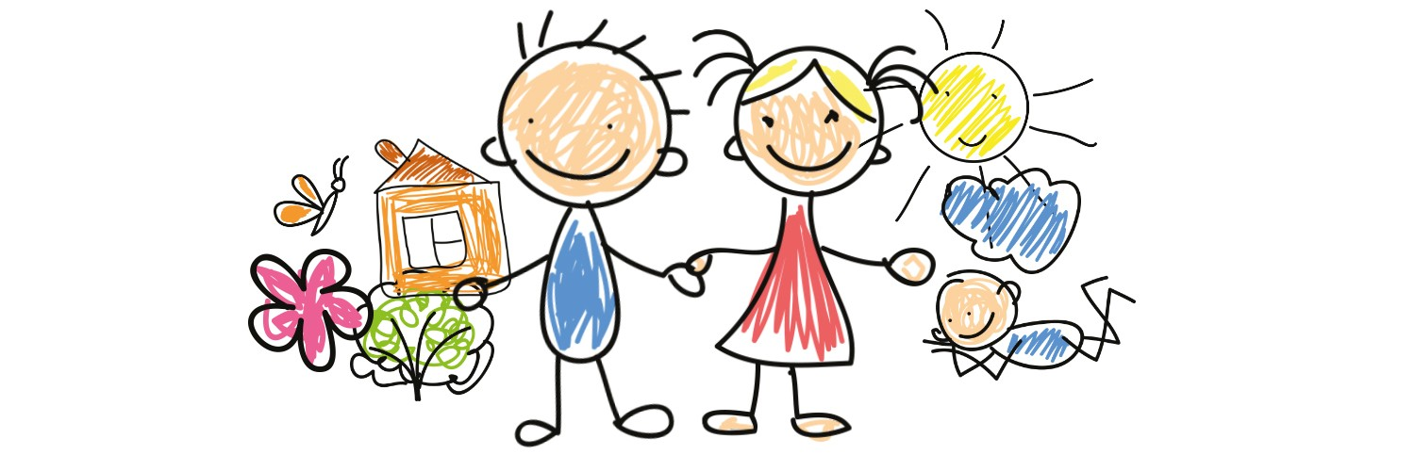
The Prime areas of learning
Personal, Social and
Emotional
Communication & Language
Physical Development
Making relationships
Self-confidence and self-awareness
Managing feelings and behaviour
Listening & Attention
Understanding
Speaking
Moving and handling
Health and self-care

Slide 4


Specific areas of learning
Literacy
Maths
Reading
Writing
Number
Shape, Space & Measure

Slide 5


Specific areas of learning
Expressive arts
and design
Understanding the world
People and communities
The World
Technology
Develop imagination
Foster creativity
Use media and materials

Slide 6

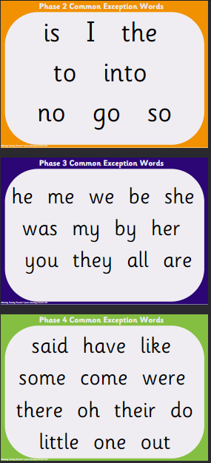
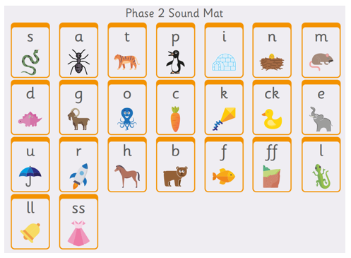
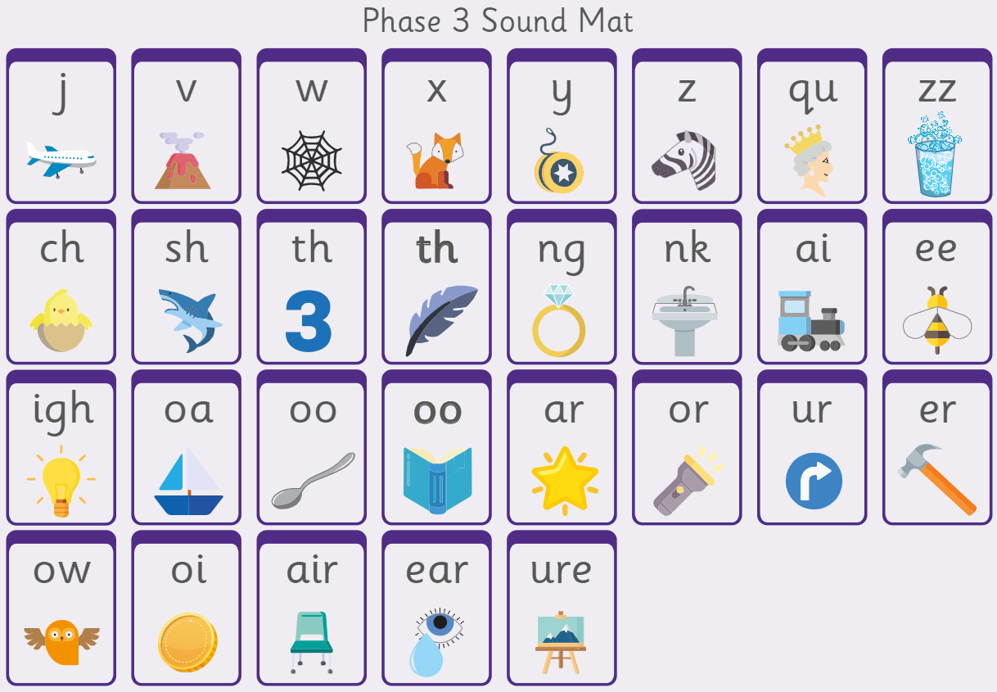
Phonics
Daily phonics lessons using Ready Steady Phonics
Phases 2 – 4 are completed in Reception

Slide 7
Phonics Terminology
Phoneme: Is a sound. We think about how many sounds a word contains.
Eg ‘hat’ has 3 phonemes h-a-t. The word ‘ship’ also has 3 phonemes sh-i-p
Segmenting: breaking up a word into its individual sounds. /b/ /e/ /d/ = bed
Blending : Putting the sounds together to read a word. /ch/ /ai/ /n/ = chain
Common Exception words: Words that cannot easily be decoded phonetically. E.g. the was said
Grapheme: The letter or group of letters representing a sound. The spelling of the sound.
Diagraph: Two letters that make one sound when read ‘sh’
Trigraph: Three letters that make one sound Eg ‘igh’.

Slide 8
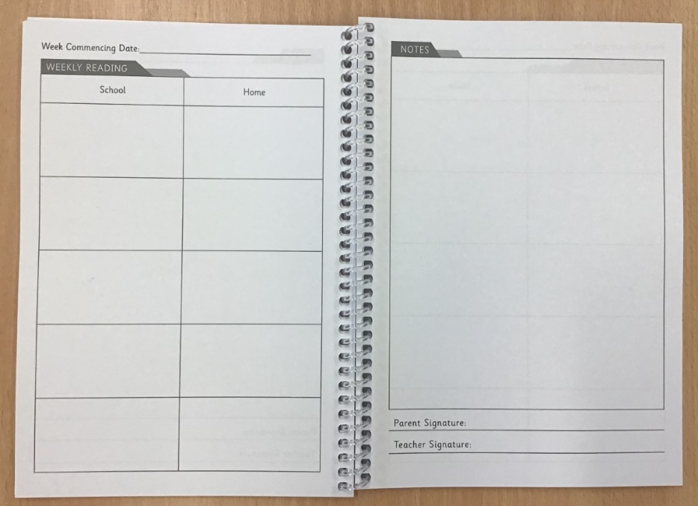
Reading
A large emphasis will be placed on getting your child to read by the end of the year.
Children will read with an adult in school at least once a week.
Children read at home with an adult at least 4 times a week. Please sign and write a comment in your child’s home-contact book when they have read.
The children will be given a QR code in their reading diaries at the end of each week. This gives you access to a reading book that matches the sounds that have been covered in their phonics sessions. This should be the primary book that they read at home and should be read as independently as possible. They will also be given a secondary book which may require a little more help to decode.
In Reception children will have lots of opportunities to read during continuous provision.

Slide 9
What can you do to help?
The role of parents/ carers is vital in supporting your child to read. Read, read and read some more!
Get children to have a good look at the pictures first, always talk about what they can see in the pictures, what they think the story may be about before attempting the text.
Get children to point to the letters as they sound out and then move their finger underneath the word as they read it.
Get children to practice spotting common exception words in their books.
Play fun games to learn the common exception words.
Use sound mats to revise the phonics sounds the children have been learning.
Talk to your child about the books they read. Ask them questions about the text.

Slide 10



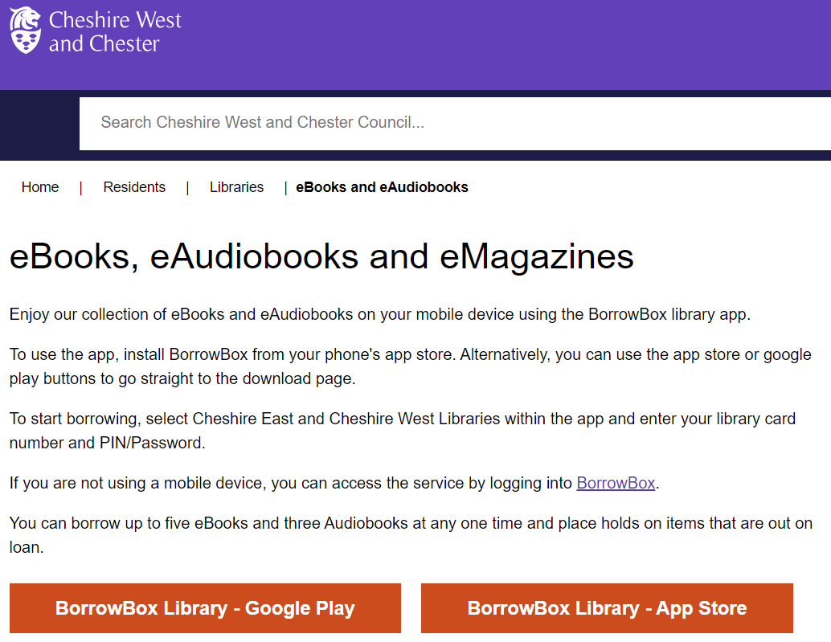



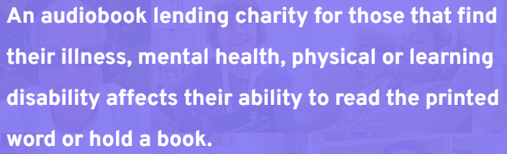

Developing language and a love of reading with Audiobooks
£20 per year!

Slide 11
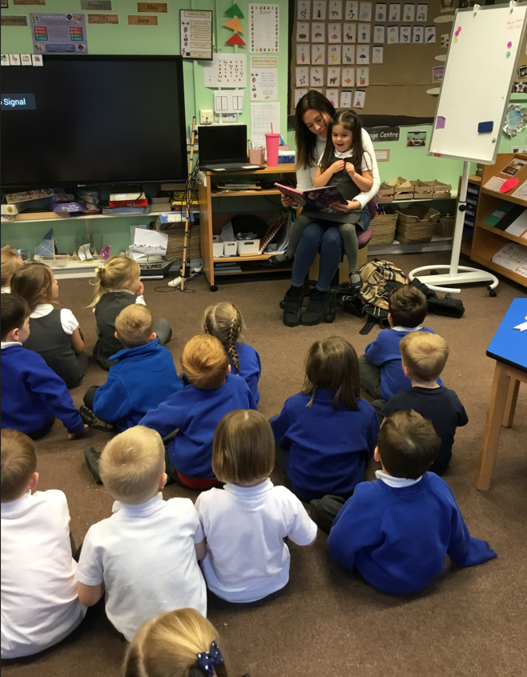
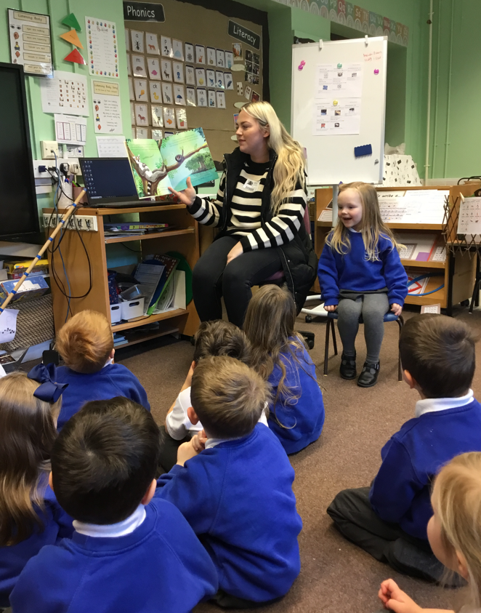
Mystery Reader
?

Slide 12
Maths
Maths lessons focus on developing the children's maths fluency skills.
We give the children lots of opportunities for practical maths which helps to enhance their understanding.
We link Maths to our topic where possible.

Slide 13
Examples of Maths Objectives
Count objects, actions and sounds (to 20).
Compare numbers.
Say which number is ‘one more than / one less than’ a given number and understand the relationship between consecutive numbers.
Know the composition of numbers to 5.
Count reliably with numbers 20.
Continue, copy and create repeating patterns.

Slide 14

What can you do to help?
Help your child learn to form their numbers correctly.
Help your child learn their number bonds to 5 then 10.
Help your child learn doubles and halves to 10.
Play maths games in the car e.g. Guess my number.
Play card games using dice which involve quick adding calculations.
Make the most of ‘Real life’ opportunities e.g. baking or paying with money at the shops.

Slide 15

Writing
In Reception children will be gradually introduced to writing. This will mainly consist of mark making and correct pencil grip in the Autumn Term.
Children are taught to spell words using their phonic knowledge. e.g. a-p-l (apple), h-or-s (horse), p-i-g (pig).
Children are taught to spell common exception words by memory e.g. the, to, no, I.

Slide 16
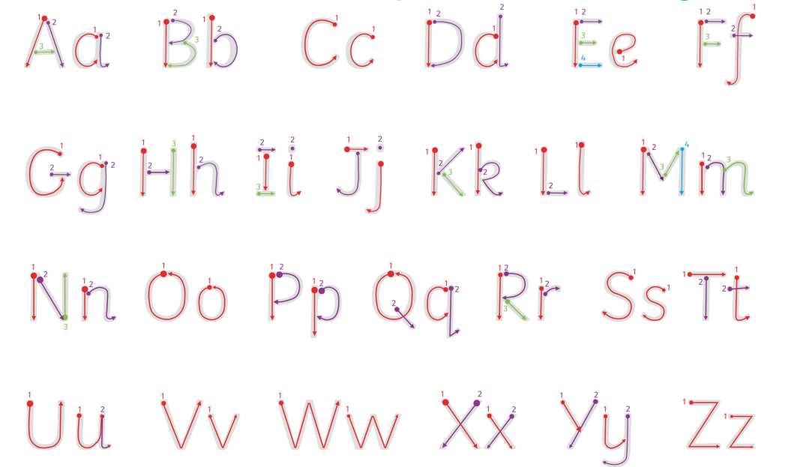
What can you do to help?
Don’t force your child to write! If your child wants to write, try to help them write their name and form
their letters correctly.
A ‘handwriting mat’ – encourage.
Let them see you write.
If the opportunity arises use descriptive language.
Encourage your child to write during play. e.g. cards, shopping lists.
Encourage your child to spell words using their phonic knowledge.
Help them count the sounds in words and then write them down.
Encourage your child to ‘stretch’ out words so they can hear all the sounds when spelling.
Do lots of fine motor activities with your child. e.g. threading, using tweezers, pincer grasp activities.

Slide 17
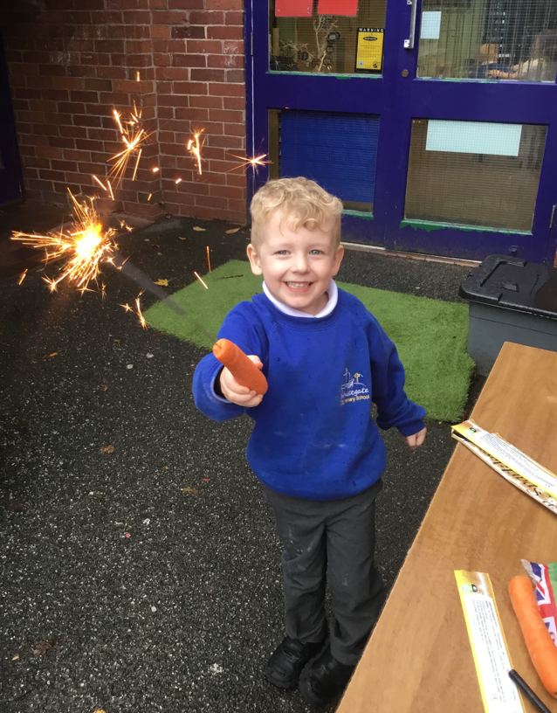
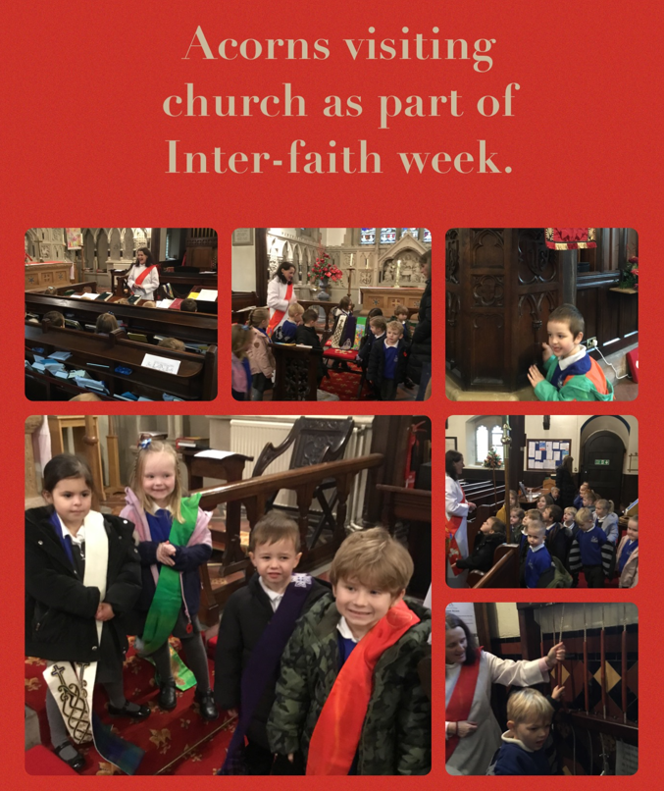
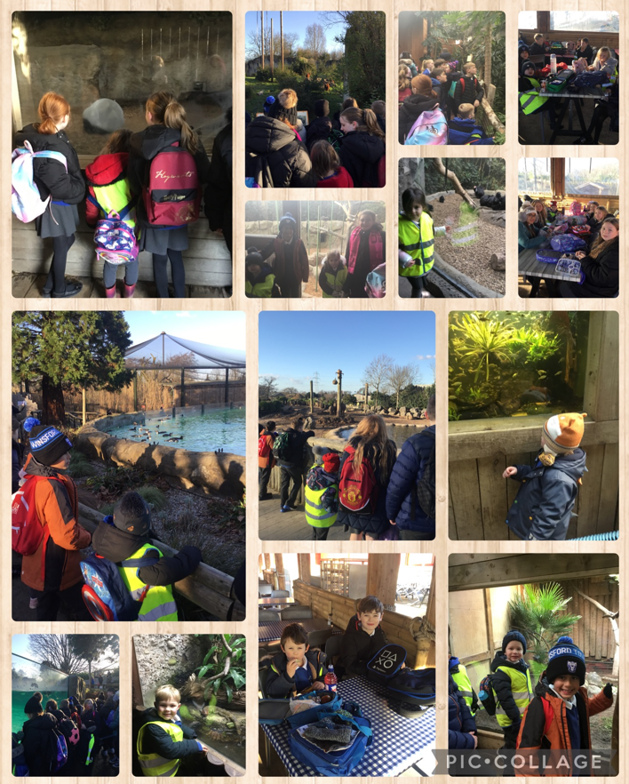
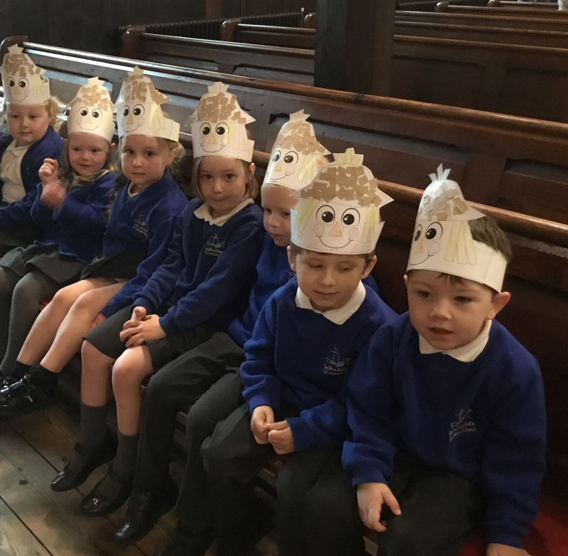
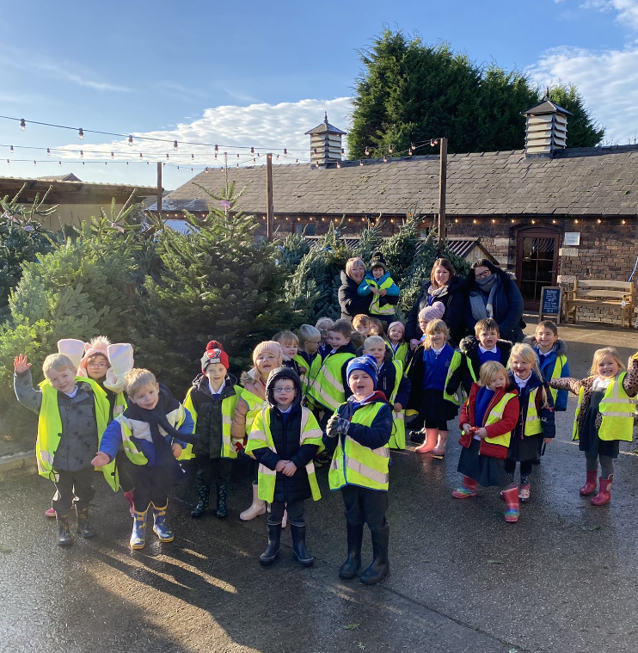
Personal Development
There are various enrichment opportunities that take place in Acorns throughout the academic year to support the learning and development of pupils and broaden their experiences and opportunities outside of the classroom.
Wider curricular activities can include carefully planned activities/days in school, visits into the community and visitors into school.

Slide 18

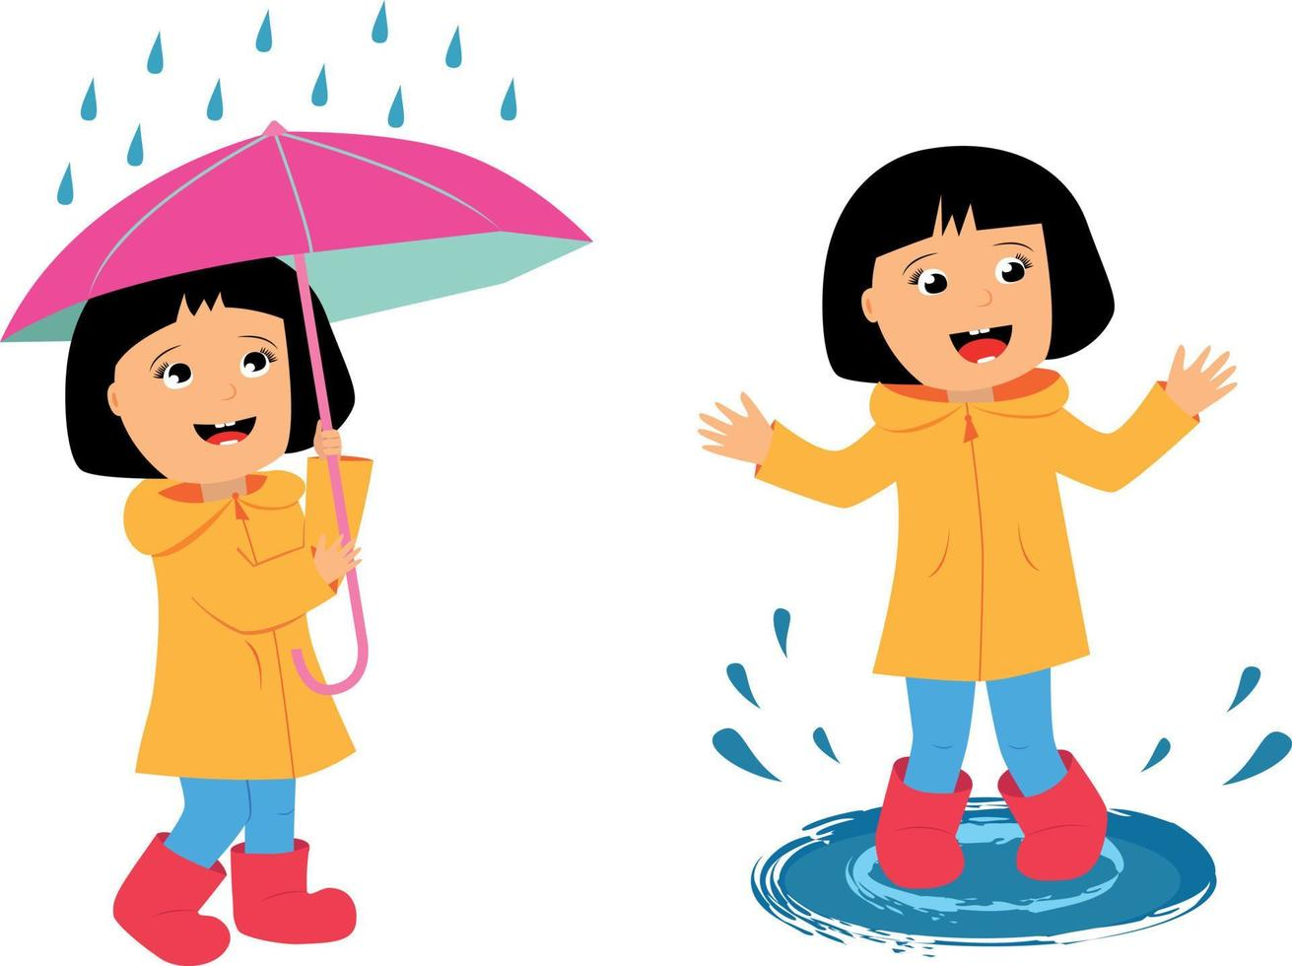
Outdoors
Homework
Outdoor learning provides children with the opportunity to explore, be physically active, to work on a large scale and to experience the natural world.
Children are given the opportunity to learn outdoors every day in all weathers.
Daily reading (4 times a week as a minimum)
Christian Value activity every half
term.

Slide 19
Learning Journeys
Paper based ‘Learning Journeys’ are completed throughout the year. You will get the opportunity to see the learning journeys at each Parent’s Evening.

Slide 20
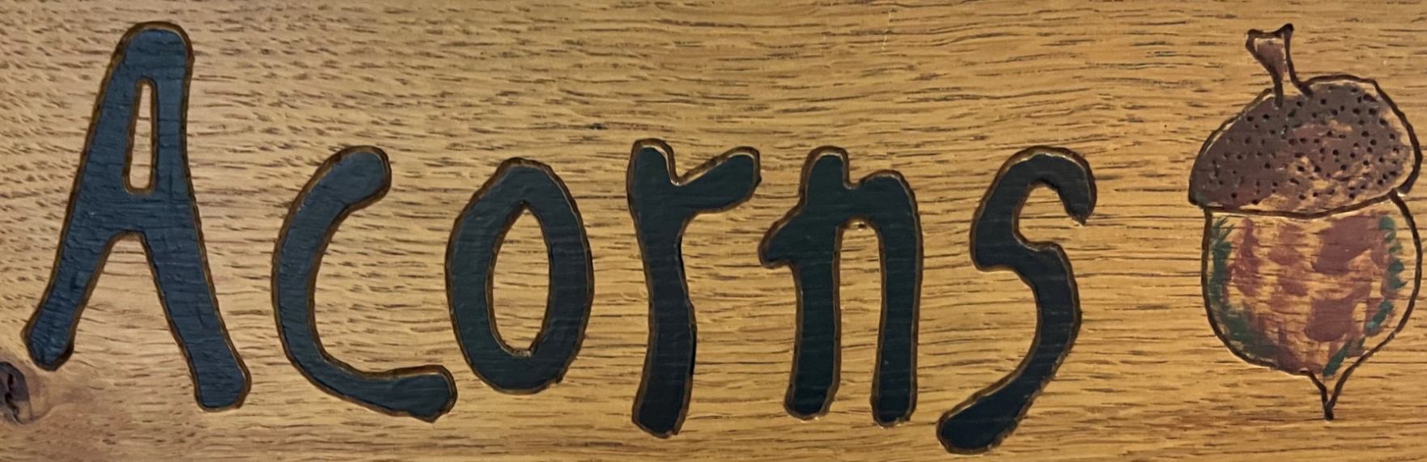
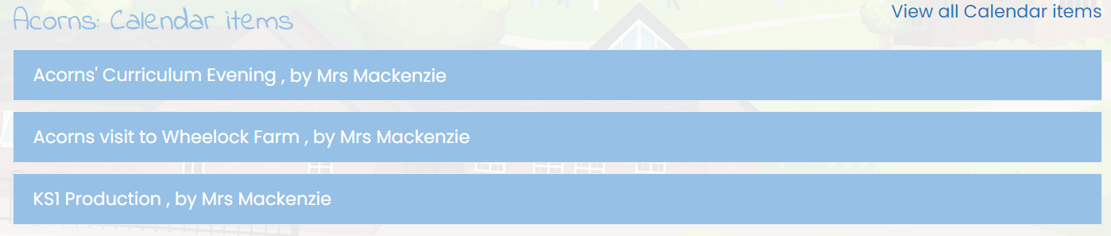
Communication
Please refer to the school calendar for important dates. It can be found at the bottom of the main page on the school website.
Website
Home-School Contact Book
ParentMail
Newsletters
Parent meetings
End of year reports
Face to face (on the playground and additional meetings if required)
Sharing Assemblies

Slide 21

Messages from Mrs Mackenzie
The Ark
Trust Appeal
Attendance including holidays in term-time
Punctuality
Parking

Slide 22

We understand that the transition to school is difficult but please be assured we are doing everything we can to make sure that you and your child are happy and supported.
We have an open door policy – if you have any concerns questions please do come and talk to us.
Thank you
Have I not commanded you? Be strong and courageous. Do not be frightened, do not be dismayed, for the LORD your God is with you wherever you go. Joshua 1:9
Teach me knowledge and good judgement, for I trust your commands. Psalm 119: 66

