Slide 1


Summer 2 – The Explorer
Week 5 and 6
Shape Poetry

Slide 2
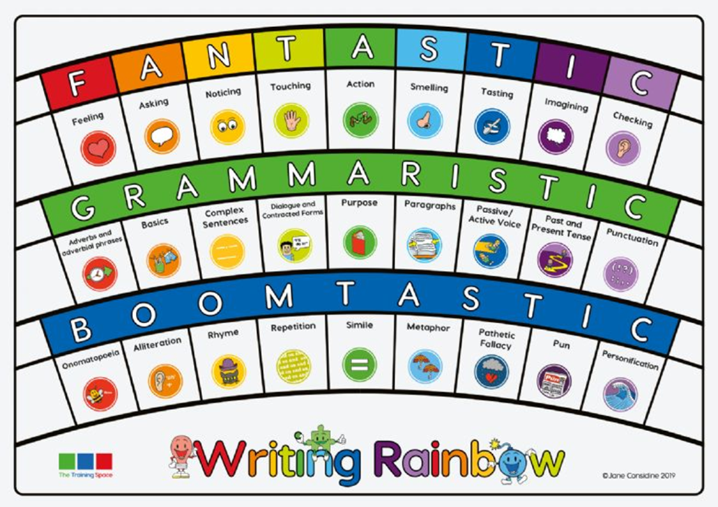

Slide 3
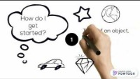
Lesson 1- WAGOLL Shape Poems
LC: WC9 Assessing the effectiveness of their own and others’ writing
SL7D Preparing poems and plays to read aloud/perform, showing understanding through intonation, tone and volume so that the meaning is clear to an audience
Purpose: to entertain, there may also be a secondary purpose to inform depending on topic.
Audience: many different audiences. It is hard to say a poem is for a certain age as they can be enjoyed by all. The language used can give you a hint as to who it is mainly aimed at.
Formality: no set formality.
Watch the clip to find out more about shape poems.

Slide 4
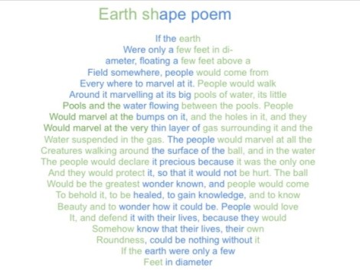
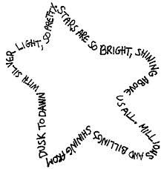
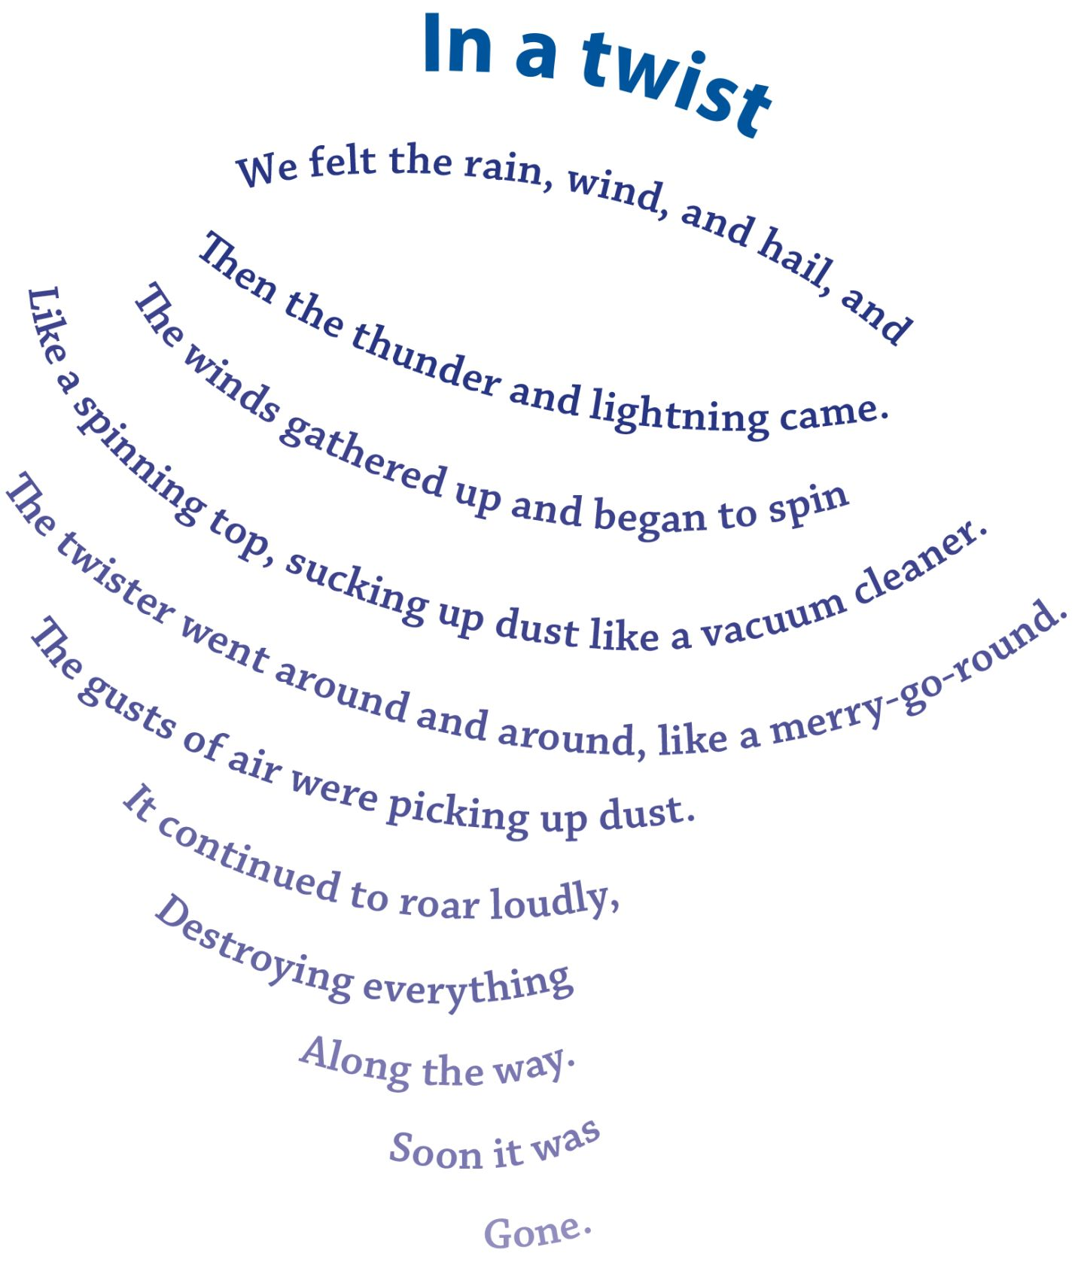
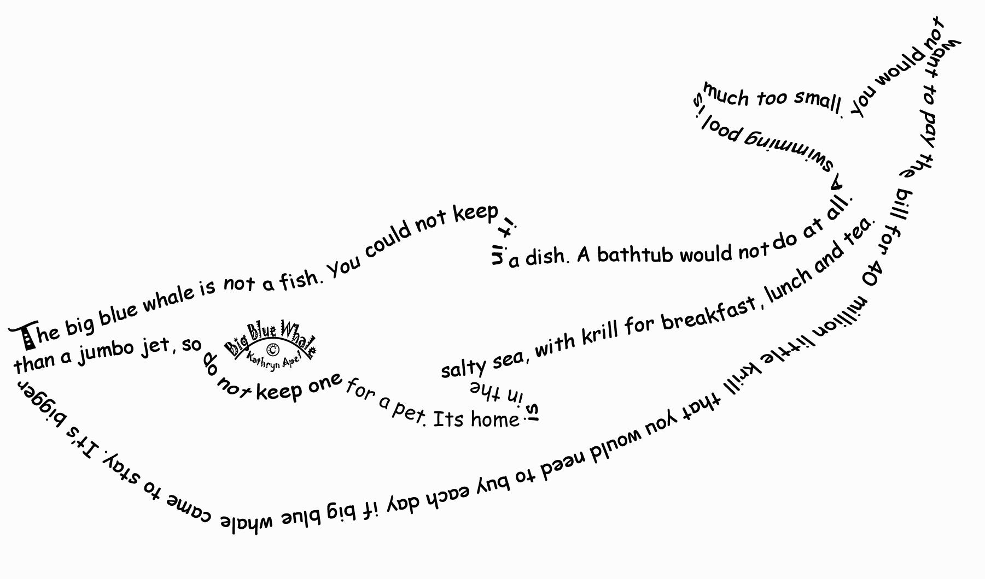

Slide 5

Read through the shape poem examples and discuss with a partner using the talking point questions
What is this poem about? What is its purpose?
How might someone feel when they read this poem?
Are there any rhymes or alliteration?
What are your favourite descriptive phrases?
Does anything happen in the poem?
Who might really like this poem?
Who might really dislike this poem?

Slide 6
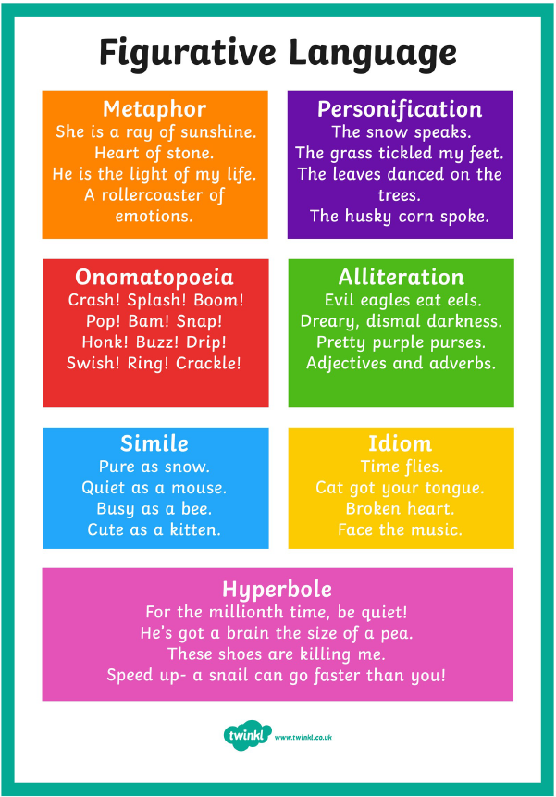
Lesson 2- Figurative language
LC: WC1 Identifying audience/purpose, selecting the appropriate form and using similar writing as models
Poetry allows us to be very creative meaning figurative language is great to use.
Think back to the WAGOLLs. Which figurative language devices did they use a lot of?

Slide 7

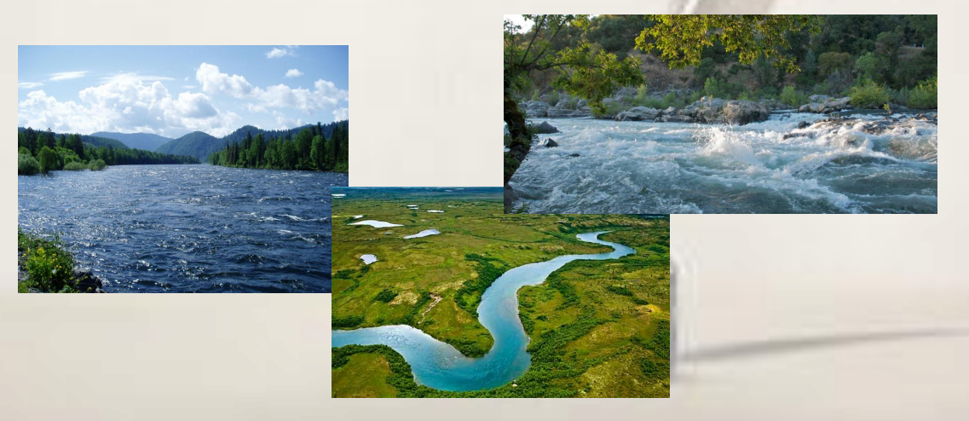
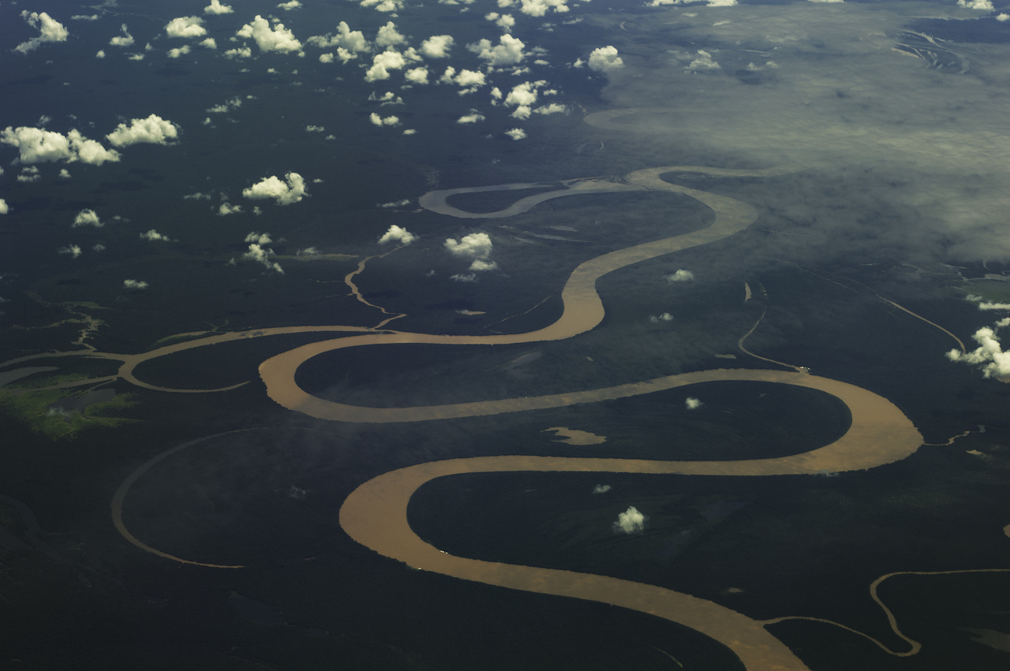

Today we are going to gather ideas to describe the Amazon River so we can then produce a shape poem about the river.
TTYP- what adjectives can you think of to describe a river? Look at the images and listen to the sounds.

Slide 8
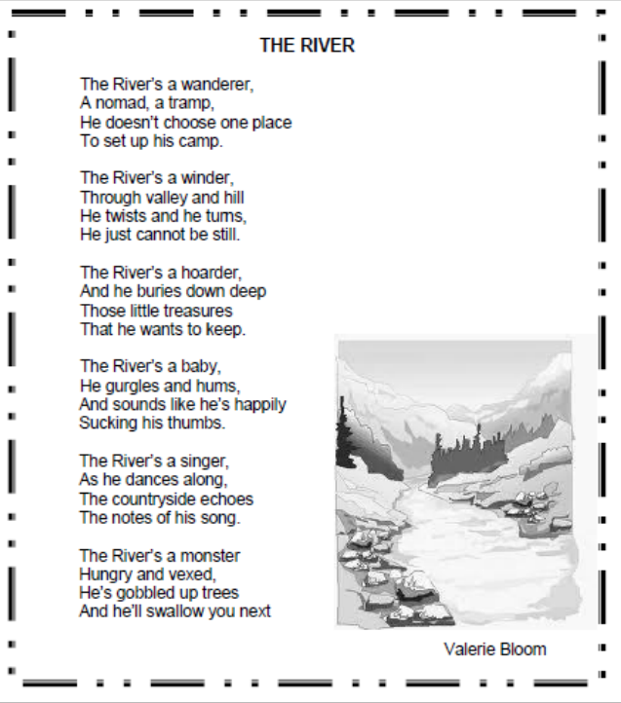
How is it structured?
Does it have a rhyme pattern?
Are there any words you are unsure of?
How does it describe a river?
What techniques are used throughout the poem?
What do you think of the poem?

Slide 9
Imagery: The main image is that of a river and its movements.
Metaphors: The river is said to be a wanderer, a winder, a collector, a baby, a dancer and singer and a destroyer.
Repetition: the words, ‘The River’ is repeated and this gives emphasis to the subject.
Simile: The river is like a baby happily sucking his thumb.

Slide 10
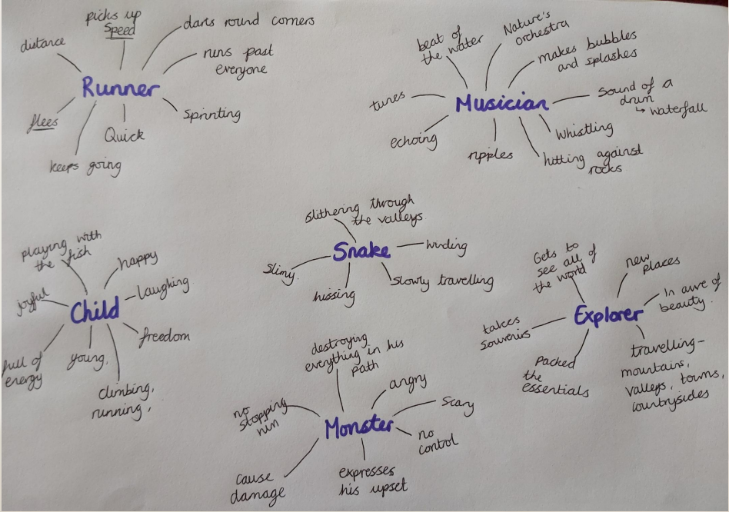
What do you think a river is?
Mind map or make a note of your ideas.
Then expand on them and write why you think this is.
e.g. a runner, a musician, a child, an explorer, a snake, a jewel, a giant etc.
Gather similes, metaphors, personification, rhyming words and noun phrases which you can then use to write your poem.

Slide 11
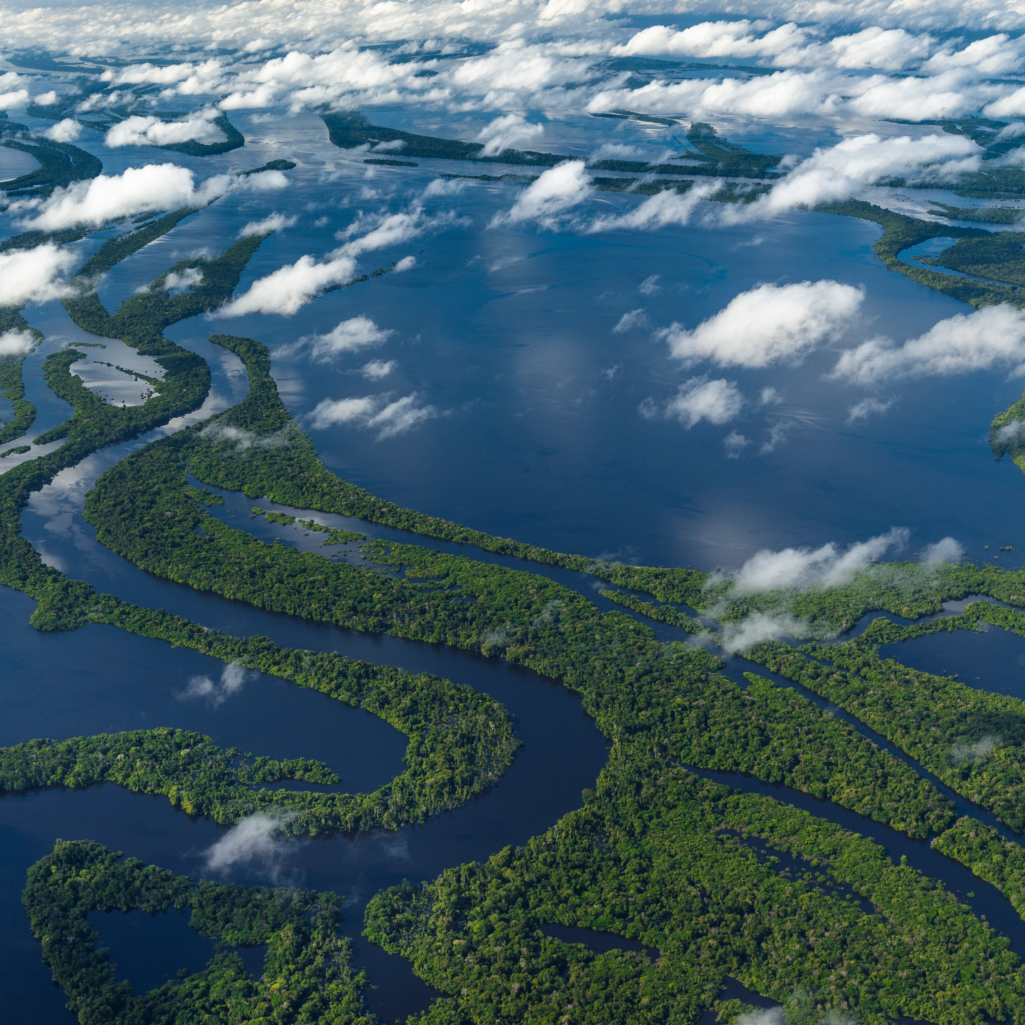
Lesson 3- Compose a river poem
LC: WC1 Identifying audience/purpose, selecting the appropriate form and using similar writing as models
Today you will be writing your own Amazon River poem.
You can follow the style of the poem we looked at by Valerie Bloom to help you structure your poem.
Try to use the same rhyming pattern if you feel confident, if not just ensure each stanza has 4 lines and are linked together.

Slide 12
My example
The River’s a runner,
always winning the race,
Picking up speed, sprinting,
keeping the pace.
The River’s a musician,
splashes of water echoing.
The sound of beats and drums,
nature’s orchestra playing.
The River’s a child,
Playing happily in fields.
Full of life and energy, laughing,
rolling down hills, cannot be concealed.

Slide 13

Lesson 4- Compose a river poem
LC: WC1 Identifying audience/purpose, selecting the appropriate form and using similar writing as models
Read back over the poem you wrote yesterday and check it through.
Have you used a rhyming pattern? If so check with someone else if your words do rhyme.
RhymeZone rhyming dictionary and thesaurus
Do your stanzas have a theme? Are all the lines linked to what you have said the river is?

Slide 14
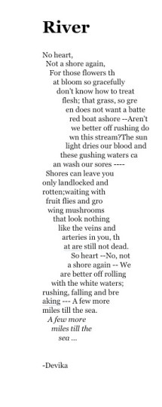
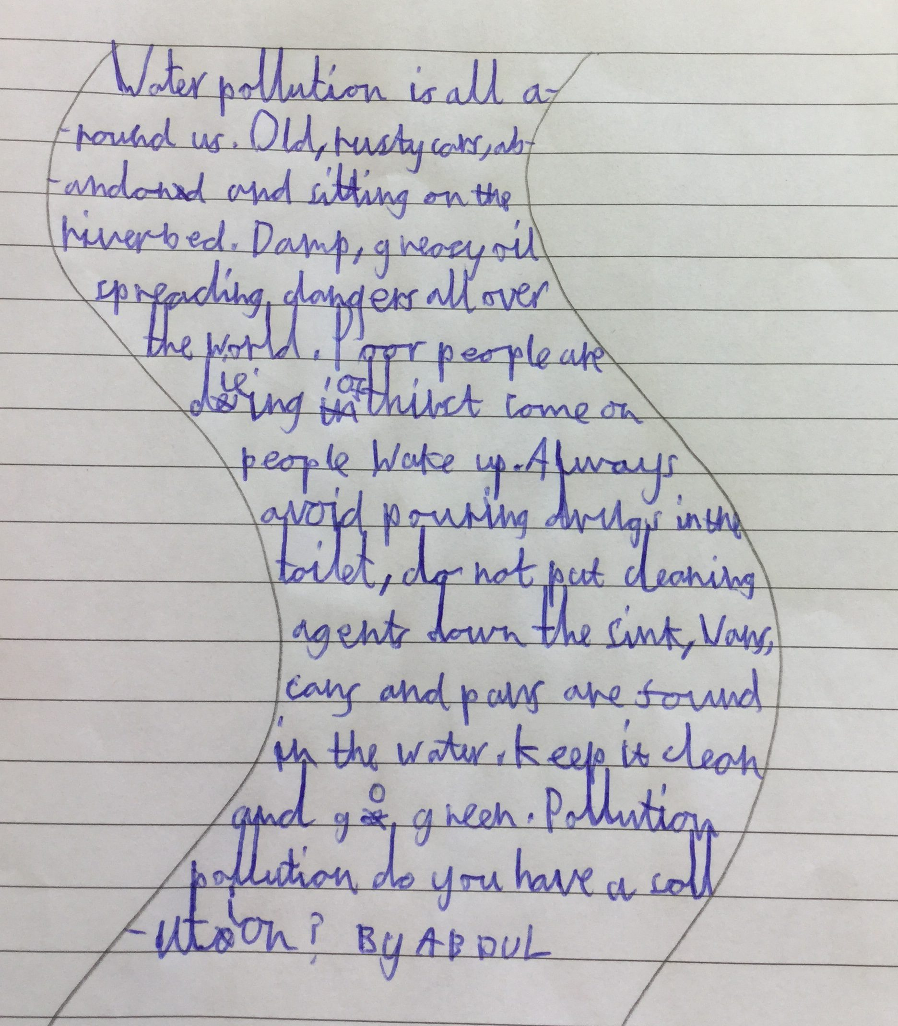
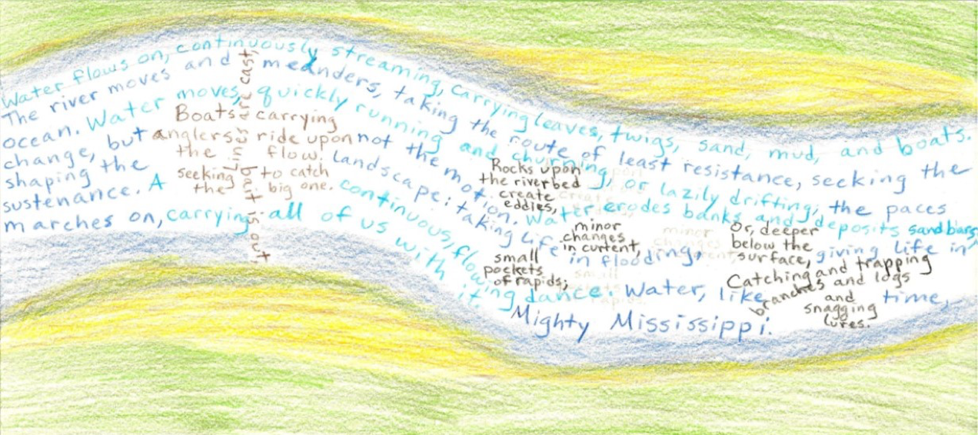
River shape poem examples
Your task today is to transform your brilliant poem from yesterday into a shape poem. Here are some examples below to help you with ideas.
At the end of the session perform your poems as this is a Year 5 objective to be able to perform your poems aloud.

Slide 15
Lesson 5- Planning ideas
LC: WC1 Identifying audience/purpose, selecting the appropriate form and using similar writing as models
Today you have free choice for your poem.
Think of a noun that you are confident and familiar with. It could be: an animal, a season, a food, a mythical creature, the weather, a feeling.
Your task: Draw your noun in the middle of the page and create a mind map of descriptive words and phrases.
See if you can include: • adjectives • similes /metaphors • powerful verbs and adverbs • all the senses (see, hear, smell, touch, taste)

Slide 16
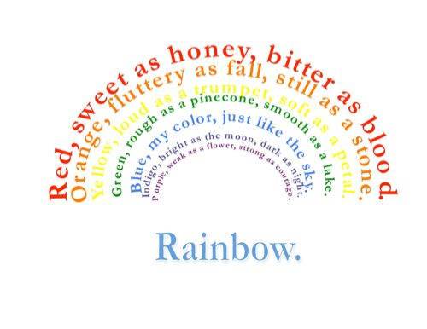
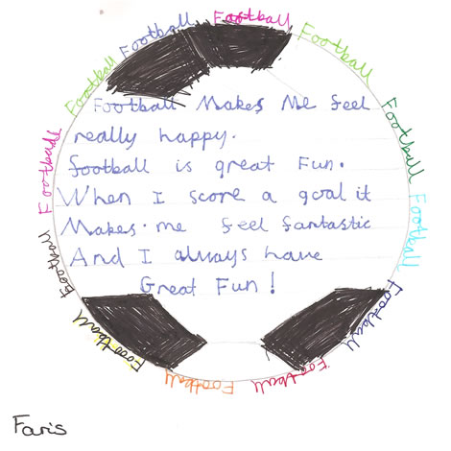
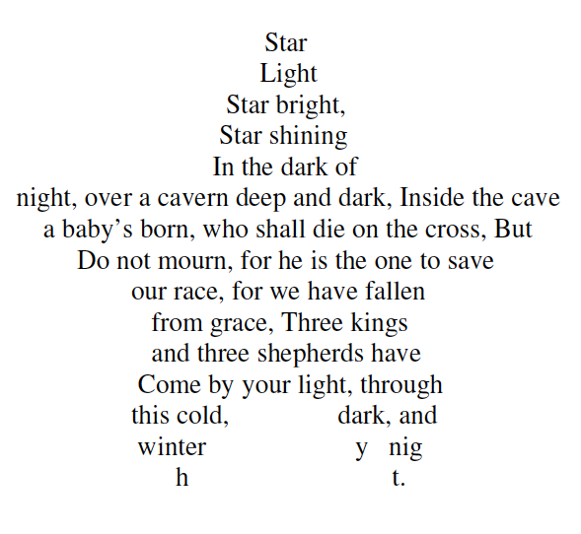
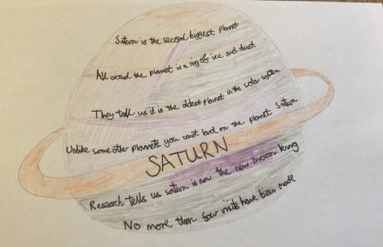
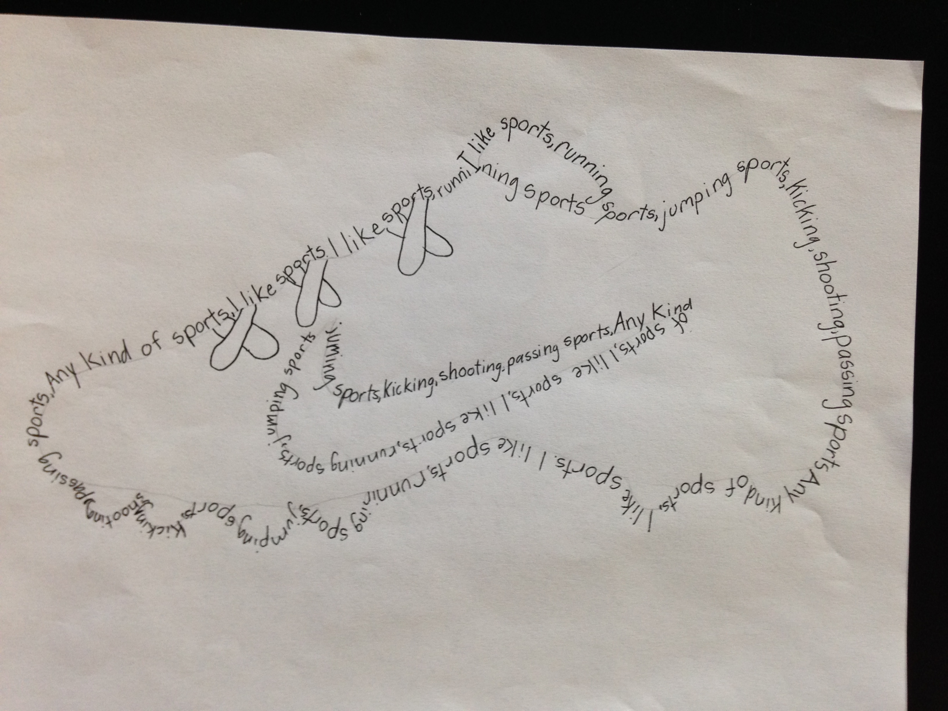

Slide 17
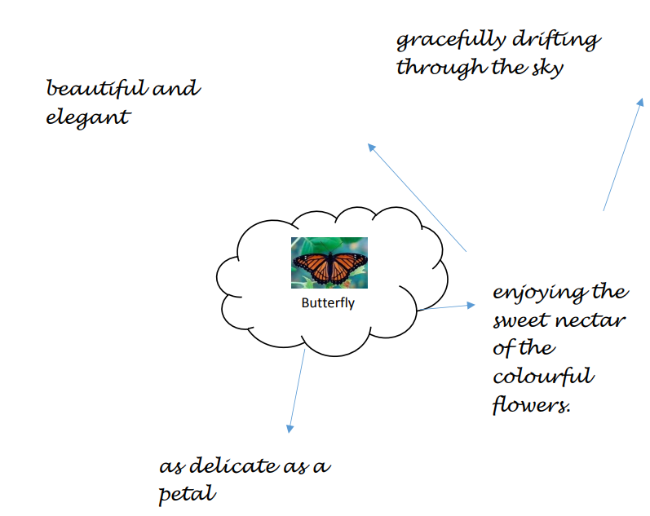
Gather your ideas like a mind map.
You need to try and think of about 8 different things.
Could you write it like the river poem you did?

Slide 18
Lesson 6- Compose
LC: WC1 Identifying audience/purpose, selecting the appropriate form and using similar writing as models
Use the ideas your gathered yesterday to now write your own poem about your chosen topic.

