Slide 1
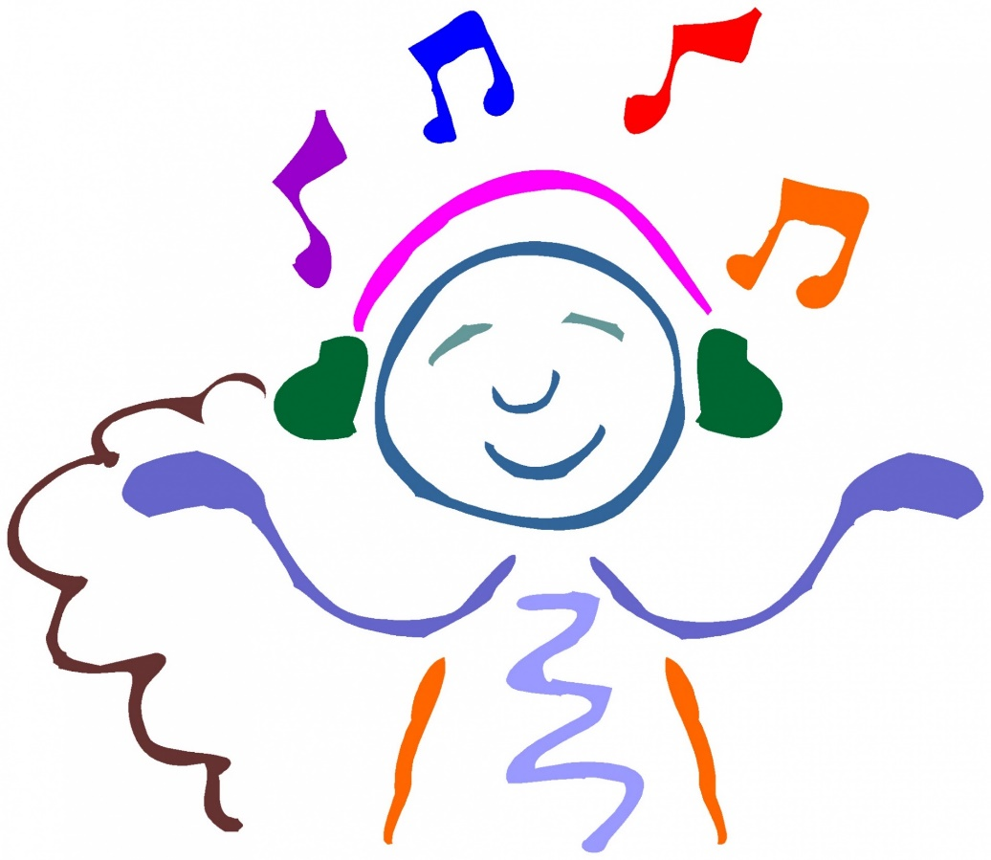

Thursday 14th July 2022
Music: Reflect, Rewind and Replay
EAD: Perform songs, rhymes, poems and stories with others, and, when appropriate, try to move in time with music.

Slide 2
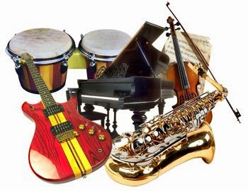
1. Listen and Appraise (Reflect and Rewind)
● Listen and Appraise - E.T. Flying Theme by John Williams (Contemporary film music)
https://www.youtube.com/watch?v=oGdRasC4O_k
● Rewind and Listen Out! I Feel Good by James Brown. A listening activity to remember songs, instruments and their sounds.
https://www.youtube.com/watch?v=U5TqIdff_DQ
Compare the different pieces of music. Can the children recall the different instruments played? How did each piece of music make you feel?

Slide 3
2. Music has its own language which we will become familiar with over time. This week we are going to revisit ‘Pitch’.
Click on the link below to find out more information on ‘Pitch’
https://www.youtube.com/watch?v=kvwUBKPgU5A
Sing some of your favourite rhymes learnt this year. Can you identify the pitch in each song?

Slide 4

3. Rewind and Replay (Revision) - revisit songs from the year.
Songs can include: ‘I’m a little teapot’, ‘5 little monkeys’,’ ‘If you’re happy and you know it’.
https://www.youtube.com/watch?v=buE6l32rCHo
4. Perform and Share (Replay)
Prepare for a performance of nursery rhymes, songs and activities from the year.

