Slide 1
Friday – o’clock
Sing Hickory dickory dock
https://www.youtube.com/watch?v=HGgsklW-mtg
Sing Whats the time Mr Wolf?
https://www.youtube.com/watch?v=qY4LG7SoRgI

Slide 2
Disclaimer/s
We hope you find the information on our website and resources useful.
Animations
This resource has been designed with animations to make it as fun and engaging as possible. To view the content in the correct formatting, please view the PowerPoint in ‘slide show mode’. This takes you from desktop to presentation mode. If you view the slides out of ‘slide show mode’, you may find that some of the text and images overlap each other and/or are difficult to read.
To enter slide show mode, go to the slide show menu tab and select either from beginning or from current slide.
You may wish to delete this slide before beginning the presentation.

Slide 4
Questions
60
How many seconds are there in a minute?
60
How many minutes are there in a hour?
30
How many minutes are there in half an hour?
28-31
How many days are there in a month?
365
How many days are there in a year?

Slide 5
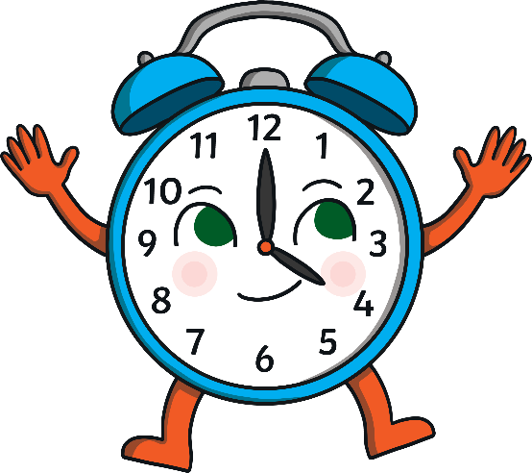
A clock face is a full circle
which is made up of 2 halves.
60
55
5
How many minutes make up half of an hour?
50
10
45
15
40
20
6
35
25
30

Slide 6
There are 30 minutes in half of an hour.
60
55
5
50
10
45
15
40
20
6
35
25
30

Slide 7
When it is 30 minutes past the hour we say ‘half past’ the hour.
60
55
5
50
10
45
15
40
20
6
35
25
30

Slide 8
Look at this time.
60
55
5
The big hand is pointing at 6, which is halfway around the clock.
50
10
Where is the small hand pointing? Is it on the number?
45
15
40
It’s half way between 1 and 2.
6
20
35
25
30
half past

Slide 9
What time is this clock showing?
60
55
5
Where is the big hand pointing?
6
50
10
halfway between 11 and 12
Where is the little hand pointing?
45
15
40
20
6
It’s half past 11.
30
half past

Slide 10
What time is this clock showing?
60
55
5
What do you notice about
the small hand?
It is halfway between 3 and 4.
50
10
45
15
40
20
It’s half past 3.
6
35
25
30
half past

Slide 11
Which clock is showing half past 9?
Which clock is showing half past 7?
Which clock is showing half past 2?
60
55
5
50
10
60
45
15
60
55
5
55
5
50
40
50
10
6
20
10
35
25
45
15
30
45
15
40
20
40
20
6
6
35
25
35
25
30
30

Slide 12
How to tell the time?
https://www.youtube.com/watch?v=8RJzoyIVzV8

Slide 13
