Slide 1
Monday 11th July
Count to 20 forwards and backwards
Can you count in 2’s to 20?

Slide 2
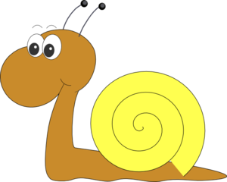

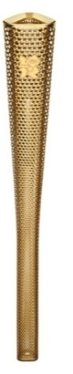

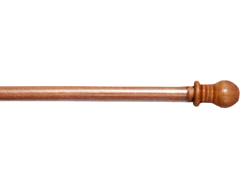
Snail Olympics

Slide 3
Snail Olympics
On your marks

Slide 4
Snail Olympics
Get set

Slide 5
Snail Olympics
GO!!!

Slide 6
Snail Olympics

Slide 7
Snail Olympics

Slide 8
Snail Olympics

Slide 9
Snail Olympics

Slide 10
Snail Olympics

Slide 11
Snail Olympics

Slide 12
Snail Olympics

Slide 13
Snail Olympics

Slide 14
Snail Olympics

Slide 15
Snail Olympics

Slide 16
Snail Olympics

Slide 17
Snail Olympics

Slide 18
Snail Olympics

Slide 19
Snail Olympics

Slide 20
Snail Olympics

Slide 21
Snail Olympics

Slide 22
Snail Olympics

Slide 23
Snail Olympics

Slide 24
Snail Olympics

Slide 25
Snail Olympics

Slide 26
Snail Olympics

Slide 27
Snail Olympics

Slide 28
Snail Olympics

Slide 29
Snail Olympics

Slide 30
Snail Olympics

Slide 31
Snail Olympics

Slide 32
Snail Olympics

Slide 33
Snail Olympics

Slide 34
Snail Olympics

Slide 35
Snail Olympics

Slide 36
Snail Olympics

Slide 37
Snail Olympics

Slide 38
Snail Olympics

Slide 39
Snail Olympics

Slide 40
Snail Olympics

Slide 41
Snail Olympics

Slide 42
Snail Olympics
1st

Slide 43
Snail Olympics
2nd
1st

Slide 44
Snail Olympics
2nd
1st
3rd

Slide 45
Snail Olympics
2nd
1st
4th
3rd

Slide 46
Snail Olympics
2nd
1st
4th
3rd
5th

Slide 47
Snail Olympics

Slide 48
Snail Olympics

Slide 49
Snail Olympics

Slide 50
Snail Olympics

Slide 51
Line some children u and ask who is 6th in line, 1st, 4th etc.
Listen to the days of the week song
https://www.youtube.com/watch?v=HtQcnZ2JWsY
Which is the 1st day of the week?
The 3rd?
The 5th?
The 7th?
The 2nd?

Slide 52
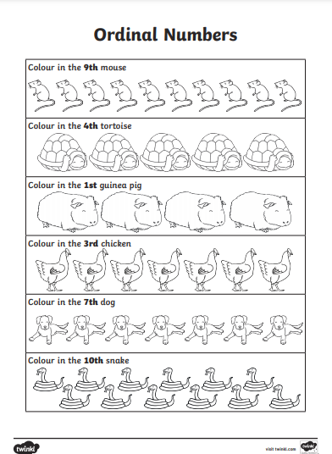

Slide 53
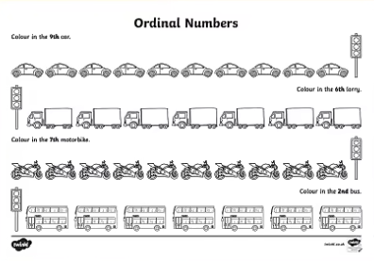

Slide 54
