Slide 1

Thursday 14th July
Lesson Objective: Write short sentences with words with known sound-letter correspondences using a capital letter and full stop.
Today we are going to write an invitation to our best friend, inviting them to our Alien Space Party.

Slide 2
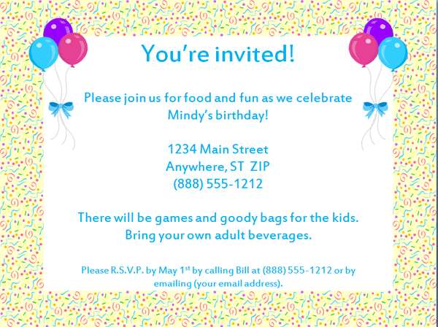
What is an invitation?
An invitation is a letter we send out to let our friends know that they can come to our party.
What do I need to include?
Where the party is.
What time it is.
What time it is.
What type of party it is.

Slide 3
