Slide 1
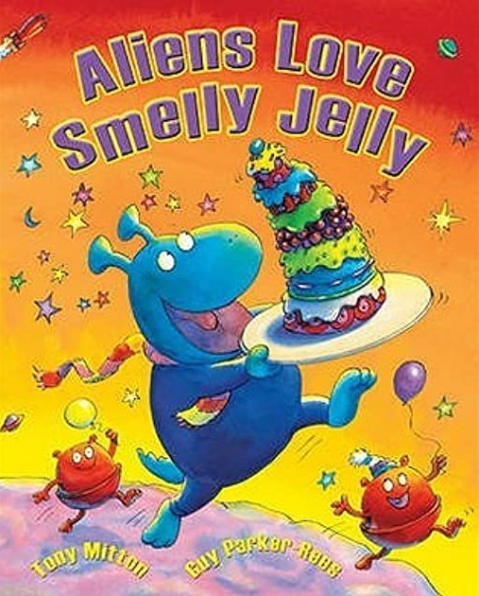
Wednesday 13th July
Lesson Objective: Write short sentences with words with known sound-letter correspondences using a capital letter and full stop.
In partners, briefly discuss what the happens in the story.
Who can share with the class what they remember about the story?

Slide 2
Last week we were introduced to adjectives.
Can you remember what an adjective is? Talk to your partner and discuss.
Where are the adjectives in these sentences?
The big tree.
The pink pig.
The black dog.

Slide 3
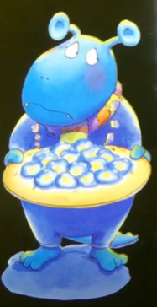
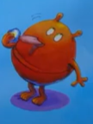
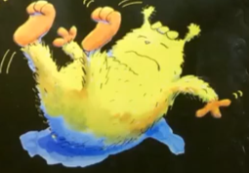
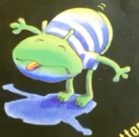
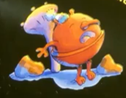
Collect some words that we could use to describe these aliens.
Now we are going to use the adjectives to create sentences about the aliens.

