Slide 1

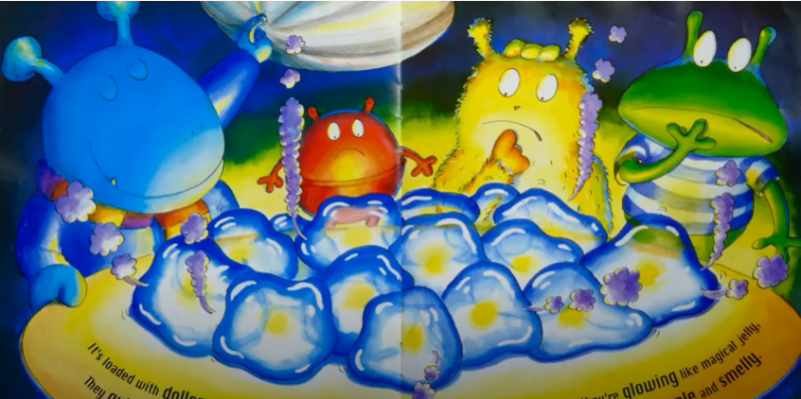
Tuesday 12th July
Can you remember what our story is about?
Can you remember this part of the story?
What are the Aliens feeling here?
Why do you think they feel like this?

Slide 2
We are going to write a thought bubble for this Alien in the picture.

Slide 3
What about this Alien?

