Slide 1
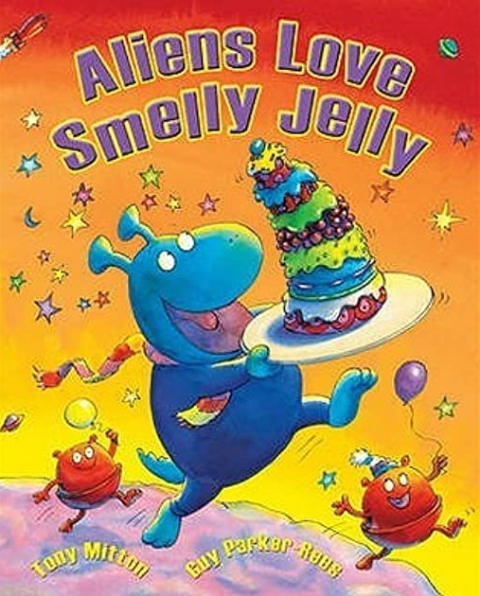
Monday 11th July
What do you think the name of the book will be this week?
Why do you think this?
Let’s read the story.
(For home learning): Aliens Love Smelly Jelly by Tony Mitton, read aloud - ReadingLibraryBooks - YouTube

Slide 2
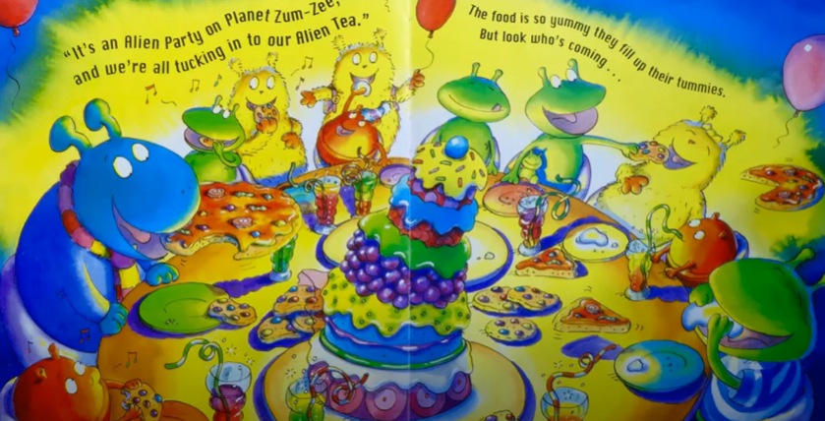
Today we are going to design our own Smelly Jelly for an alien tea party.
What would it smell like?
What would it taste like?
What colour would it be?
In your books, write a sentence to describe your own Smelly Jelly. After, draw a picture of your Smelly Jelly.

