Slide 1


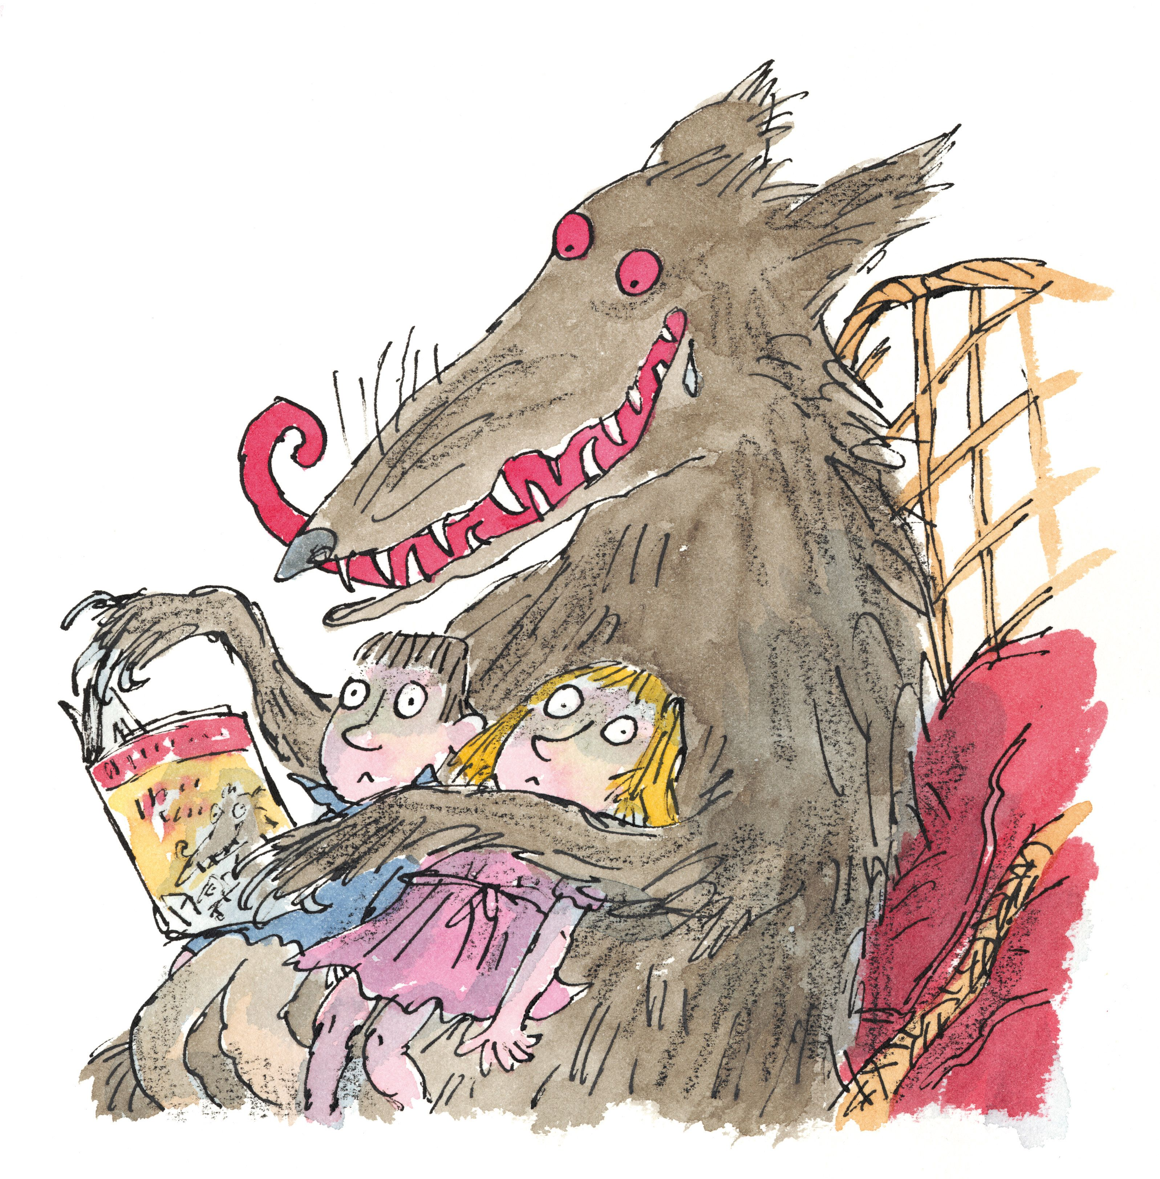
Purpose: Entertain
Audience: Year 3
Genre: Poetry
In narrative texts, creating settings, characters and plot (WC2)

Slide 2


Lesson 6
Write your date on your new planning sheet.
Read through and edit your previous paragraph in purple pen.

Slide 3
Lesson 6 – Sentence Stacker
LC: To encapsulate what you want to say, sentence by sentence (WC5)
The first little pig, you may not know, was as fearless as a superhero.
He was a solider who fought across the world.
Crash! Pow! Swish! Pig number could make a racket.
He was a ninja who could not be beaten.
Pig number 3 was fearless and free.
He was the best firepig you ever did see.

Slide 4

Sentence 1
Initiate – Personification

Slide 5

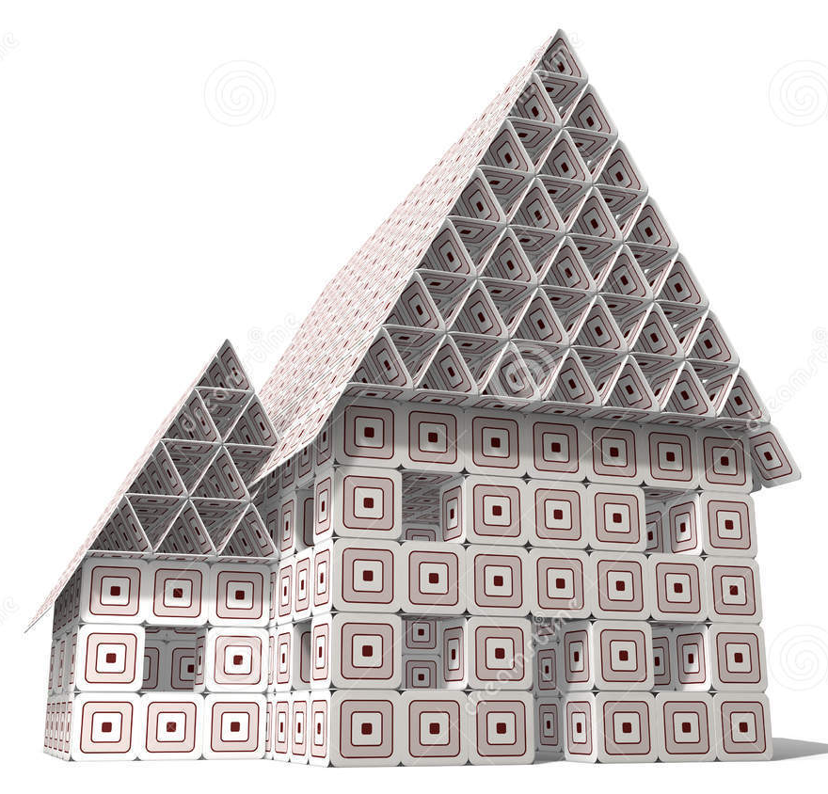

Sentence 1
Initiate
TTYP
What was the first pig’s house made from? Can you give it a human feature?

Slide 6


Sentence 1
Our ideas
Stood tall and strong
Protected the land
Deceived the cleverest theif

Slide 7



Sentence 1
Model and enable
Model:
Deepen the moment
Give your reader more detail about the appearance of the house.
Notes:
House number one was made of steel. It stood tall and overlooked the fields.

Slide 8
Sentence 2
Initiate – Metaphor

Slide 9
Sentence 2
Initiate
TTYP
What could you compare house number two to?

Slide 10
Sentence 2
Our ideas
Prison fort
Fortress strong hold
Haven sanctuary

Slide 11
Sentence 2
Model and enable
Model:
Deepen the moment
What was the house made of?
Notes:
House number two was a sanctuary of refuge.

Slide 12
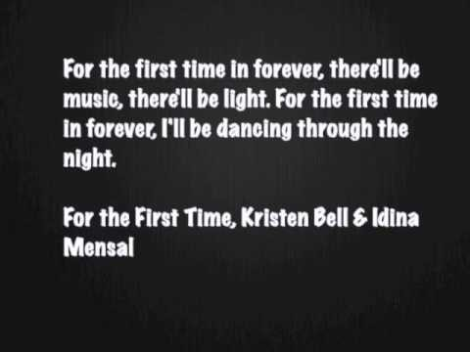
Sentence 3
Initiate - Repetition
Notes:
https://youtu.be/TUp_MGQuuMw

Slide 13
Sentence 3
Initiate
TTYP
How would you describe house number three?

Slide 14
Sentence 3
Our ideas
safe
indestructible
imperishable
unbreakable

Slide 15
Sentence 3
Model and enable
Model:
Deepen the moment
Choose your own!
Notes:
House number three was completely imperishable, imperishable, imperishable!

Slide 16

My finished paragraph
House number one was made of steel. It stood tall and overlooked the fields.
House number two was a sanctuary of refuge.
It was made of tunnels, mazes and paths.
House number three was completely imperishable, imperishable, imperishable!
This house was locked up with unbreakable chains.
Time to share your paragraph!

Slide 17
Lesson 7
Read through and edit your previous paragraph in purple pen.

Slide 18

Lesson 7 – Independent Write
LC: To encapsulate what you want to say, sentence by sentence (WC5)
Today you will be telling your reader how the wolf tries to enter the house.

Slide 19
Lesson 8
Read through and edit your previous paragraph in purple pen.

Slide 20

Lesson 8 – Independent Write
LC: To encapsulate what you want to say, sentence by sentence (WC5)
Today you will be telling your reader how the story ends.

Slide 21
Lesson 9 – Performance
LC: Performing and reading poems and play scripts aloud, showing understanding through intonation, tone, volume and action (SL7B)

