Slide 1

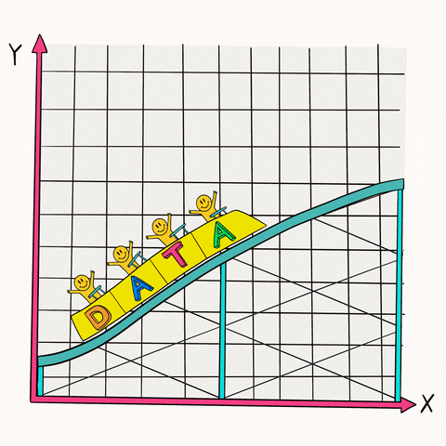
Maths
Summer 2
WC: 04.07.2022
IV.VII.MMXXII

Slide 2
Lesson 1 - IV.VII.MMXXII
LC: Interpret and present data using bar charts, pictograms and tables; solve one-step and two-step questions using information presented in scaled bar charts, pictograms and tables.

Slide 3
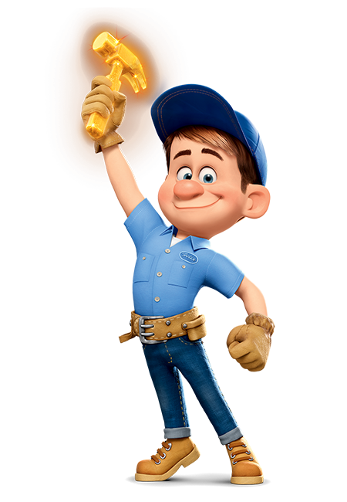

Fix it Felix
Correct your errors identified from marking and respond to any questions set by your teacher.
Remember to make any corrections in purple pen.

Slide 4
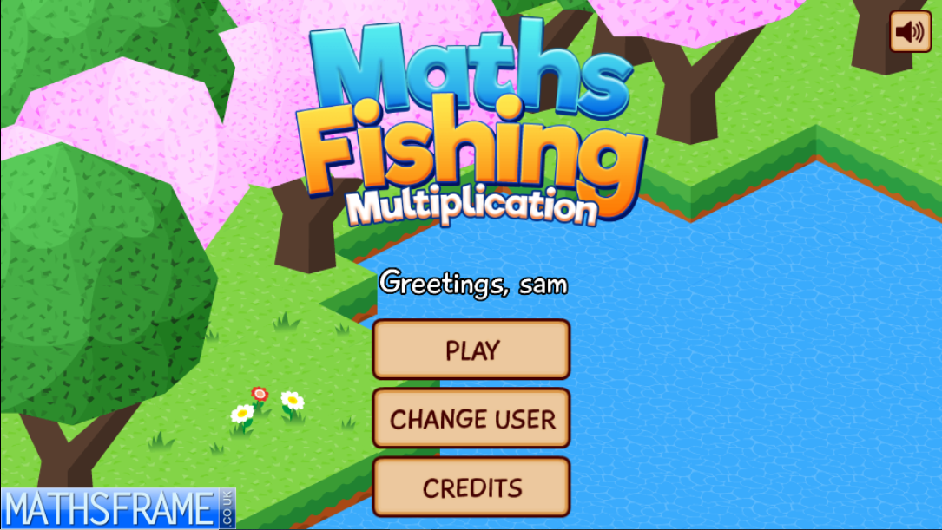


Counting Stick Activity
Let’s practice our 3, 4 and 8’s by playing a game of Maths Fishing Multiplication!
See how many fish you can catch by answering questions all about your 3, 4 and 8s.
If you have the iPads, you could all have a go using this QR code!

Slide 5

New Vocabulary
Do you know what any of these new words mean?
Tell a partner!
Count, tally, sort, vote
Graph, block graph, pictogram
Represent
Group, set
List, table, chart, bar chart, frequency table
Carroll diagram, Venn diagram
Label, title, axis, axes
Diagram
Most popular, most common
Least popular, least common

Slide 6
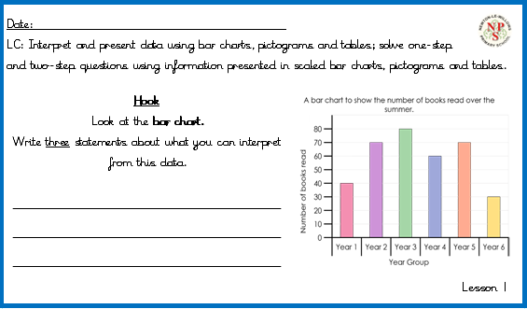
Hook
What is it a bar chart to show?
What does the Y axis go up in?
Which year group read the most? least?
How do you know?
How would you work out how many books were read altogether?
Notes:
This starter activity reviews the previous lesson;
Concrete resources –
Key Questions –
Misconceptions/ Common Errors – Pupils need to remember
Further Practice –
Extension –

Slide 7
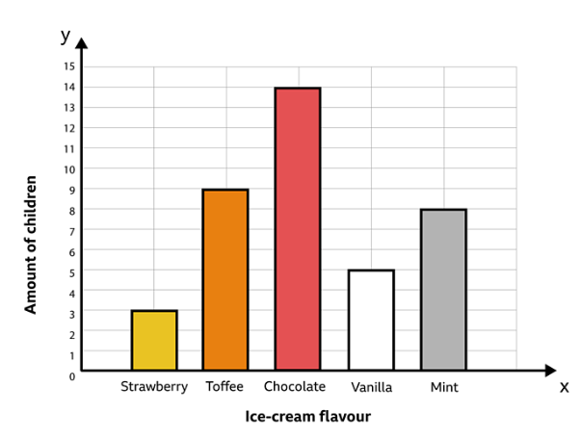
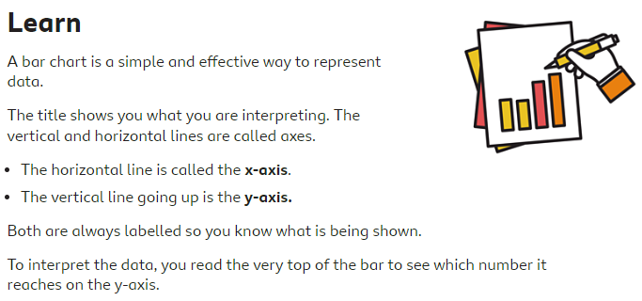
New Learning
Title
Scale
Bars
Axis
Label

Slide 8
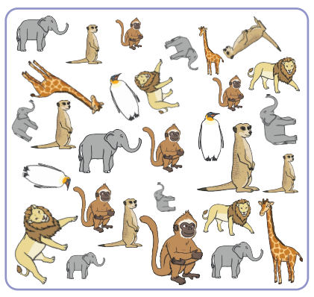
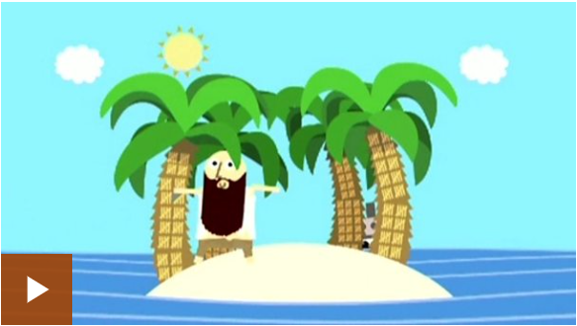
New Learning
How could we count the following animals using a tally?
Click on the image to find out more about tally charts!

Slide 9
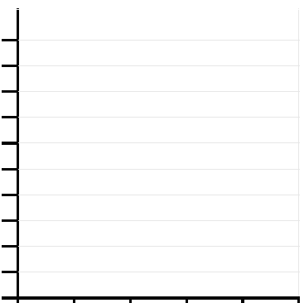

Task 1
Use the table to complete the bar chart below. It shows the favourite fruit of children in Year 3.
Healthy Snack | Votes
Banana | 14
Apple | 18
Grapes | 6
Orange | 11
Other | 3
How would your record the odd numbers on the graph?
Notes:
Concrete resources –
Key Questions –
Misconceptions/ Common Errors – Pupils need to remember
Further Practice –
Extension –

Slide 10
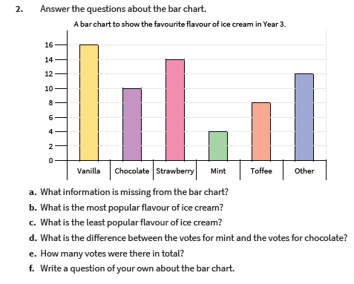
Task 2
Use the bar chart to answer the following questions about favourite ice cream flavours in Year 3.
40
35
30
25
20
15
10
5
0
Notes:
Concrete resources –
Key Questions –
Misconceptions/ Common Errors – Pupils need to remember
Further Practice –
Extension –

Slide 11
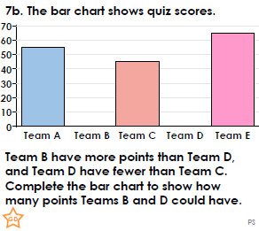
Task 3
Notes:
Concrete resources –
Key Questions –
Misconceptions/ Common Errors – Pupils need to remember
Further Practice –
Extension –

Slide 12
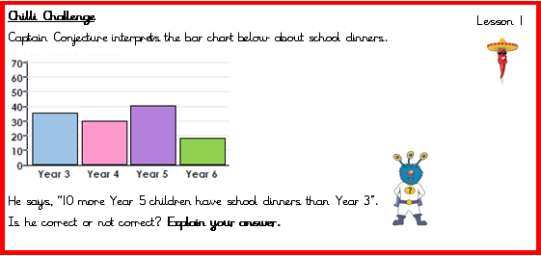
Chilli Challenge

Slide 13
Lesson 2 - V.VII.MMXXII
LC: Interpret and present data using bar charts, pictograms and tables; solve one-step and two-step questions using information presented in scaled bar charts, pictograms and tables.

Slide 14
Fix it Felix
Correct your errors identified from marking and respond to any questions set by your teacher.
Remember to make any corrections in purple pen.

Slide 15
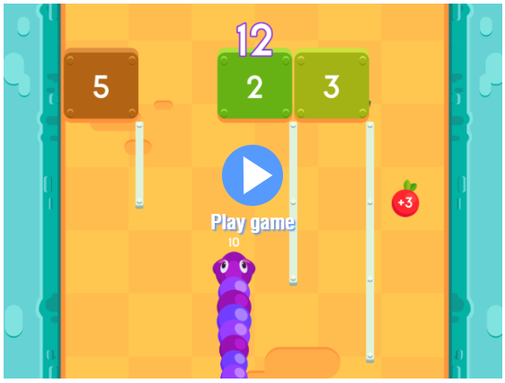

Counting Stick Activity
Let’s practice our 3, 4 and 8’s by playing a game of Caterpillar Carnage!
Avoid the blocks or pick the lowest numbers to help the Caterpillar get to the finish line!
Don’t forget to look out for the power-ups!
If you have the iPads, you could all have a go using this QR code!

Slide 16
Vocabulary
Anagram sort!
laleb chrat
tleti bleta
sixa
diamrag
grpha
Who can unscramble these anagrams the quickest! Work with your partner! Hands up once you have them all.

Slide 17
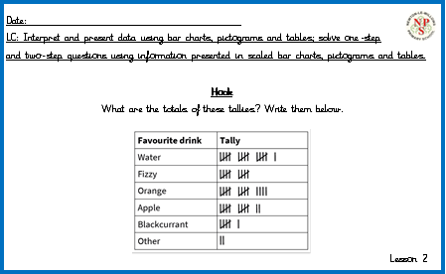
Hook
What is a tally chart?
What does it show?
What is a gate?
What is this worth?
What times tables will you use to help you?
Notes:
This starter activity reviews the previous lesson;
Concrete resources –
Key Questions –
Misconceptions/ Common Errors – Pupils need to remember
Further Practice –
Extension –

Slide 18


Secret Vote
Day | Cupcakes made throughout the week
Monday
Tuesday
Wednesday
Thursday
Friday
A bakery have recorded the number of cupcakes they made in a pictogram.
The owner of the shop says that Monday is their busiest day. Do you…
Agree
Disagree
Not know
Key
d
2 cupcakes
Notes:
Assessment point for the lesson – ask the pupils to vote for the answer they think is correct.
A – The pupil has not counted on in steps of five to find the duration
B – Correct answer
C – The pupil has mixed up the ‘start’ minutes and ‘end’ minutes
D – The pupil has not counted on in steps of five to find the duration
If answers A, C or D are given, pupils may require extra support through small group or 1:1 discussions. There are support slides covering lessons from the previous year group at the end of these slides.

Slide 19
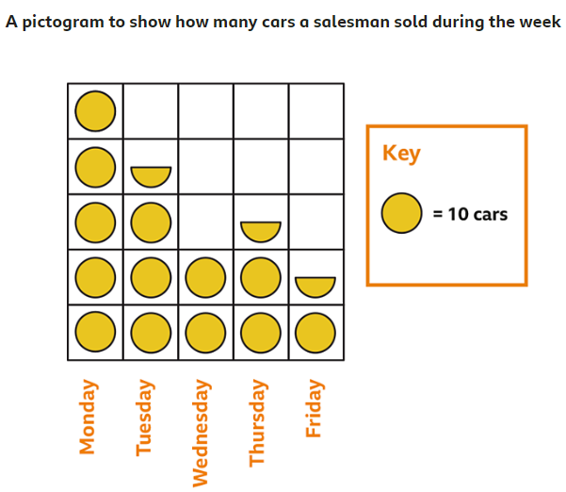
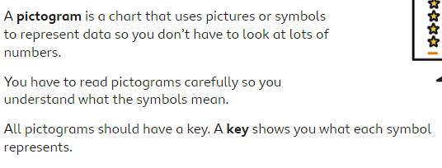
New Learning
What do you think half a circle would be worth?

Slide 20
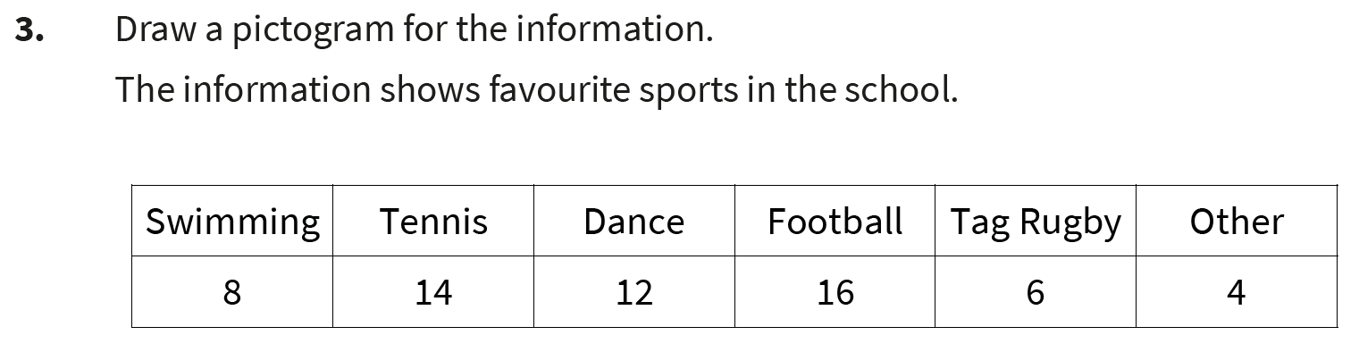
Task 1
Notes:
Concrete resources –
Key Questions –
Misconceptions/ Common Errors – Pupils need to remember
Further Practice –
Extension –

Slide 21
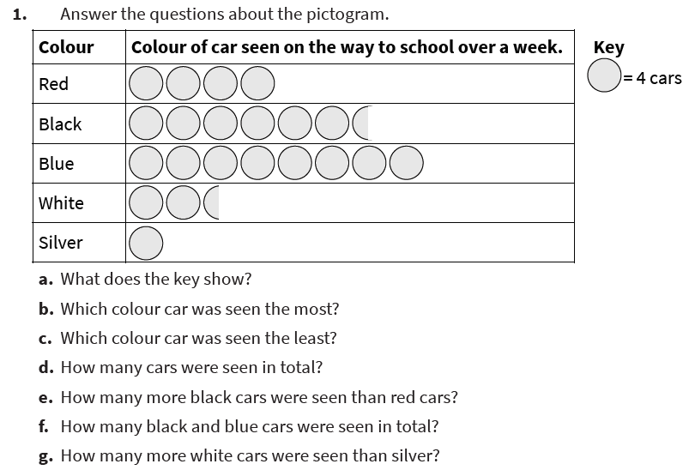
Task 2
Answer the following questions about the pictogram.
Notes:
Concrete resources –
Key Questions –
Misconceptions/ Common Errors – Pupils need to remember
Further Practice –
Extension –

Slide 22
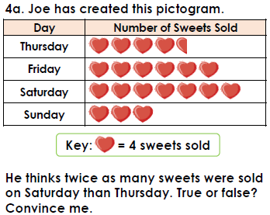
Task 3
Notes:
Concrete resources –
Key Questions –
Misconceptions/ Common Errors – Pupils need to remember
Further Practice –
Extension –

Slide 23
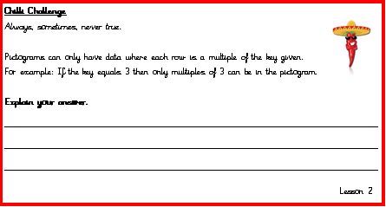
Chilli Challenge

Slide 24
Lesson 3 - VI.VII.MMXXII
LC: Interpret and present data using bar charts, pictograms and tables; solve one-step and two-step questions using information presented in scaled bar charts, pictograms and tables.

Slide 25
Fix it Felix
Correct your errors identified from marking and respond to any questions set by your teacher.
Remember to make any corrections in purple pen.

Slide 26
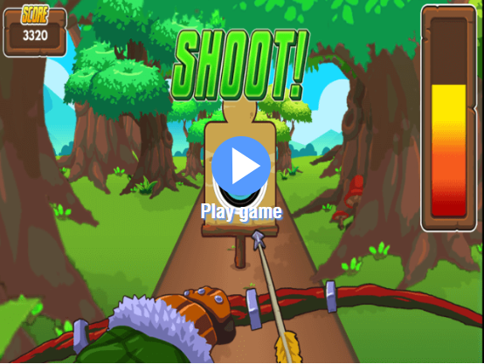

Counting Stick Activity
Let’s practice our 3, 4 and 8’s by playing a game of Archery Arithmetic!
Answer the times table questions correctly, to be in with a chance to take a shot at the target!
If you have the iPads, you could all have a go using this QR code!

Slide 27

Vocabulary
Match me up!
A type of graph that uses pictures Sort
A chart that uses lines and gates to count frequency Pictogram
To categorise things using common features Tally
A diagram where values are shown using rectangles of equal width Axis
A line that is used to measure coordinates on graphs and grids Bar Chart

Slide 28
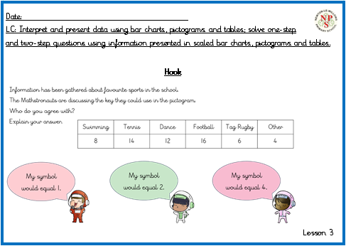
Hook
Notes:
This starter activity reviews the previous lesson;
Concrete resources –
Key Questions –
Misconceptions/ Common Errors – Pupils need to remember
Further Practice –
Extension –

Slide 29
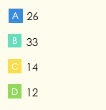
Secret Vote
The table shows how many children have hot dinners in school.
How many children in Year 3 have hot dinners?
Team | Boys | Girls
Year 3 | 12 | 14
Year 4 | 18 | 15
Year 5 | 23 | 19
Year 6 | 15 | 16
Notes:
Assessment point for the lesson – ask the pupils to vote for the answer they think is correct.
A – The pupil has not counted on in steps of five to find the duration
B – Correct answer
C – The pupil has mixed up the ‘start’ minutes and ‘end’ minutes
D – The pupil has not counted on in steps of five to find the duration
If answers A, C or D are given, pupils may require extra support through small group or 1:1 discussions. There are support slides covering lessons from the previous year group at the end of these slides.

Slide 30
New Learning
This table show which teachers own different types of pets.
How do you read this table?
 | Cat | Dog | Rabbit | Snake | Bird
Mr Mills | ✔ | ✔
Mrs Smith |  | ✔ |  | ✔
Miss Kahn |  |  | ✔
Mr Jackson |  | ✔ |  |  | ✔
Miss James | ✔ |  |  | ✔
Notes:
Play the directions game
To practise turns and angles, try this game. Blindfold your child and give them directions to a specific location. To get them there, you can use the language of direction and turns – for example, ‘Make a half turn clockwise, now take three steps forward’, and so on.

Slide 31
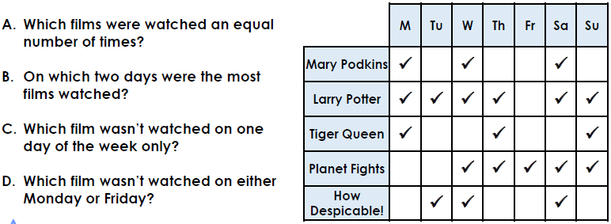
Task 1
Use the table to answer the questions about film viewings during one week.
Notes:
Concrete resources –
Key Questions –
Misconceptions/ Common Errors – Pupils need to remember
Further Practice –
Extension –

Slide 32
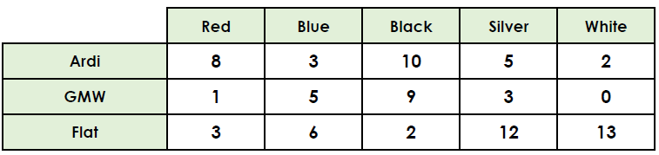
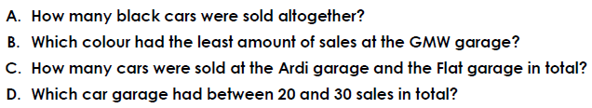
Task 2
Find the totals of the rows and columns in the below table.
Notes:
Concrete resources –
Key Questions –
Misconceptions/ Common Errors – Pupils need to remember
Further Practice –
Extension –

Slide 33
Task 3
This table shows how long it takes Lucy to walk to school in the morning and walk home in the afternoon.
Which one of these statements is false?
Explain your reasoning.
1) It always takes longer for Lucy to walk home.
2) Lucy walks for 28 minutes on a Friday.
3) The biggest difference in time is on Thursday.
Day | Morning walk time | Afternoon walk time
Monday | 15 minutes | 10 minutes
Tuesday | 12 minutes | 17 minutes
Wednesday | 14 minutes | 18 minutes
Thursday | 10 minutes | 20 minutes
Friday | 13 minutes | 15 minutes
Notes:
Concrete resources –
Key Questions –
Misconceptions/ Common Errors – Pupils need to remember
Further Practice –
Extension –

Slide 34
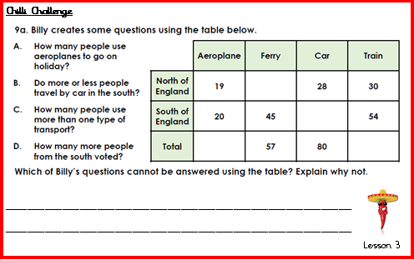
Chilli Challenge
If you had to add the numbers together to get the totals, how will you find missing numbers?

Slide 35
Lesson 4 - VII.VII.MMXXII
LC: Interpret and present data using bar charts, pictograms and tables; solve one-step and two-step questions using information presented in scaled bar charts, pictograms and tables.

Slide 36
Fix it Felix
Correct your errors identified from marking and respond to any questions set by your teacher.
Remember to make any corrections in purple pen.

Slide 37
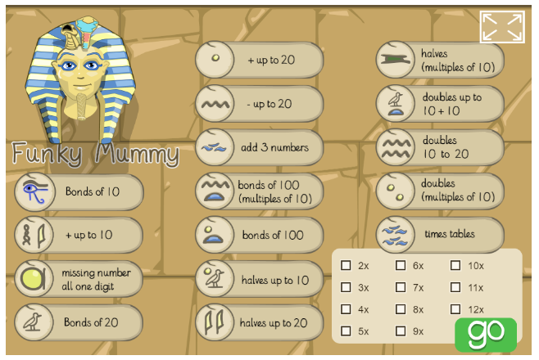
Counting Stick Activity
Let’s practice our 3, 4 and 8’s by playing a game of Funky Mummy!
Complete the calculation, press on the correct sarcophagus and watch the mummy dance.

Slide 38
New Vocabulary
Count, tally, sort, vote
Graph, block graph, pictogram
Represent
Group, set
List, table, chart, bar chart, frequency table
Carroll diagram, Venn diagram
Label, title, axis, axes
Diagram
Most popular, most common
Least popular, least common
Talk it!
Define the vocabulary learnt this unit in your own words.

Slide 39
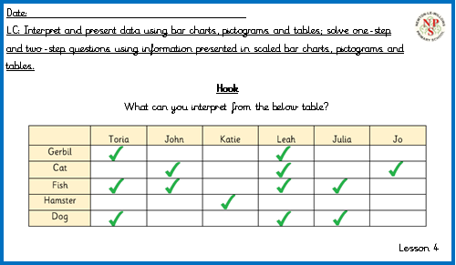
Hook
Notes:
This starter activity reviews the previous lesson;
Concrete resources –
Key Questions –
Misconceptions/ Common Errors – Pupils need to remember
Further Practice –
Extension –

Slide 40

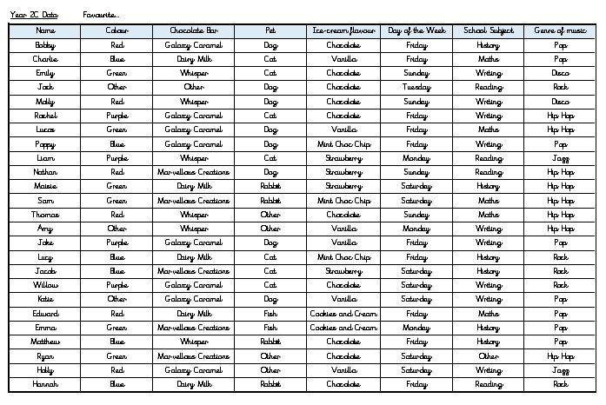
Today’s activity
Using the data sheet given to you, you are going to work in pairs to read, interpret and present the data from one of the columns.
As part of this task you must:
Create a tally chart (including totals)
Present the data by drawing either a bar chart
or pictogram accurately (including labels/a key)
Write some one-step and two-step problems
for you peers to answer.
Notes:
Play the directions game
To practise turns and angles, try this game. Blindfold your child and give them directions to a specific location. To get them there, you can use the language of direction and turns – for example, ‘Make a half turn clockwise, now take three steps forward’, and so on.

Slide 41
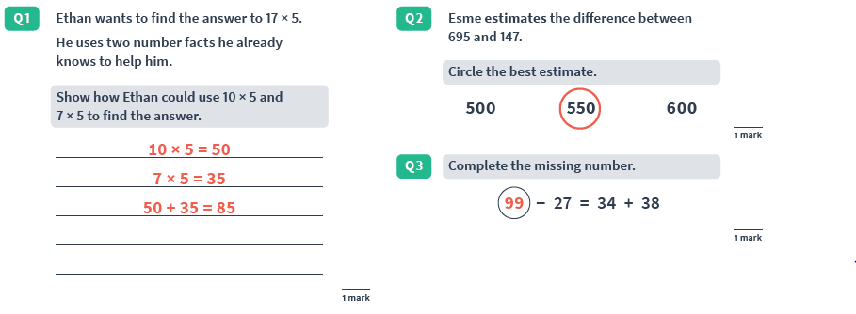
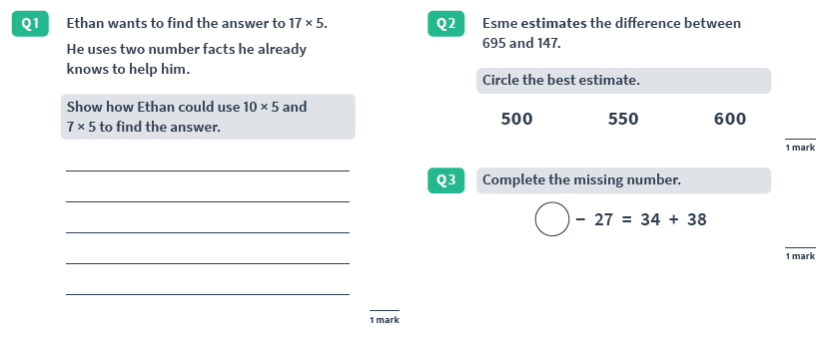

Arithmetic Session

Slide 42
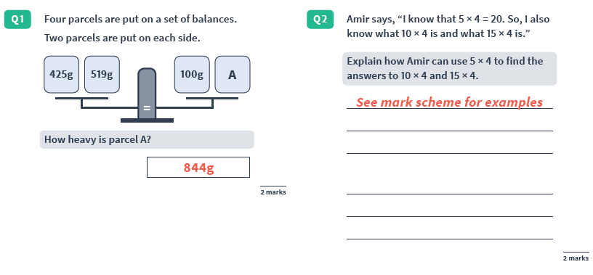
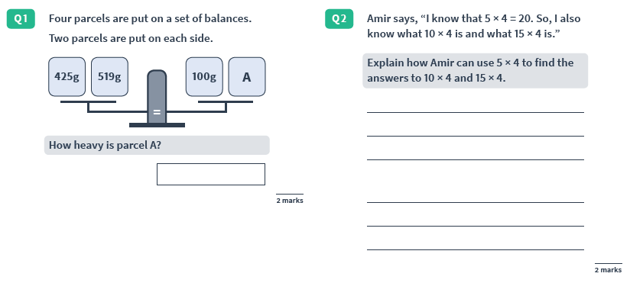
Arithmetic Session

Slide 43
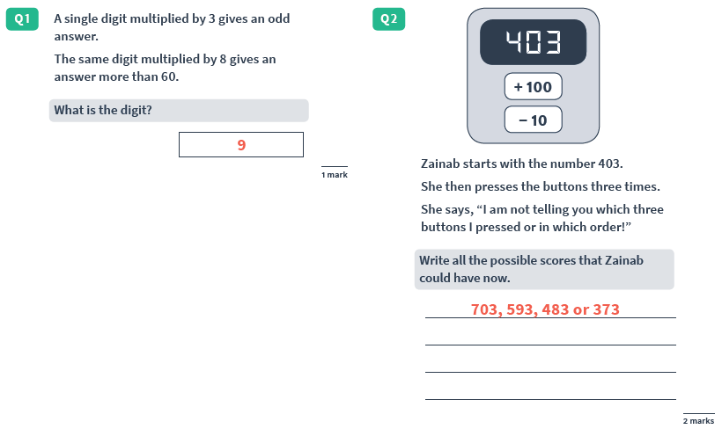
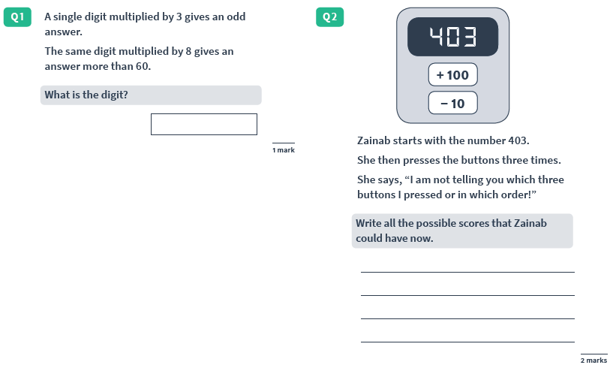
Arithmetic Session
If you complete all of the above, see the staff share for further reasoning questions.

Slide 44
Basic Skills
Session

