Slide 1

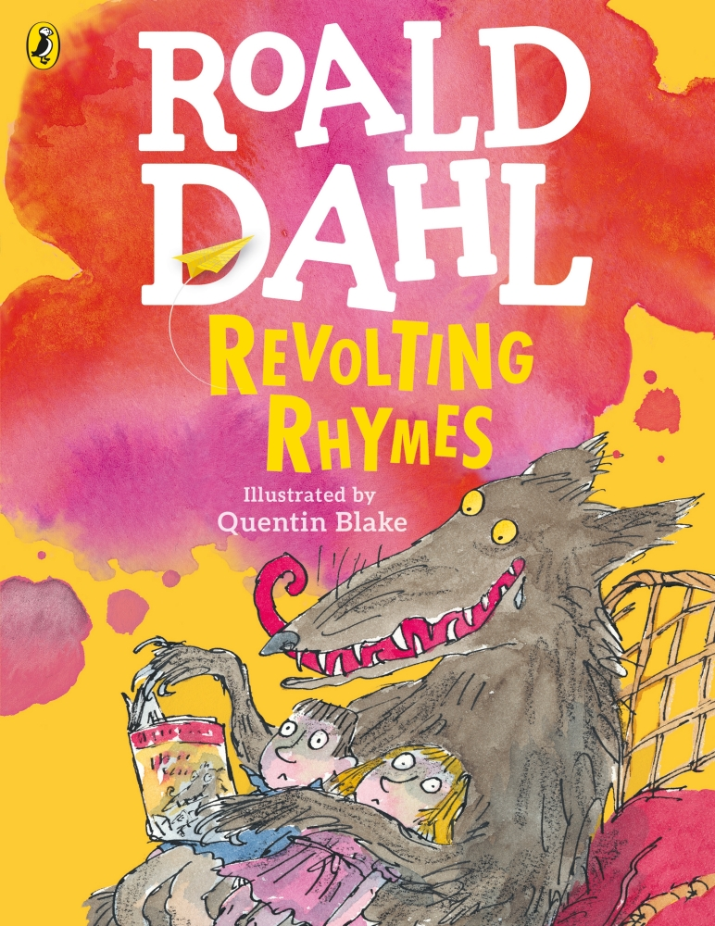
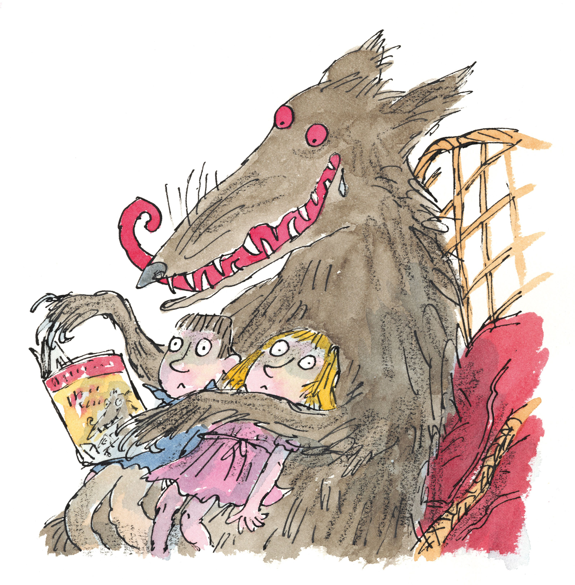
Purpose: Entertain
Audience: Year 3
Genre: Poetry
In narrative texts, creating settings, characters and plot (WC2)

Slide 2

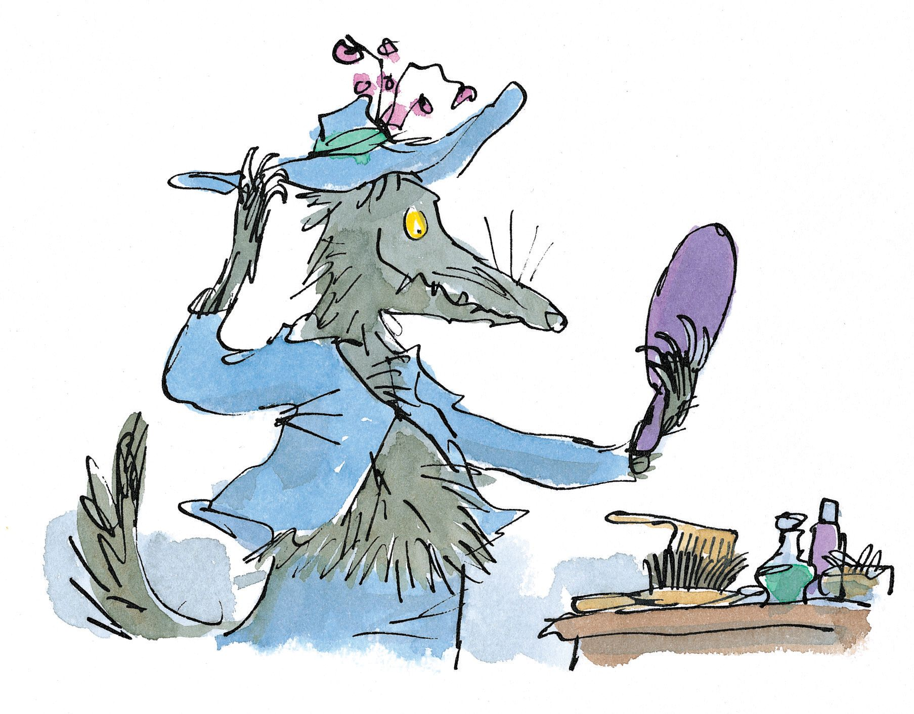
Lesson 1 - SPaG
LC: Performing and reading poems and play scripts aloud, showing understanding through intonation, tone, volume and action (SL7B)

Slide 3
Lesson 1 - SPaG
Performance Vocabulary
Intonation: the rise and fall of the voice in speaking
Tone: vocal sound (quality and strength)
Volume: quantity or power of sound
Action: a thing done; an act

Slide 4
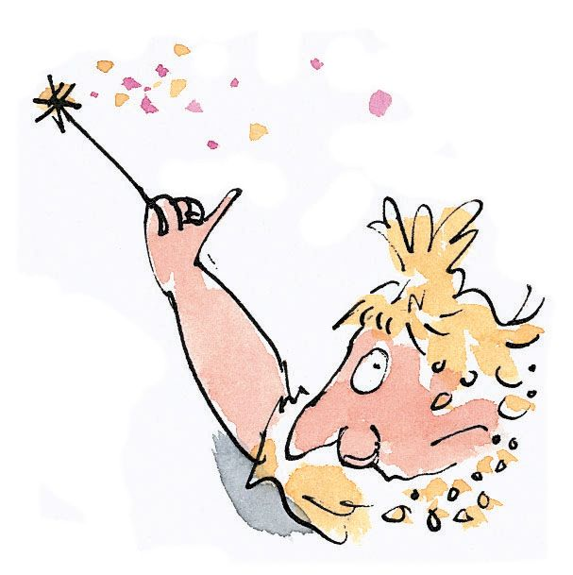
Lesson 1 - SPaG
How would you perform the first stanza of Cinderella?
Cinderella
I guess you think you know this story.
You don't. The real one's much more gory.
The phoney one, the one you know,
Was cooked up years and years ago,
And made to sound all soft and sappy
just to keep the children happy.
Mind you, they got the first bit right,
The bit where, in the dead of night,
The Ugly Sisters, jewels and all,
Departed for the Palace Ball,
While darling little Cinderella
Was locked up in a slimy cellar,
Where rats who wanted things to eat,
Began to nibble at her feet.
Which words do we need to use intonation for ?

Slide 5
Lesson 1 - SPaG
Work with your partner to explore the different tones that each character could use.
She bellowed 'Help!' and 'Let me out!
The Magic Fairy heard her shout.
Appearing in a blaze of light,
She said: 'My dear, are you all right?'
'All right?' cried Cindy .'Can't you see
'I feel as rotten as can be!'
She beat her fist against the wall,
And shouted, 'Get me to the Ball!
'There is a Disco at the Palace!
'The rest have gone and I am jealous!
'I want a dress! I want a coach!
'And earrings and a diamond brooch!
'And silver slippers, two of those!
'And lovely nylon panty hose!
'Done up like that I'll guarantee
'The handsome Prince will fall for me!'
The Fairy said, 'Hang on a tick.'
She gave her wand a mighty flick
And quickly, in no time at all,
Cindy was at the Palace Ball!
Can you add in some actions?

Slide 6
Lesson 1 - SPaG
Working in pairs or small groups, your teacher will assign you a stanza to perform.
Each group will perform their stanza to the class.
You must include:
Intonation: the rise and fall of the voice in speaking
Tone: vocal sound (quality and strength)
Volume: quantity or power of sound
Action: a thing done; an act
You can use props to help with your role play!

Slide 7
Lesson 2
LC: Discussing writing similar to that which they are planning to understand and learn from its structure, vocabulary and grammar (SL7E)

Slide 8
Lesson 2 – Writing Focus
To write a narrative poem based on a traditional tale.
Purpose: Entertain
Audience: Year 3
Genre: Poetry

Slide 9
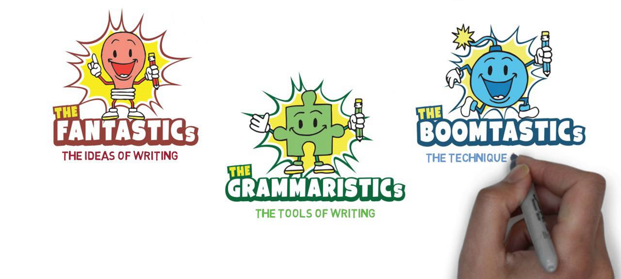
Our writing tools
The Three Zones of Writing

Slide 10
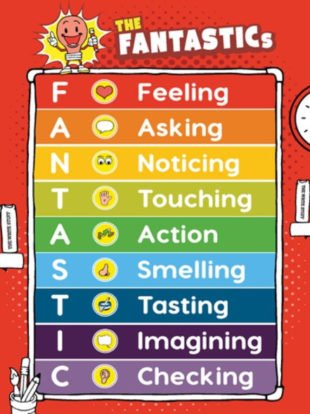
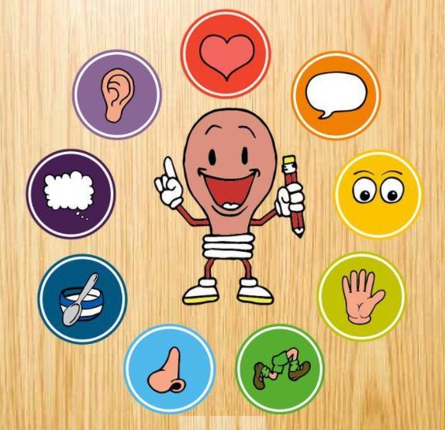
Our writing tools
The FANTASTICs
We use these to deepen the moment.

Slide 11
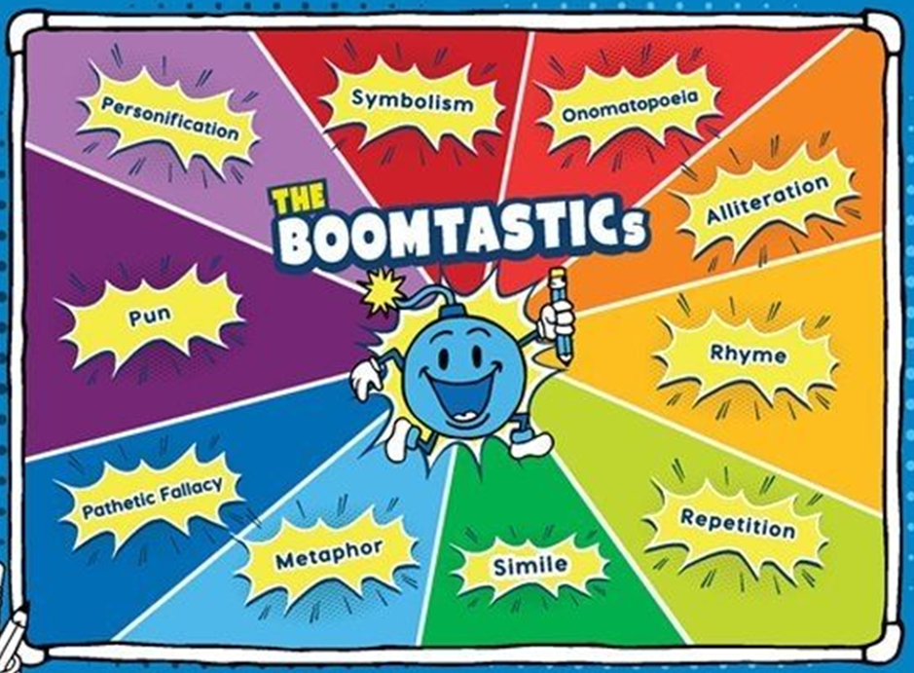
Our writing tools
The BOOMTASTICs
These are the techniques of writing.

Slide 12
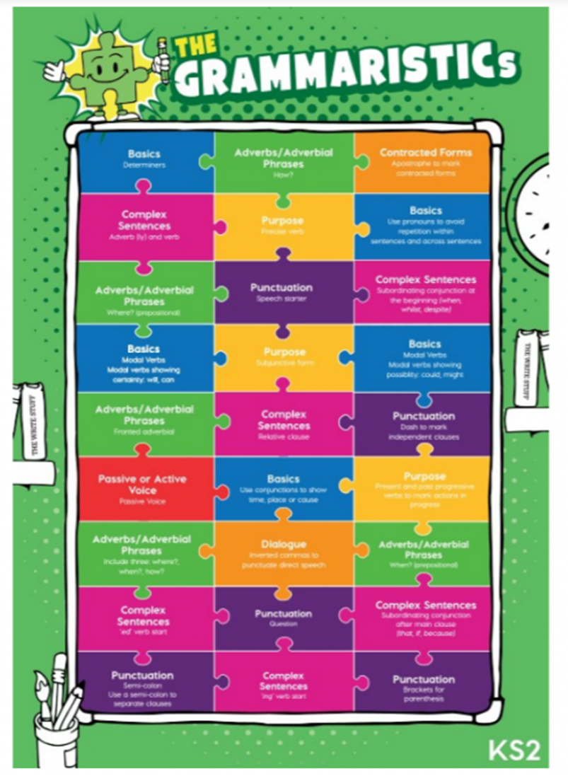
Our writing tools
The GRAMMARISTICs
These are the tools of writing.

Slide 13
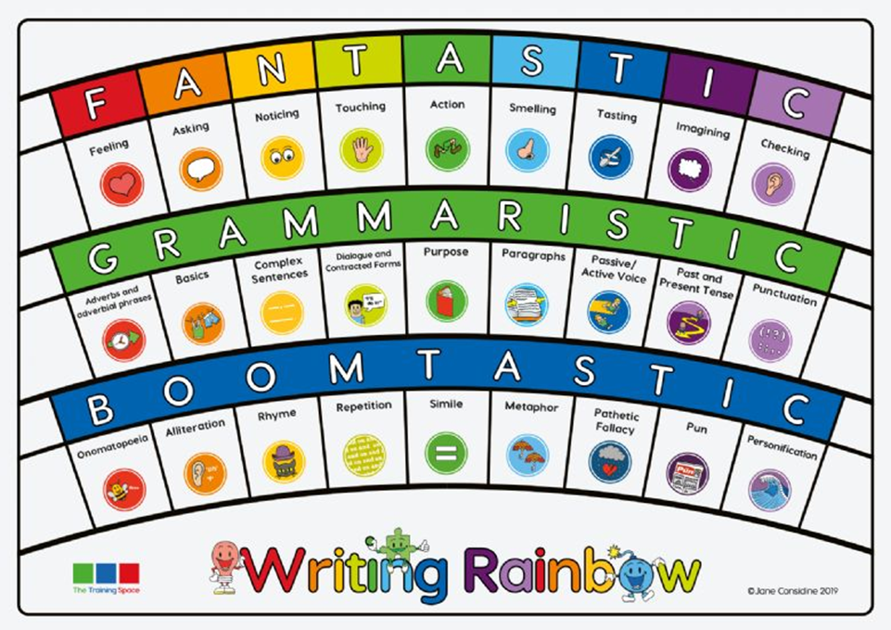
Our writing tools
We call all three zones the Writing Rainbow. We use all three zones together to make our writing most effective.

Slide 14
WAGOLL
Yesterday we read Roald Dahl’s Revolting Rhyme based on the traditional tale of Cinderella.
This is our WAGOLL.
What A Good One Looks Like

Slide 15
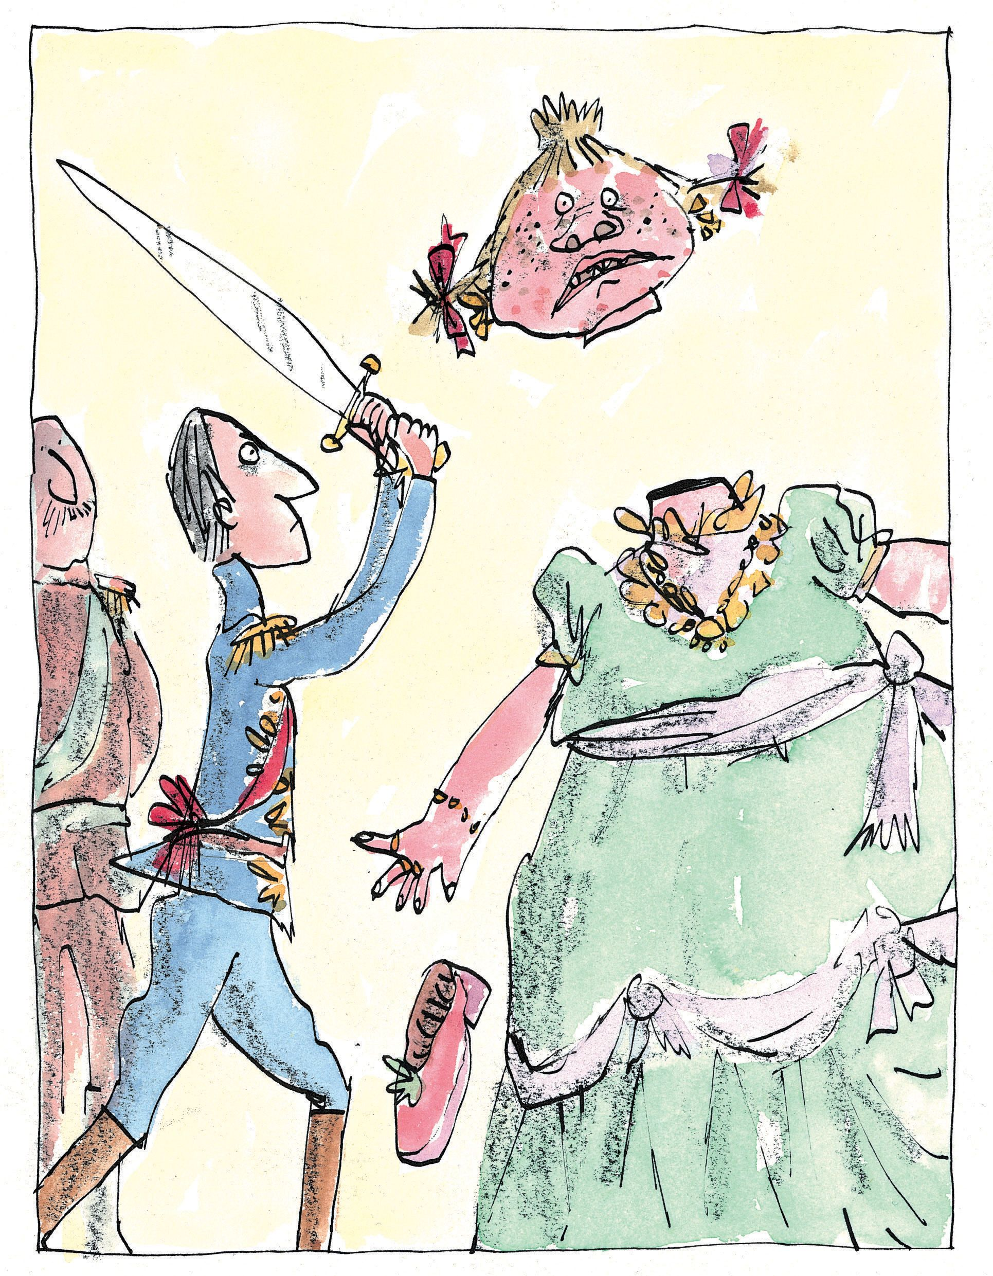
WAGOLL
Let’s compare how Roald Dahl has changed the traditional tale into his own Revolting Rhyme.

Slide 16
WAGOLL
Traditional Tale
soft and sappy
Revolting Rhyme
The real one's much more gory

Slide 17

WAGOLL
Traditional Tale
Revolting Rhyme
'Get me to the Ball!
What happened in the traditional tale?

Slide 18
WAGOLL
Traditional Tale
At midnight, Cinderella leaves the ball but leaves behind a glass slipper
Revolting Rhyme
What happened in the Revolting Rhyme?

Slide 19
WAGOLL
Working in pairs, work through the poem to compare the Revolting Rhyme with the traditional tale.

Slide 20
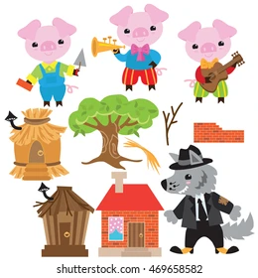
Lesson 3
LC: Discussing and recording ideas for writing (SL7F)

Slide 21

Lesson 3
In one minute, retell the story of the Three Little Pigs!

Slide 22
Lesson 3
The Three Little Pigs is the traditional tale that we are going to change into a Revolting Rhyme!
Which parts of the story could we change?

Slide 23
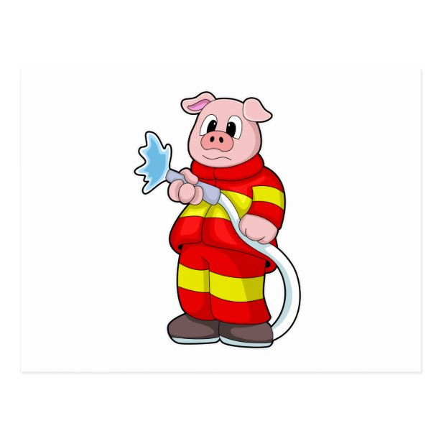
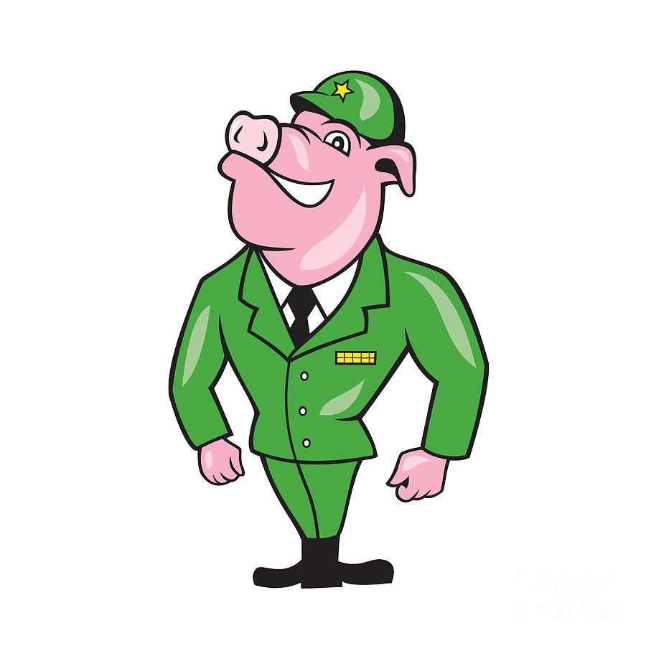
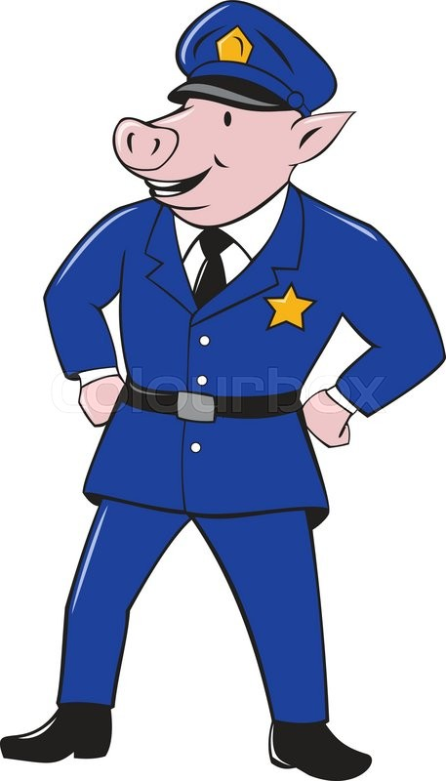
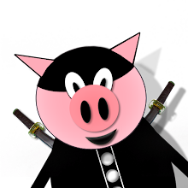
Lesson 3
Each Pig could have a job.
What could these jobs be and how will they help them to defeat the wolf?
Write this into your books.

Slide 24
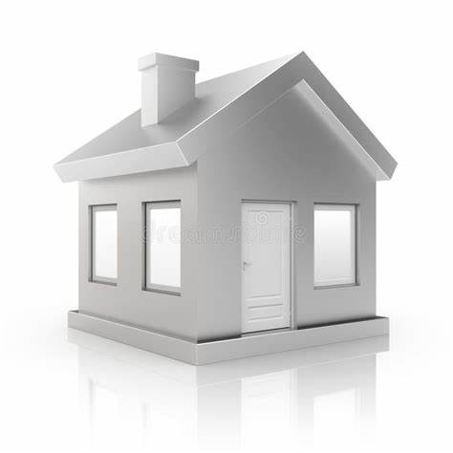
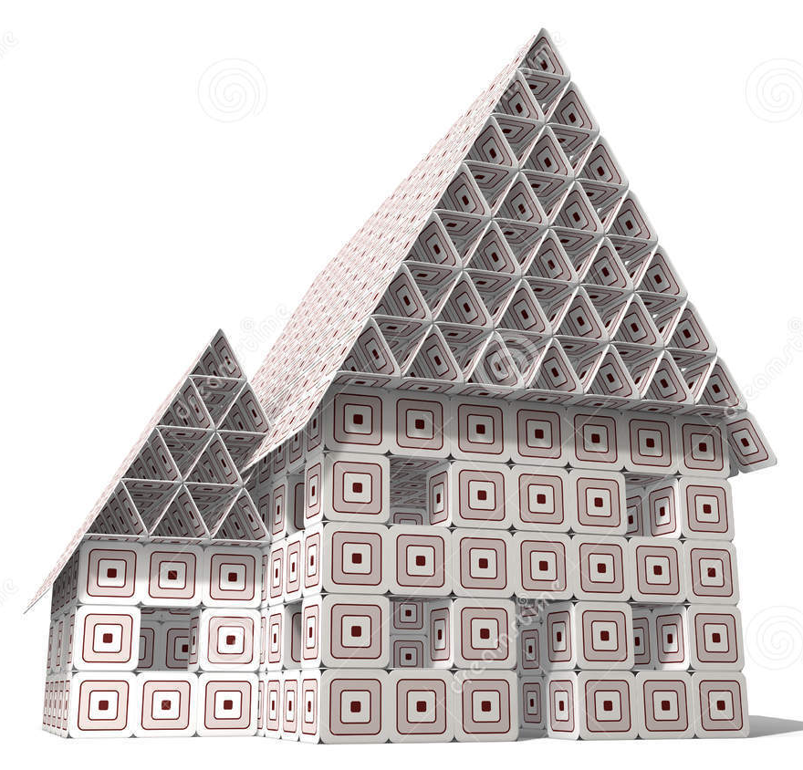
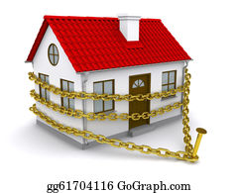
Lesson 3
What could the houses be made of?
Write this into your books.

Slide 25


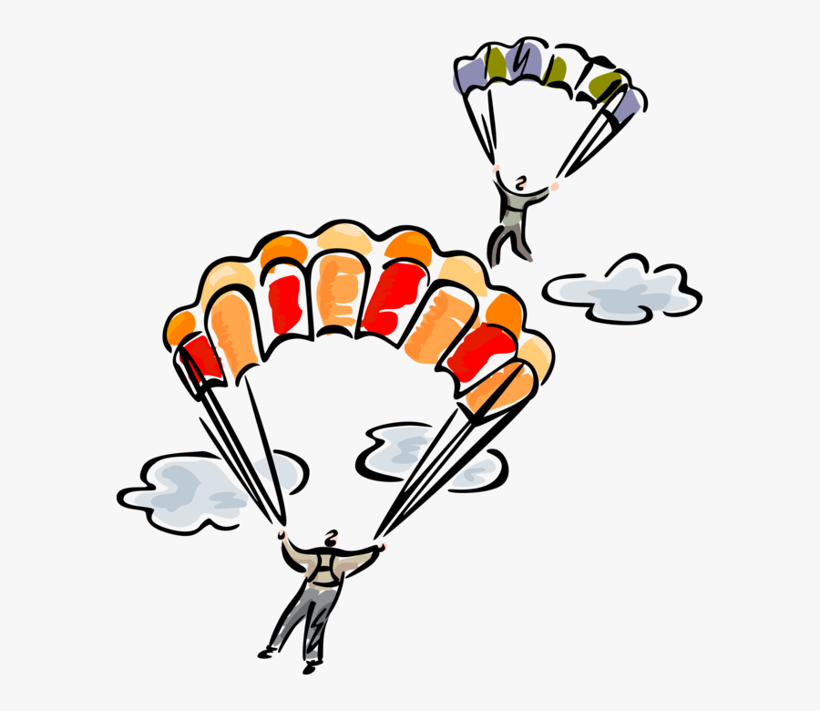
Lesson 3
How could the Wolf enter the houses?
Write this into your books.

Slide 26
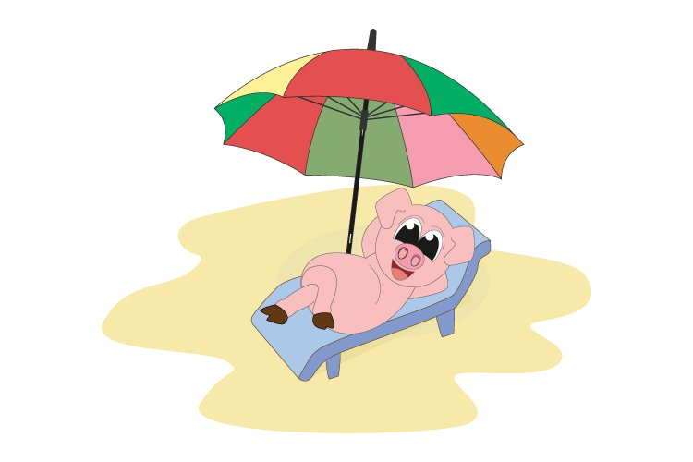
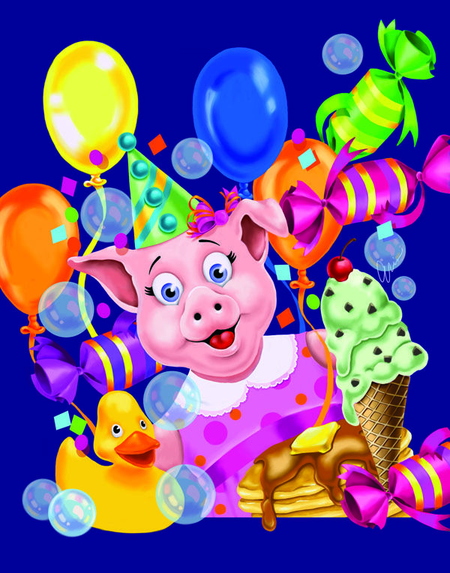
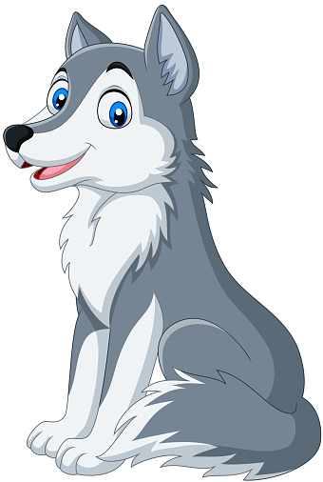
Lesson 3
How could the story end differently?
Write this into your books.

Slide 27
Lesson 4 – Sentence Stacker
LC: Composing and rehearsing sentences orally (including dialogue), building a rich vocabulary and range of sentence structures (WC1)

Slide 28
Writing Focus
To write a narrative poem based on a traditional tale.
Purpose: Entertain
Audience: Year 3
Genre: Poetry

Slide 29
Our writing tools
The Three Zones of Writing

Slide 30
Our writing tools
We call all three zones the Writing Rainbow. We use all three zones together to make our writing most effective.

Slide 31

Sentence 1
Initiate – Simile

Slide 32
Sentence 1
Initiate – Repetition
TTYP
How would you describe the first pig?
What job did you decide they did?

Slide 33
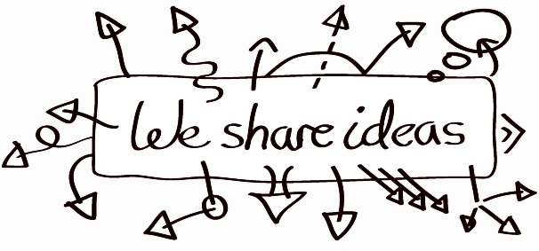

Sentence 1
Our ideas
As strong as an ox
As brave as a hero
As daring as a spy

Slide 34



Sentence 1
Model and enable
Model:
Deepen the moment
What job does your pig do?
Notes:
The first little pig, you may not know, was as fearless as a superhero.

Slide 35
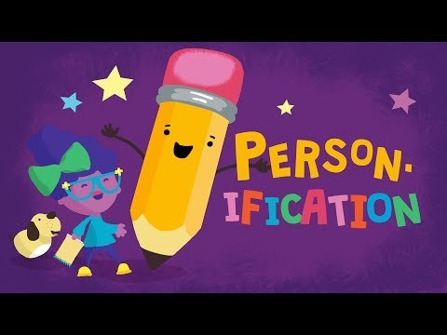
Sentence 2
Initiate – Onomatopoeia

Slide 36
Sentence 2
Initiate – Onomatopoeia
TTYP
What noises does the second pig make?

Slide 37
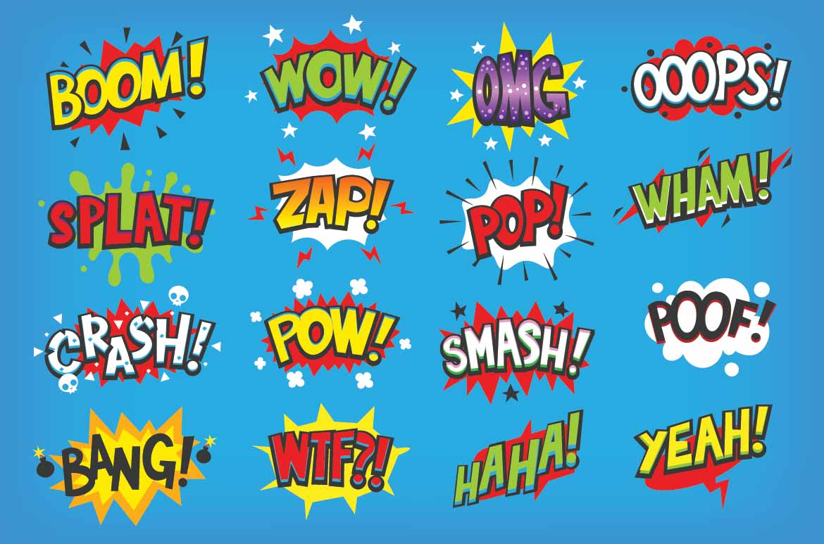
Sentence 2
Our ideas

Slide 38
Sentence 2
Model and enable
Model:
Deepen the moment
What job does your pig do?
Notes:
Crash! Pow! Swish! Pig number could make a racket.

Slide 39
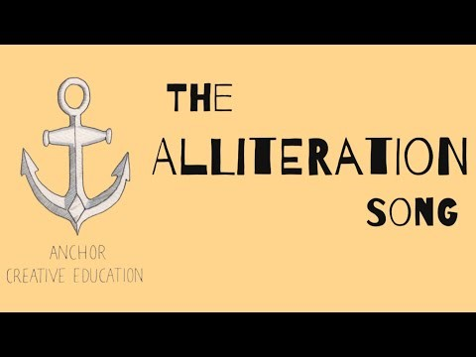
Sentence 3
Initiate – Alliteration

Slide 40
Sentence 3
Initiate
TTYP
Describe pig number three.

Slide 41
Sentence 3
Our ideas
Dangerous, daring
Strong, successful
Brave, bold

Slide 42
Sentence 3
Model and enable
Model:
Deepen the moment
What job does your pig do?
Notes:
Pig number 3 was fearless and free.

