Slide 1
Friday 8th July PSED
LO:- Explain the reasons for rules, know right from wrong and try to behave accordingly.
This term we have been thinking about looking after our environment. We have also investigated different ways we can look after ourselves and our wellbeing.
Today we are going to look at being safe.
What does ‘being safe’ mean?
(It means free from harm or hurt).

Slide 2
Click on the link below and listen to the story about
Detective Digiduck https://www.childnet.com/resources/digiduck-stories/detective-digiduck
(You can also download the book from the website)

Slide 3
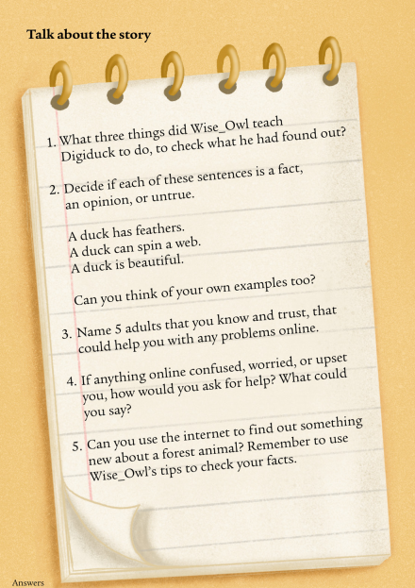
In talk partners, discuss the questions and share your thoughts with the class:

