Slide 1
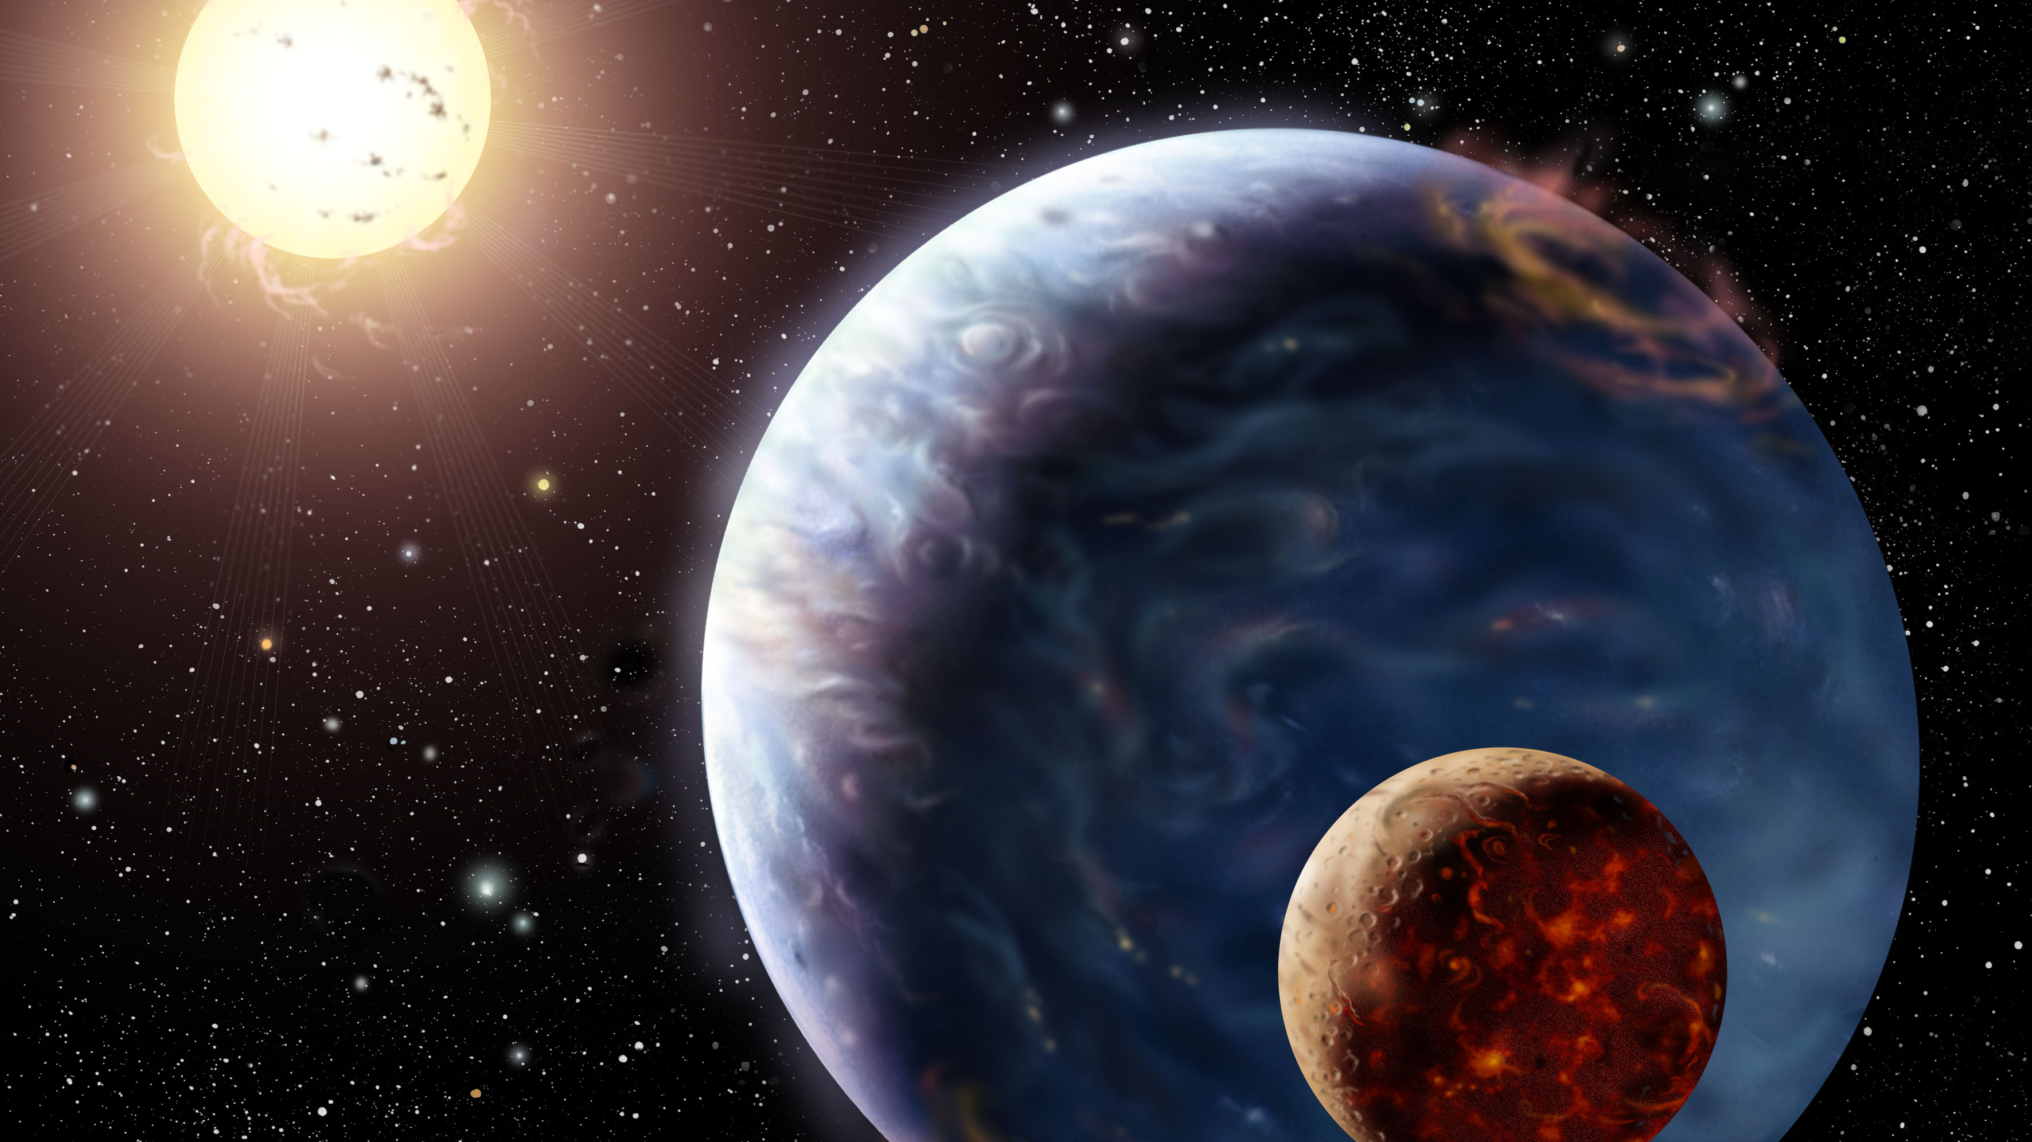
The Moon https://www.youtube.com/watch?v=K3YfLAAi3Vc
This Photo by Unknown Author is licensed under CC BY

Slide 2
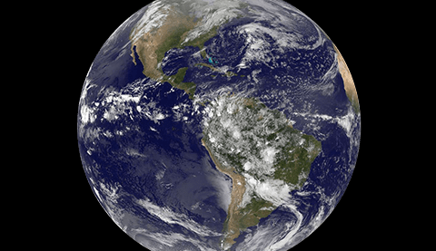
The Earth
Earth is the third planet from the Sun and our home planet.
Earth revolves around the Sun once every 365.25 days - this is known as one Earth year.
In one year, Earth rotates like a spinning ball about 366.25 times – they are known as Earth days.
Only 3% of Earth’s water is fresh and 97% of it is salty.
The surface of Earth is covered by water, around 71%, only 29% of Earth’s surface is covered by land.
The Earth has one moon.

Slide 3
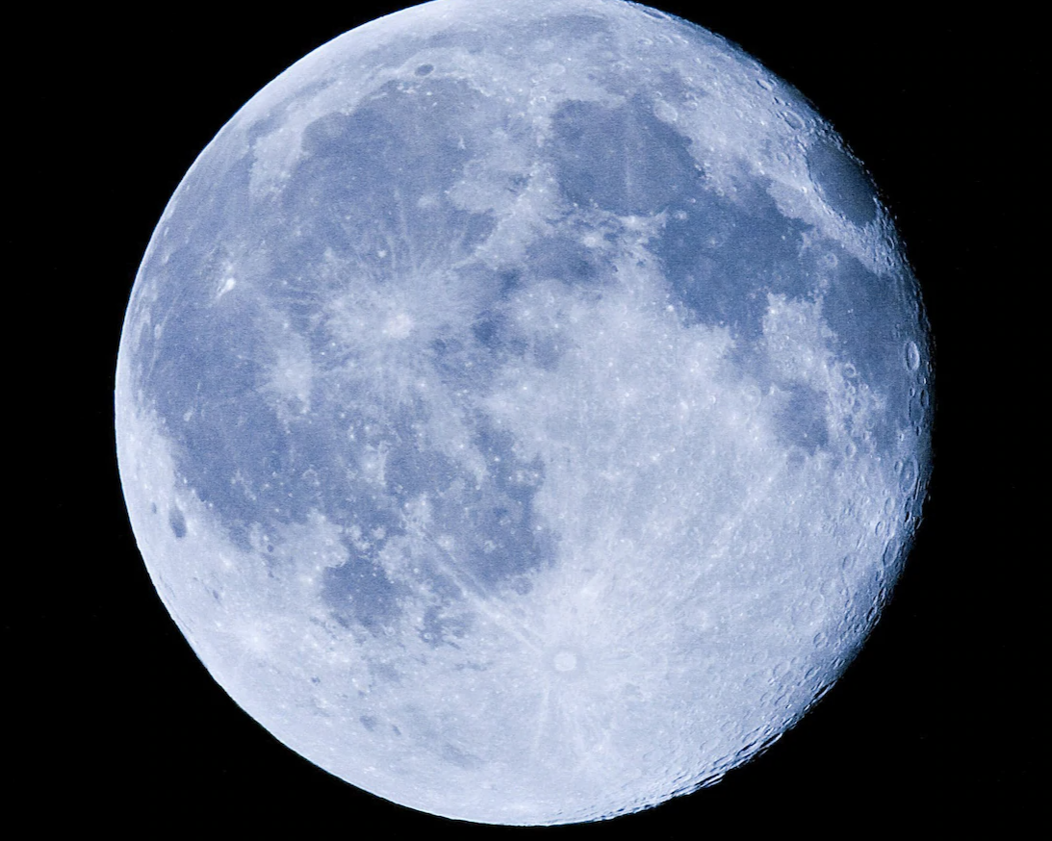
The Moon
Click on the link below to find out all about the moon.
https://www.youtube.com/watch?v=6bSShLJMOmc

Slide 4
Task:
Draw and cut a large circle shape. (This is your moon).
With glue, draw circle shapes. (These will represent the craters and the glue will give texture to your moon).
Paint your moon using grey, green, blue or red colours.
(Colours that represent super moons)

