Slide 1
Wednesday 06.07.22
Count in 2’s song
https://www.youtube.com/watch?v=hae10bsW_CM
What do you notice about the numbers that you say?
These are called even numbers.

Slide 2
Disclaimer/s
We hope you find the information on our website and resources useful.
Animations
This resource has been designed with animations to make it as fun and engaging as possible. To view the content in the correct formatting, please view the PowerPoint in ‘slide show mode’. This takes you from desktop to presentation mode. If you view the slides out of ‘slide show mode’, you may find that some of the text and images overlap each other and/or are difficult to read.
To enter slide show mode, go to the slide show menu tab and select either from beginning or from current slide.
You may wish to delete this slide before beginning the presentation.

Slide 4
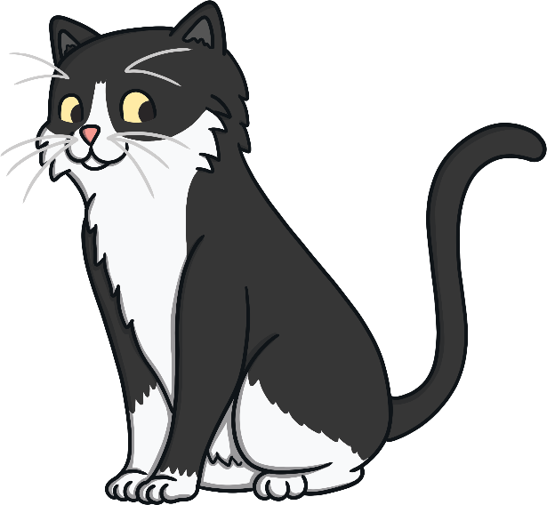
Meow! My name is Purdy.
Every day, I sit on this wall and watch the buses drive past.
I like to see how many passengers are on board each bus and spot odd and even numbers.
Can you help me?

Slide 5

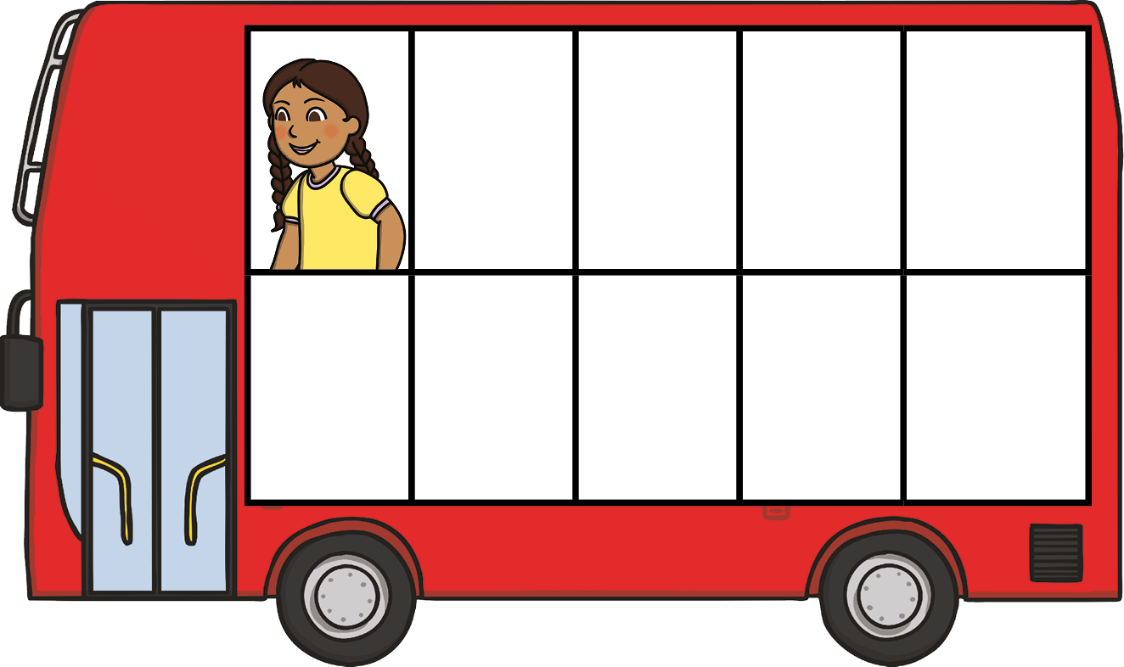
How many passengers are on this bus?
1 is an odd number. It cannot be made into a pair.

Slide 6
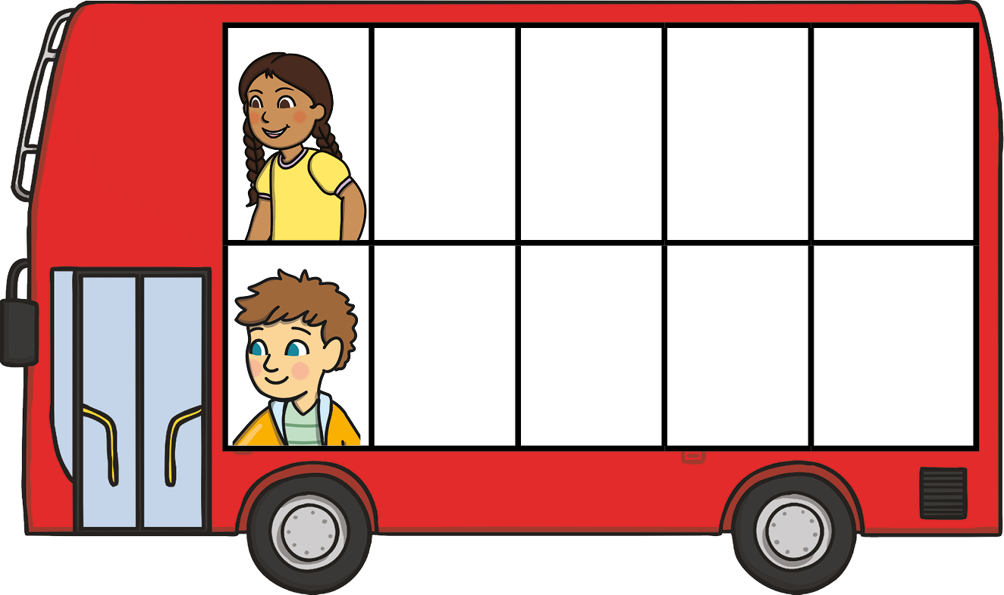
How many passengers are on this bus?
2 is an even number. The passengers can be grouped together into a pair, with none left over.

Slide 7
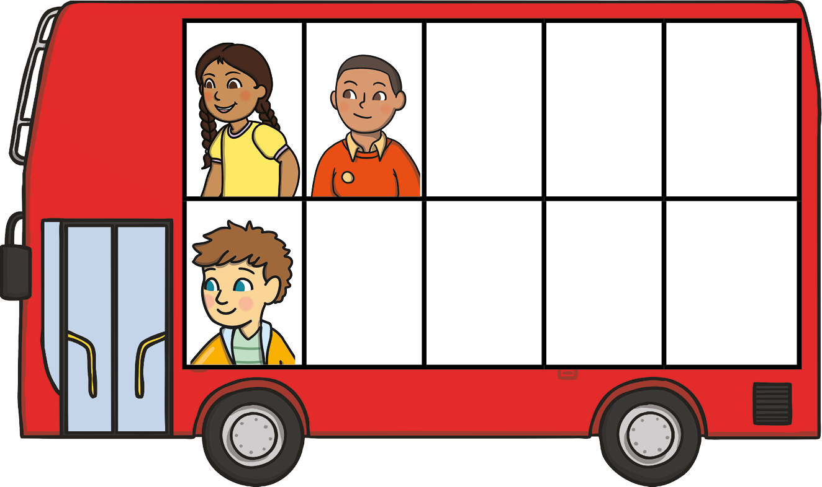
How many passengers are on this bus?
3 is an odd number. When the passengers are grouped into pairs, there is one left over.

Slide 8
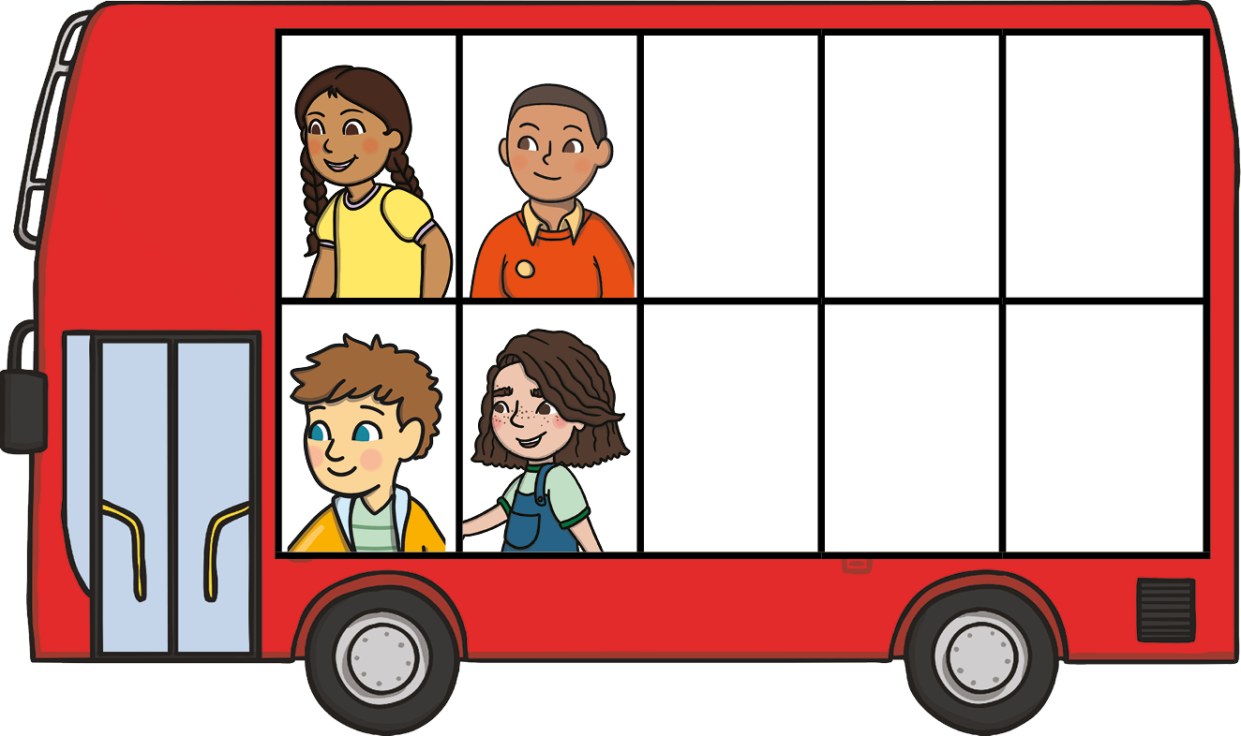
How many passengers are on this bus?
4 is an even number. The passengers can be grouped together into pairs, with none left over.

Slide 9
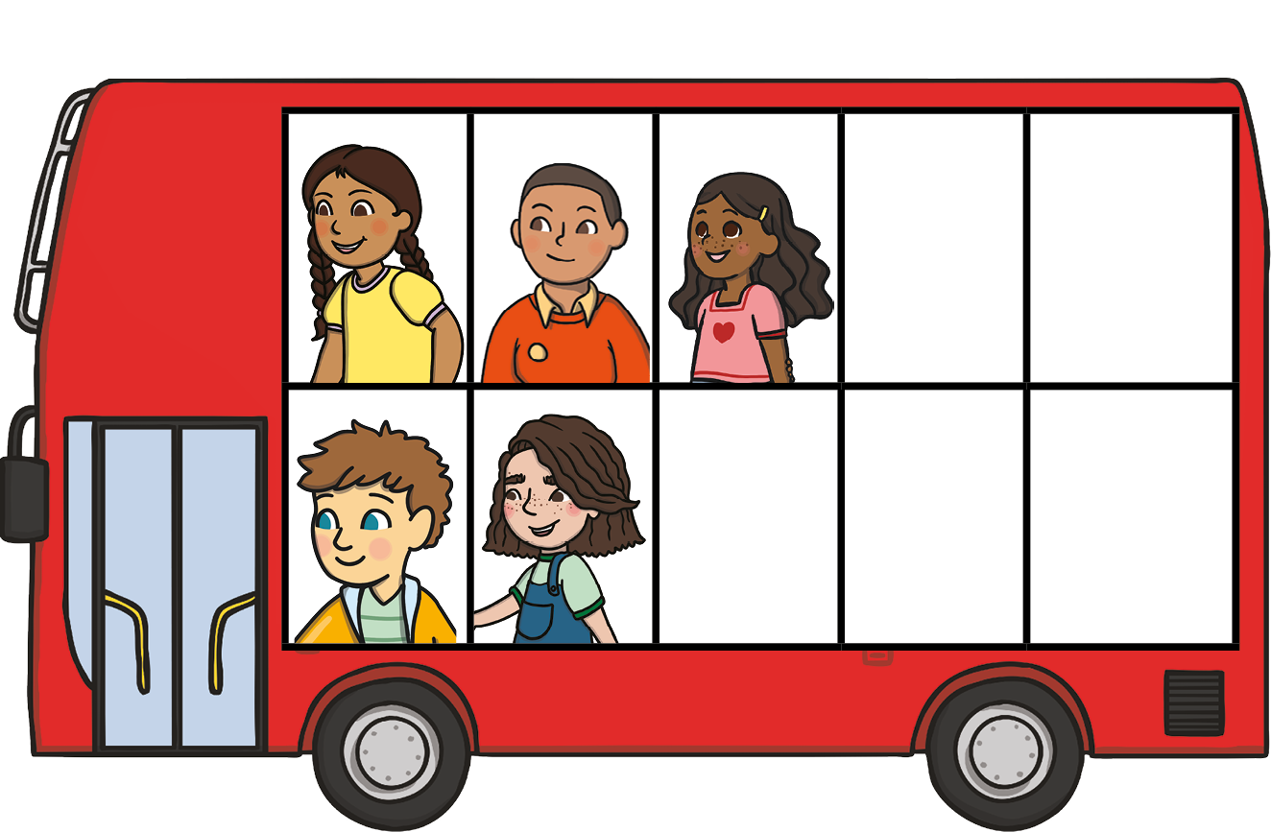
How many passengers are on this bus?
5 is an odd number. When the passengers are grouped into pairs, there is one left over.

Slide 10
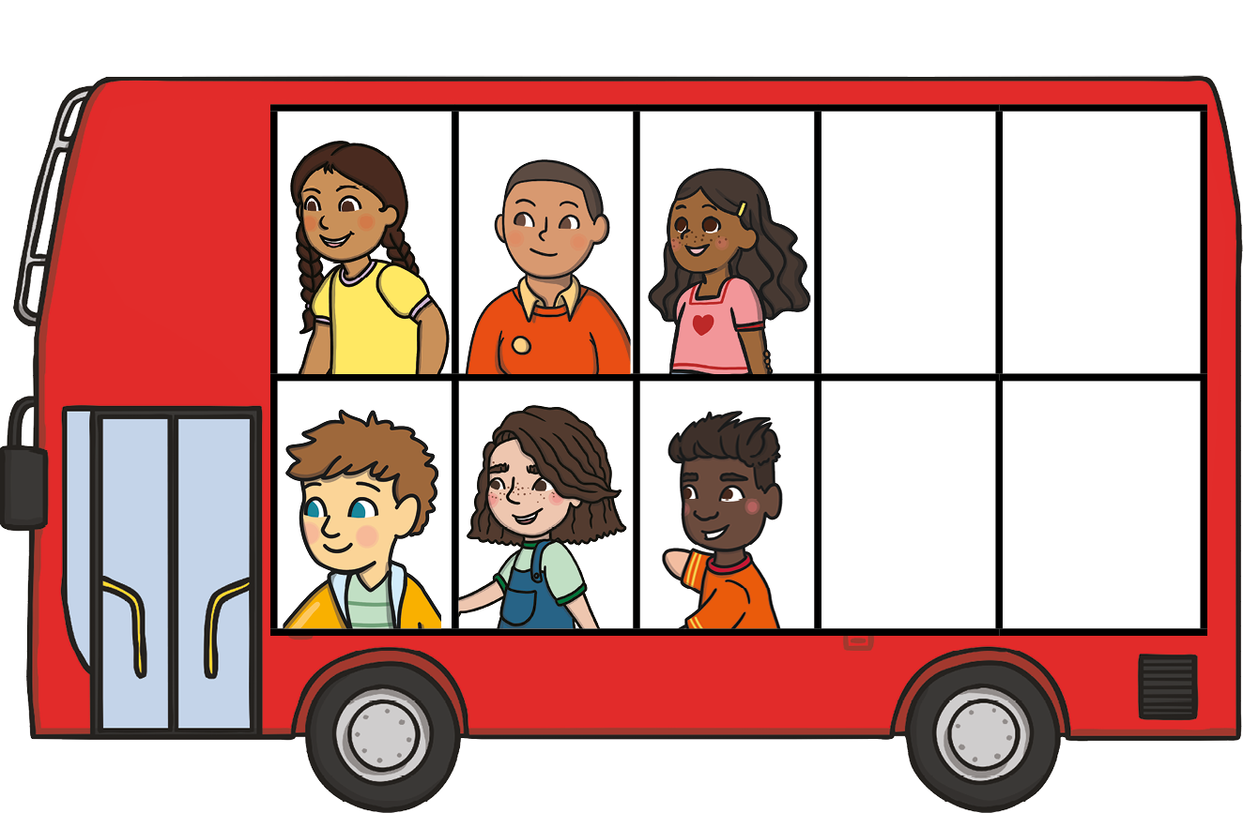
How many passengers are on this bus?
6 is an even number. The passengers can be grouped together into pairs, with none left over.

Slide 11
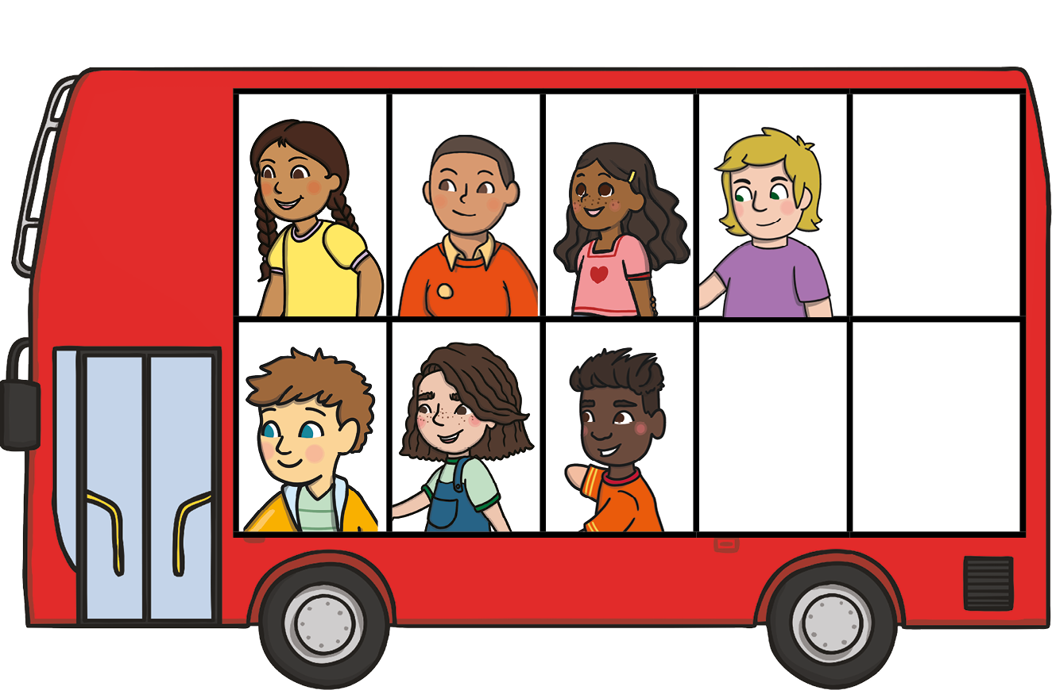
How many passengers are on this bus?
7 is an odd number. When the passengers are grouped into pairs, there is one left over.

Slide 12
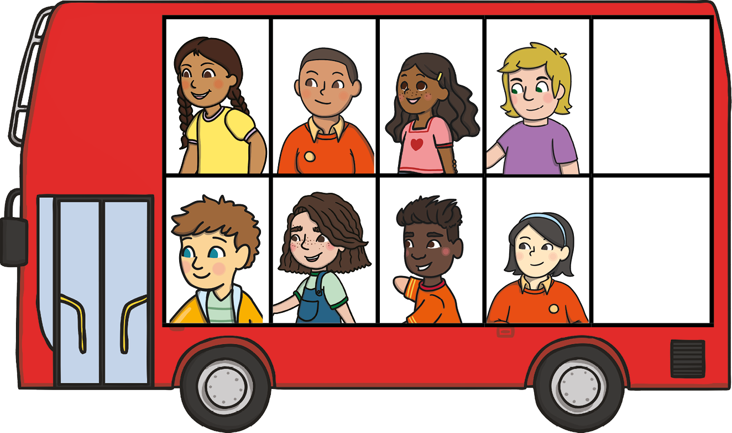
How many passengers are on this bus?
8 is an even number. The passengers can be grouped together into pairs, with none left over.

Slide 13
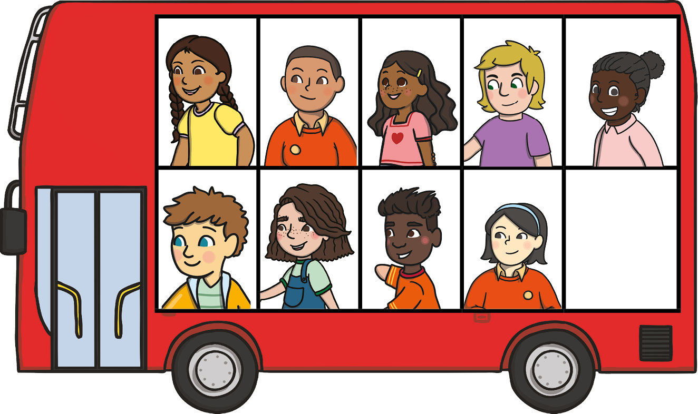
How many passengers are on this bus?
9 is an odd number. When the passengers are grouped into pairs, there is one left over.

Slide 14
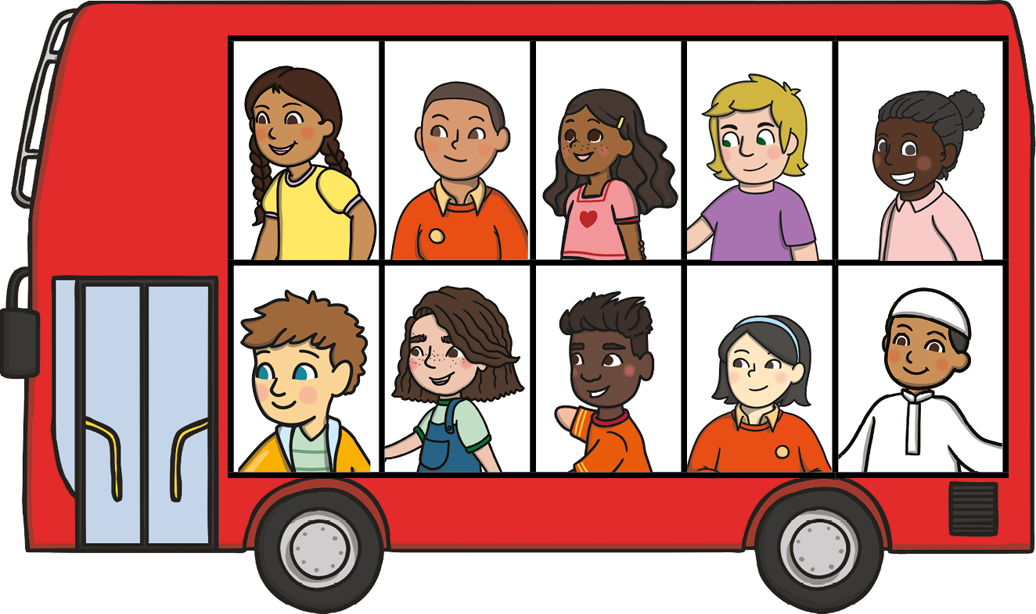
How many passengers are on this bus?
10 is an even number. The passengers can be grouped together into pairs, with none left over.

Slide 15
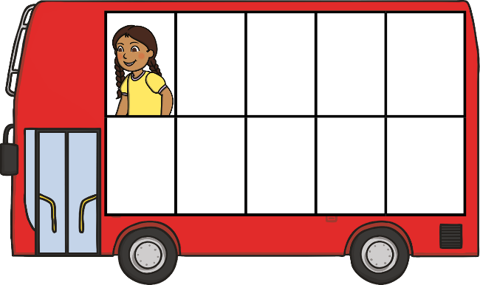
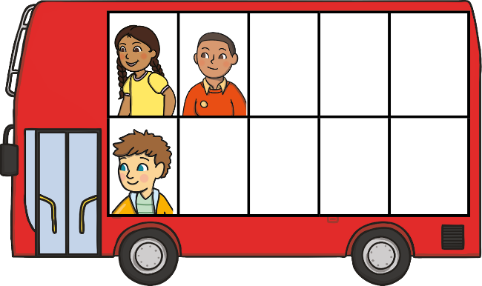
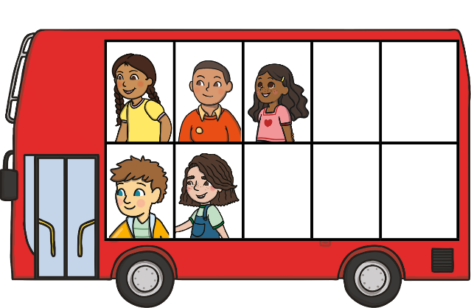
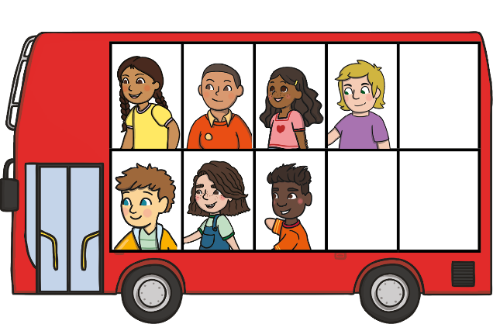
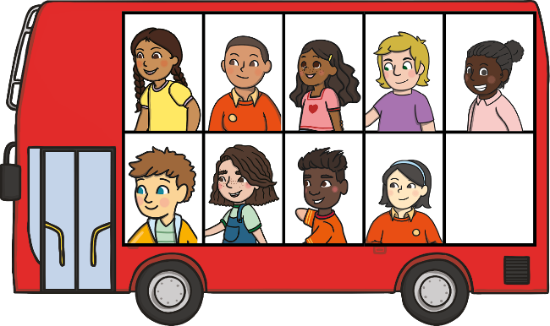
Let’s look at the buses we saw today. What do you notice about these buses?
1
3
5
7
9

Slide 16
The buses are all carrying odd numbers of passengers. When grouped into pairs, there is one left over.
1
3
5
7
9

Slide 17
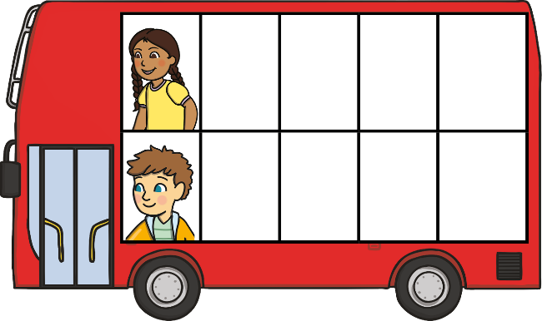
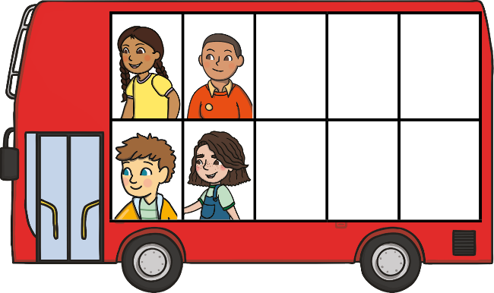
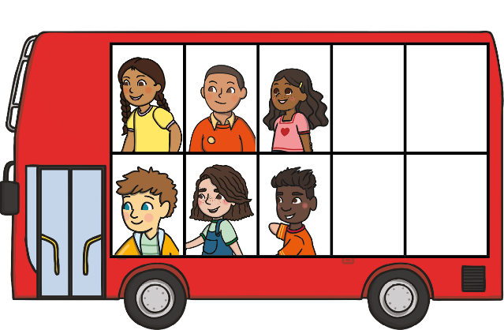
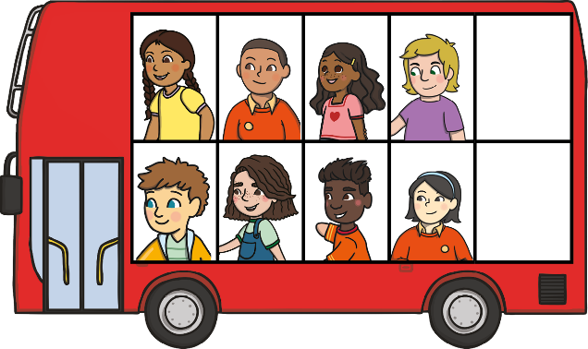
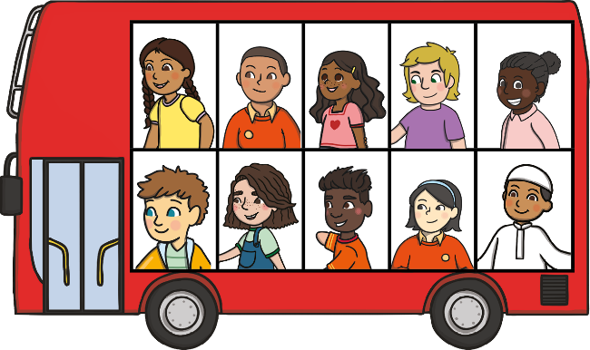
Let’s look at the other buses we saw today. What do you notice about these buses?
2
4
6
8
10

Slide 18
These buses are all carrying even numbers of passengers. The passengers can be grouped into pairs, with none left over.
2
4
6
8
10

Slide 19
Watch as the buses drive past. See if you can spot any patterns on the number line.
6
even
9
odd
10
even
5
odd
3
odd
8
even
4
even
7
odd
1
odd
2
even
3
5
10
1
4
6
9
7
2
8

Slide 20
We saw a lot of buses today.
Some with odd numbers and some with even numbers.
Can you remember any odd numbers?
What even numbers can you remember?
6
even
5
odd
9
odd
10
even
3
odd
7
odd
8
even
4
even
1
odd
2
even
3
5
10
1
4
6
9
7
2
8

Slide 22
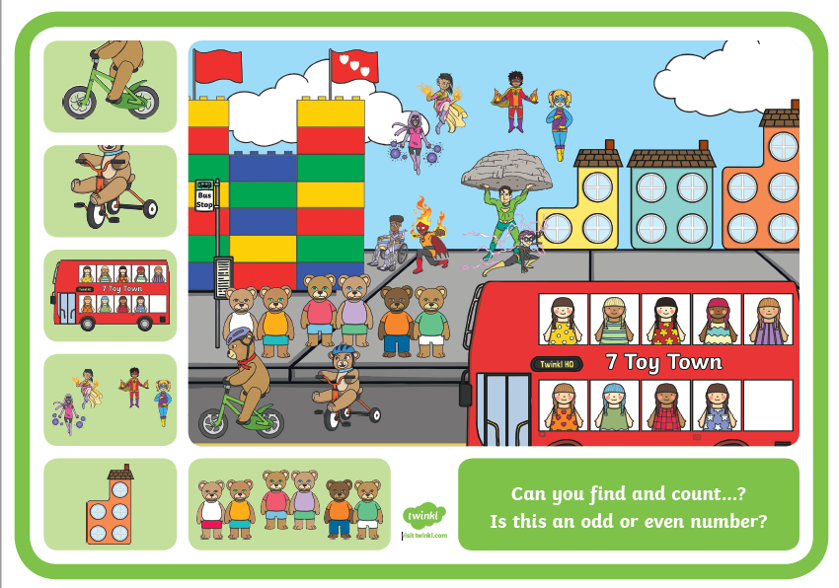

Slide 23
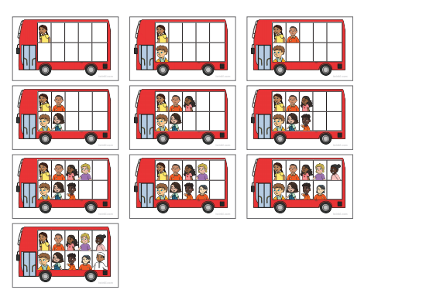
Count the people and decide if they are odd or even. Glue on the sheet in the right columns.

