Slide 1

Friday 8th July
Let’s read our story for the week.
Would you like to visit the moon?
Can you give reasons why you would or would not like to visit the moon?

Slide 2
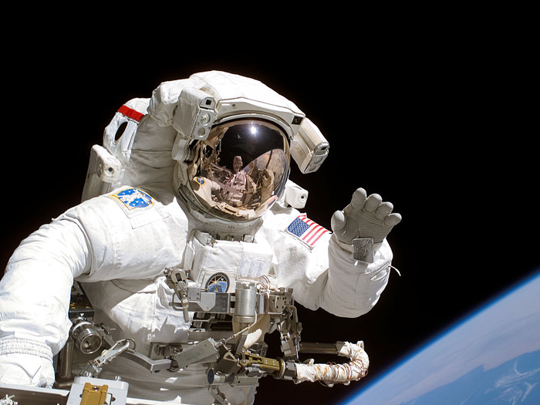
Share your thoughts with your partner.
Would anyone like to share to the class?
Write a sentence about why you would or would not like to go to space.

