Slide 1

Thursday 7th July
Today we are going to think about what it would be like to be an astronaut.
Watch the clip below.
Astronauts! Fun Astronaut Facts for Preschoolers and Toddlers - YouTube
Would you like to be an astronaut?

Slide 2
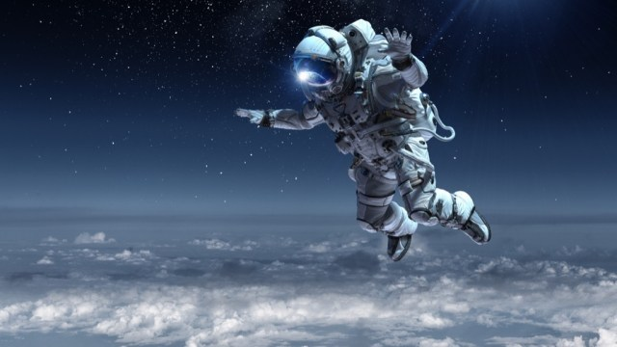
Let’s make a list of words and phrases that we could use to describe Astronauts.
What do they need to do?
What are they like? (qualities)
Write a sentence to describe an Astronaut.

