Slide 1

Wednesday 6th July
Today we are going to watch some this video of the moon.
It will show us what it would look like if we were on the moon.
Try to think of some words to describe it, then we will share with our partners.
NASA | Tour of the Moon - YouTube

Slide 2
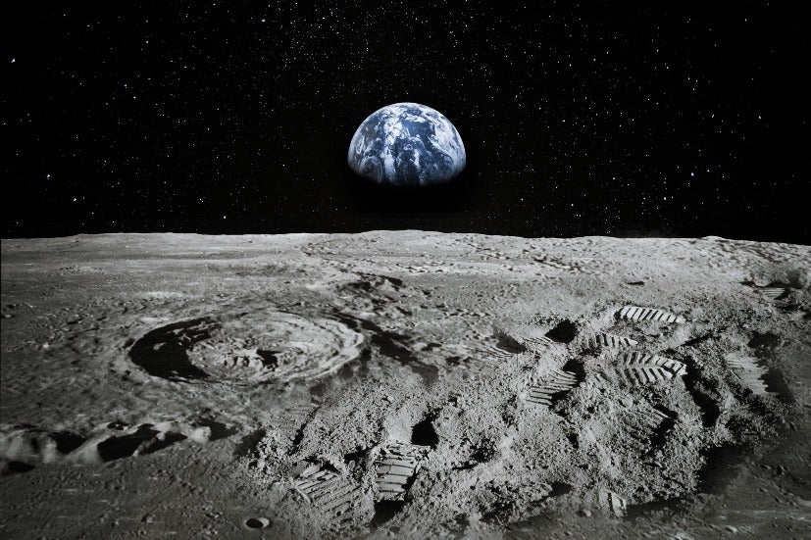
Let’s share some words that we would use to describe the moon.
Let’s put some of these words into a sentence.

