Slide 1
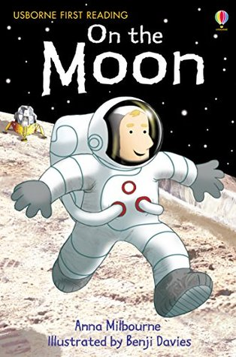
Tuesday 5th July
Our story this week is...
Can you remember what our story is about?
Would you like to visit the moon?

Slide 2
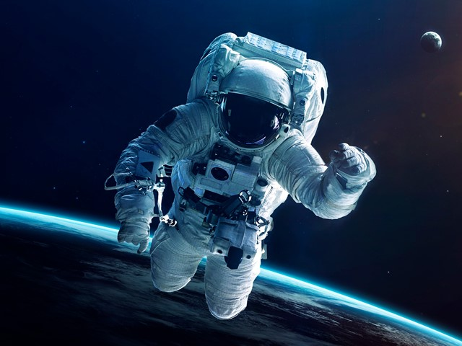
If you were going for a trip to the moon, what would you take with you?
Think about things that are important, what would you need to take with you?
Make a list of things you would need to take with you, then we are going to write a sentence.

