Slide 1
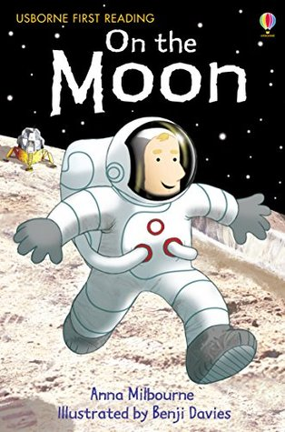
Monday 4th July
Our story this week is...
This story is a non-fiction book.
Can you remember what this means?
Let’s read the story.

Slide 2
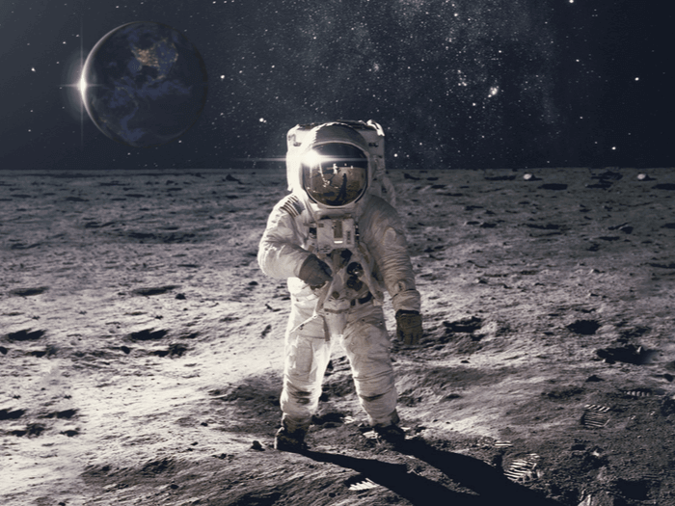
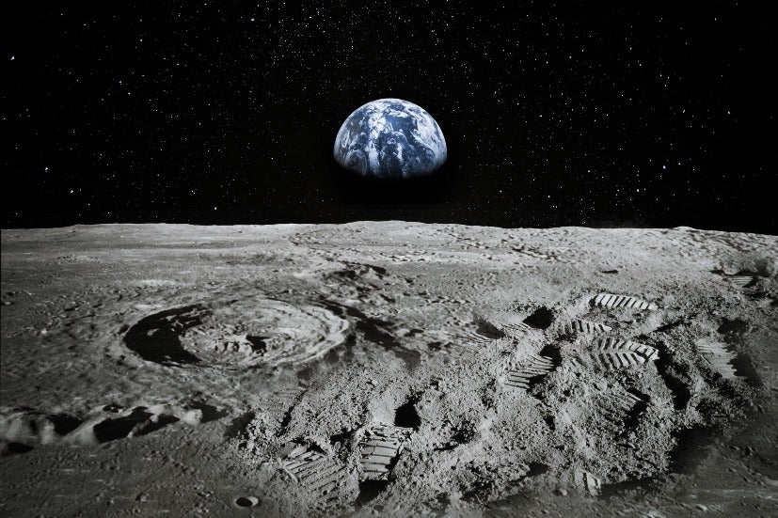
What types of things did the astronaut do when he got to the moon?
What would you like to do if you got the chance to go to the moon?
In your book, write a sentence about what you would do if you got to visit the moon. Draw a picture to go along with your sentences.

