Slide 1

Date: W.B 24th May
LC: Content Domain 1B
To retrieve and record information

Slide 2
1. Prediction
Let look at the front cover and make a prediction about the book.
Is this fiction or non- fiction?
What might it be about?

Slide 3
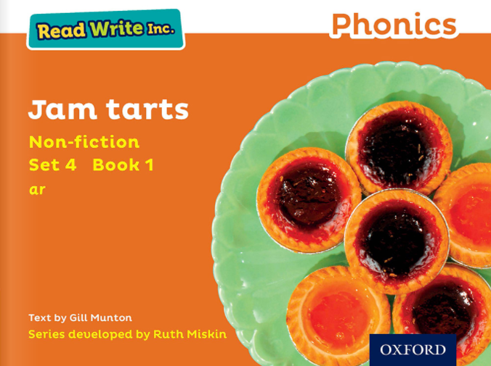

Slide 4

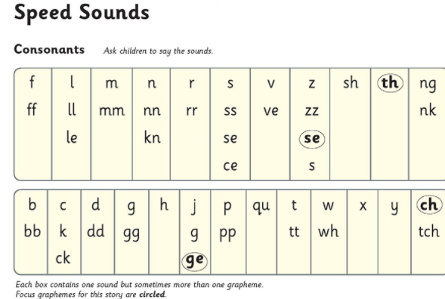
1. Read & Listen...
Lets read the speed sounds together

Slide 5
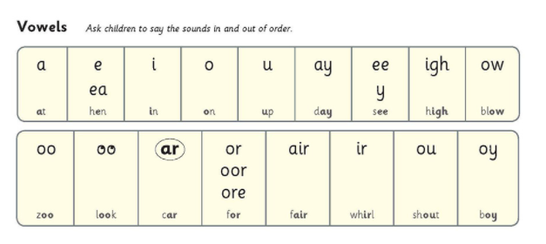
1. Read & Listen...
Lets read the vowels together

Slide 6
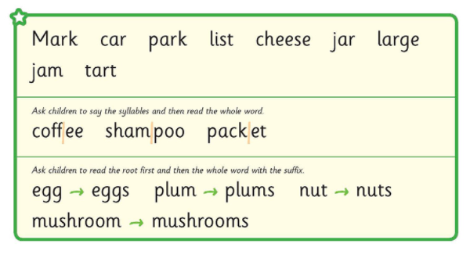
1. Read & Listen...
Lets read the story green words together

Slide 7
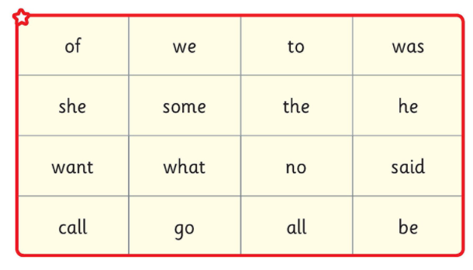

Slide 8
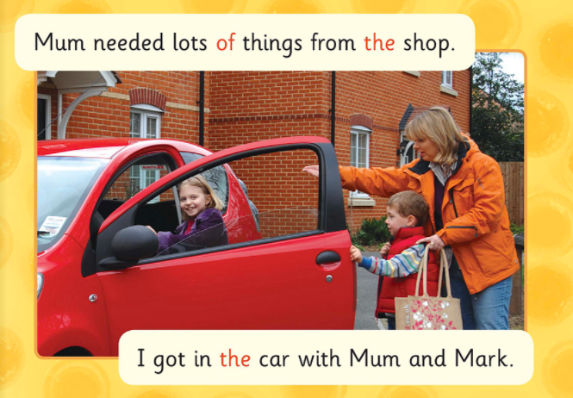

Slide 9
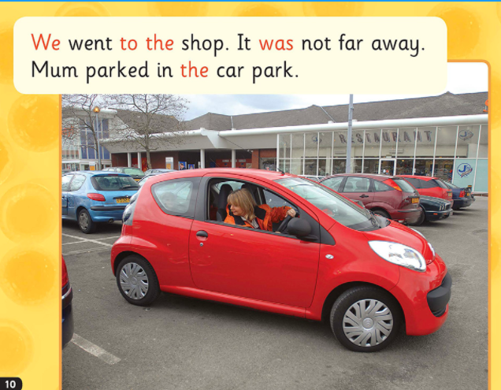

Slide 10
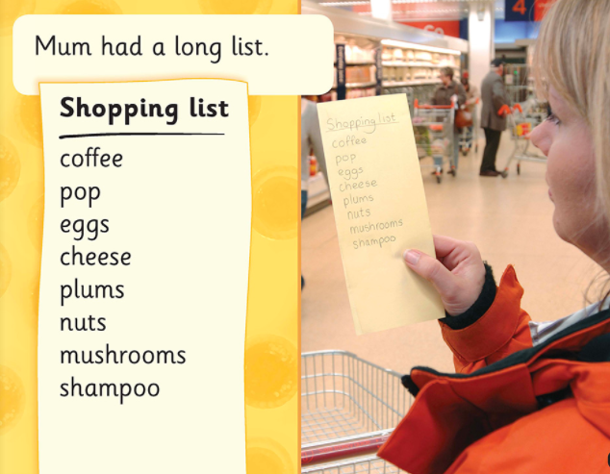

Slide 11
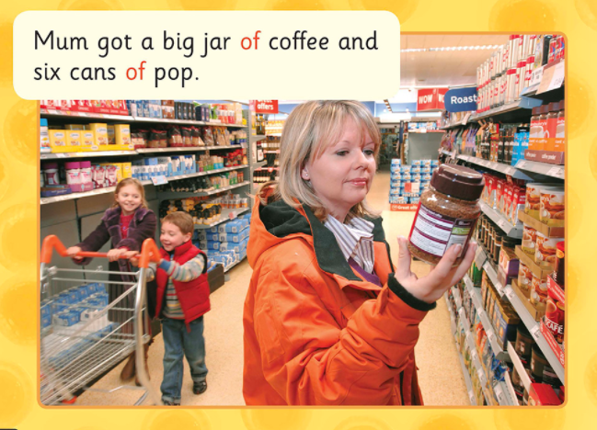

Slide 12
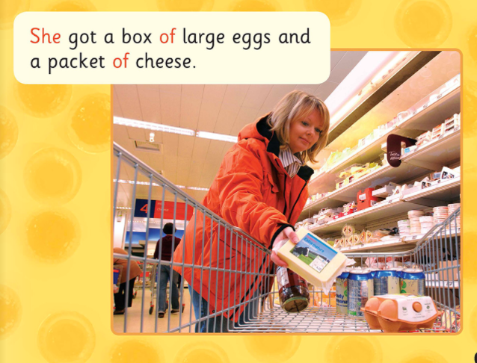

Slide 13
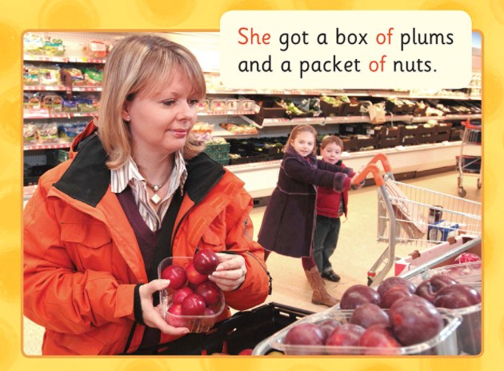

Slide 14
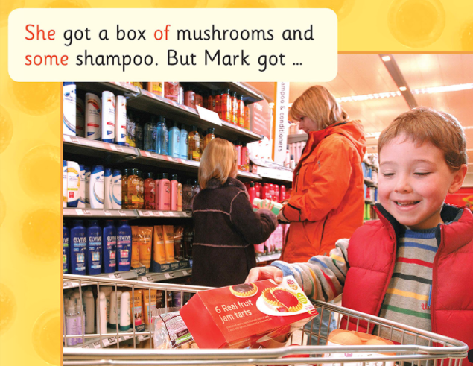

Slide 15
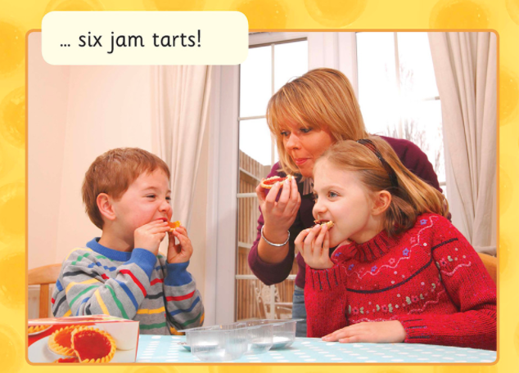

Slide 16
3. Text Organisation
Class Discussion
What type of text is this?
Fiction or non-fiction?
What is the purpose of this text?
To entertain? To persuade? To inform?

Slide 17
4. Star vocabulary!
What would the dictionary say?
“Mum needed lots of things from the shop.”
need- to have to get
.

Slide 18
Supported questions
1) Mum got a big jar of ? (tick 1)
a) Pop b) coffee c) nuts
.

Slide 19
Supported questions
2) Which 2 items did she buy?
1. ----------------- 2.-----------------------

Slide 20
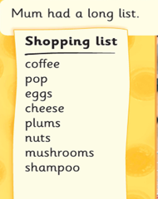
Independent Questions
3) What is at the top of mum’s shopping list? (tick 1
a) plums b) shampoo c) coffee

Slide 21
4) What did she buy a packet of?
_-----------------------------------------

Slide 22
5) How many boxes of jam tarts did Mark pick up (tick 1)
a) 6 b) 1 c) 3

Slide 23
6) Do you think Mum was cross with Mark?
Yes/No (circle 1) Why?/ Why not?
Because -----------------------------------------------
-------------------------------------------------------

