Slide 1

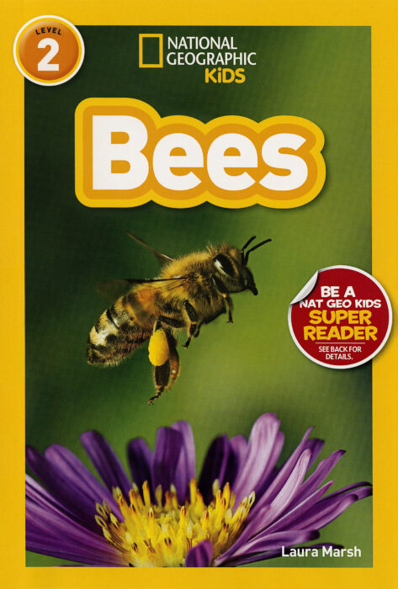
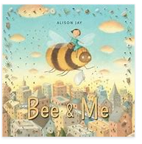
Week 1:
All about Week 1:
All about bees:
Bee and Me

Slide 2
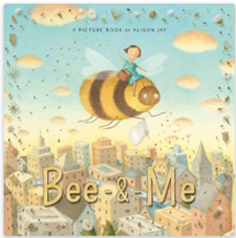
What are we exploring and working towards for this unit of writing?
For this unit of writing, you
will be introduced to non fiction writing
You will explore the features
of non fiction.
Your end goal- By the end of this
unit of writing, you will be able to write some facts about bees to help you write a non chronological report.

Slide 3
Lesson 1 -
Re-read the text.
Bee and Me by Allison Jay - Bing video
Task- WAGOLL – dog report
Highlight the title, subheadings, caption,
Circle the map and photograph.
Find 2 adjectives split with a comma

Slide 4
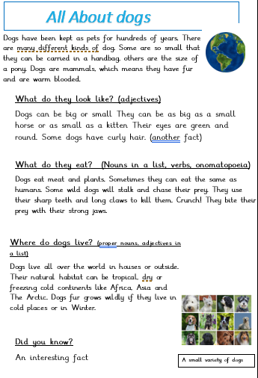
All About Dogs
Non chronological report
WAGOLL

Slide 5

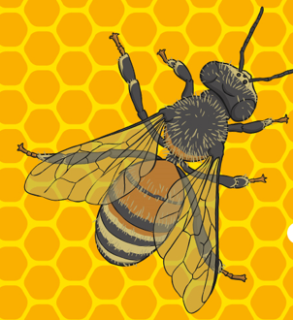
Lesson 2:
Introducing non- fiction writing
Understand the purpose and form of some simple information writing
My turn
What do we already know about bees?
What do they look like?
What do they eat?
What are their body parts like?
How do they produce honey?

Slide 6
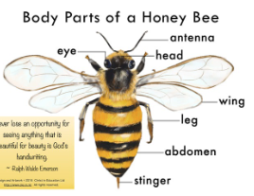
Lesson 2:
Non fiction texts
Let’s have a treasure hunt!
We are looking for information around the classroom about bees
What do they look like?
What do they eat?
Where do they live?
Place the treasure finds in the correct box on the sheet
Notes:
More interesting facts about tigers:
They are the biggest cats in the world.
They can live up to 25 years.
A tiger’s pee smells like buttered popcorn!
Tigers can't purr, but they can “chuff”.
The stripes on a tiger’s fur are different for every tiger.
The smallest species of tiger is the Sumatran tiger and the largest is the Siberian tiger.
Tigers are carnivores. Their prey is deer, wild boar,, wild pigs, buffalo, porcupine They will also eat snakes and lizards.
Tigers are solitary hunters and mostly hunt at night.
Tigers are good swimmers.
No two tigers have the same stripes.

Slide 7
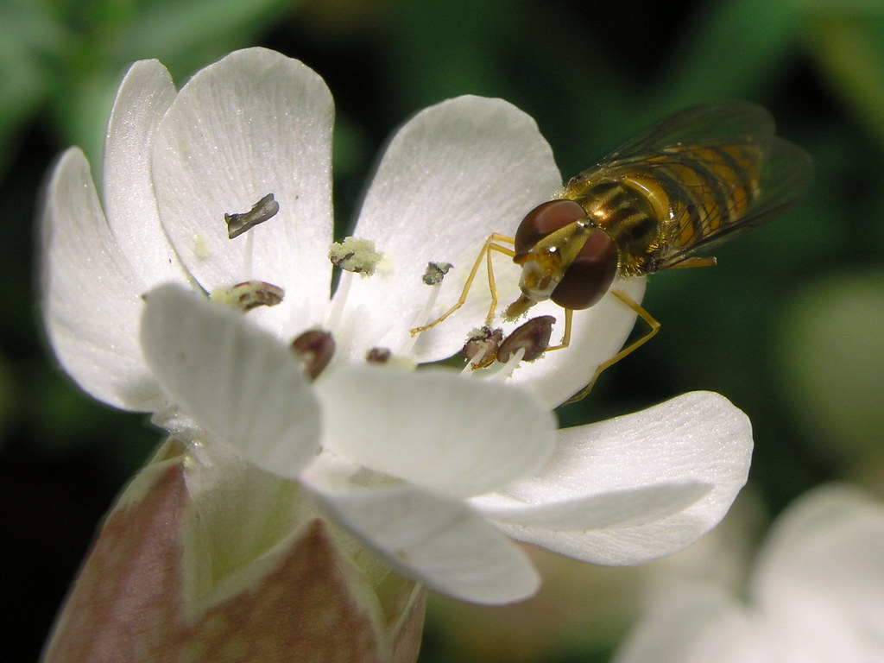
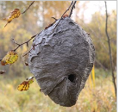
Lesson 2:
Non fiction texts
In pairs-
Look at copies of p6-11 National Geographic Kids- Bees
ALL ABOUT Bees Find the pictures and place them in the correct section | What bees eat
What bees look like | Where bees live

Slide 8
Lesson 3. To understand the purpose and form of some simple writing
Let’s read then write some simple facts about bees, using capital letters and full stops.

Slide 9
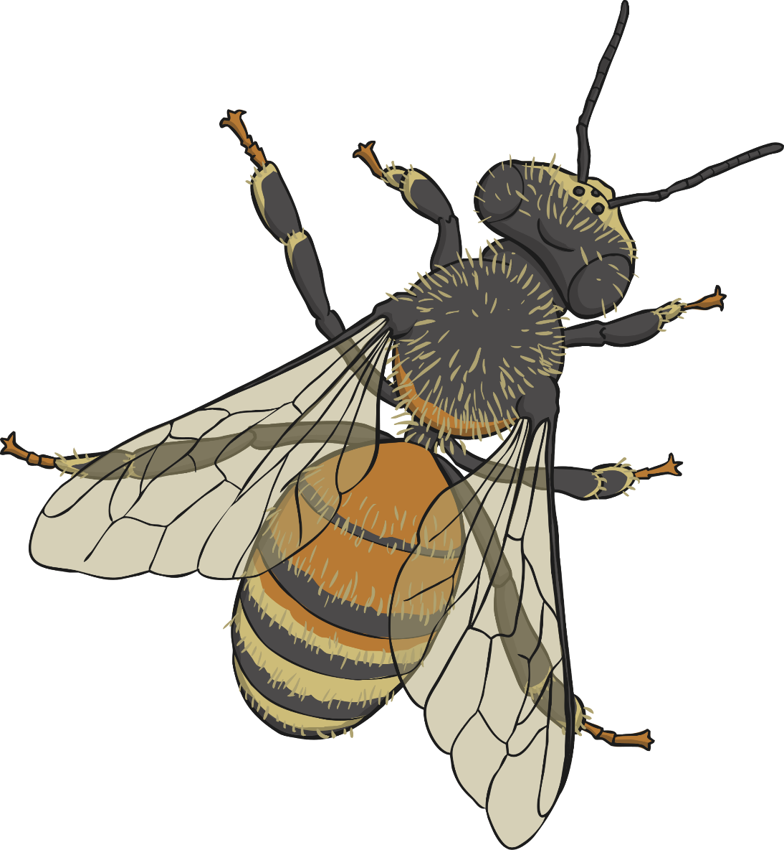
Honeybees
Click the different parts of the honeybee to learn more.
1
2
6
3
4
5
7
Next slide

Slide 10


The Honeybee’s Antennae
1
A honeybee has two antennae which are bent. They are very sensitive and con pick up the flow of air and temperature which helps the honeybee land safely. They can also taste and smell with the antennae.
Watch this video to learn more about a honeybee’s antennae.
Please check the content in this link, including any comments, is suitable for your educational environment before showing. Please do not let the next video automatically play at the end of the clip. Twinkl accepts no responsibility for the content of third party websites.
Back to Honeybee

Slide 11
The Honeybee’s Mandible
The honeybee’s mouth parts are called the mandible.
The honeybee’s mandibles are too small to bite human skin but they can be quite dangerous for other insects that try to invade the hive. They use their mandibles to drink and eat.
2
Back to Honeybee

Slide 12
The Eye Of The Honeybee
3
A honeybee has five eyes. It has two large eyes that are made up of many tiny lenses. We call these large eyes compound eyes. These eyes allow the bee to see movement very well. Honeybees do not see the same colours as we do. They can see ultraviolet light which is impossible for us to see but they can’t see red.
A honeybee has three other eyes called ocelli. They are in a triangle shape on the bee’s head. They can’t see images but they can see light and dark.
Back to Honeybee

Slide 13
The Honeybee’s Body Parts
The honeybee has three different body sections: the head, thorax and abdomen.
head
thorax
abdomen
Back to Honeybee

Slide 14
The Honeybee’s Wings
The honeybee has two pairs of transparent wings that are attached to it’s thorax. Honeybee’s flap their wings very fast, it is almost impossible to see the wings flapping while the bee hovers or flies.
5
Watch this video to see a honeybee flying in slow motion
Please check the content in this link, including any comments, is suitable for your educational environment before showing. Please do not let the next video automatically play at the end of the clip. Twinkl accepts no responsibility for the content of third party websites.
Back to Honeybee

Slide 15
The Honeybee’s Legs
Honeybees have 6 legs that are attached to the thorax. The hindlegs have pollen baskets on them that the bees stuffs full of pollen to take back to the hive. The baskets are transparent (see through) so when you look at a bee you can see the yellow and orange pollen inside the baskets.
The honeybee has a special notch on its front legs that it uses to help keep it’s antennae clean.
6
Watch this video to see a honeybee collecting pollen
Please check the content in this link, including any comments, is suitable for your educational environment before showing. Please do not let the next video automatically play at the end of the clip. Twinkl accepts no responsibility for the content of third party websites.
Back to Honeybee

Slide 16
The Honeybee’s Sting
A honeybee is the only kind of bee with a barbed (hooked) stinger. This means that it can only sting once and the sting stays behind in the creature that they have stung. Unfortunately when a honeybee stings part of it’s abdomen, the venom sack, is left behind connected to the sting, which means that the honeybee dies. This is why honeybees only sting if they feel they are in a lot of danger and to protect the hive.
If you are ever stung, make sure you scrape the sting out and do not squeeze the venom sack connected to the sting.
7
Back to Honeybee

Slide 17
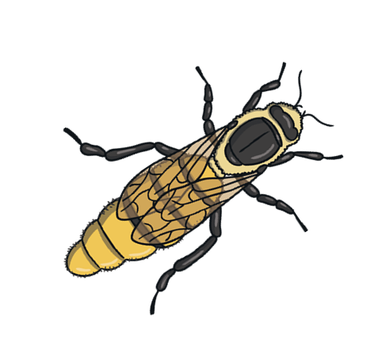
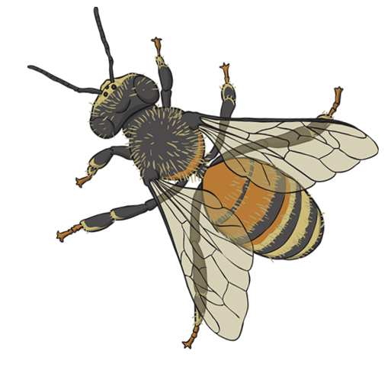
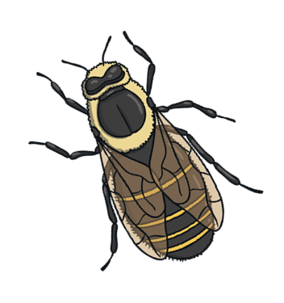
How Do Honeybees Make Honey?
Watch this video to see how a honeybee makes honey
Please check the content in this link, including any comments, is suitable for your educational environment before showing. Please do not let the next video automatically play at the end of the clip. Twinkl accepts no responsibility for the content of third party websites.

Slide 19
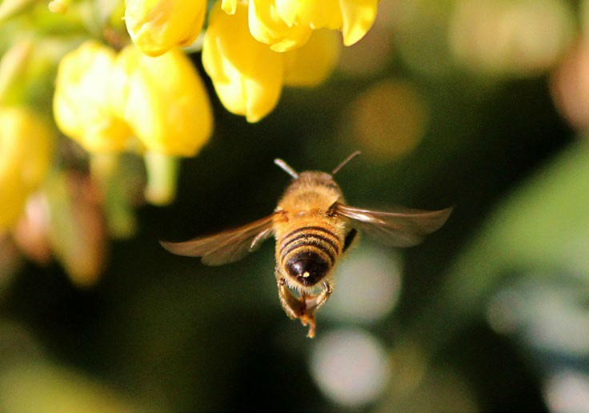
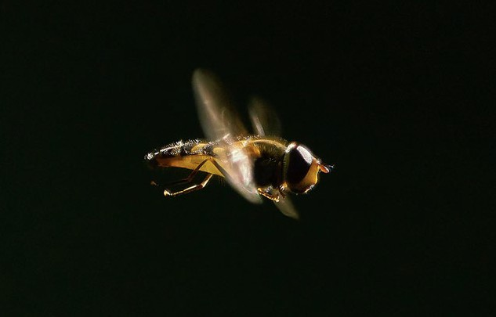

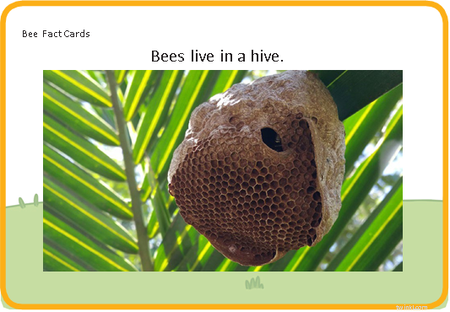
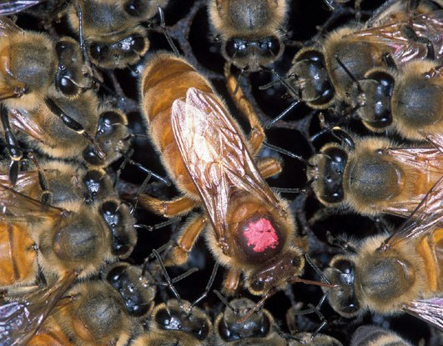
Bee Fact Cards
Honey bees are amazing and super-fast flyers!
Bee Fact Cards
When the worker bees come home to their hive, they dance to show the other workers where to find food!
twinkl.com
Bee Fact Cards
In a hive there is a queen bee, who
lives until she is 5 or 6 years old.
or nest.

Slide 20
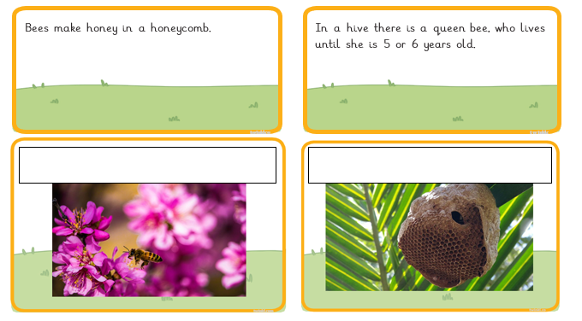
Lesson 3- Make your own fact file
Now you have a go. Draw 2 diagrams to match the captions in the first 2 boxes.
Write 2 captions to match the photographs in the second 2 boxes.

Slide 21
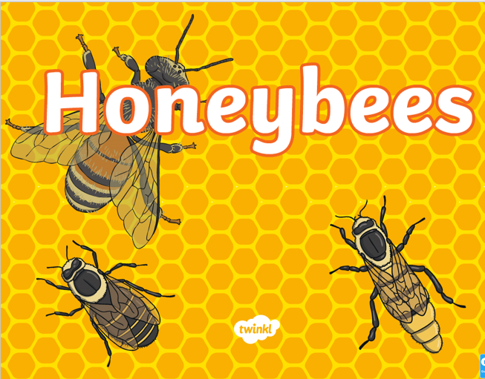
Lesson 4
To use relevant words about a topic. To label a diagram of a bee
Today we will watch last week’s information PP about bees again and use the information to help us to label the honeybee. We will then write a caption, that matches, in the box below.

Slide 22
Lesson 4
To use relevant words about a topic. To label a diagram of a bee
Let’s read the labels together starting at the top.
Now you can copy them into the boxes in your best handwriting. Once you’ve finished, think of a good caption and write it in the box below the bee.

Slide 23
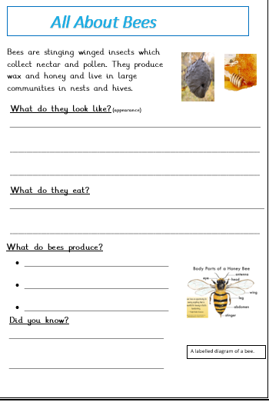
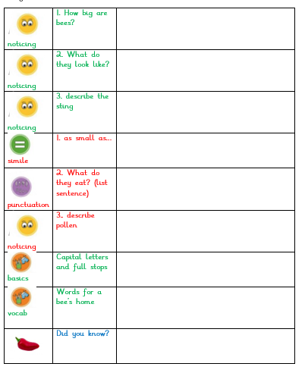
Week 2
Lesson 1, 2, 3 stackers

Slide 24
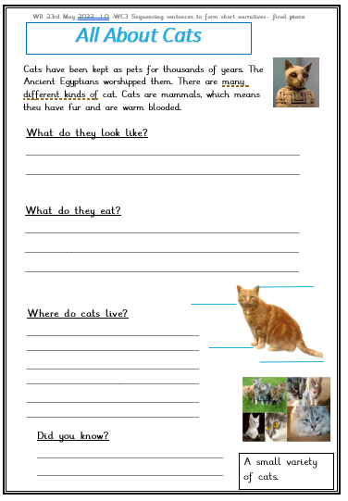
Week 2 lesson 4 and 5
It is now time for you to complete your report over the next 2 days.
We will do each section together
Don’t forget to use all the information needed for a non- chronological report
This one will be all about CATS11
Just a reminder-
You still need to use
Capital letters
Full stops
Question marks
Finger spaces
Best handwriting

