Slide 1

Summer 1- Week 6
WB: 23.5.22
Place Value
(Numbers to 100)

Slide 2
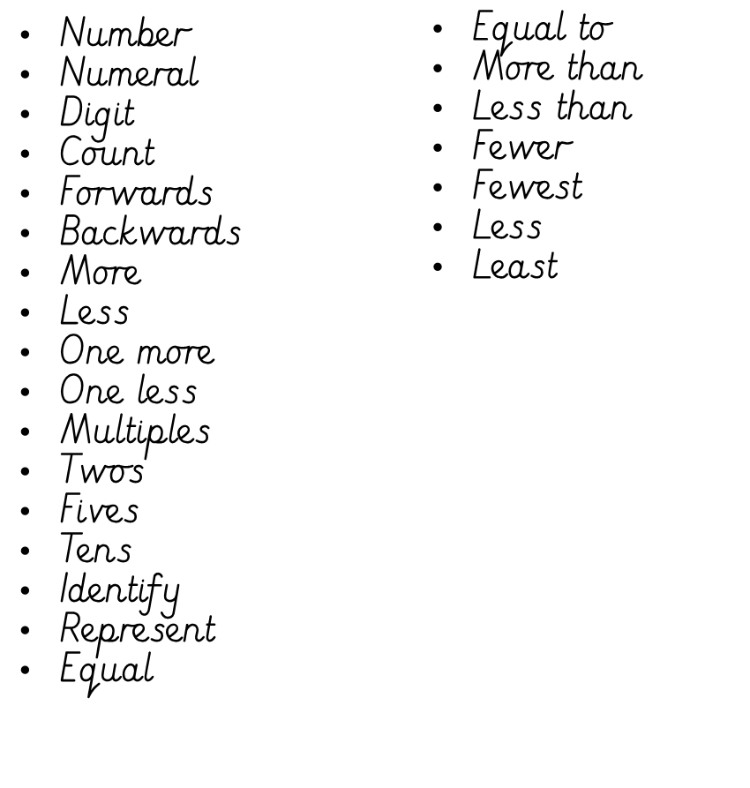
Vocabulary for the unit...

Slide 3
Session 1
Identify and represent numbers up to 100 using objects and pictorial representations including the number line, and use the language of: equal to, more than, less than (fewer), most, least

Slide 4
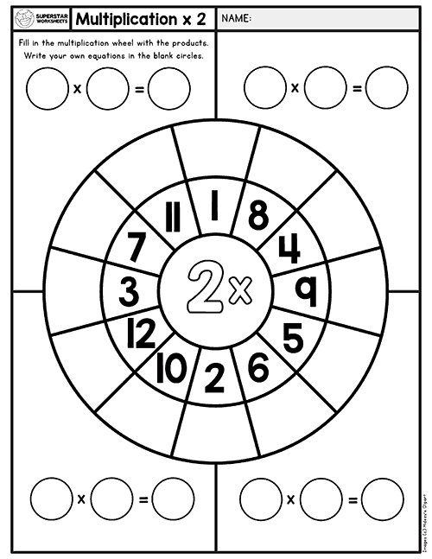
Multiplication Wheel
2 x

Slide 5
Hook:
True of false
‘The number 62 is made up of 6 tens and 2 ones.’

Slide 6
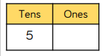
Hook:ANSWER
True
‘The number 62 is made up of 6 tens and 2 ones.’
6
2
60 + 2 = 62

Slide 7
Task 1: Order the Numicon cards from greatest to smallest

Slide 8
Task 2:Order the numbers 50 to 70 70 in order from smallest to greatest.

Slide 9
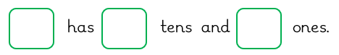
Task 3: Complete the statements
52

Slide 10
Task 3: Answer
52
5
2

Slide 11
Task 3: Complete the statements
58

Slide 12
Task 3: Answer
58
5
8

Slide 13
Task 3: Complete the statements
63

Slide 14
Task 3: Answer
63
6
3

Slide 15
Task 3: Answer
68

Slide 16
Task 3: Answer
68
6
8

Slide 17
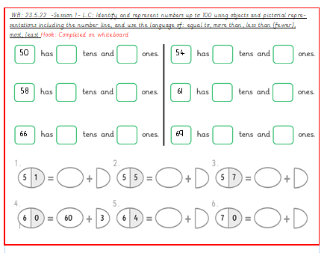
Over to you...

Slide 18

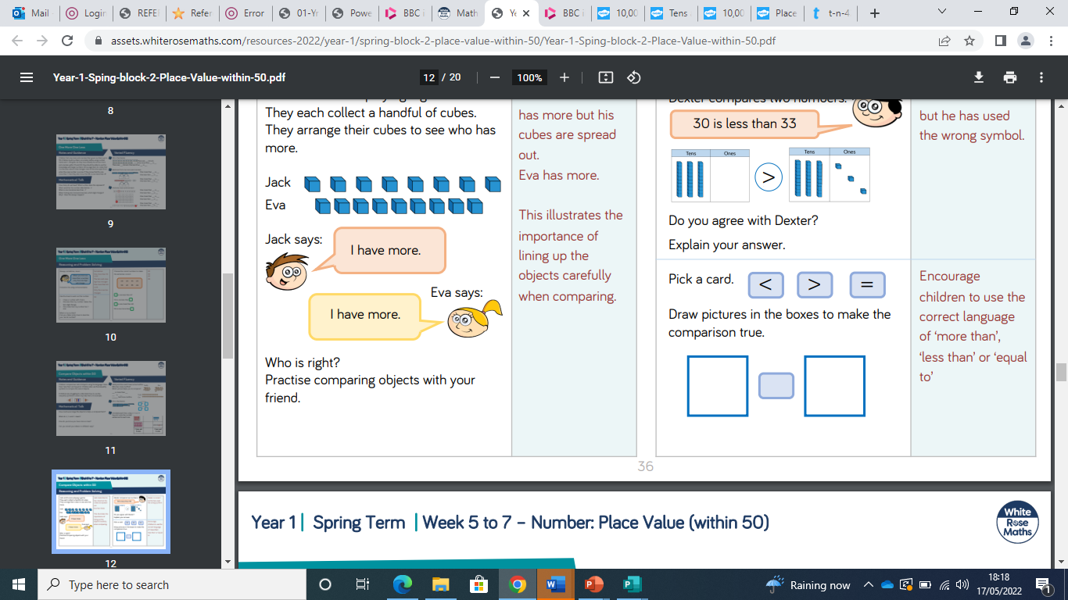
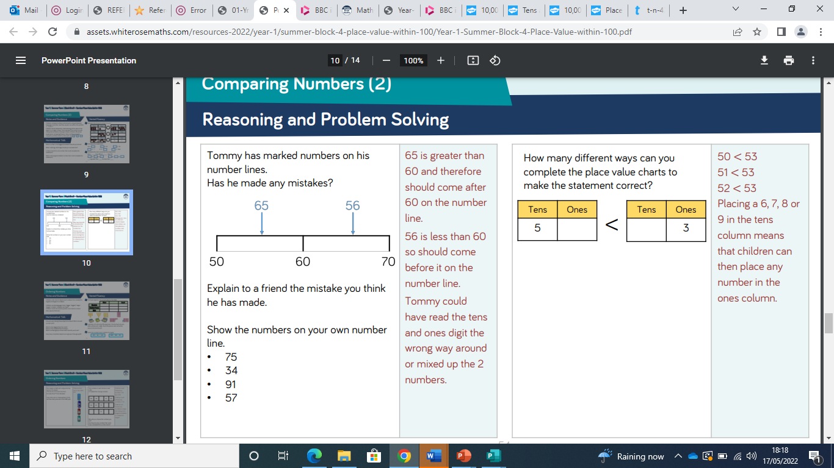
Chilli Challenge
Complete the statements so that they are correct.
6
2
3
6

Slide 19
Session 2
Identify and represent numbers up to 100 using objects and pictorial representations including the number line, and use the language of: equal to, more than, less than (fewer), most, least

Slide 20
Vocabulary
Number
Numeral
Digit
Count
Forwards
Backwards

Slide 21
Multiplication Wheel
2 x

Slide 22
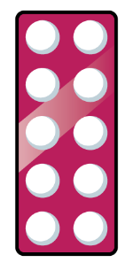


Hook:
Which representation shows the greatest amount?

Slide 23
Hook:ANSWER
Which representation shows the greatest amount?

Slide 24
Task 1: Order the Numicon cards from greatest to smallest.
Discussion: What do you observe about the tens and ones?
What is the same? What is different?

Slide 25
Task 2:
-Choose 2 of the Numicon cards.
-Now use the < > = symbols to make a correct statement about the two Numicon cards

Slide 26
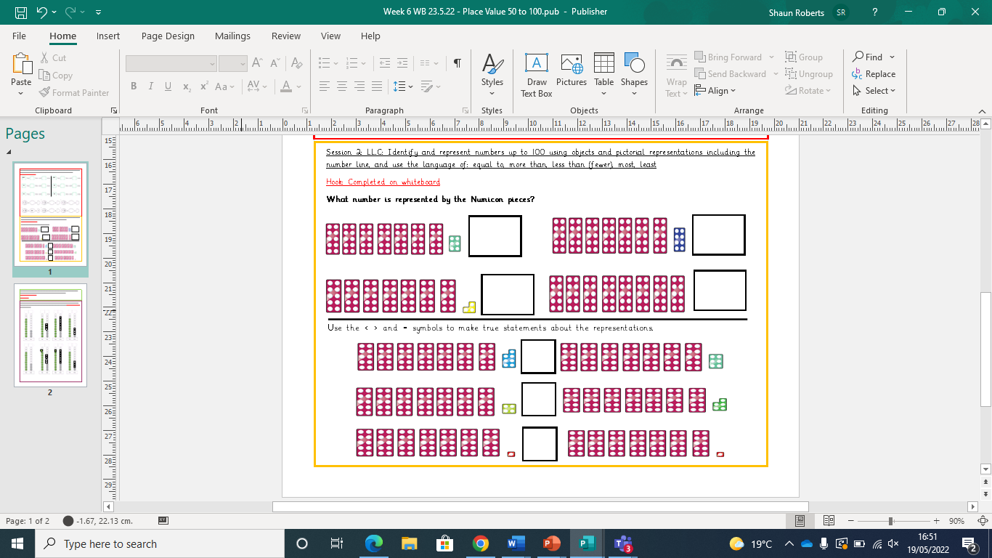
Over to you...

Slide 27
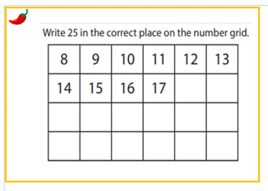
Chilli Challenge

Slide 28
Session 3
Identify and represent numbers up to 100 using objects and pictorial representations including the number line, and use the language of: equal to, more than, less than (fewer), most, least

Slide 29
Multiplication Wheel
2 x

Slide 30
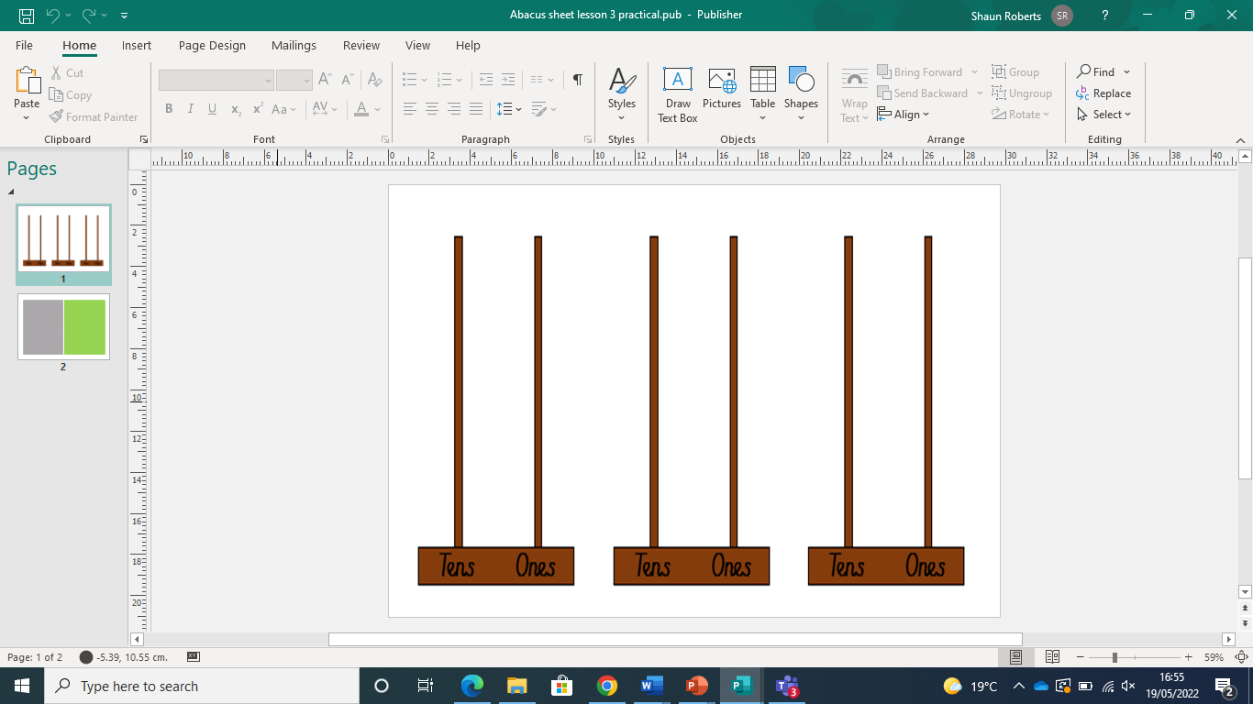
Hook..
True or False?
The number represented is 81

Slide 31
Hook..ANSWER
True or False?
The number represented is 81
FALSE
The number represented is 80 .
Discuss

Slide 32
Practical Task 2:
‘I am thinking of a number’ game.
Notes:
DISCUSS PATTERNS CH CAN FIND, LOOL AT TENS AND ONES DIGITS IN ROWS AND COLUMNS

Slide 33
Practical Task 3:
‘I am thinking of a number’ game with a partner.
Notes:
DISCUSS PATTERNS CH CAN FIND, LOOL AT TENS AND ONES DIGITS IN ROWS AND COLUMNS

Slide 34
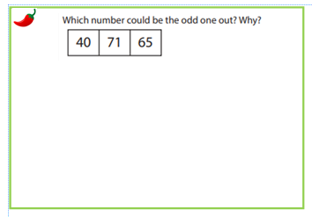
Chilli Challenge

Slide 35
Session 4
LC:Identify and represent numbers up to 100 using objects and pictorial representations including the number line, and use the language of: equal to, more than, less than (fewer), most, least

Slide 36
Multiplication Wheel
10 x

Slide 37
Vocabulary
Number
Numeral
Digit
Count
Forwards
Backwards

Slide 38
Hook..
What is one more and one less for the number represented?

Slide 39
Hook..
What is one more and one less for the number represented?
99
One less than 99 is 98
One more than 99 is 100

Slide 40
Practical Task 1: Match the arrow card value to the abacus representation.
Notes:
DISCUSS PATTERNS CH CAN FIND, LOOL AT TENS AND ONES DIGITS IN ROWS AND COLUMNS

Slide 41
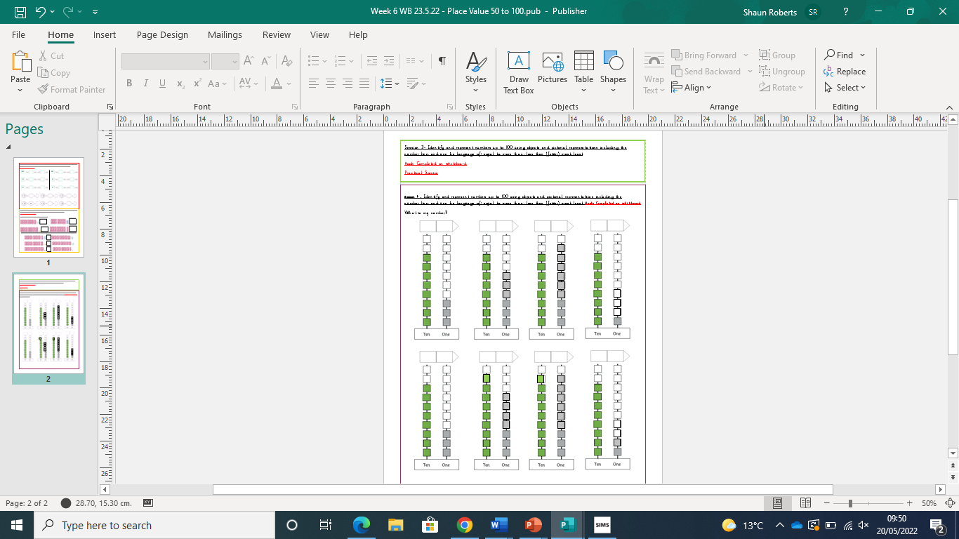
Over to you...

Slide 42
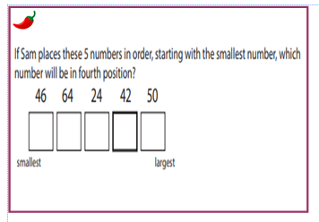
Chilli Challenge

Slide 43
Session 5
Arithmetic
Recalling Number bonds to 20

