Slide 1
The Magic of the Brain
LC: Can I retrieve and record information / identify key details from fiction?
(Content Domain 2b)

Slide 2
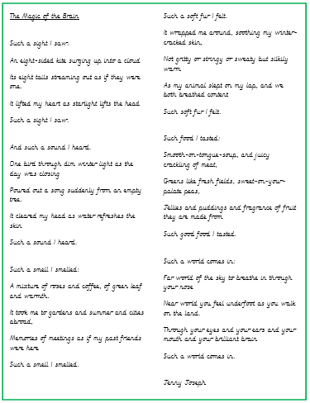

Text to be presented to children

Slide 3
Skim and Scan.
Can you find and highlight the following words in the text?
Who will be the quickest?
fragrance
surging
soothing
palate

Slide 4
Do we know the meaning of all of these words?
fragrance
surging
soothing
palate

Slide 5
Star vocabulary!
What would the dictionary say?
Fragrance
Fragrance of fruit they are made from.
A pleasant, sweet smell.
Can you put this word into your own sentence?

Slide 6
Star vocabulary!
What would the dictionary say?
Surging
An eight-sided kite surging up into a cloud.
To move suddenly.
What word class is this word?

Slide 7
Organisation of the text
What type of text is this?
How do you know this?
How is the text organised?
Why do you think it is organised in this way?

Slide 8
Whole text questions
What is the text about?
What can we learn from this text?
What part of the text do you like best? Why?

Slide 9
Supported questions
Which 4 smells has the author chosen that reminds her of her friends? Why did she choose these? (2 marks)
Find and copy an example of alliteration in the poem. (1 mark)

Slide 10
Independent questions
Remember to skim and scan.
Underline the answer in the text.
Copy exactly.

Slide 11
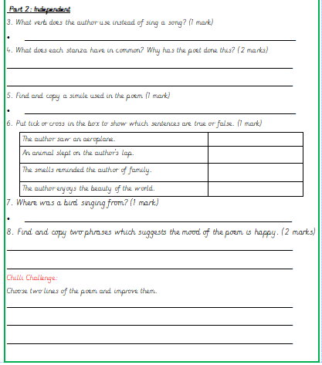
Independent questions

