Slide 1

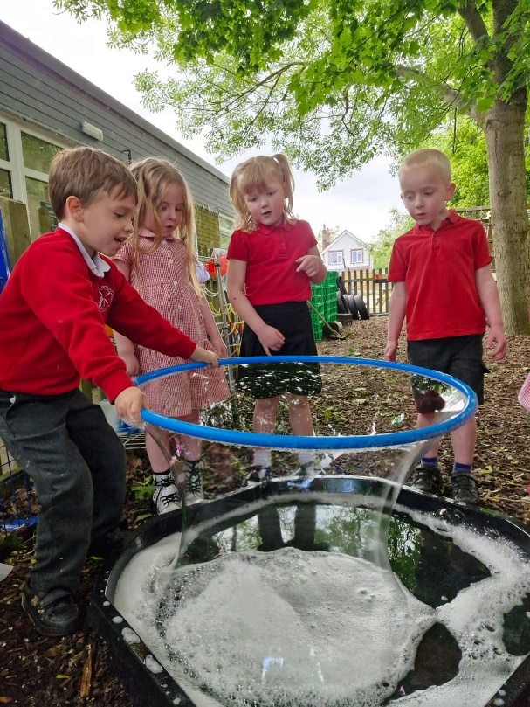
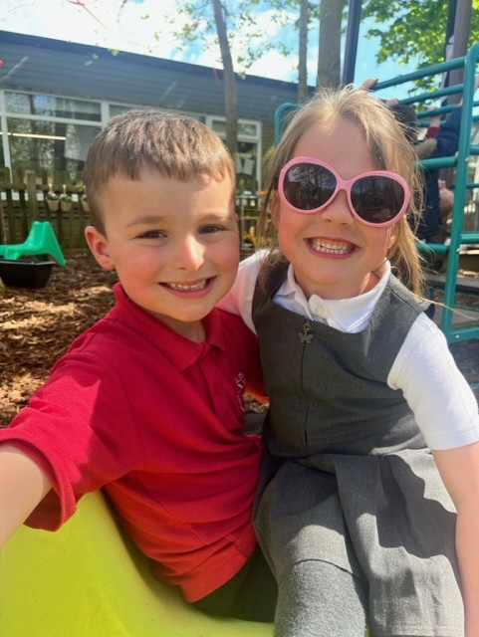
Welcome to…
Reception!

Slide 2
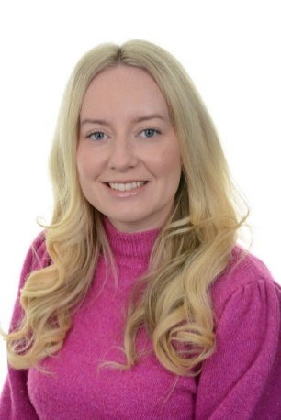
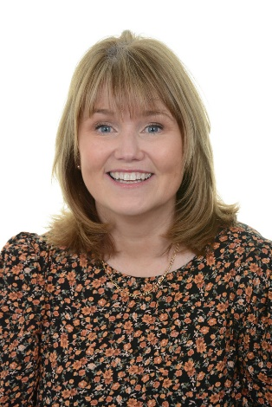
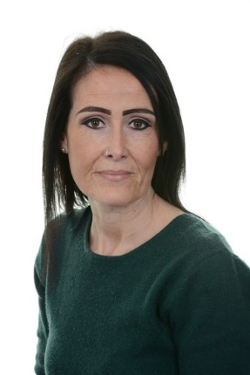
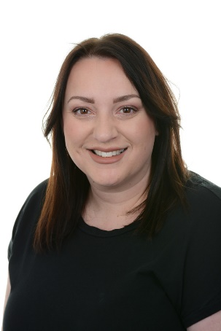

The Early Years Team
Alice Davies
Class Teacher
Sharon Wyatt
Friday Class Teacher
Beth Parker
Teaching Assistant
Hannah Griffiths
Teaching Assistant – Part Time
Sarah Davies
Teaching Assistant – Part Time

Slide 3
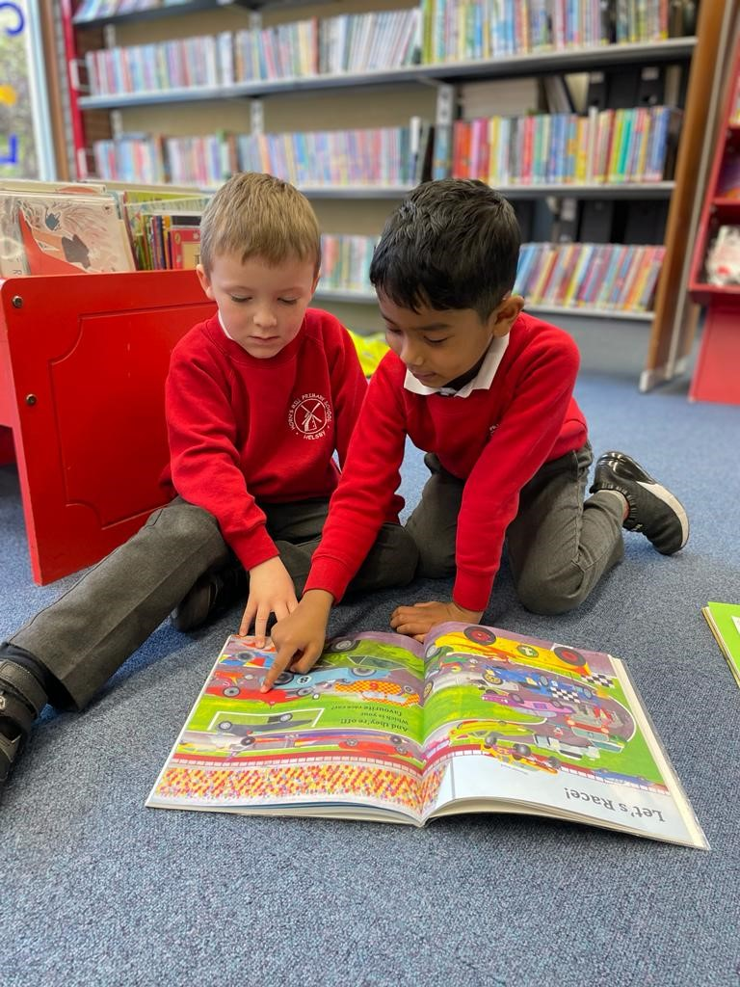
Transition to Reception…
Time in Reception
Pre-school visits
Lunch at school
Nursery Visits

Slide 4
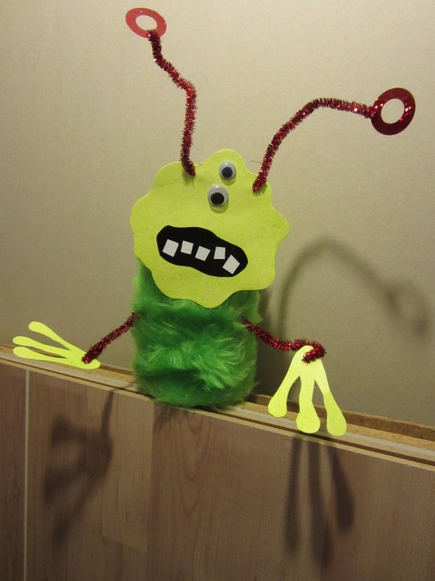
Stay and Play Session
A welcome visit for you and your child
This session will take place on Monday 7th July. During this 45 minute session, you will visit school with your child, complete a short activity and have the opportunity to explore the classroom and ask any questions you have.

Slide 5
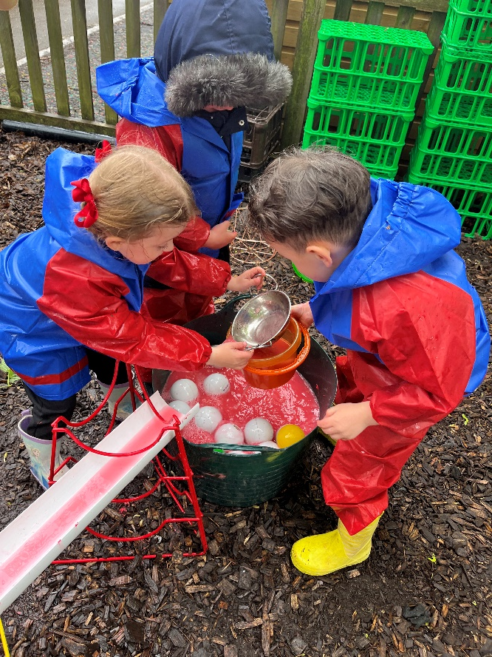
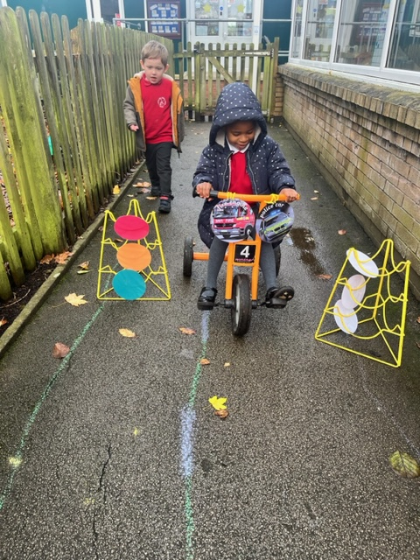
Beginning Reception…
Staggered Starting Dates
Short sessions
Parent stay & play session
Lunch

Slide 6
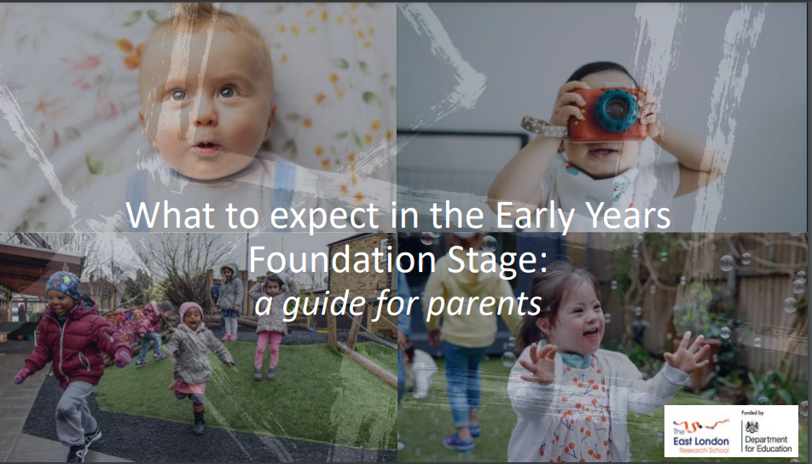
Early Years Foundation Stage
(EYFS)
Your child’s Reception year at school is the final year of the EYFS.
‘What to expect in the EYFS’ document
https://foundationyears.org.uk/wp-content/uploads/2021/09/What-to-expect-in-the-EYFS-complete-FINAL-16.09-compressed.pdf

Slide 7
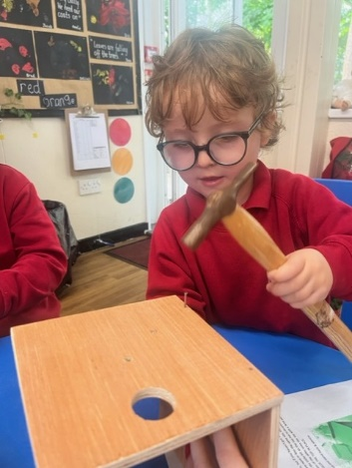
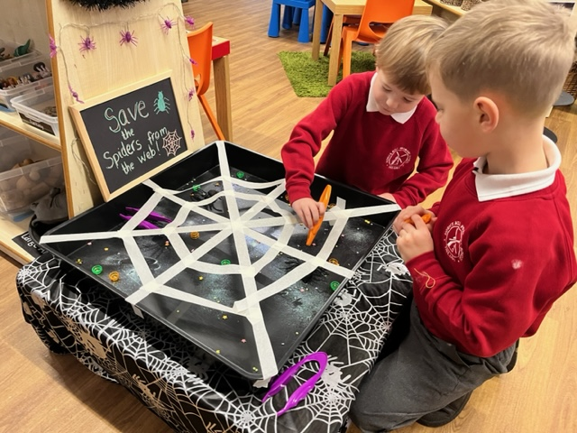
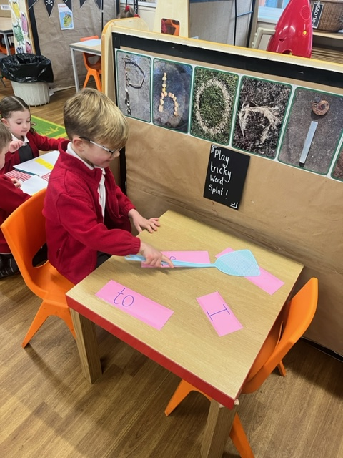
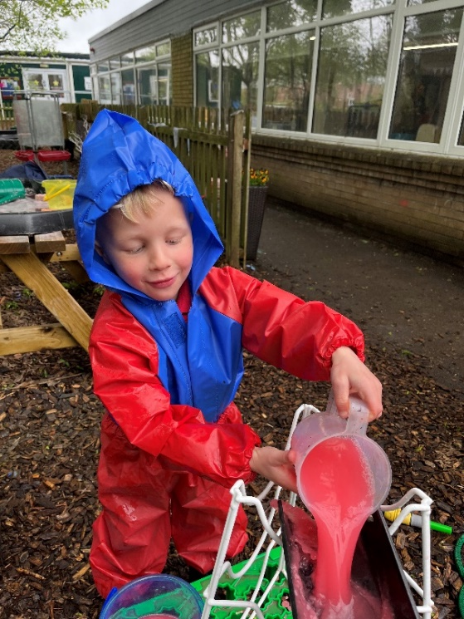
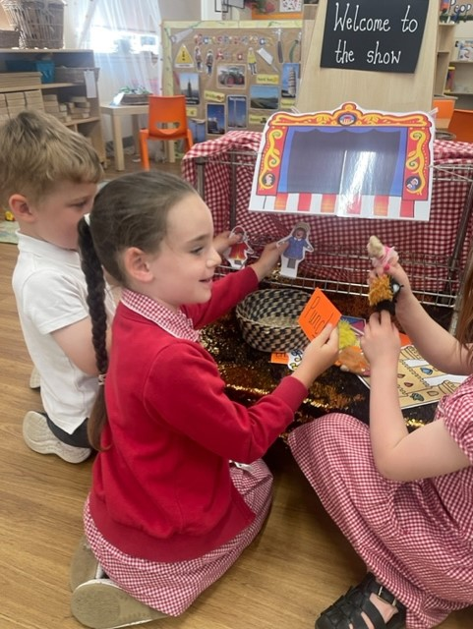
Children in the EYFS learn by playing and exploring, being active, and through creative and critical thinking which takes place both indoors and outside.
Children are exposed to a range of different experiences and learning, that support their development as individual learners.

Slide 8
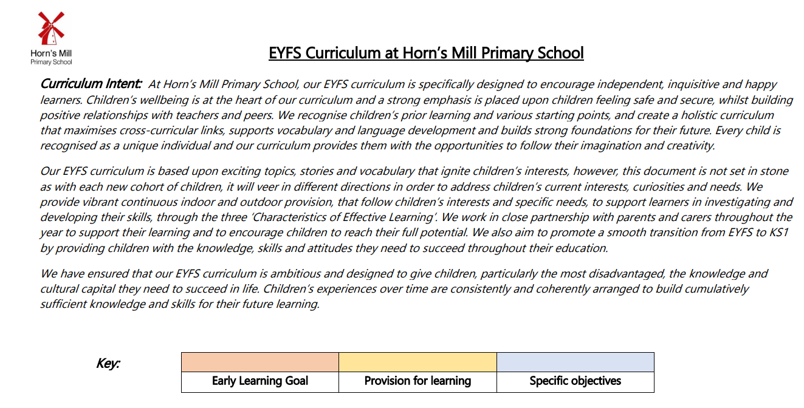
EYFS Curriculum at Horn’s Mill
Our EYFS curriculum is designed to encourage independent, inquisitive and happy learners.
Children’s wellbeing is at the heart of our curriculum and a strong emphasis is placed upon children feeling safe and secure, whilst building positive relationships with teachers an peers.
It prepares children for the staring the National Curriculum in Year 1.
All information is on our website page below:
https://www.hornsmill.cheshire.sch.uk/page/early-years-foundation-stage/133105

Slide 9
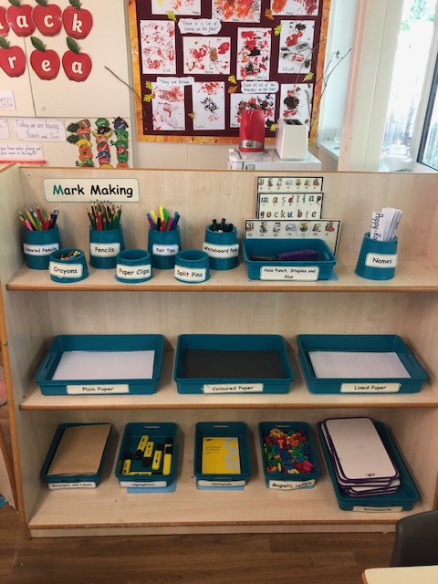
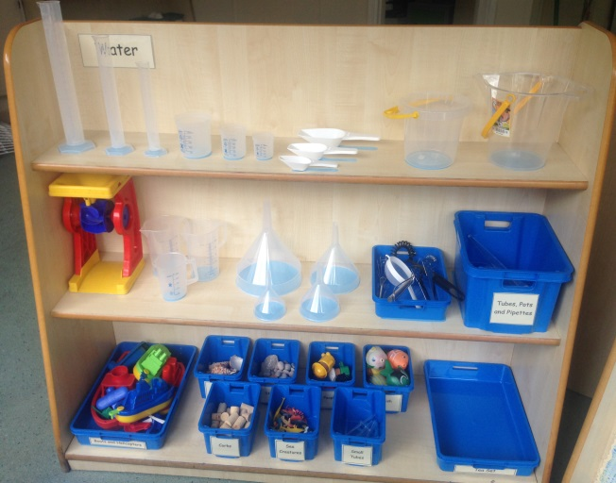
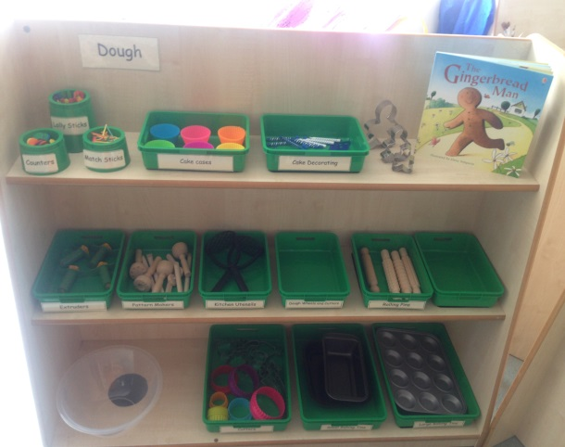
Classroom Organisation
Water Area
Mark Making Area
Indoor area within our Reception classroom
Dough Area

Slide 10
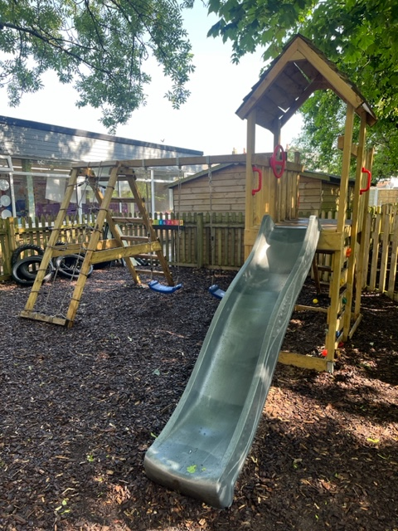
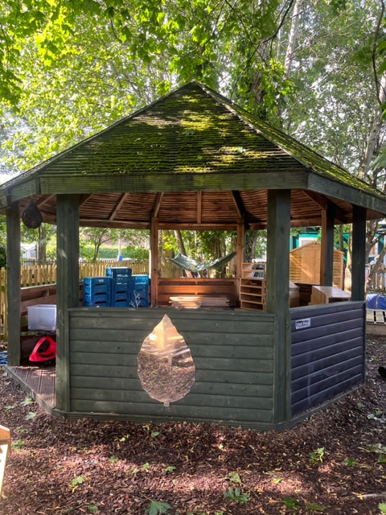
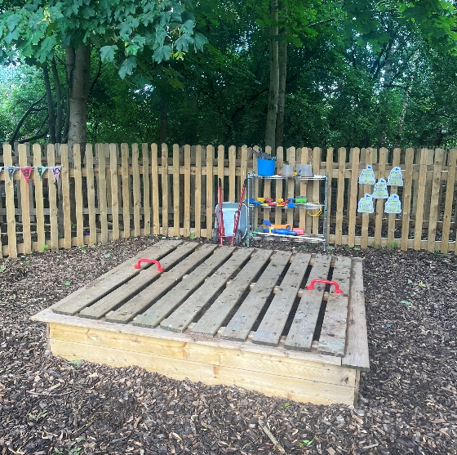
Classroom Organisation
Outdoor Climbing Frame
Construction Hut
Outside area within our Reception classroom
Sand Pit

Slide 11
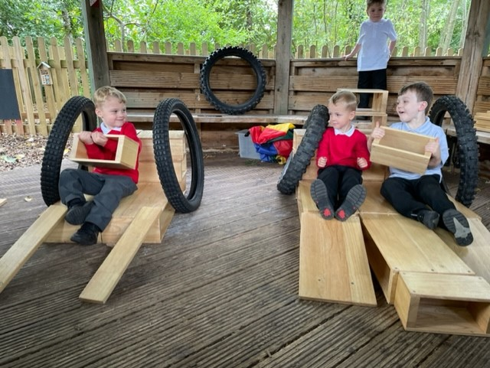
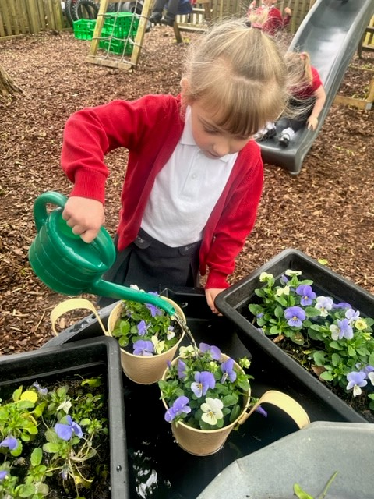
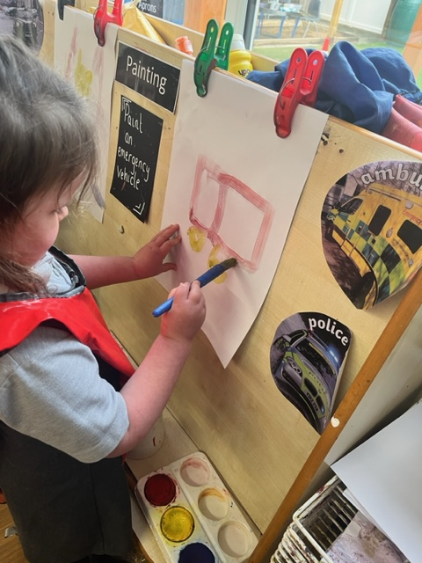
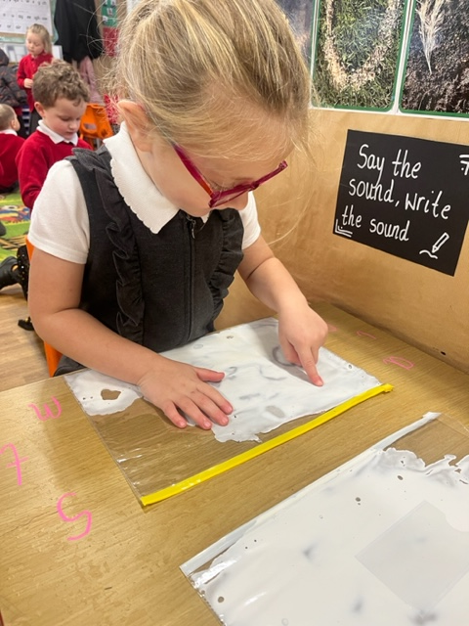
A Day in the Life of Your Child in
Reception…

Slide 12
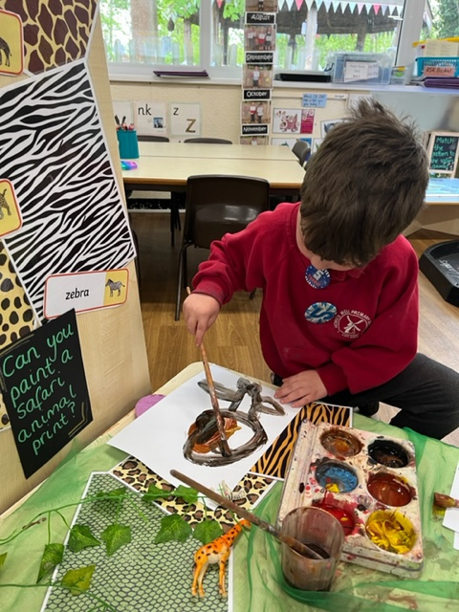
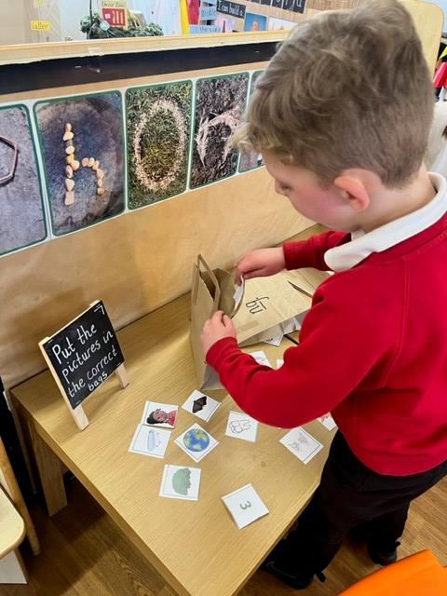
Morning Challenges
Children begin their day by completing different morning challenges.

Slide 13
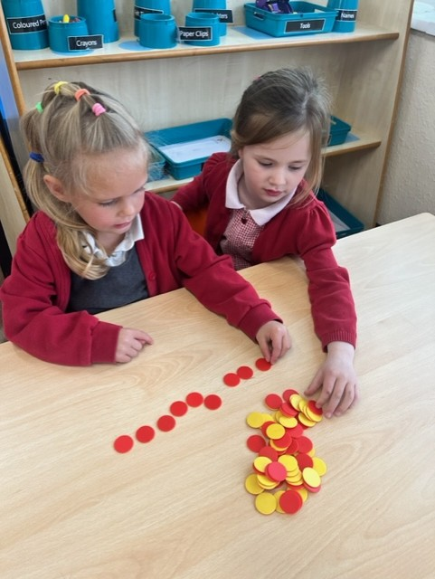
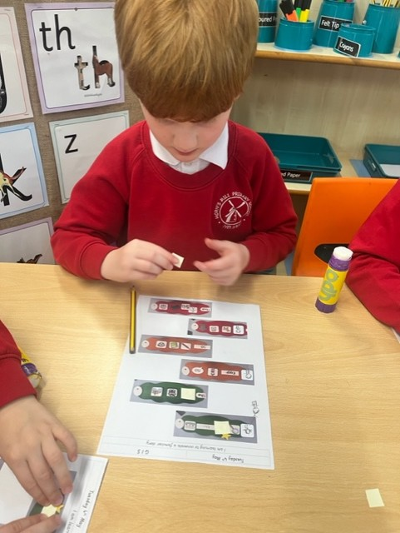
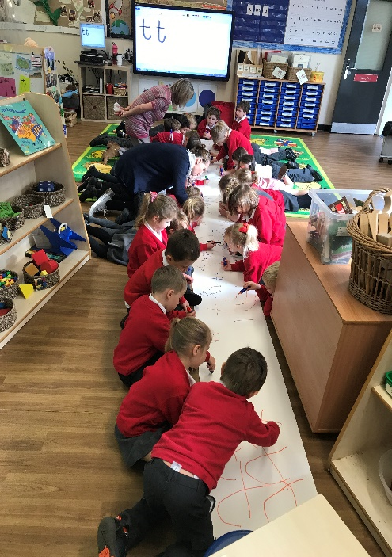
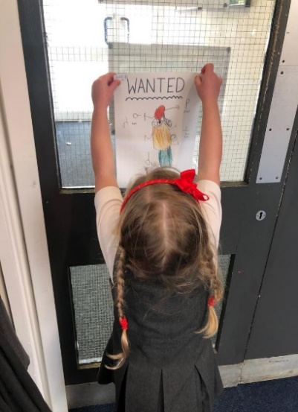
Focused Teaching Time
Children will be taught through practical activities focused on their development needs; moving on to recording their learning as they are ready.

Slide 14
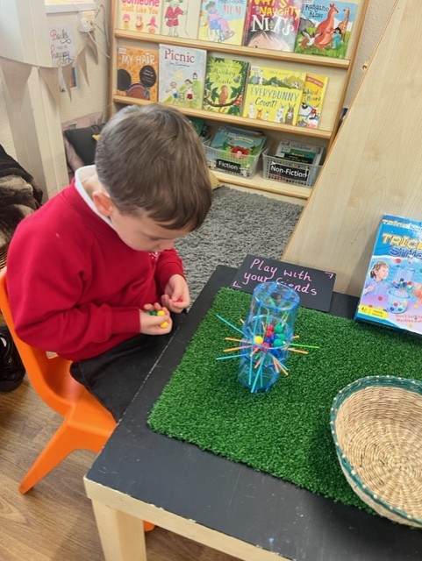
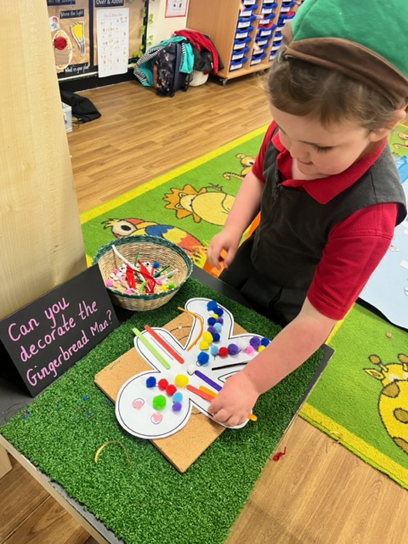
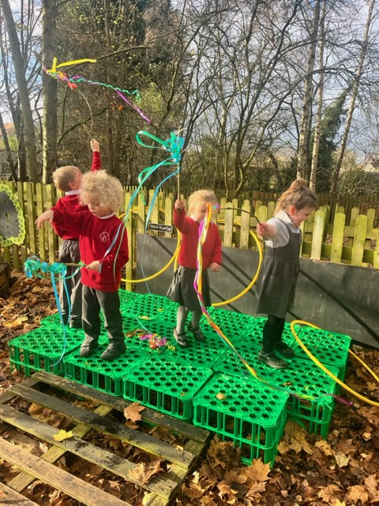
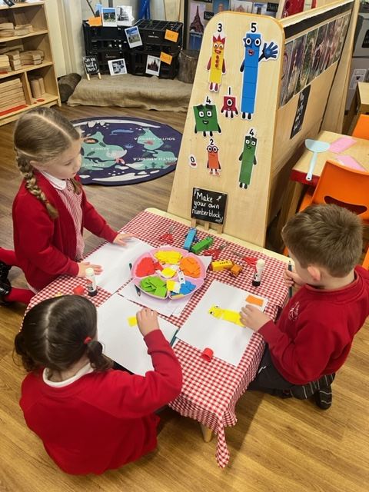
Learning Time
Children’s make their own learning choices based on their own interests.

Slide 15
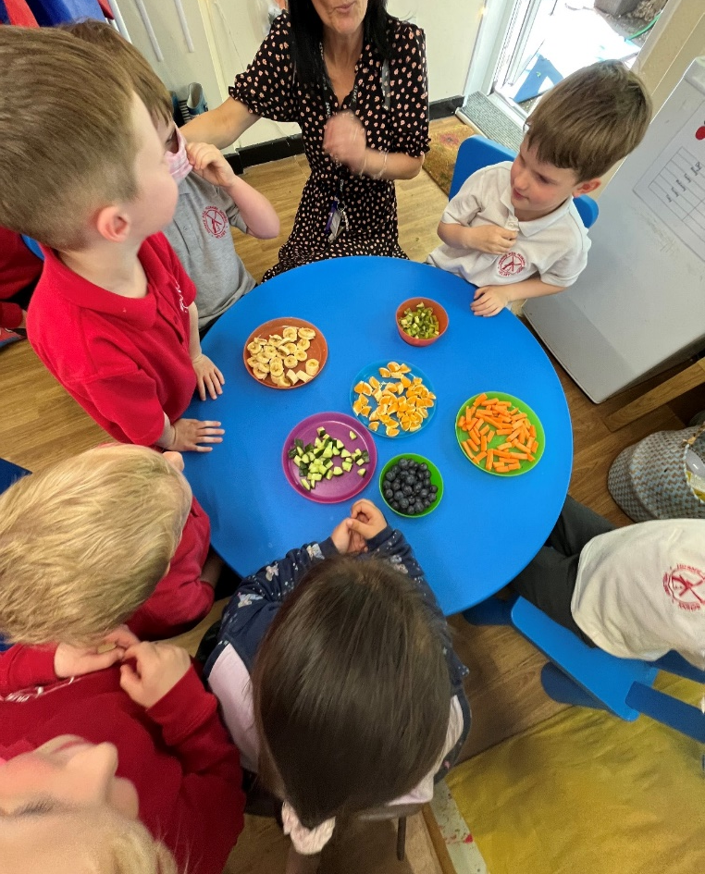
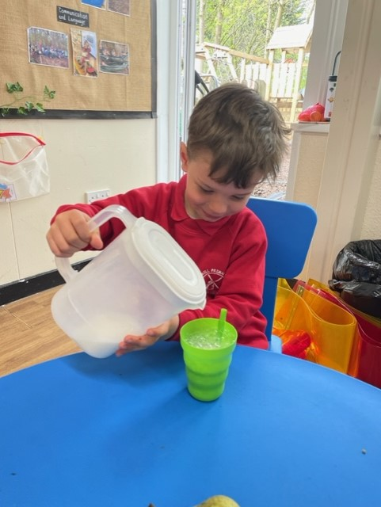
Snack Time
Rolling snack provides the children with a skill based learning experience
Snack is £4 per half term

Slide 16
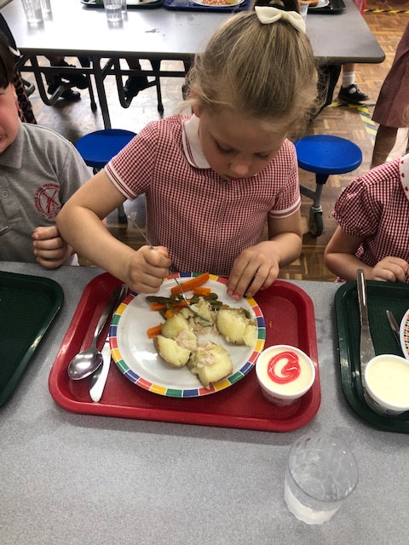
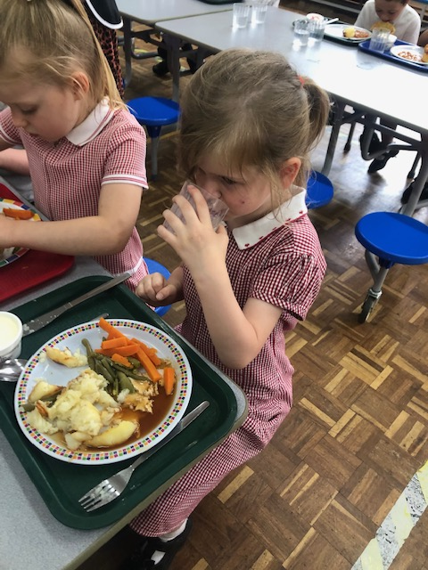
Lunchtime
The children having sandwiches or dinners will go to the dinner hall and eat together.
Children select what they will be eating for lunch every morning, or this can be ordered from home. Further information will be given in due course.

Slide 17

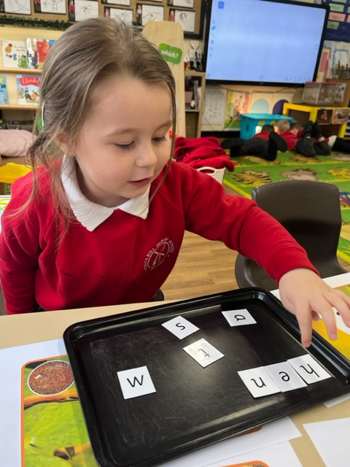
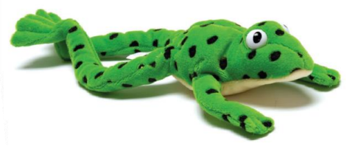
Ready Steady Read
All children will be involved in a daily phonic session that includes reading and spelling.
Read Write Inc. is a lively phonic programme that develops childrens’ reading skills.

Slide 18
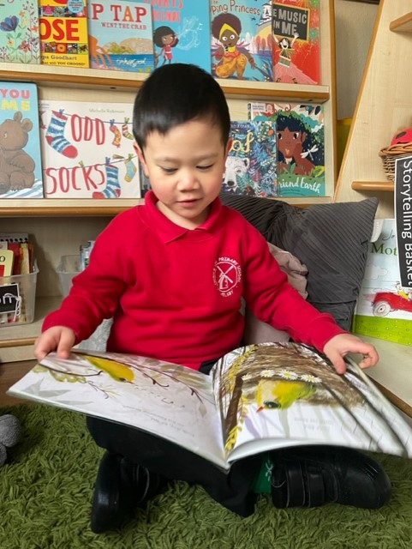
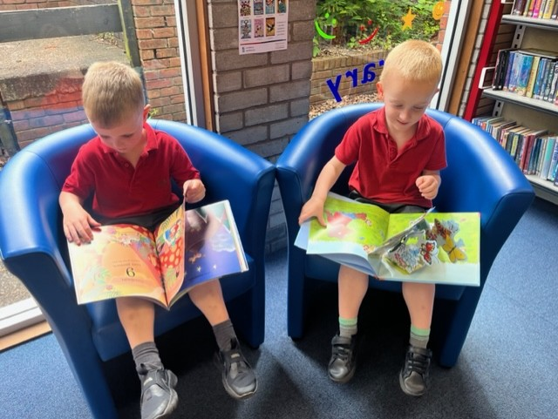
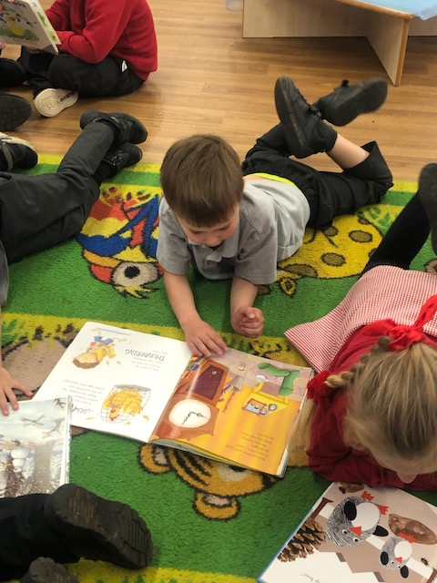
Reading
Books for Sharing
Reading Books
Library Visits
Join our reading team

Slide 19
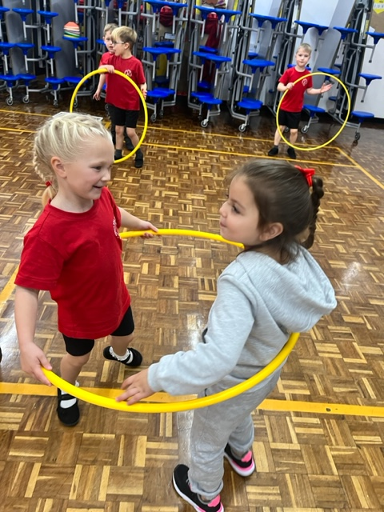
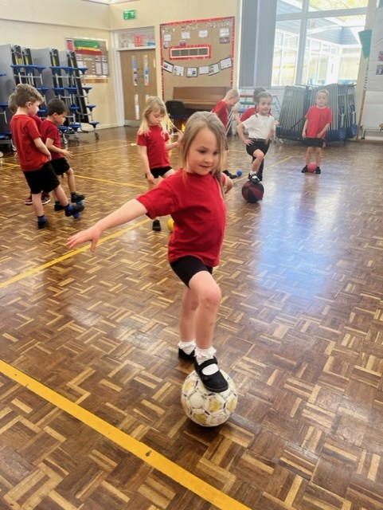
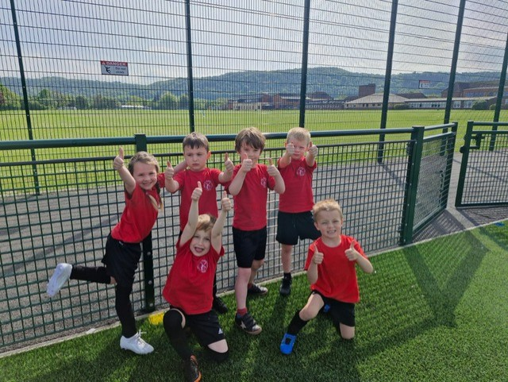
PE
Children have a weekly PE lesson. They will need a PE kit in school to get changed into for these sessions.
Sports events

Slide 20
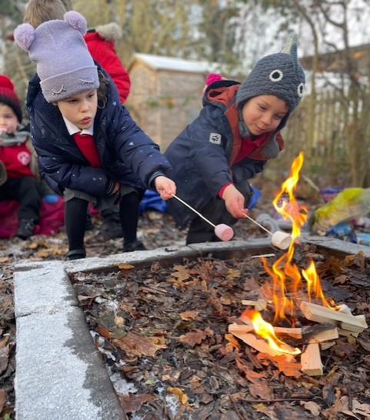
Mousemania
To celebrate a great week of learning, children choose a treat to have on a Friday afternoon.
Big Cheese of
the Week
One person from each class is awarded the ‘Big Cheese’ each week.
Assembly is on a Friday morning at 8.50am.

Slide 21

How can I support my child over the summer?

Slide 22



All your children have had different early learning experiences at the nurseries & pre-schools they have been attending.
To prepare them for starting in Reception, some of the following activities over the summer would be of great benefit:
Mark making activities – drawing, painting, printing, pattern making, writing name
Holiday books
Activities & days out with friends & family
Story- telling and story time together
Visits to local library
Bike rides
‘Funky Finger’ time for
early writing

Slide 23

Independent Skills
To give your child the best possible start in school, support them to be able to do the following over the Summer:
Recognise their own coat
Put their own coat on – use the hood and holes method if teaching from fresh
Use the toilet independently
Know how to wipe themselves properly
Button/zip up their trousers
Put their shoes on
Take their jumper and cardigan off
Organise their belongings
The following document gives lots of information on what your child should be doing when they start school – please have a read online.
https://www.cheshirewestandchester.gov.uk/documents/education-and-learning/schools/admissions/information-booklets/school-readiness-booklet.pdf

Slide 24


Buddies
Throughout the year, there will be opportunities for the children to spend time with their buddies.
The children will be assigned a Year 5 buddy when they start school to support them during dinner times.

Slide 25

Water Bottles
We ask that children bring a water bottle to school in September, that is to be kept in school. Children have constant access to fresh drinking water all day.

Slide 26

Weather and outdoor clothing
Wellies will need to be labelled and will be stored in school.

Slide 27

After School Clubs
A range of after school clubs are offered across school.
This year Reception can access these clubs from January, once they are settled into school life and are more familiar with new teachers around school.
Pre-school offer wrap around care, which can be booked by contacting Sue Huntbach.

Slide 28

Partnership with Parents
Reading Record and communication book
Catch-Up and Cake Sessions
Twitter!
Weekly blog
Weekly Learning on webpage

Slide 29

Learning Journeys
Every child has their own learning journey which shows your child’s learning journey across the year. It is documented on a half termly basis through use of pictures, learning moments and mini reports.

Slide 30

In your information pack….
Welcome Booklet
Uniform letter
Hutchinsons Letter
Free school meals letter
School holiday dates
Holiday book
School Spider information
Wrap around care info

Slide 31



Book Bag
- Holiday Diary
Collect photographs and drawings of:
Special people
Holidays
Days out
Please return the holiday books to school in September. Your child will then have something familiar to talk about in school to remind them of home.

Slide 32



Delamere Forest Trip
During the Autumn term, we organise a trip to Delamere forest. An adult can join their child on the trip and it’s a lovely opportunity for families to get to know one another. Throughout the day we take part in different forest activities including pond dipping and den building.
This year’s trip is Wednesday 5th November.

Slide 33

October 2024
Thank you all for listening. We are truly looking forward to sharing this exciting educational journey with you.
adavies@hornsmill.cheshire.sch.uk

