Slide 1


Collective Worship
We all join together this morning to worship
This Photo by Unknown Author is licensed under CC BY-SA

Slide 2

Welcome Words- Our Worship Monitors are:
Jayden and Lily

Slide 3
Our Christian Value this half term is
Thankfulness
Let’s reflect on all the things we are thankful for.
Don’t share them, think about Mrs Knight’s assembly yesterday and the things we have spoken about in the last week.

Slide 4

On a Wednesday, we think about stories from the bible and how they illustrate our Christian values
This Photo by Unknown Author is licensed under CC BY-SA-NC

Slide 5

We started with a very famous story:
Here are some clues: Can you remember?

Slide 6
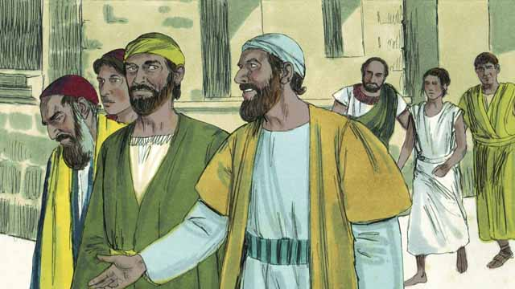
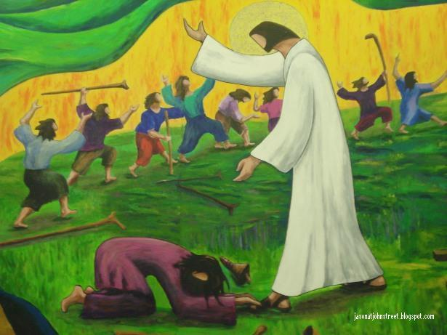
Adam continued this in church.
ThePhoto by PhotoAuthor is licensed under CCYYSA.
ThePhoto by PhotoAuthor is licensed under CCYYSA.

Slide 7

What messages have these stories reminded us

Slide 8
Being thankful even for the small things.

Slide 9
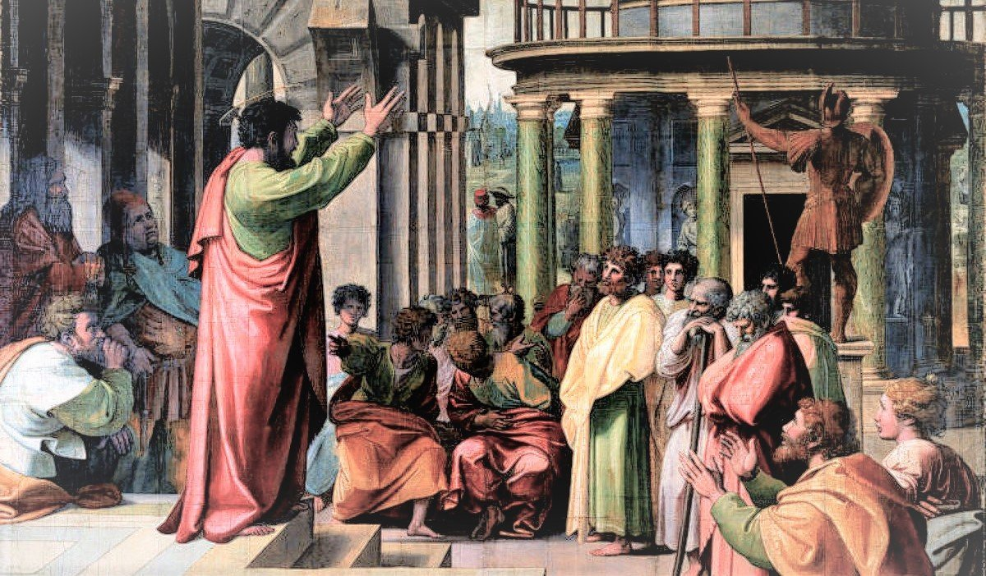
Thankfulness Being thankful even when times are tough.
ThePhoto by PhotoAuthor is licensed under CCYYSA.

Slide 10
We now invite you all to join in with our prayer:
Dear Lord,
We ask that you help us to take the time to be thankful, for the big things that amaze and the small things that we can overlook. For the people who always help and support and those unexpected people who go out of their way to make things easier. For all of this, we thank you.
Amen.
The Grace

Slide 11

Worship monitors:
We thank them (Lily and Jayden) for their contribution to our Collective Worship.

Slide 12

Go in peace to love and serve the Lord
In the name of Christ. Amen
This Photo by Unknown Author is licensed under CC BY

Slide 13

Designer helps you get your point across
PowerPoint Designer suggests professional designs for your presentation, based on the content in your slides.
Designer is a subscription-only feature. If you have an Office 365 subscription, the next slide shows you how it works in a new presentation.

Slide 14
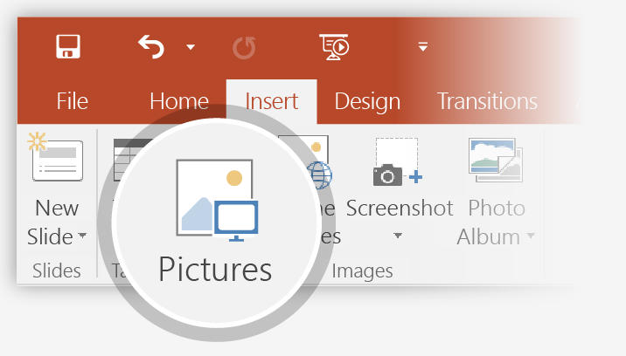
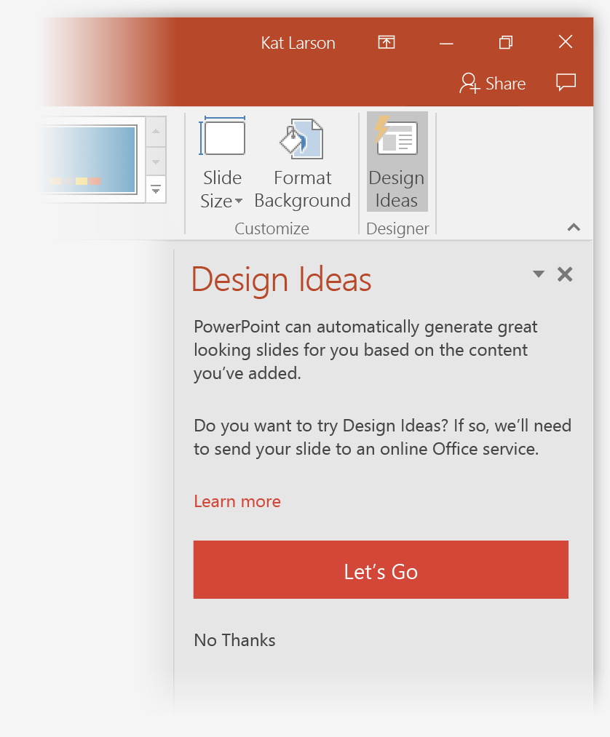
How to use PowerPoint Designer
How it works:
1
Start a new presentation by going to File > New > Blank Presentation.
2
On the very first slide, add a picture: Go to Insert > Pictures or Insert > Online Pictures and choose the picture.
Hint: You need to be online when you add the picture.
3
When PowerPoint asks your permission to get design ideas, select Let's Go.
4
Choose a design you like from the Design Ideas task pane.

Slide 15
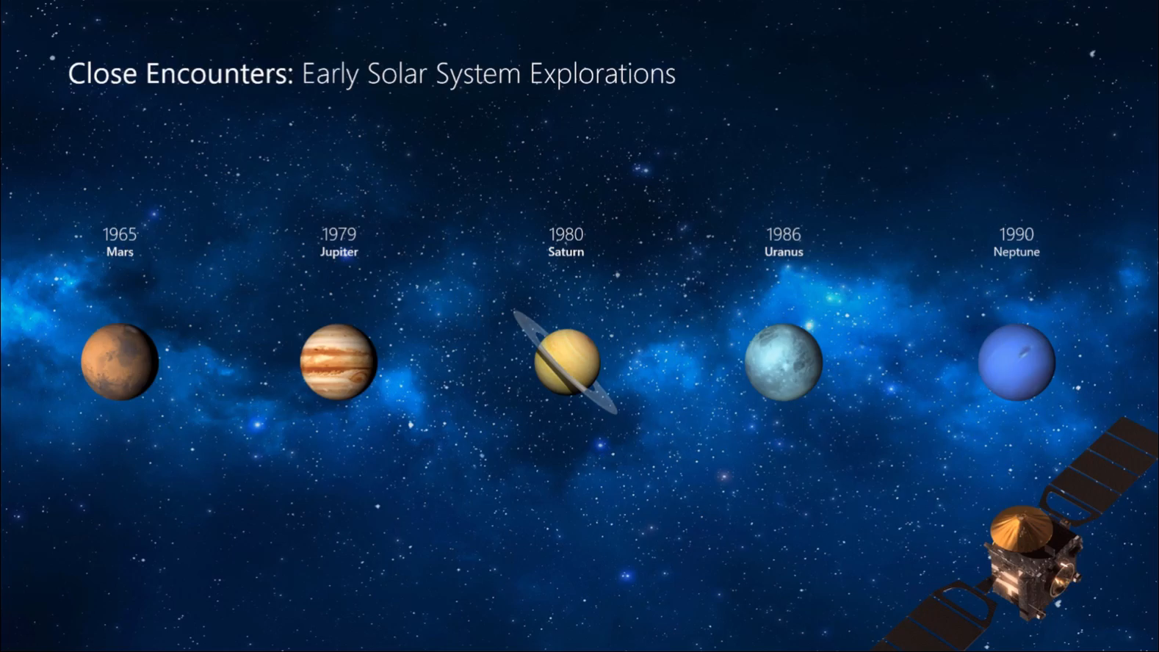
Morph
Morph makes smooth animations and object movements in your presentation. You use two similar slides to perform the animation, but it looks to your audience like the action happens on one slide.
Play the video on the right to see a quick example.
Morph is a subscription-only feature. If you have an Office 365 subscription, you can try it yourself with the steps on the next slide.

Slide 16
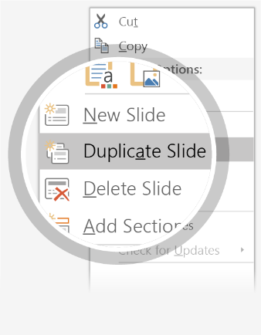
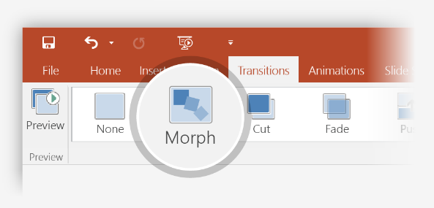

Setting up Morph
Try it yourself with these two simple “planets”:
1
Duplicate this slide: Right-click the slide thumbnail and select Duplicate Slide.
2
In the second of these two identical slides, change the shapes on the right in some way (move, resize, change color), then go to Transitions > Morph.
3
Return to the first of the two slides and press Slide Show button and then select Play to see your circle morph!
Hint: Effect Options gives you even more options for Morph.

Slide 17
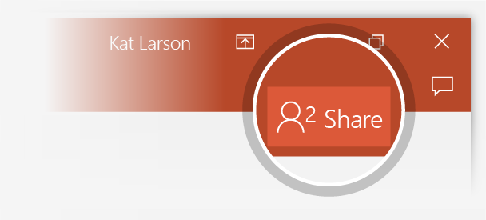
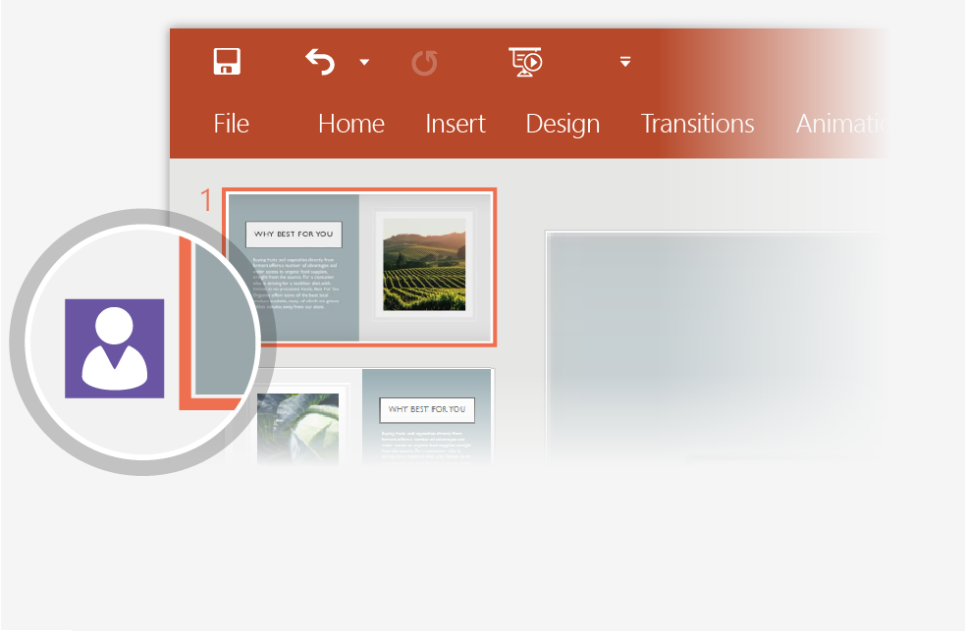
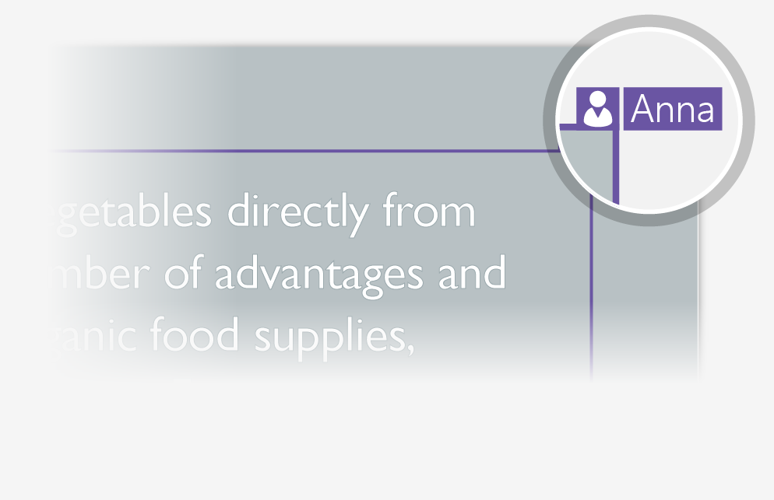
Working together in real time
When you share your presentation with others, you’ll see them working with you at the same time.
How it works:
1
Select Share from above the ribbon, or by using short-key Alt-ZS, to invite people to work with you (You can save to the cloud at this point.)
2
When other people are in the presentation, a marker shows who is on which slide…
3
…and the part of the slide they're editing.

Slide 18



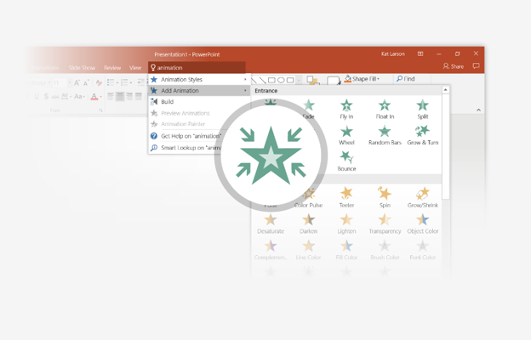
You’re an expert with Tell Me
The Tell Me box finds the right command when you need it,
so you can save time and focus on your work.
Try it:
SELECT ME
1
Select the Robot picture on the right.
2
Type animation in the Tell Me box, and then choose Add Animation.
3
Choose an animation effect, like Zoom, and watch
what happens.

Slide 19
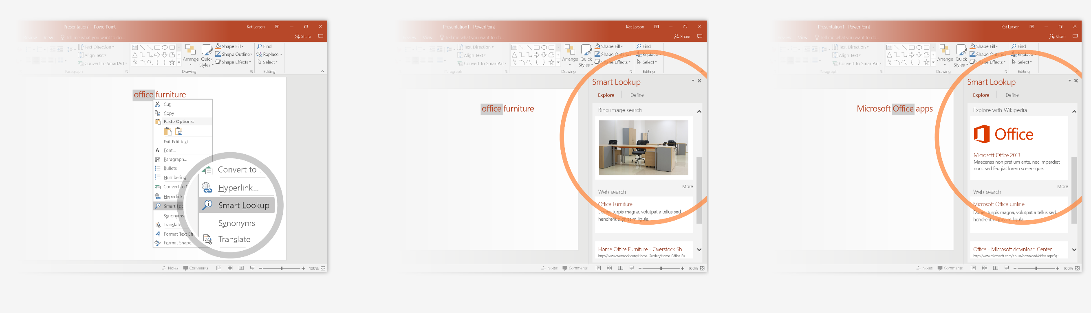
Explore without leaving your slides
Smart Lookup brings research directly in to PowerPoint.
Try it:
1
Right-click in the word office in the following phrase: office furniture
2
Choose Smart Lookup, and notice that results are contextual for that phrase, not Microsoft Office apps.
3
Just for fun, try Smart Lookup again by right-clicking in the word Office in Step 2.

Slide 20

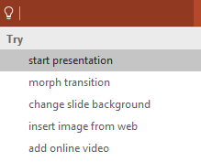

More questions about PowerPoint?
Select the Tell Me button and type what you want to know.
Visit the PowerPoint team blog
Go to free PowerPoint training
SELECT THE ARROW WHEN IN SLIDE SHOW MODE

