Slide 1
Duddon St Peters Primary School
Parent’s Meeting 2022

Slide 2
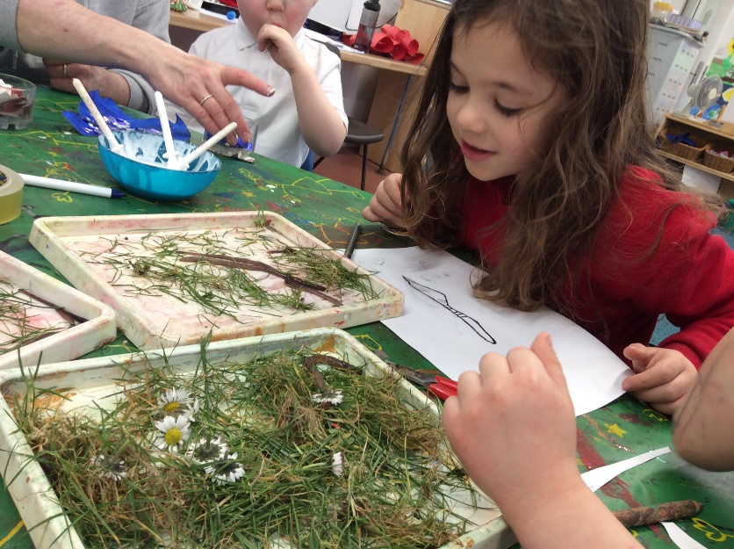
We do a lot of things!
Lots of children deny all knowledge of doing anything at school or nursery…it’s not true!
We follow a play based curriculum
‘through play…children can: explore, develop and represent…experiences that help them make sense of the world’

Slide 3
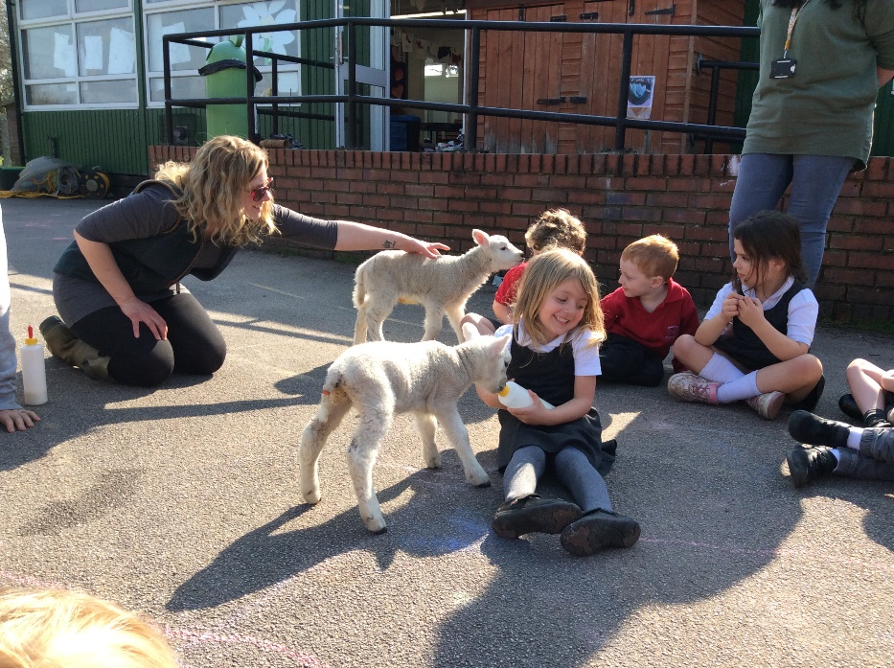
Lunchtime
We have lunch in the hall at 12.45 – it’s quieter
Nursery – have their own mid day assistant and come back to Treetops when they’ve finished
Reception stay in school and have older buddies to look after them
Choose if hot dinners or packed lunch, just let us know in the morning

Slide 4
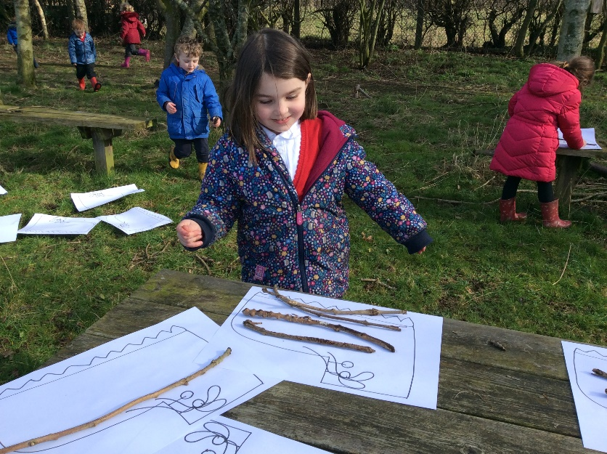
House keeping
Uniform – names, practice putting jumpers on & off
Velcro shoes – no laces
Wellies – names, practice
Coats – practice putting on
Spare clothes
PE – Friday – come in trainers and jogging bottoms
Forest School – Thursday - come in warm trousers

Slide 5
Worried?
Come and chat to me, Diana, Lynne no matter how small the worry might seem
Important for children that we have a good relationship and they see communication between us, security & confidence
Parents evening – during the Autumn term
Please feel free to ring school or email me via admin@dstp.cheshire.sch.uk if you have any questions and I will do my best to answer them.

Slide 6
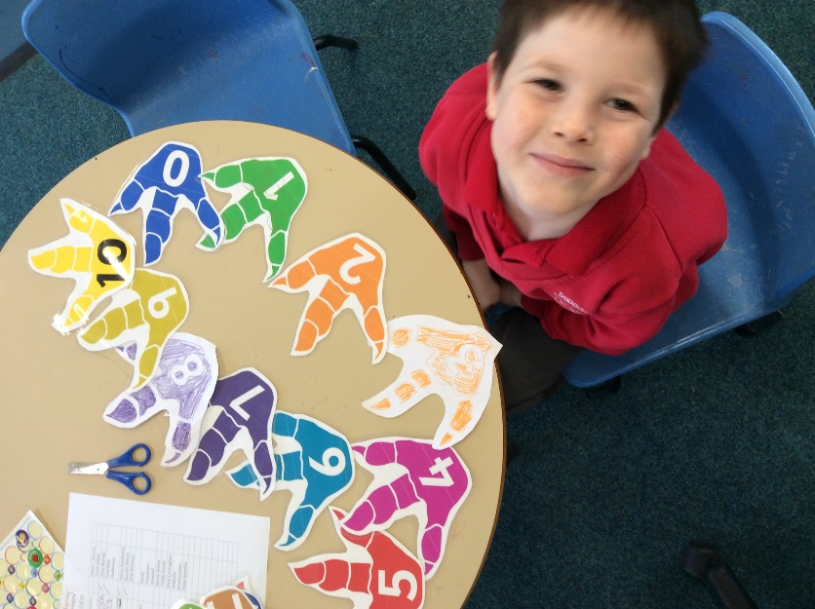
Curriculum
EYFS is the statutory curriculum for children from birth to end of Reception.
Focus on three prime areas:
Personal, Social and Emotional Development.
Communication and Language
Physical Development.

Slide 7
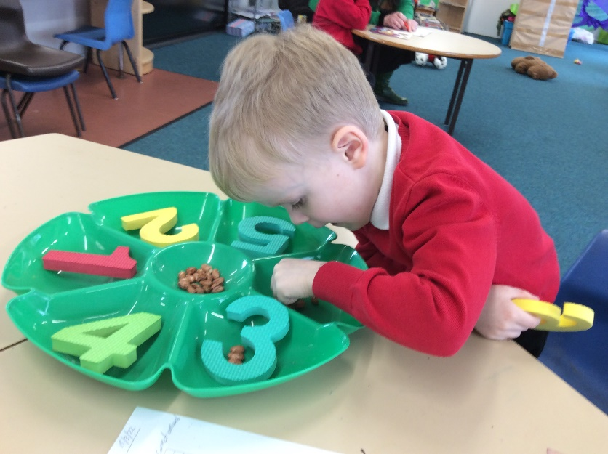
Curriculum
Specific areas:
Literacy
Mathematics
Expressive Arts and Design
Understanding the World
Underpinning this Characteristics of effective learning – how the children learn

Slide 8
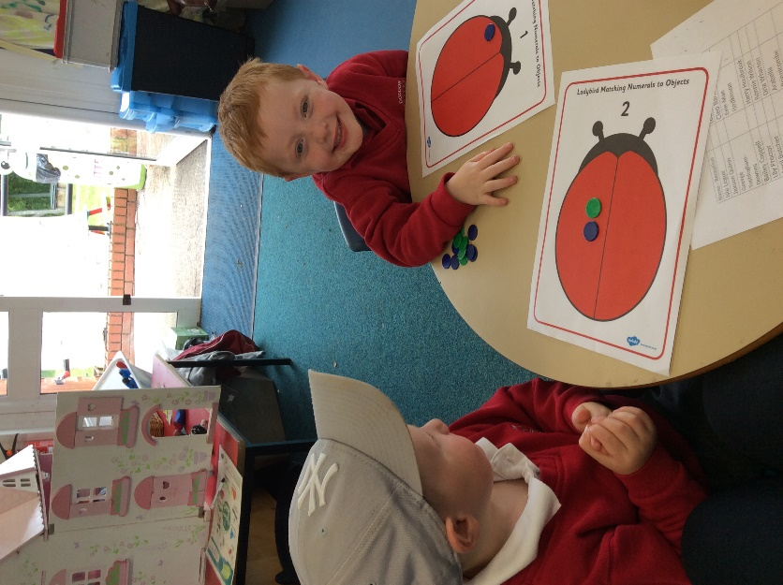
Teaching
Nursery- more opportunities for child initiated play
Reception becomes more adult led throughout the year in preparation for Year One.
Lots of practical activities,
we make learning fun!
We choose topics with the
children, based on their interests

Slide 9
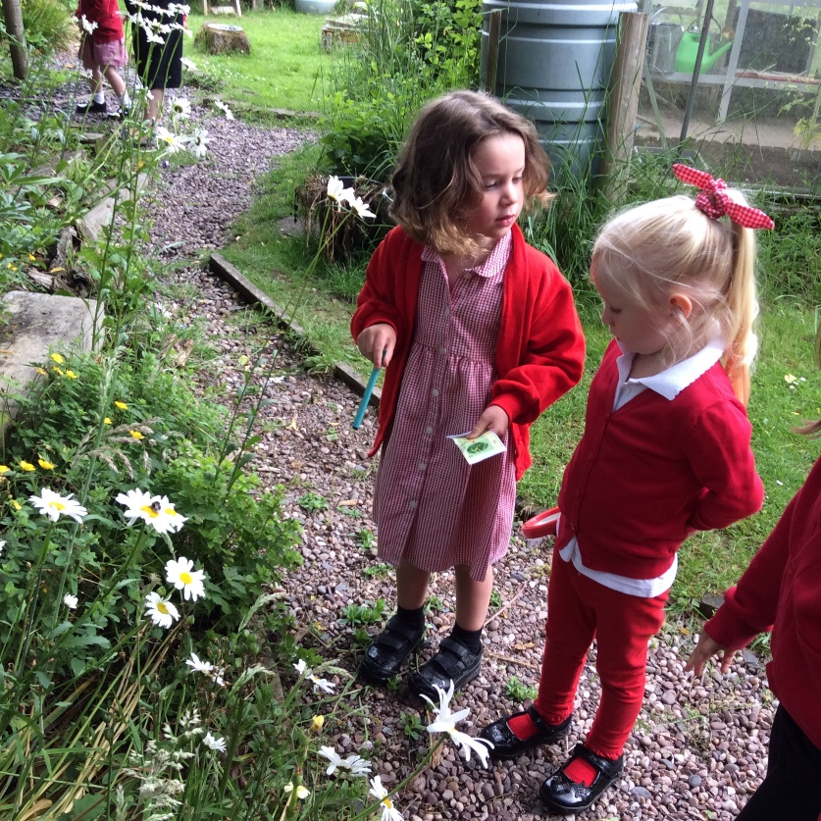
Role of the Adult
Continually supporting and enhancing the children’s play- next steps - introduce challenges, language development
Observing what they do and helping them to achieve
Plan next steps, based on their ability and interests

Slide 10
Assessment
Baseline Assessment takes place in the first few weeks, statutory for Reception – feed back to government and you. We assess Nursery children too so we get to know the children and where they are in terms of the curriculum
Assessment continuous throughout the children’s time with us, measure progress against the curriculum
Early Years Foundation Stage Profile – end of Reception, Early Learning Goals
Tapestry

