Slide 1
Mathematics in the Early Years
Claire Knight
Duddon St Peter’s Primary School

Slide 2
Number
We play with numbers & sing rhymes and songs which are fun & involve the children, try & make them relevant to the season & topic
We have lots of lovely resources to count with and numerals to play with such as Numicon
Initially for Nursery we want to familiarize the children with the language of number and gradually introduce symbols & counters really working on numbers -5

Slide 3
Number
We do lots of practical work and role play to make using numbers a fun and natural thing the children don’t think about
At home – count anything & anywhere!
Focus on 1-1 correspondence when counting, i.e. move objects to ensure 1 number is 1 thing
Beware! Rote learning & counting – we make sure that children understand what 1/2/3 etc means by physically moving and counting counters and objects

Slide 4
Number - Reception
By the end of Reception we want the children to have a deep understanding of 10
Be able to subitise – recognize quantities to 5 without counting
Recall number bonds to 5 and some to 10
Verbally count beyond 20, compare quantities to 10 and recognize more/less/same as
Explore and represent patterns in numbers -10 including odds and evens, doubling facts and sharing

Slide 5
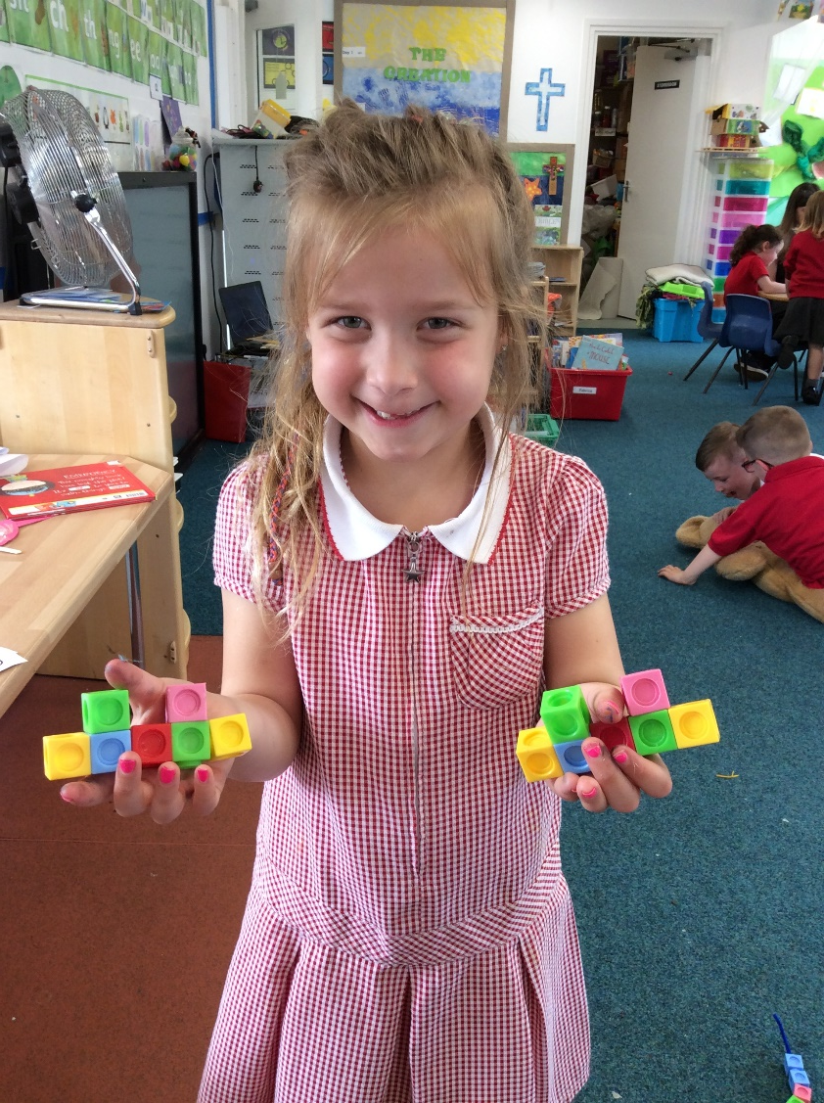
Shape, Space & Measure
Not assessed at end of Reception in EYFSP
Developing language & understanding of shapes, pattern, measuring, positional language, time & money
Nursery children develop understanding and use of vocabulary e.g. language of size
Encourage Reception to develop this language & use and apply their knowledge in practical problem solving activities

Slide 6
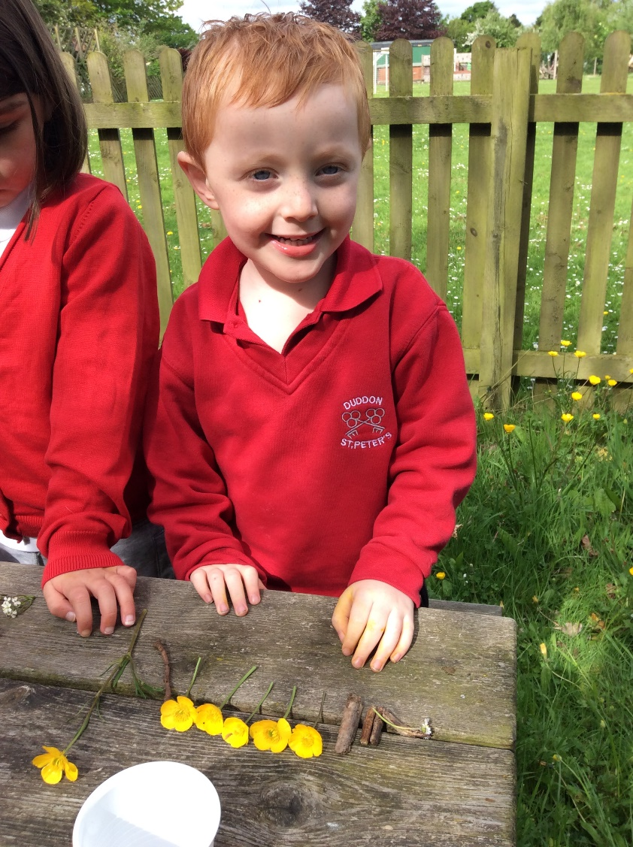
Shape
Initially about noticing shapes in the environment, then explore how they fit together and can be used to build/make pictures
Use the language of shape – round/corner
Introduce the names of shapes both 2D & 3D for Reception – they are all around us & very easy to develop language at home
Here we make models, use play dough, bake, play with shapes

Slide 7
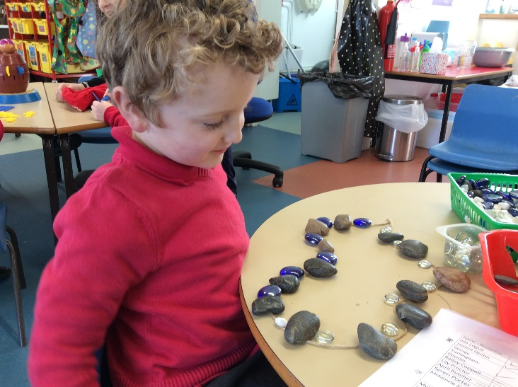
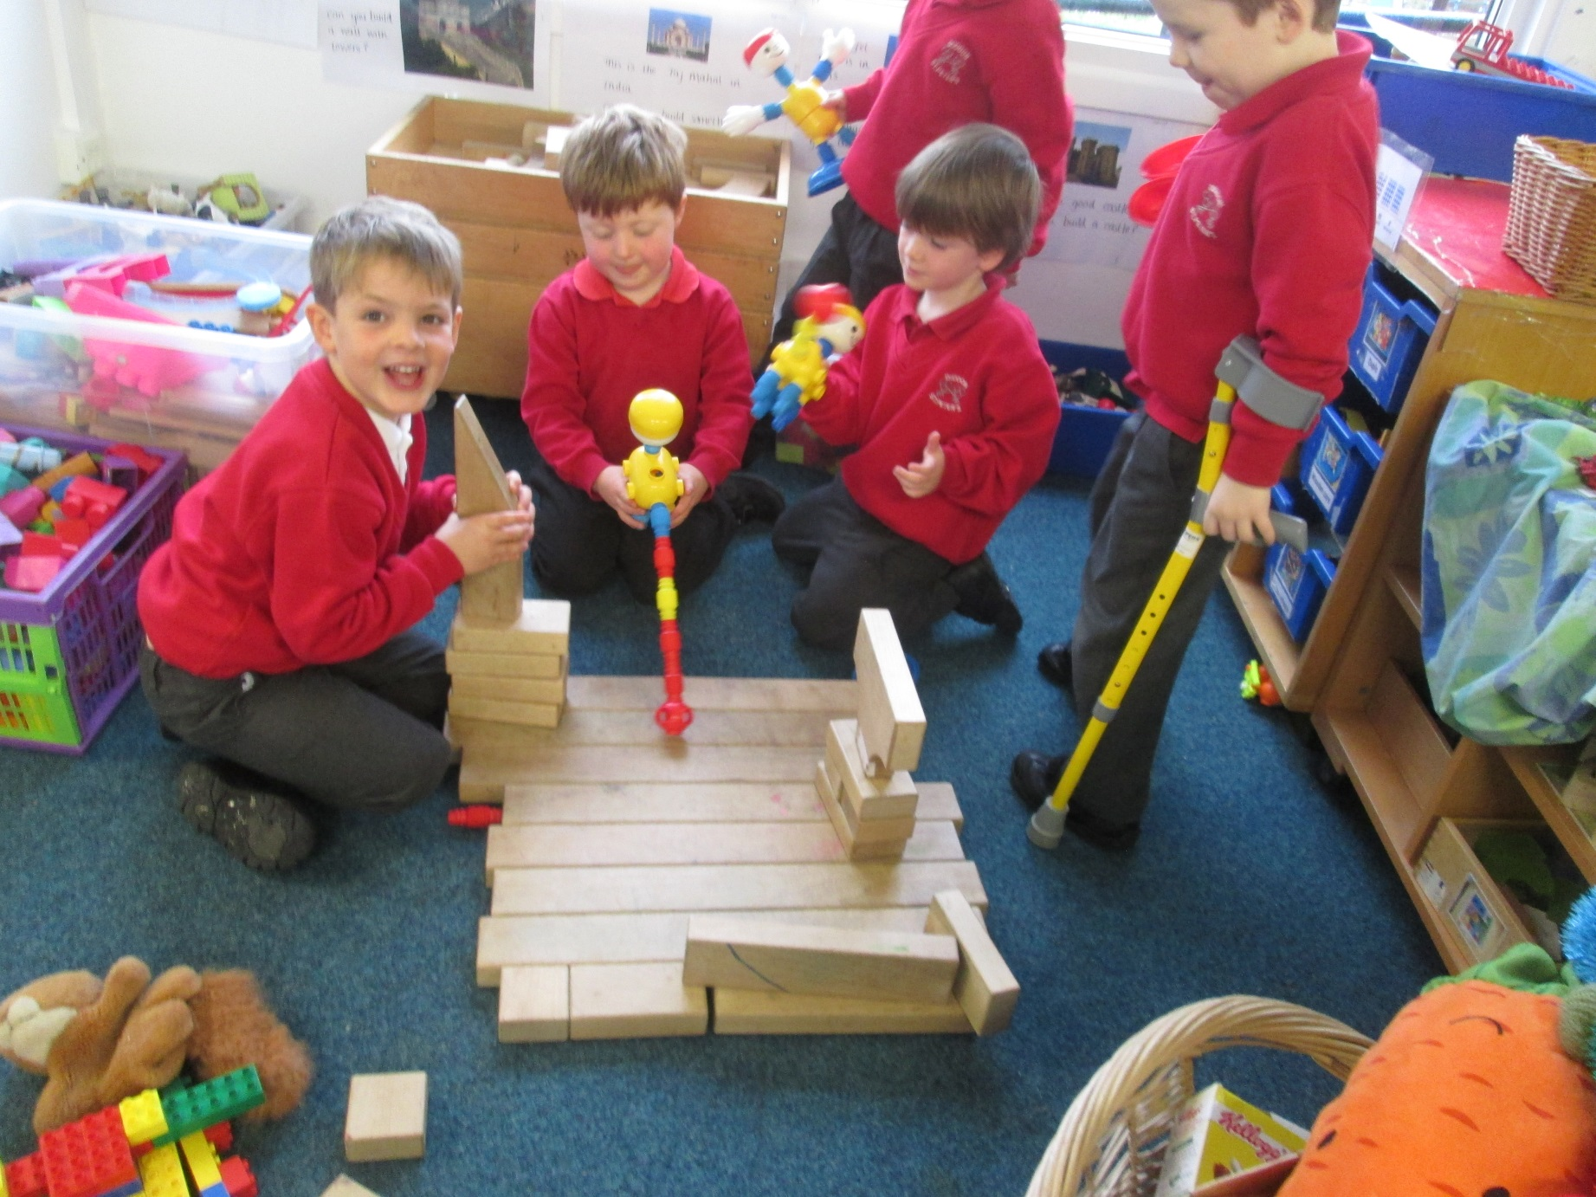
Pattern & positional language
We work on patterns – for example repeating patterns like red/yellow, square/circle/triangle etc
Positional language is key and is really important to develop right from Nursery through to Reception & beyond, such as behind, and next to

Slide 8
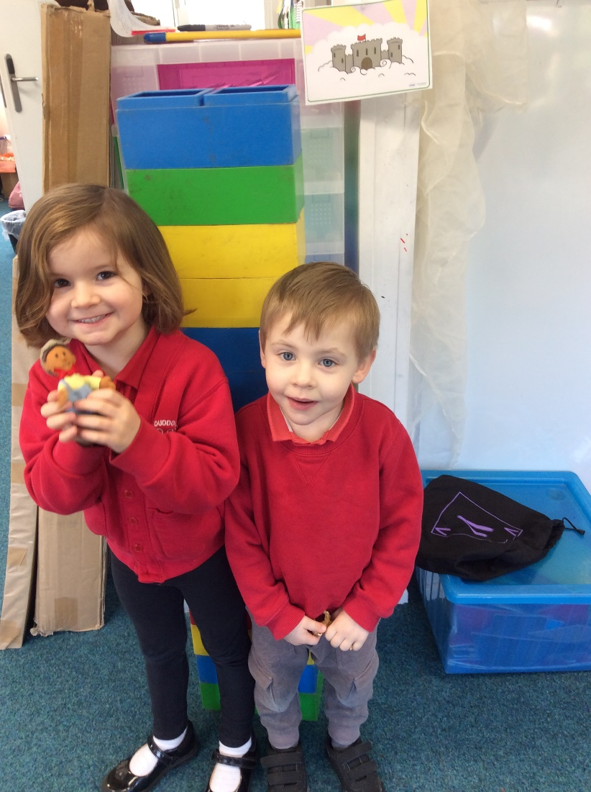
Size
Link to stories –Jack and the Beanstalk
Measure each other, water, sand and objects in the environment
Begin with simple language big/small/long/longer/short etc.
Once the language is secure we order & compare
We measure with non standard units

Slide 9
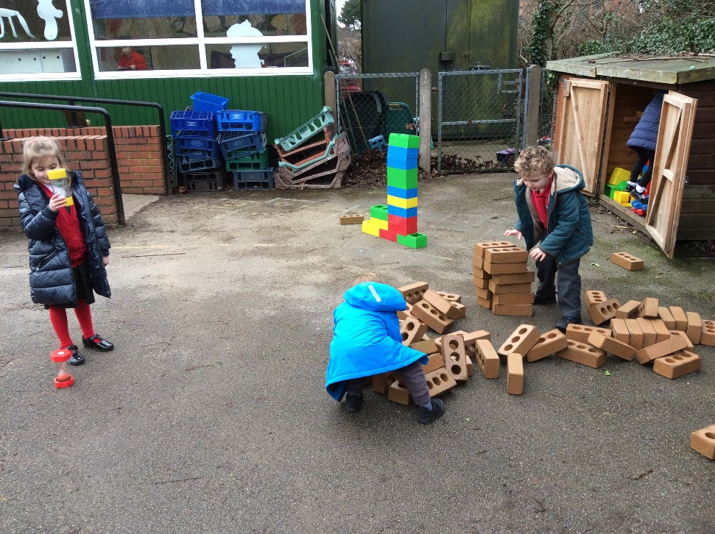
Time
Again understanding & using language – before/after, order & sequence familiar events
We use pictures, children’s own experiences at home & Treetops, make sandwiches and more practical activities

